Slide 1

Khulna University of Engineering & Technology Department of Computer Science and Engineering
Project Title
Thief Finder
(Android App)
Developed by:
Nazimuddin Gazi 1107036
Md.Awon-uz-zaman 1107057
Supervised by
Md. Abdul Awal
Lecturer, Dept. of CSE
KUET, Khulna-9203

Slide 2
Presentation Topics
Introduction
Objectives
Platform
Why use Thief Finder
Interface
Implementation
Limitations
Future Plan

Slide 3
Introduction
Thief Finder:
Thief finder provides a protection from being theft for its users
It is helpful to detect the thief by seeing the face sent to an Email
User can change the email address anytime

Slide 4
Objectives
The main objective of thief finder is to allow the user to at least see the image of the thief.
User will be notify through email if some one tries to use his phone without permission

Slide 5
Platform
We use android operating system to implement our project for several reason
It is an open source operating system so almost anyone can create apps for it. The Android operating system is on devices ranging from tiny phones to nicely sized tablets.
There are total 12 lac people user smartphone in Bangladesh,among them 57% uses android,800 millions in the world uses android

Slide 6
Why we use this App
We use it for different reason.
The owner of the phone doesn’t know who has taken his phone.
He can easily identify the thief.
Get information easily.
Flexible Interface.

Slide 7
Interface
UML Diagram:
For Enable/ disable Admin Power
On/Off
Lock the Device
Lock Button
Very small surface for camera
Go to Lock Screen View
Set Receiving Email
Image Button
Update User Email
Save

Slide 8
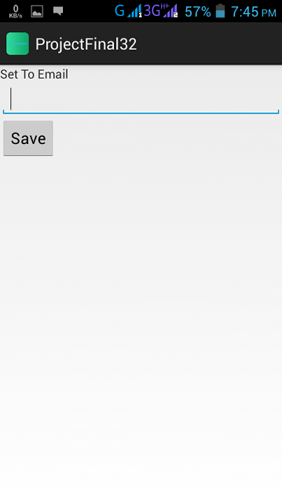
Interface
First time User Interface:
If the user haven’t give any Email to send pic . then
This UI will appear.
Fig(2).Snapshot for enter email interface

Slide 9
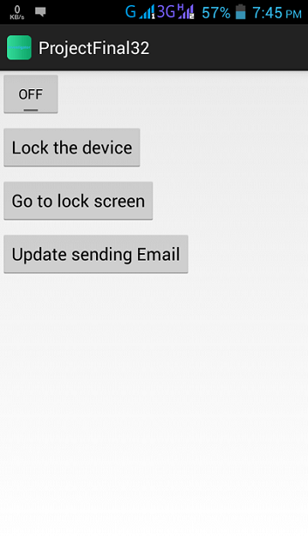
Interface
Normal user Interface:
Fig. (3): Snapshot for user Interface

Slide 10
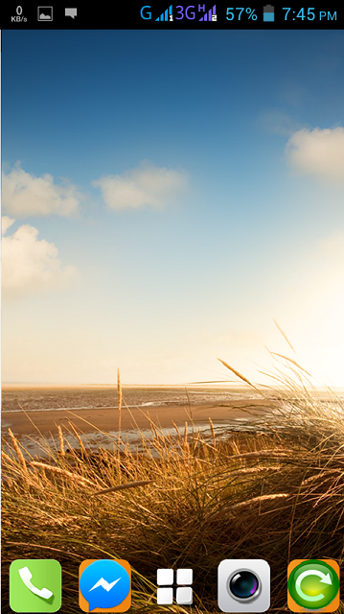
Interface
Default Lock Screen Interface:
Fig(4).Snapshot of fake lock screen view

Slide 11
Implementation
Admin Receiver
Implementation Intent Filter
Procedure:
If 3 times failed
By pressing picture
Button/On backpress
Fig(7).Implementation
procedure.
OnPasswordFailed method
Camera Class
Take Picture & Send Email
Go to Locked Screen

Slide 12
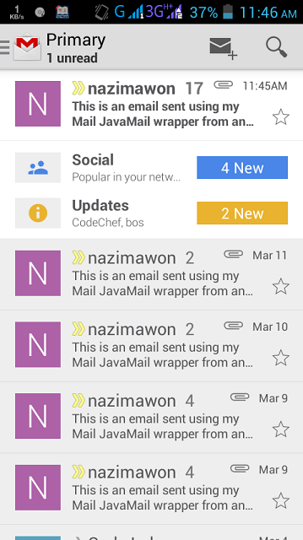
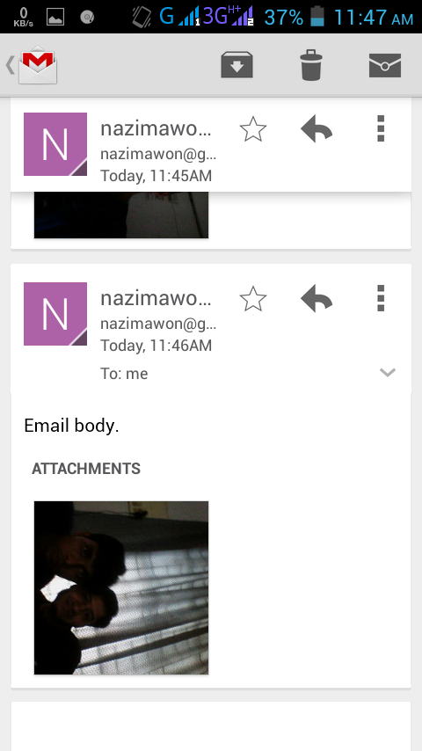
Implementation Results

Slide 13
Limitations
Limitations:
Need high speed Internet.
Needs to press the picture button or Backpressed

Slide 14
Future Plans
Future Plans:
Make more efficient by not opening the lock for anytime.
Auto trigger the app, don’t need to press any picture button.
Send mms using phone network.

Slide 15
Thank you

