Slide 1
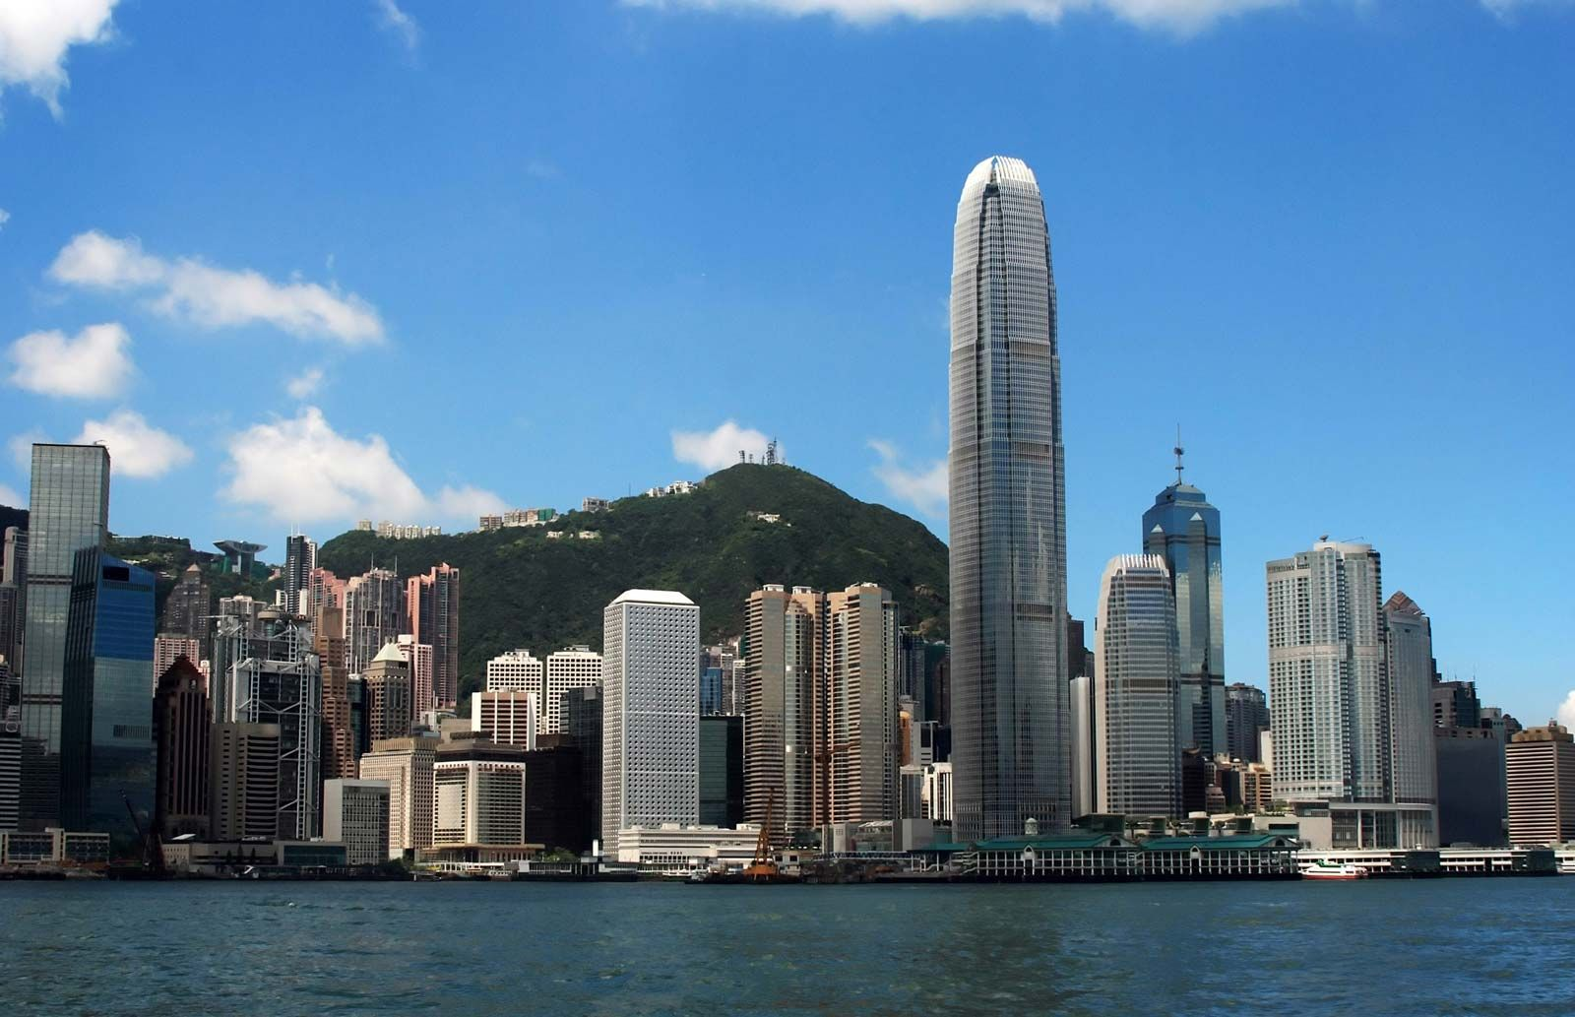
E-Commerce Business Analysis
Sia Partners
Notes:
Add background image and send it to back:
Click on the icon to add a Image >> Choose your Image >> Right Click on Image >> Send to Back >> Send to Back.
Change the image:
Right Click on Image >> Change Picture >> Choose your Image.

Slide 2

Overview
01
Goal
02
Sales Trend and Customer Analysis
03
Customer Segmentation
Notes:
Add background image and send it to back:
Click on the icon to add a Image >> Choose your Image >> Right Click on Image >> Send to Back >> Send to Back.
Change the image:
Right Click on Image >> Change Picture >> Choose your Image.

Slide 3
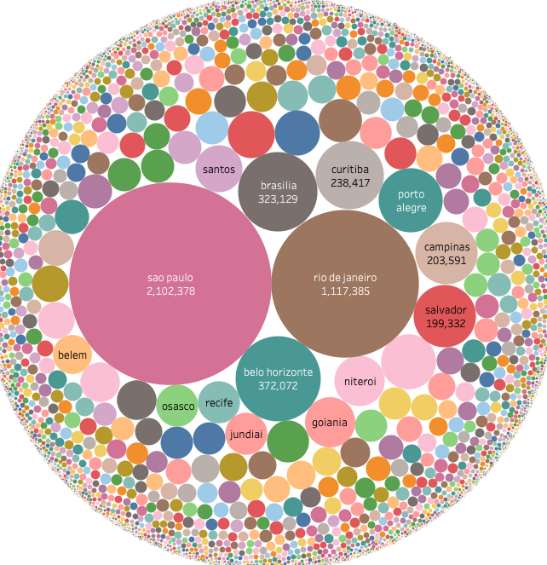
Revenue Channels Overview
Less than 20% of cities account for more than 80% of sales
Sao Paulo is the major income channel
Later, customers can be separated as being from the major or minor city
Notes:
Add image
Click on the icon to add a Image >> Choose your Image.
Change the image:
Right Click on Image >> Change Picture >> Choose your Image.

Slide 4
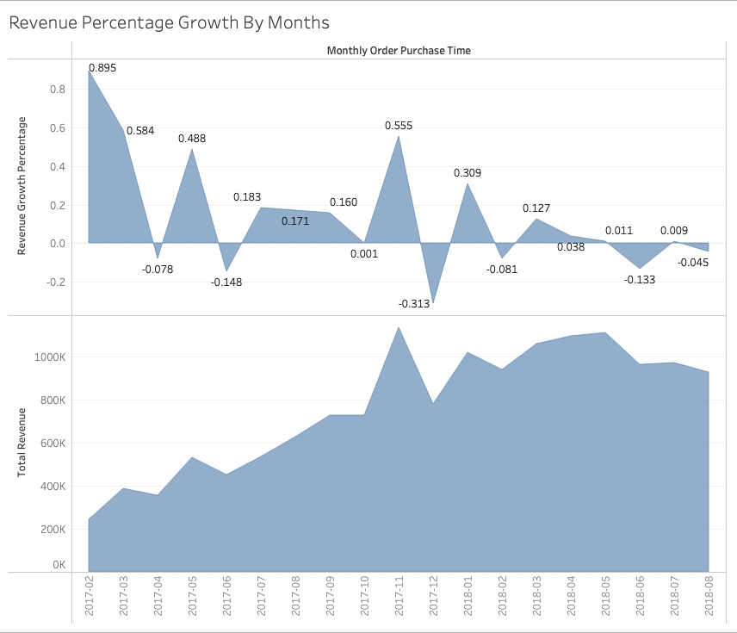
Goal
Revenue is increasing, but slowing down. The growth rate is occasionally negative.
The population of only Sao Paulo and Rio De Janeiro is about 20 million, while e-commerce has only about 95000 customers.
The market is huge and there are good opportunities for revenue growth acceleration.
Notes:
Add background image and send it to back:
Click on the icon to add a Image >> Choose your Image >> Right Click on Image >> Send to Back >> Send to Back.
Change the image:
Right Click on Image >> Change Picture >> Choose your Image.

Slide 5
1
STEP 01
Identification of Major Revenue Channels
2
STEP 02
Product Level Analysis
3
STEP 03
Customer Level Analysis
3
STEP 04
Suggestions to boost growth rate
What might be the cause of the revenue growth rate decline?
01
02
03
04
CUSTOMER DEMAND IS NOT GROWING
LESS NEW CUSTOMERS ARE JOINING
CUSTOMERS ARE NOT ACTIVE BUYERS
SOME EXTERNAL FACTORS

Slide 6

Sales
and
Customer
Analysis
Notes:
Add background image and send it to back:
Click on the icon to add a Image >> Choose your Image >> Right Click on Image >> Send to Back >> Send to Back.
Change the image:
Right Click on Image >> Change Picture >> Choose your Image.

Slide 7
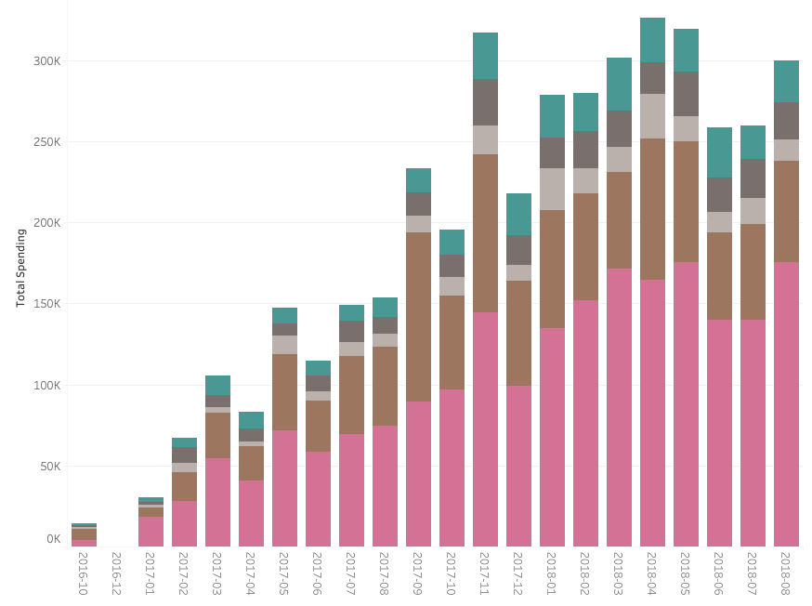
SAO PAULO
RIO DE JANEIRO
CURITIBA
BRASILIA
BELO HORIZONTE
Notes:
BACKGROUND
Add background image and send it to back:
Click on the icon to add a Image >> Choose your Image >> Right Click on Image >> Send to Back >> Send to Back.
Change the image:
Right Click on Image >> Change Picture >> Choose your Image
PEOPLE
Add or change image
Right click on image >> Format Picture >> Fill Tab >> Picture or texture fill >> File button >> Choose your Image

Slide 8
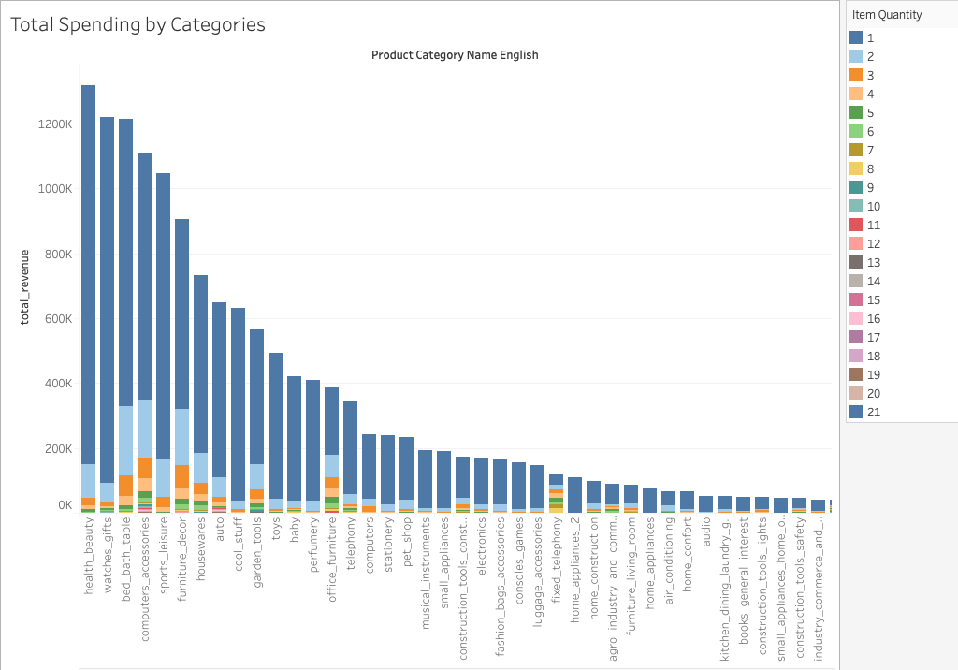
Total Revenue by Categories
There are a few top categories that account for most of the revenue
Most of the revenue comes from a single item orders.
One of the goals can be increasing the share of orders with several items per order.
Understanding what products can be sold together can help to increase item quantity per order, which will further increase the growth rate.
Notes:
Add background image and send it to back:
Click on the icon to add a Image >> Choose your Image >> Right Click on Image >> Send to Back >> Send to Back.
Change the image:
Right Click on Image >> Change Picture >> Choose your Image.

Slide 9
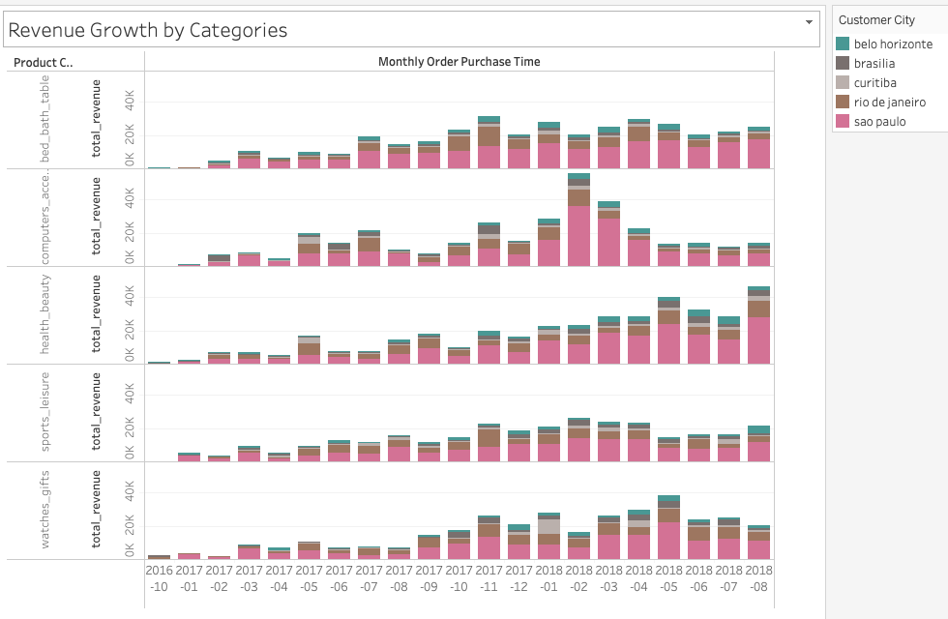
Revenue Change of Top 5 categories
Growth of top-selling categories IS NOT steady
Product categories that account for the largest amount of revenue are not experiencing steady growth.
Most of the sales take place in Sao Paulo, but computer accessories are experiencing decline.
All categories' categories are fluctuating and experiencing decline in a growth rate.
Notes:
Add background image and send it to back:
Click on the icon to add a Image >> Choose your Image >> Right Click on Image >> Send to Back >> Send to Back.
Change the image:
Right Click on Image >> Change Picture >> Choose your Image.

Slide 10
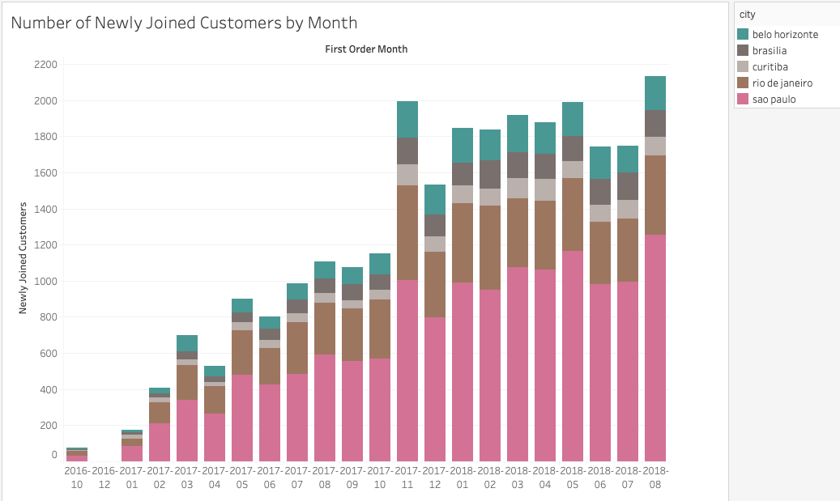
Number of Newly Joined Customers
The relatively same number of new customers placed their first orders over the last months.
The platform’s customer attraction rate is not growing quickly.
The current rate of newly joined customers can be boosted considering the large population of the market.
Notes:
Add background image and send it to back:
Click on the icon to add a Image >> Choose your Image >> Right Click on Image >> Send to Back >> Send to Back.
Change the image:
Right Click on Image >> Change Picture >> Choose your Image.

Slide 11
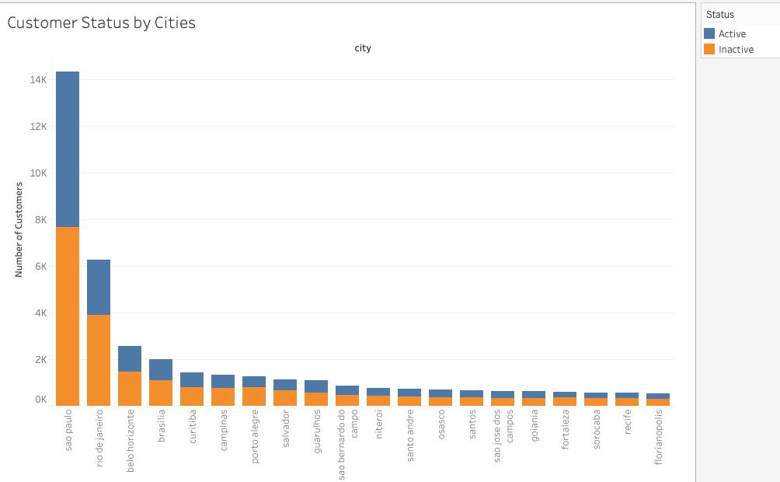
Number of Active and Inactive Buyers
Customers are active buyers if their last order was made within the last 6 months.
The ratio of active customers is large only because of newly joined customers.
Most of the customers are inactive buyers. That is why it is important to pay attention to customer churn. The customers can be kept active through good marketing plan.
Notes:
Add background image and send it to back:
Click on the icon to add a Image >> Choose your Image >> Right Click on Image >> Send to Back >> Send to Back.
Change the image:
Right Click on Image >> Change Picture >> Choose your Image.

Slide 12
Causes of declining revenue growth rate
Share of orders with more than 1 items is very small
Demand for top selling product categories is not growing steadily
Rate of newly joined customers is small
Most of the customers are not active buyers
01
Can be solved by customer segmentation and calculation of product association for each segment.
02
Can be solved using targeted marketing of specific top product to a specific customer segment.
03
Can be solved by a large-scale marketing campaign considering tastes of existing customer segments in a local area.
04
Can be solved by sending frequent notifications about arrival of a new product based on which segment the customer belongs to.

Slide 13
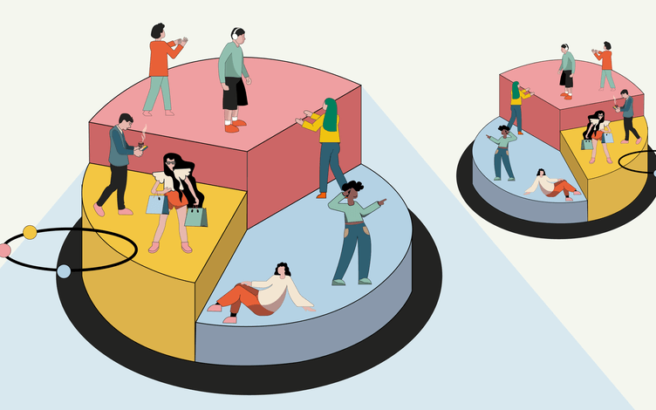
Customer Segmentation
Notes:
Add background image and send it to back:
Click on the icon to add a Image >> Choose your Image >> Right Click on Image >> Send to Back >> Send to Back.
Change the image:
Right Click on Image >> Change Picture >> Choose your Image.

Slide 14
Customer Segmentation
04
Purchase Min
07
Freight Sum
Customers are separated into 5 segments.
Only customers from major two cities, namely, Sao Paulo and Rio de Janeiro were segmented since they share about 80 percent of total revenue. Also, this helps to achieve results for a more convenient interpretation.
Diagram on the left, illustrates some of the data used for customer segmentation.
06
Freight Mean
03
Purchase Mean
05
Purchase Max
Over 21000
02
Purchase Sum
Segmentation is performed on over 21000 customers
01
Top 15 product categories

Slide 15
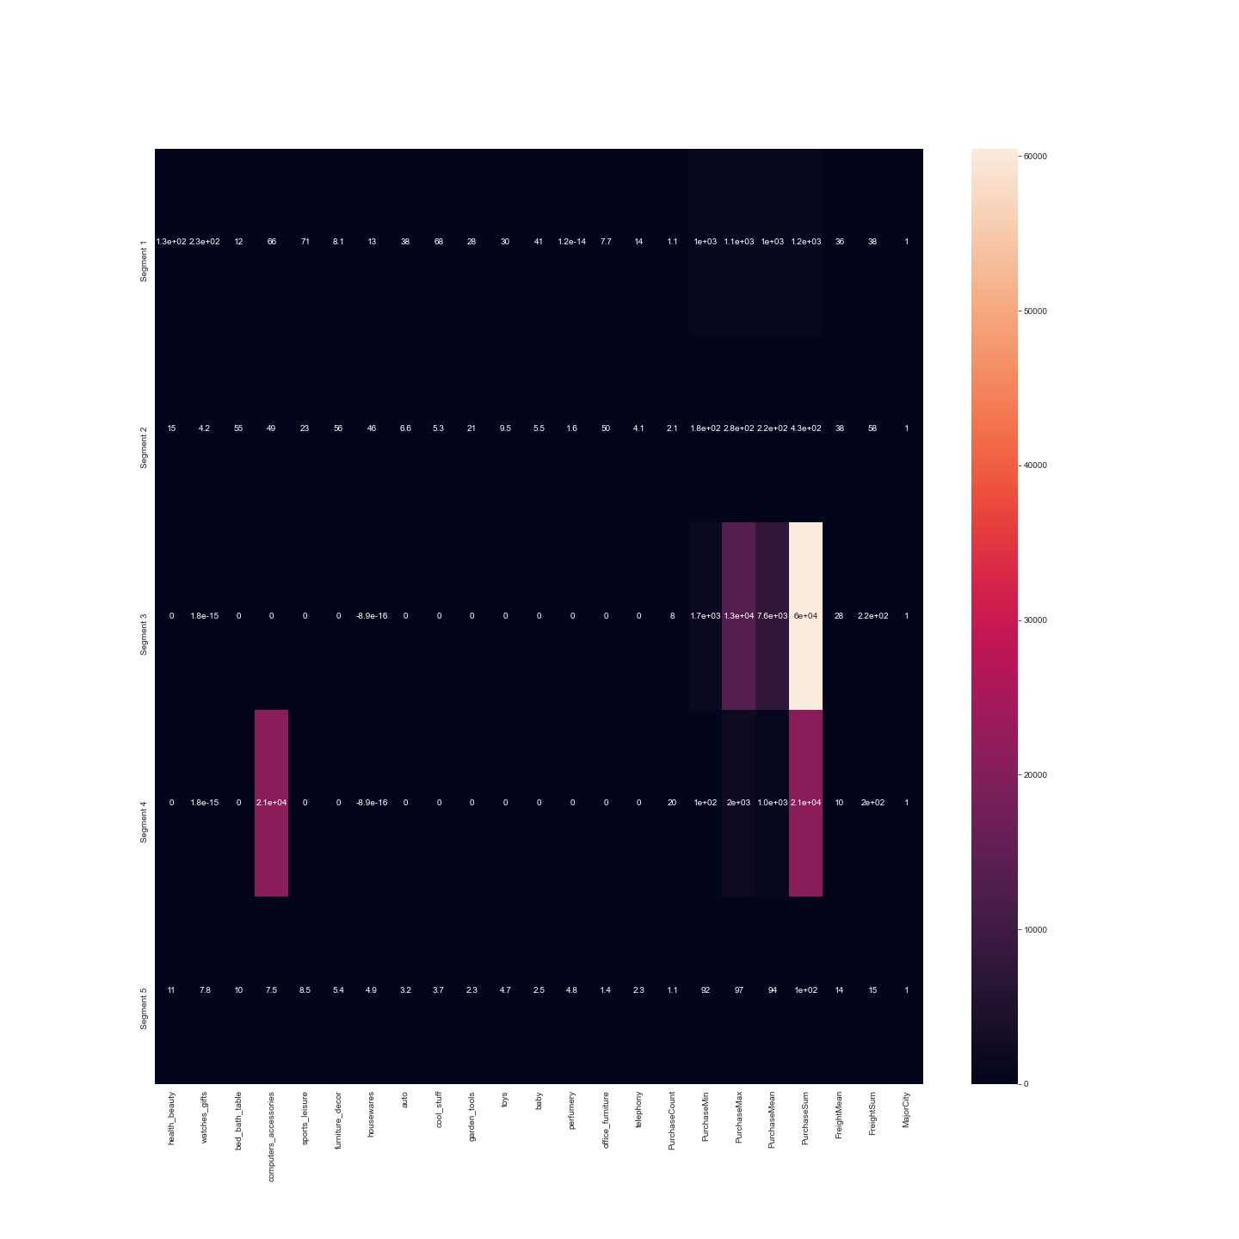
Results (need to zoom in)

Slide 16
Main Insights
SEGMENT 01
SEGMENT 02
SEGMENT 03
SEGMENT 04
SIMPLE BUYERS
HOME BUYERS
RICHEST BUYERS
FREQUENT BUYERS
They like buying health beauty products and watches, gifts
They might like buying things as a gift for someone
They like purchasing furniture, decor, bed, baths, tables.
Overall, they like buying things for home.
They purchase less but expensive products.
This segment makes highest contribution to the revenue
Segment does not have specific category preferences, but they buy fairly more amount than some segments.
It is important to keep this segment’s customers as active because they are the most frequent buyers.
This segment likes buying computer accessories

Slide 17
Conclusion
Marketing adjustment
Marketing strategies applied to each segment should be adjusted accordingly.
Product Association
Attempt to sell several products together to some segments.
Customer Activity
Send newly arrived specific products to each segment depending on their tastes.
New Customers
Try to produce targeted large-scale campaign on major cities based on information about existing segments.

