Slide 1

Southern Company Power Usage: A Data-Driven Analysis
Presenter: Gazali Agboola
Date: 06/10/2025

Slide 2




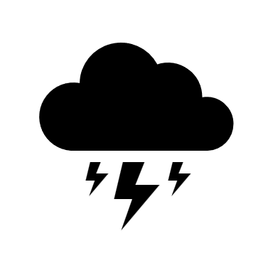
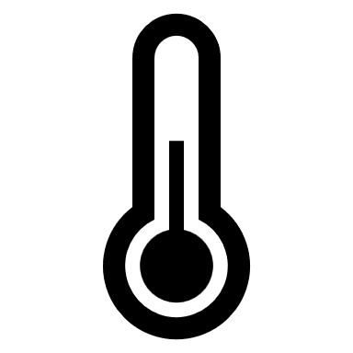
Objectives
The scale of electricity usage in 2024
Sector breakdown (commercial, residential, industrial)
Key insights across time (hourly, seasonal)
Relationship between weather condition and power usage

Slide 3



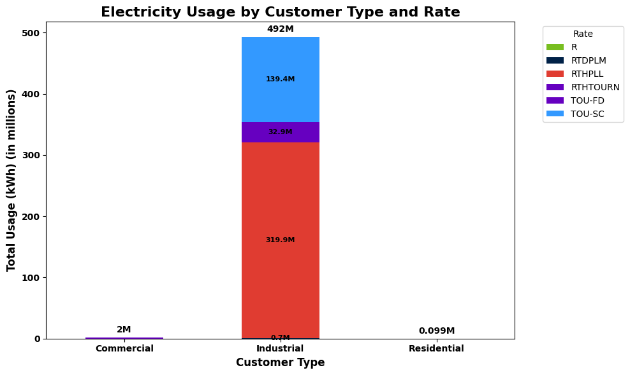
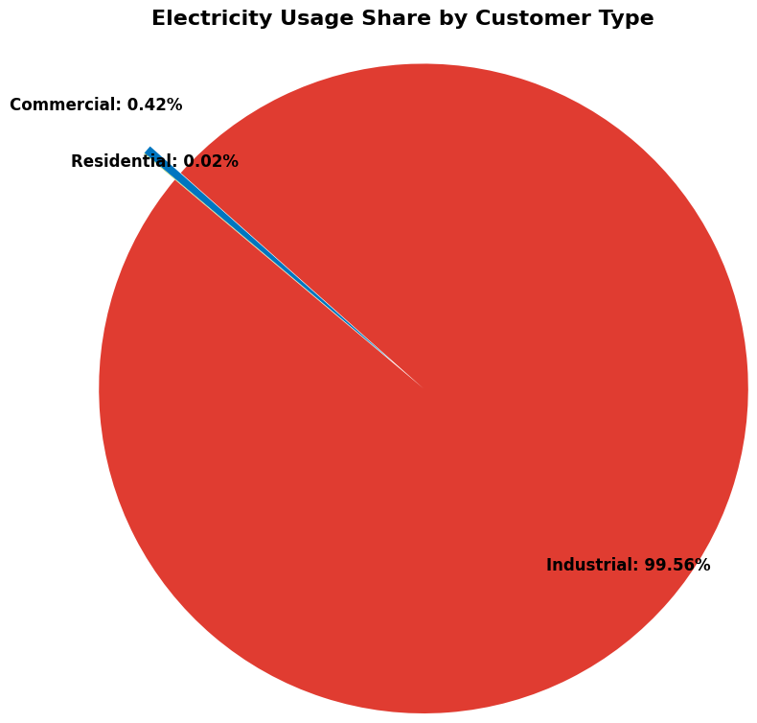
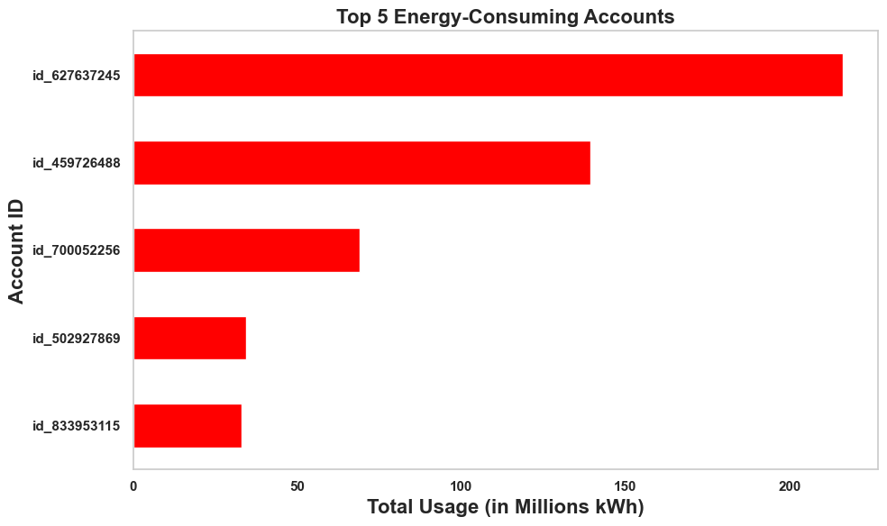
Southern Company 2024 Power Usage Overview
Commercial Commercial
495,075.30MWh
492,876.8MWh
2,099.2MWh
99.3MWh
👥 Total Customers
26
🏠Residential
10
Monthly: 41,256.3MWh
Monthly: 41,073.1MWh
Monthly: 174.9MWh
Monthly: 8.3MWh
Daily: 1352.7MWh
Daily: 1346.7MWh
Daily: 5.7MWh
Daily: 0.27MWh
🏢 Commercial
10
🏭Industrial
6
Total Usage
Industrial Usage
Commercial Usage
Residential Usage

Slide 4
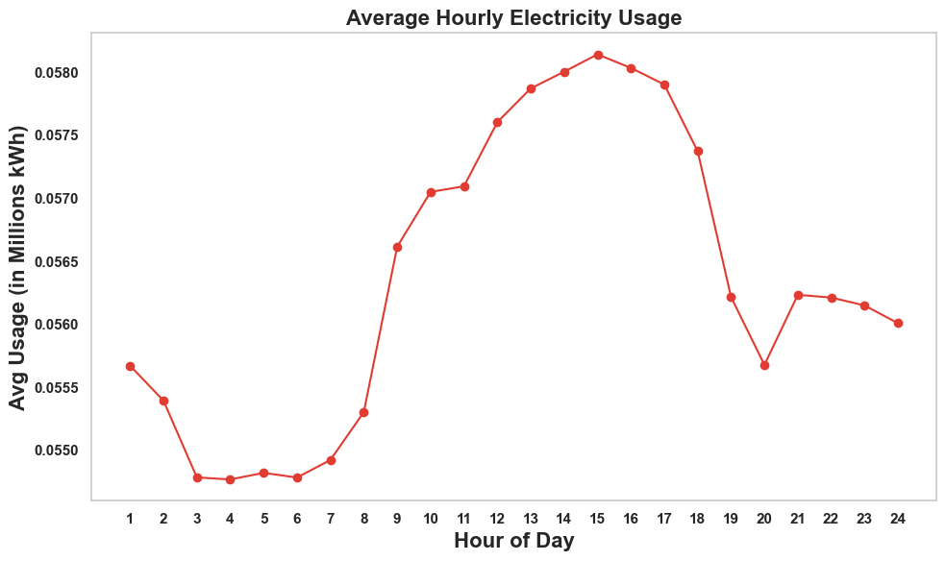
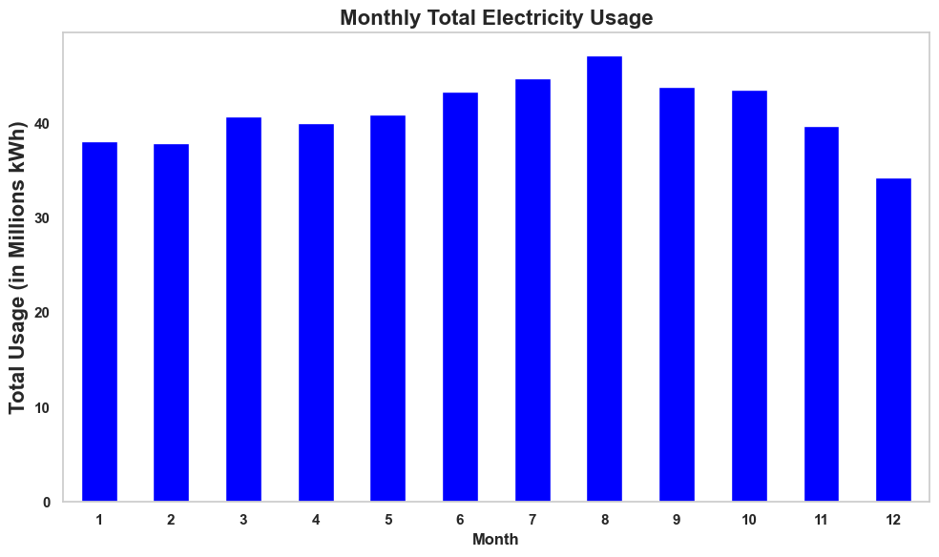
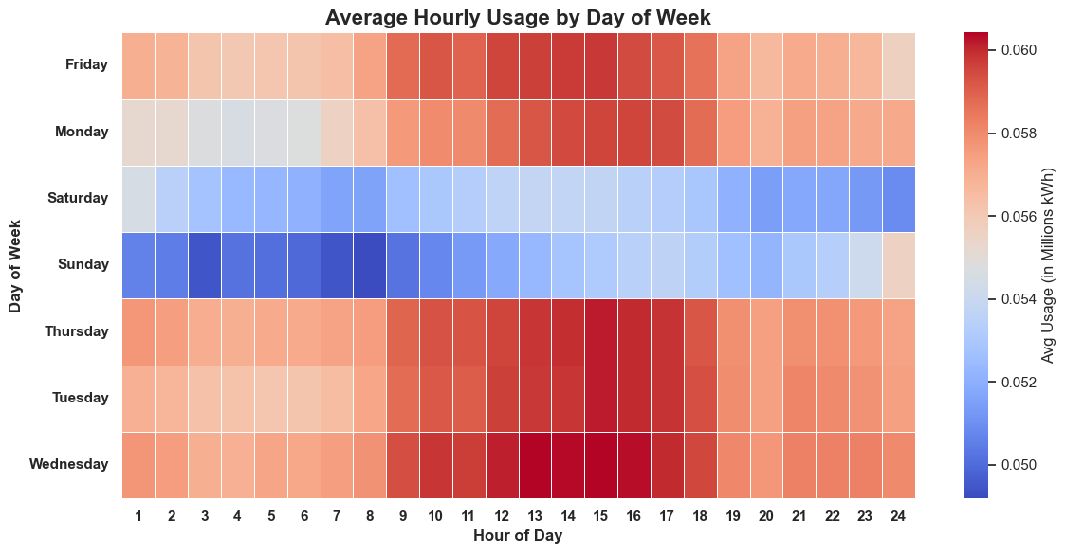
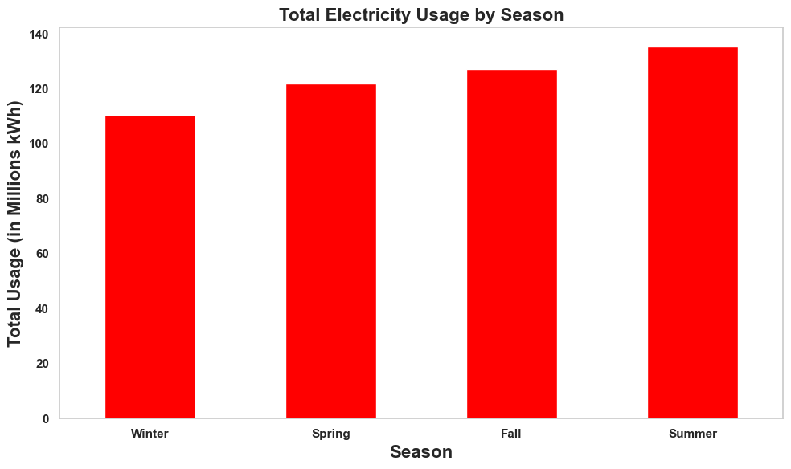
Hourly and Seasonal Usage
Seasonal Electricity Usage Highlights
Summer peaks in electricity consumption, primarily due to higher air conditioning demand and extended daylight activities
Winter shows the lowest total usage: less industrial production and potentially more energy-efficient heating practices
Daylight hours correlate with increased usage, emphasizing the impact of daily industrial usage and human activities

Slide 5
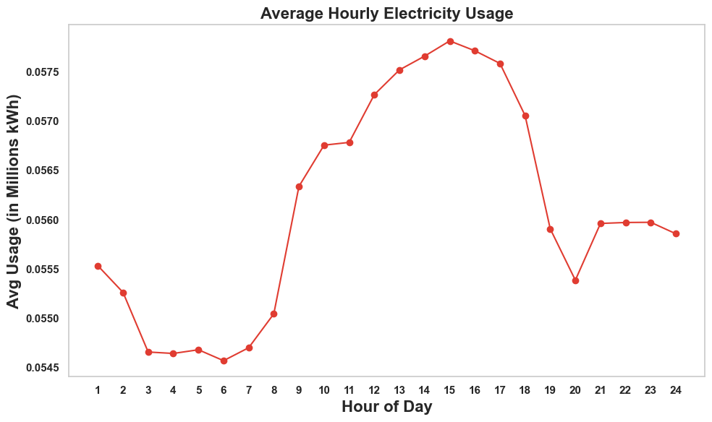


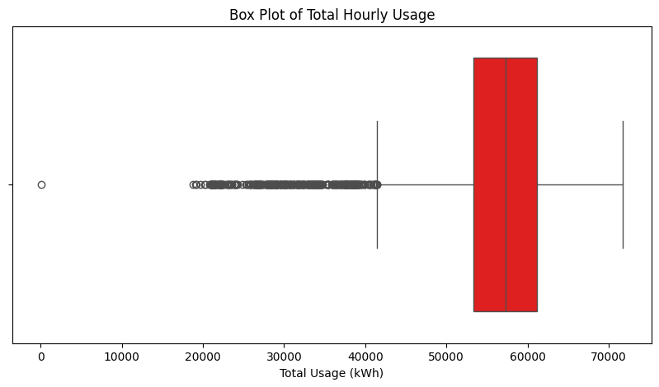
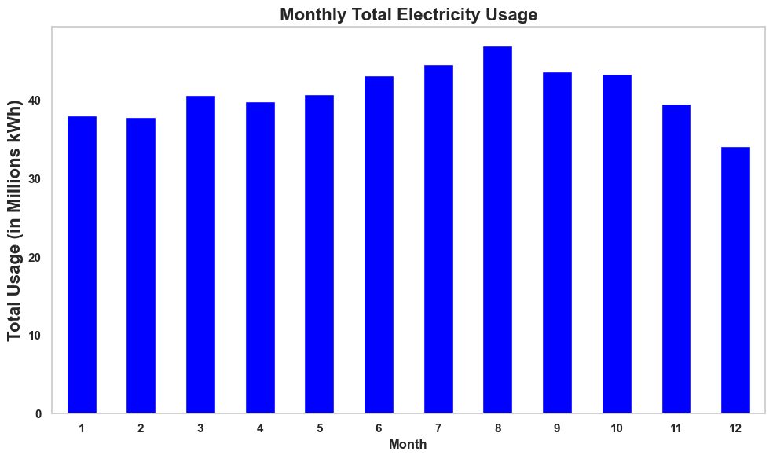
Hourly and Seasonal Usage for Industrial
Industrial Usage Highlights
Industrial activity patterns align closely with total electricity usage, indicating industry is a major driver of demand.
There are outliers due to non-usage of power especially from 2am to 3am on 3/10, no industrial usage
Weekends show significantly lower usage: reduced industrial operations
Peak consumption occurs consistently between 9:00 AM and 6:00 PM, aligning with standard business hours and daily routines

Slide 6
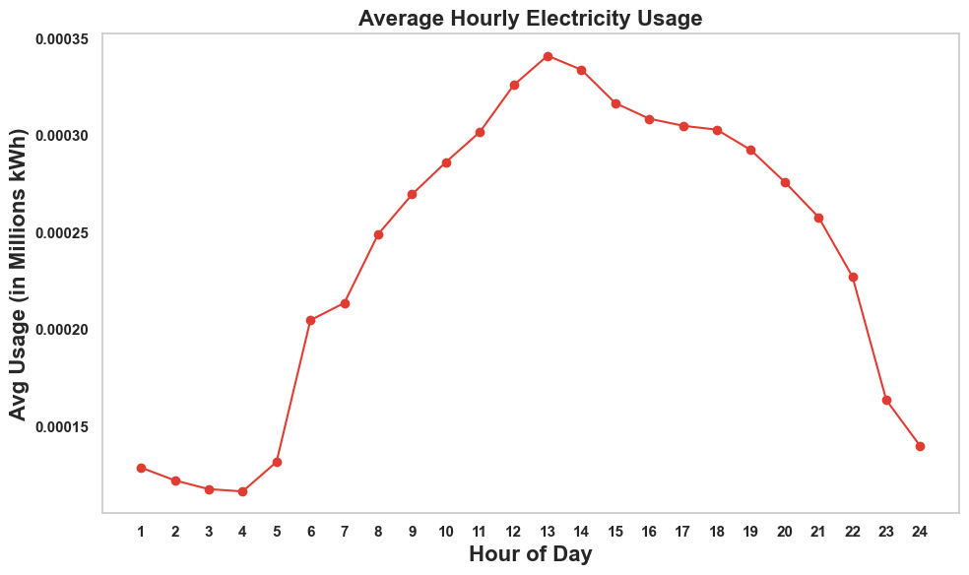
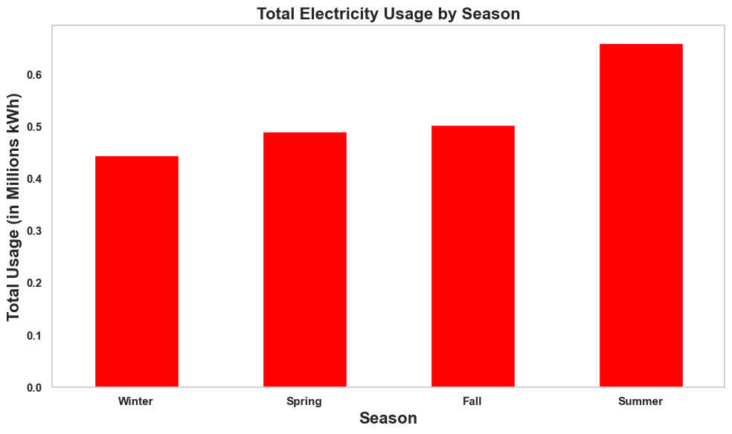
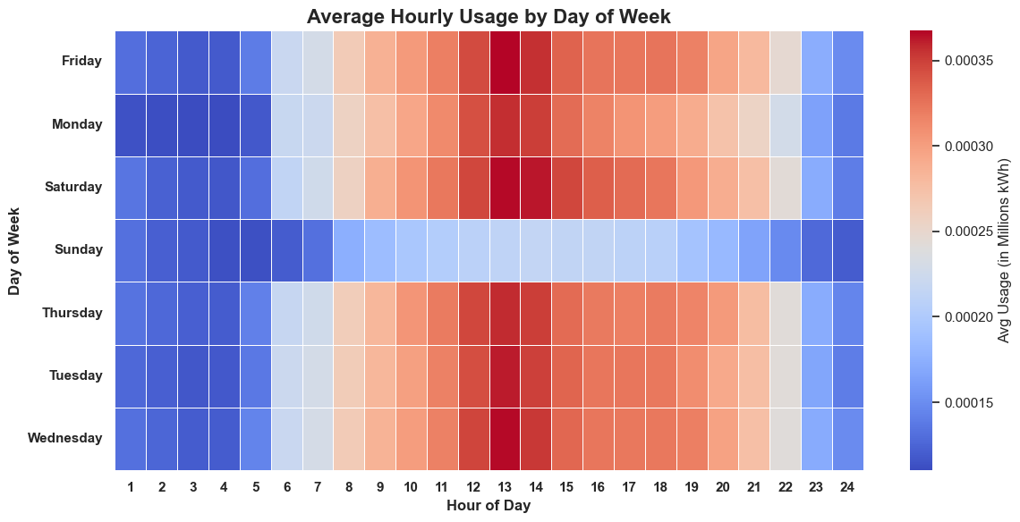
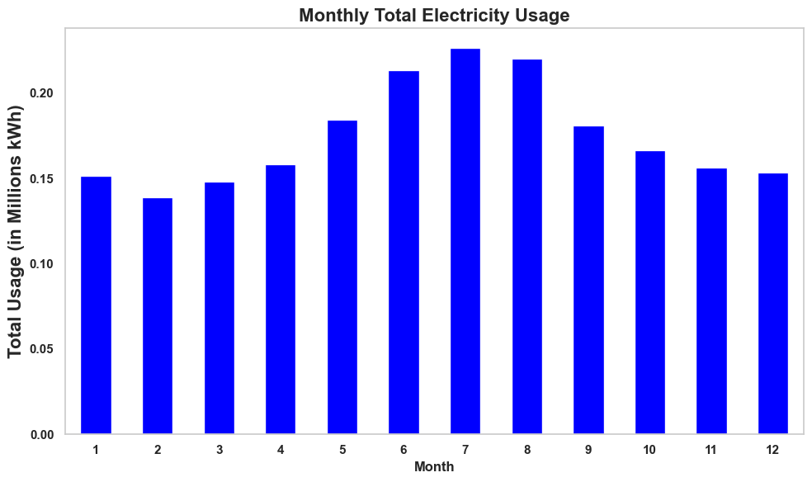
Hourly and Seasonal Usage for Commercial
Commercial Usage Highlights
Sunday is the least active day for commercial customers, with significantly lower electricity usage compared to weekdays.
Peak consumption typically occurs between 12:00 PM and 3:00 PM, reflecting core operational hours in commercial facilities
Summer months show the highest power demand, likely driven by increased cooling needs and extended commercial activity.

Slide 7
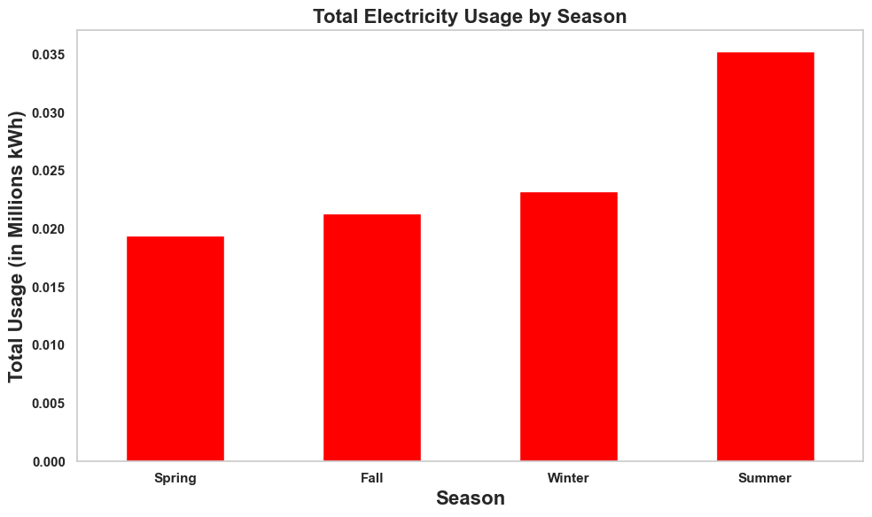
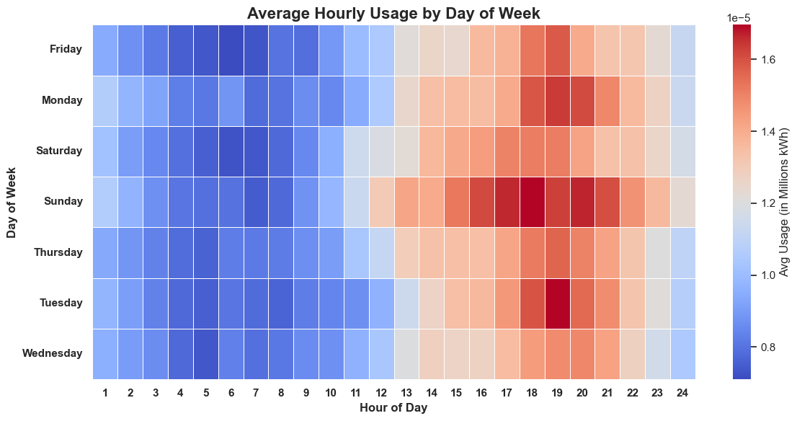
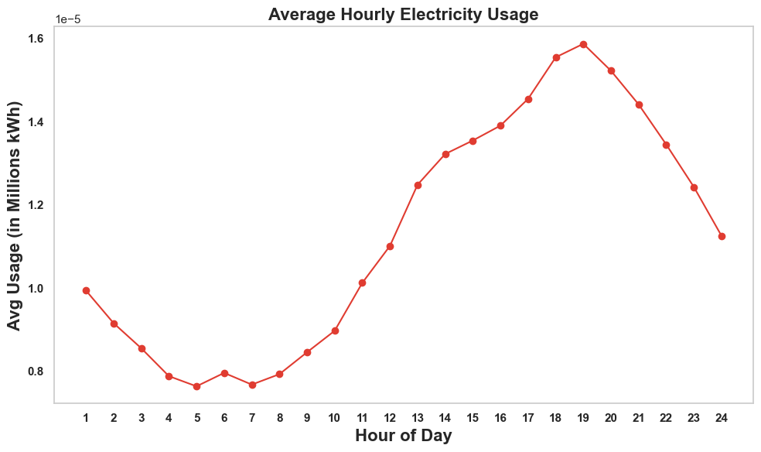
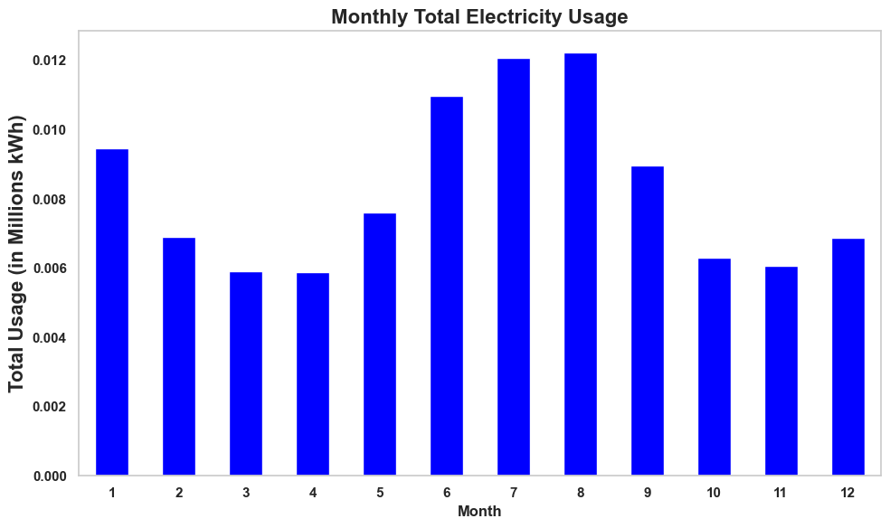
Hourly and Seasonal Usage for Residential
Residential Usage Highlights
Evening hours (5 PM – 9 PM) show the highest residential power usage, likely due to after-work home activities and appliance use
Sunday long time of high usage, reflecting more time spent at home and increased residential demand
Summer months exhibit increased residential electricity usage, driven by cooling needs and longer daylight hours

Slide 8
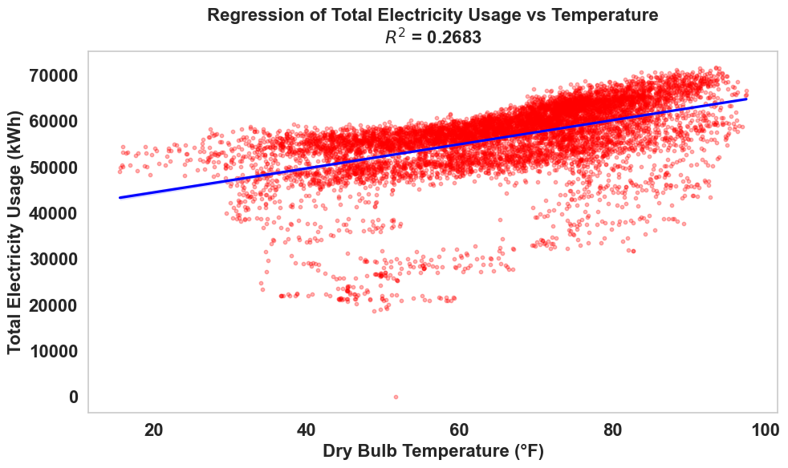
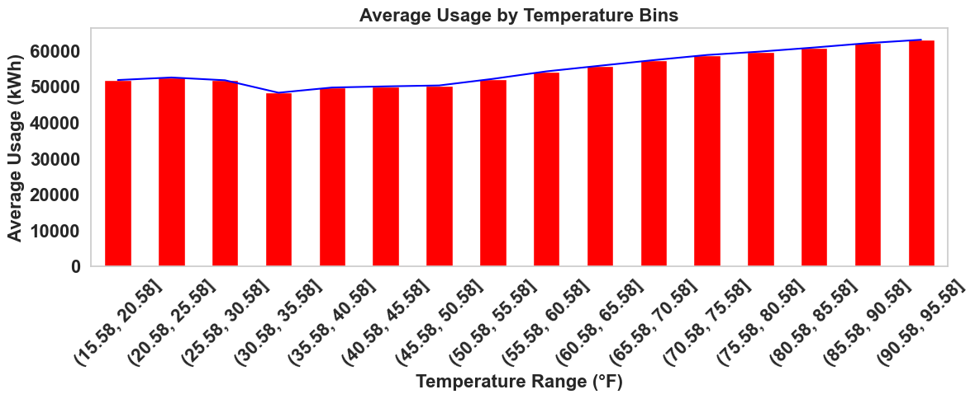
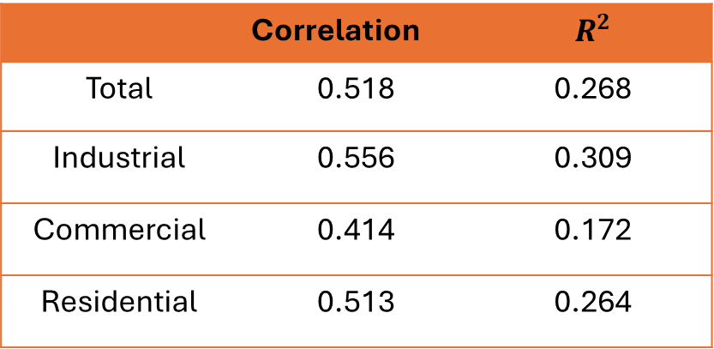
Relationship Between Bulb Temperature and Power Usage
 | Correlation | $$R^{2}$$
Total | 0.518 | 0.268
Industrial | 0.556 | 0.309
Commercial | 0.414 | 0.172
Residential | 0.513 | 0.264
Electricity usage increases steadily with temperature, particularly above 50°F, highlighting a strong cooling demand effect in warmer conditions
While the overall correlation is moderate (R² = 0.27), the positive correlation shows temperature sensitivity

Slide 9
Conclusion:
Electricity usage peaks during warm months and business hours, driven by cooling demand
Residential and commercial patterns vary by weekday and season
Electricity usage patterns are influenced by temperature and time of day, with peak demand aligning with business hours and warmer months.
Conclusion and Recommendations
Recommendations
Implement demand-side management strategies during peak hours (12 PM – 6 PM) for industrial and commercial usages and 6pm to 9pm for residential to reduce load pressure and improve grid efficiency
Focus on managing peak-hour demand and promoting energy-efficient cooling
Encourage off-peak usage through pricing models and monitor industrial trends for optimization
Provide hourly usage forecasts to help customers better manage their energy consumption and control their bills

Slide 10




Thank You Data-informed strategies can improve reliability and cost-efficiency
Gazali Agboola
Seeking Operation Analyst position
(779)777 -8515
goagboola@aggies.ncat.edu
https://gazmaths.github.io/
agboolagazal@gmaail.com

