Slide 1
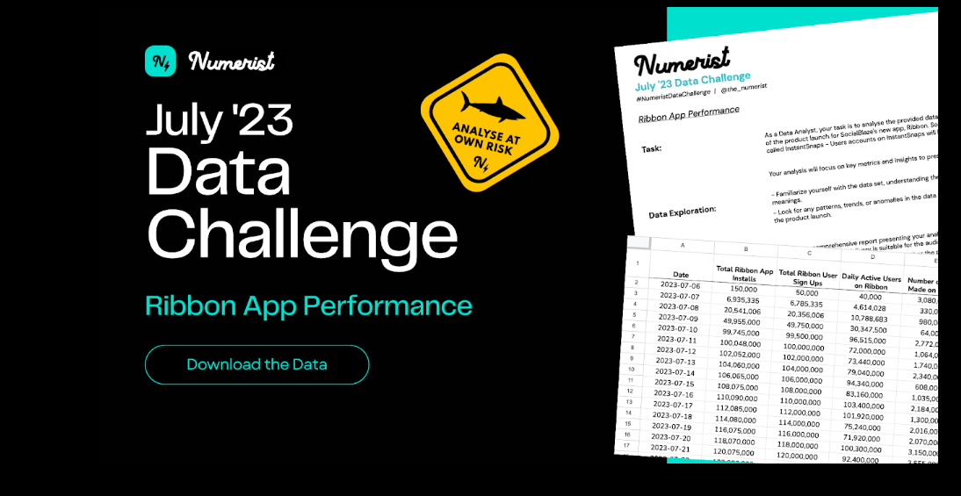
Analysis Report

Slide 2


Ribbon
Table of Contents
Executive Summary
Key Metrics and Findings
Success of the App Launch
Opportunities for Enhancement
User Acquisition and Engagement
Answering CEO’s Questions
Actionable Recommendations

Slide 3
Ribbon
Executive Summary

Slide 4
Ribbon
Key Metrics and Findings

Slide 5
Ribbon
Success of the App Launch

Slide 6
Ribbon
Opportunities for Enhancement

Slide 7
Ribbon
User Acquisition and Engagement

Slide 8
Ribbon
Answering CEO’s Questions

Slide 9
Ribbon
Actionable Recommendations

