Slide 1
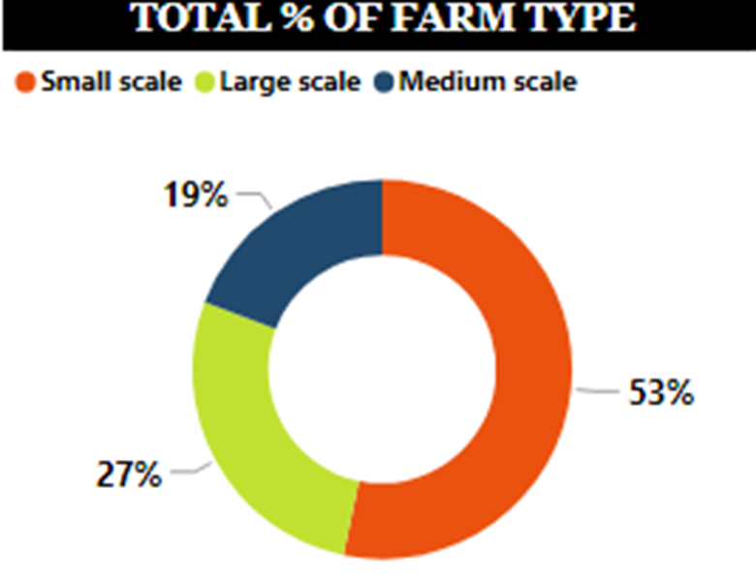
The farm type consist of three different types which are the small scale, medium scale and large scale.
The small scale is the most used farm type by the farmers in all the 11 African countries that was involved in the survey.

Slide 2
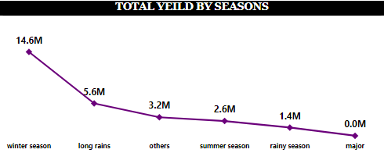
In season 1, we have 5 different types of seasons and others representing other seasons that were not mentioned.
From this visual, we have the total yield (gain) from the different seasons in season 1. And we have more yield gotten during the winter season of 14.6M.

Slide 3
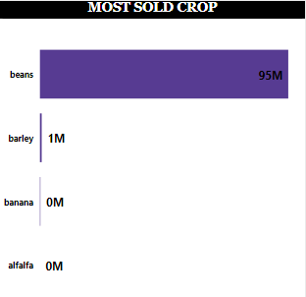
There are different crops that are planted and there are four(4) major crops planted in (season 1-plot 1-crop 1), which are Beans, Barley, Banana and Alfalfa.
From the visual seen, Beans is the most sold crop with 95M yeild.

Slide 4
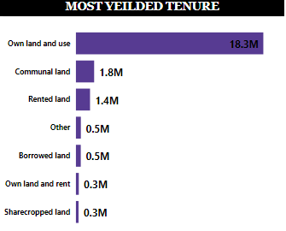
There are different tenure used in this analysis, but the tenure that yielded the most is the ‘Own land and Own use’ that gave 18.3M yield in season 1.

Slide 5
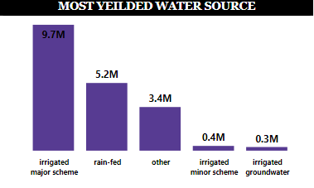
There are different water sources used for planting
From the visual, irrigated major scheme(public) source was the water source that yielded the most with 9.7M.

Slide 6
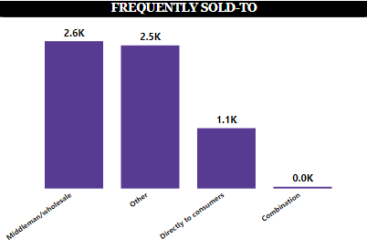
From the visual, the output gotten from the harvested crops of the farm were mostly sold to the wholesalers(middleman) and then others, then sold directly to consumers.

