Slide 1
Food Accessibility and Profitability
Data from Agricultural Survey of African Households (https://www.kaggle.com/datasets/crawford/agricultural-survey-of-african-farm-households)

Slide 2
Aim and Objective
To create a model that can indicate the best investment decision for the farming industry.
To visualize and Identify the best farming practice for substantial results

Slide 3
Flowchart
Data Preparation
Data Visualization
Model Training
Model Deployment
Model Validation
Model Evaluation

Slide 4
Data Preparation
A dataset on an agricultural survey for more than 9,500 African households was obtained from Kaggle
The dataset contained 9597 rows and 1753 columns which was processed to 6823 rows and 54 columns
This was gotten by handling missing values ,scaling numerical data and filtering the columns necessary for our model.

Slide 5
Feature Enginnering.
We discovered the dataset has a lot of features so we used a Recursive Feature Elimination to give the best features that will significantly affect our model
In order to facilitate the creation the dataset was divided into two parts: the training dataset and the testing dataset.

Slide 6
Data analysis and Visualization
This step was taken to gain insights from the data to uncover and comprehend patterns or trends that would explain unexpected results. Some of the valuable insights are:
The total cost of transportation was estimated to 351 million.
The total agricultural yield in a season was 29 million.
Majority of households rely on irrigation major schemes.
Trucks are the most used for transportation.

Slide 7
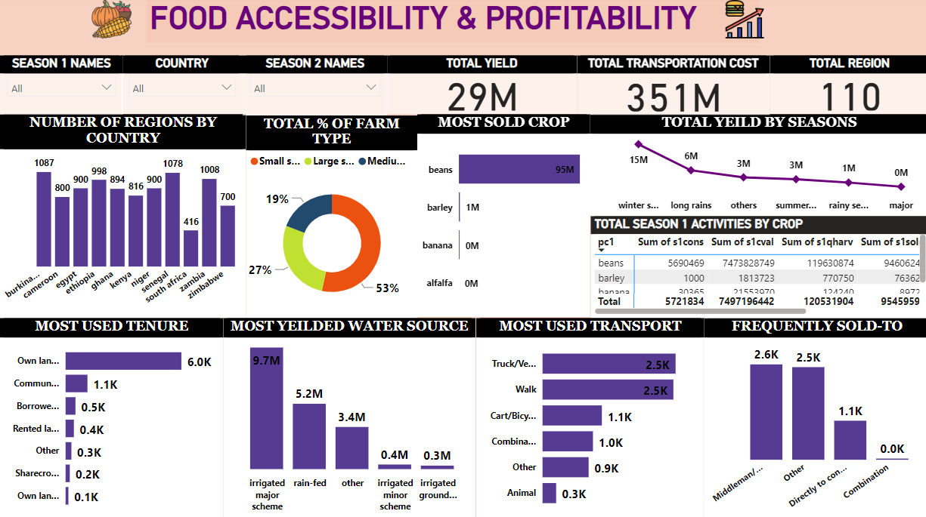
Data visualization.
The visualization outlines the data as provided and further give numbers per countries and per region.
It shows how much could also be gotten per season.
The amount differences can help decide best to invest in and the best farming system to carry out.

Slide 8
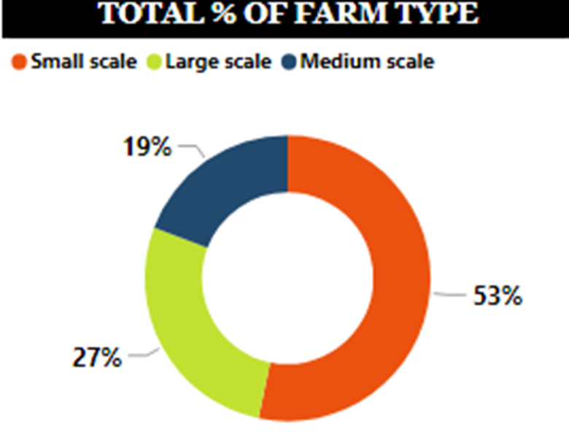
The farm type consist of three different types which are the small scale, medium scale and large scale.
The small scale is the most used farm type by the farmers in all the 11 African countries that was involved in the survey.

Slide 9
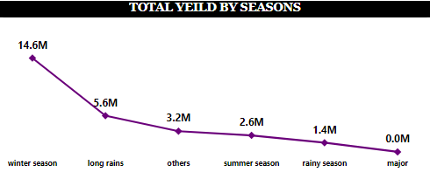
In season 1, we have 5 different types of seasons and others representing other seasons that were not mentioned.
From this visual, we have the total yield (gain) from the different seasons in season 1. And we have more yield gotten during the winter season of 14.6M.

Slide 10
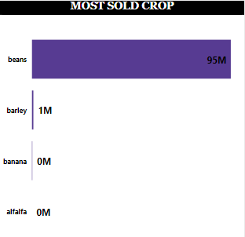
There are different crops that are planted and there are four(4) major crops planted in (season 1-plot 1-crop 1), which are Beans, Barley, Banana and Alfalfa.
From the visual seen, Beans is the most sold crop with 95M yeild.

Slide 11
Model Evaluation.
In the building of the model, various supervised machine learning algorithms such as Random Forest Regressor and Light GBM Algorithm were used.
The Root Mean Square Error(RMSE) metric was used in evaluating the models. LightGBM was the best performing algorithm based on our evaluation Metrics with a score of 0.36311
As compared to Random Forest Regressor with a RMSE score of 0.6....

Slide 12
MODEL VALIDATION
The test data was used to validate the model.
Our model was neither overfitting nor underfitting the training data.

Slide 13
Model Deploment
Dash is (a Python web application framework) was used in deployment.
The trained model is integrated into the Dash backend, allowing users to interact with it through the web interface.
We chose Dash because it provides a seamless user experience, making complex models accessible to a broader audience

Slide 14
CONCLUSION
Through rigorous testing and validation, our model has demonstrated commendable predictive accuracy.
Our model has successfully identified and assessed a myriad of factors influencing food accessibility and profitability.
We leveraged the use of data analytics and machine learning in the agriculture sector.

