Slide 1
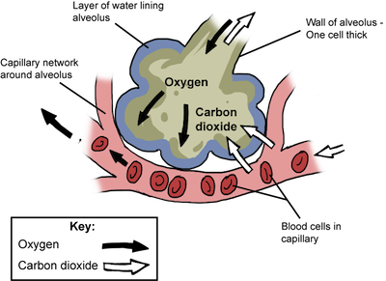
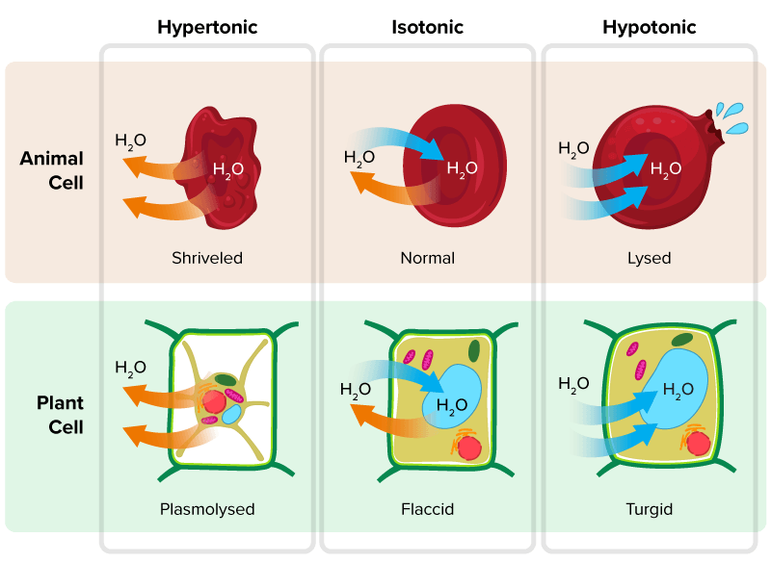
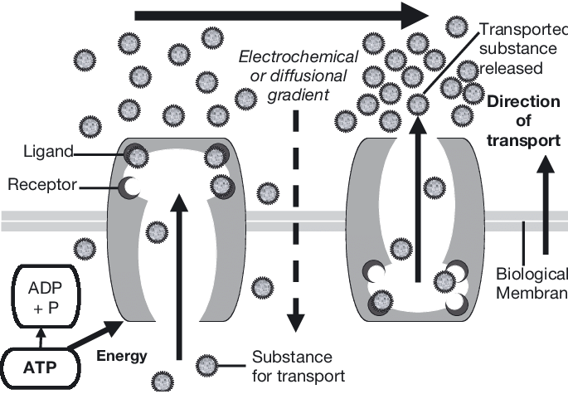
Diffusion, Osmosis, and Active Transport
How Substances Move Across Cell Membranes
🟣 Introduction
Every living cell depends on the constant movement of substances in and out through the plasma membrane, which is a selectively permeable barrier controlling material exchange (Campbell, Urry, Cain, Wasserman, & Minorsky, 2020).
This regulation maintains homeostasis, ensuring optimal internal conditions for metabolism (Sherwood, 2012). The three key mechanisms enabling molecular transport are diffusion, osmosis, and active transport (Silverthorn, 2012).
Diffusion refers to the passive movement of particles from areas of high concentration to areas of low concentration due to molecular motion (Kratz, 2010).
Osmosis is the diffusion of water molecules across a selectively permeable membrane.
Active transport, in contrast, requires cellular energy in the form of ATP to move substances against the gradient (Lodish et al., 2008). Together, these processes sustain vital biological functions in both plant and animal cells.
Diffusion
Osmosis
Figure 1. Diffusion of oxygen and carbon dioxide across the alveolar-capillary membrane.
Adapted from Gilam (2015)
Figure 2. Osmosis in animal and plant cells under different solute conditions.
Adapted from Wilkin and Brainard (2021)
Diffusion operates without energy expenditure and continues until equilibrium is reached (Campbell et al., 2020). Factors such as temperature, membrane surface area, and concentration gradient influence diffusion rate (Silverthorn, 2012). A classic example is the exchange of oxygen and carbon dioxide between alveoli and blood capillaries, which occurs entirely by diffusion (Sherwood, 2012).
Osmosis involves water movement from regions of low solute concentration to high solute concentration through a partially permeable membrane (Kratz, 2010). In plant cells, water uptake maintains turgor pressure, essential for structural support, while loss of water causes plasmolysis (Campbell et al., 2020). In animal cells, excessive water inflow may lead to lysis, whereas hypertonic conditions result in crenation
Active Transport
Figure 3. ATP-driven active transport across a biological membrane.
Adapted from Quinnell et al (2004)
Process | Energy Requirement | Direction of Movement | Example
Diffusion | No energy (passive) | High → Low | Oxygen exchange
Osmosis | No energy (passive) | Water → Higher solute | Root water uptake
Active Transport | Requires ATP | Low → High | Sodium-potassium pump
References
Barnard, C. J., Gilbert, F. S., & Mcgregor, P. K. (2007). Asking questions in biology : key skills for practical assessments and project work. Prentice Hall.
Campbell, N. A., Urry, L. A., Cain, M. L., Wasserman, S. A., Minorsky, P. V., & Orr, R. B. (2021). Biology: A Global Approach (12th ed.). Pearson Education Limited.
Gillam, P. (2015, October 19). diffusion – PMG Biology. PMG Biology. https://pmgbiology.com/tag/diffusion/
Kratz, R. F., & Siegfried, D. R. (2010). Biology For Dummies. John Wiley & Sons.
Lodish, H. F., Berk, A., Kaiser, C. A., Krieger, M., & Scott, M. P. (2007). Molecular Cell Biology. W H Freeman & Company.
Quinnell, S., Hulsman, K., & Davie, P. (2004). Protein model for pollutant uptake and elimination by living organisms and its implications for ecotoxicology. Marine Ecology Progress Series, 274(12), 1–16. https://doi.org/10.3354/meps274001
Sherwood, L. (2016). Human Physiology : from Cells to Systems (9th ed.). Cengage Learning.
Silverthorn, D. U., Johnson, B. R., Ober, W. C., Ober, C. E., & Silverthorn, A. C. (2016). Human physiology : an integrated approach (6th ed.). Pearson.
Wilkin, D., & Brainard, J. (2021, November 23). CK12-Foundation. Flexbooks.ck12.org. https://flexbooks.ck12.org/cbook/ck-12-biology-flexbook-2.0/section/2.12/primary/lesson/osmosis-bio/
Unlike passive mechanisms, active transport requires metabolic energy (ATP) and specialized carrier proteins to move molecules against their concentration gradients (Lodish et al., 2008).
A key example is the sodium-potassium pump that maintains electrochemical gradients critical for nerve impulse transmission (Silverthorn, 2012). In plants, proton pumps in root cells actively absorb minerals from the soil even when concentrations outside are lower (Sherwood, 2012).
Summary
Diffusion, osmosis, and active transport form the foundation of cellular exchange systems. While diffusion and osmosis enable passive molecular movement, active transport uses energy to maintain concentration differences vital for life (Silverthorn, 2012). Their integration preserves homeostasis in cells, tissues, and entire organisms. Understanding these mechanisms is essential in explaining phenomena from plant water balance to nerve physiology (Campbell et al., 2020; Sherwood, 2012).

