Slide 1
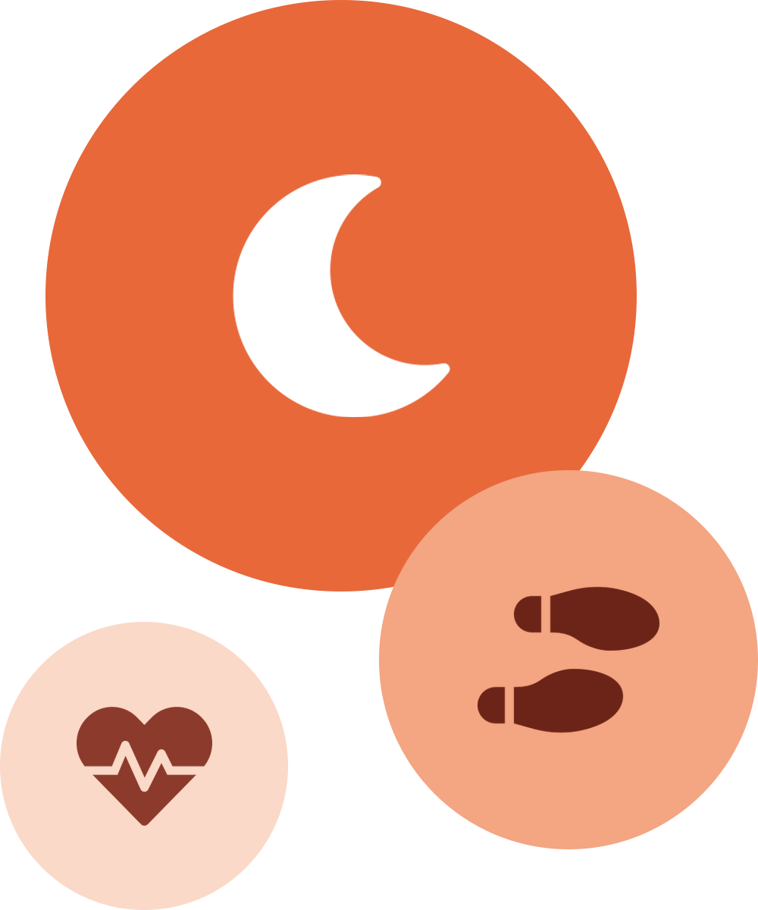
How People Use
Smart Devices
Activity and sleep trends to guide Bellabeat's marketing strategy
Gbenga Rahman A. | November 2026
Notes:
Introduce yourself and the project: an analysis of how people use smart devices, done for Bellabeat's marketing team. The goal is to turn activity and sleep trends into marketing recommendations.

Slide 2





Bellabeat: tech-driven wellness for women
Founded in 2013, Bellabeat designs health-focused smart products that give women knowledge about their activity, sleep, stress and reproductive health.
Bellabeat app
Leaf
Activity, sleep, stress and cycle insights
Tracker worn as bracelet, necklace or clip
BUSINESS TASK
Find how people use non-Bellabeat smart devices, then turn those trends into marketing recommendations for one Bellabeat product.
Time
Spring
Wellness watch with activity and sleep tracking
Smart bottle that tracks daily water intake
Stakeholders: Urška Sršen (cofounder, Chief Creative Officer), Sando Mur (cofounder) and the marketing analytics team.
Membership
PRODUCT FOCUS
The Bellabeat app, backed by membership
24/7 personalized wellness guidance
Notes:
Bellabeat sells the app, Leaf, Time, Spring and a membership. The app connects to every device, so it is the product I chose to focus on.

Slide 3






From raw data to recommendations
FitBit Fitness Tracker Data (Kaggle, public domain)
Ask
Define the business task and stakeholders
33
users, 940 daily activity rows
Prepare
Review the source, credibility and privacy
Process
Clean the data in MySQL
24
users, 413 sleep rows
Analyze
Segments, weekdays, sleep and correlations
31
days, 12 Apr to 12 May 2016
Share
Power BI dashboard and written report
Act
Recommendations for the Bellabeat app
Tools: MySQL for cleaning and analysis, Power BI for the dashboard.
Notes:
The work followed Google's six-step process: Ask, Prepare, Process, Analyze, Share, Act. Data is two Fitbit files: daily activity and daily sleep, covering 31 days in spring 2016.

Slide 4



Cleaning removed 80 unreliable rows
DAILY ACTIVITY
SLEEP
940 to 863
413 to 410
77 zero-step days removed
3 duplicate records removed
Duplicates
Dates
Raw data kept
Grouped by user and date to find repeats, then kept one record each.
Converted text dates into real dates so weekdays and ranges work.
Original tables untouched. All work was done on clean copies.
Notes:
Activity had no duplicates but 77 days with zero steps, most likely days the tracker was not worn, so I removed them. Sleep had 3 duplicate records. After cleaning: 863 activity rows and 410 sleep rows. All 410 sleep nights matched an activity day.

Slide 5
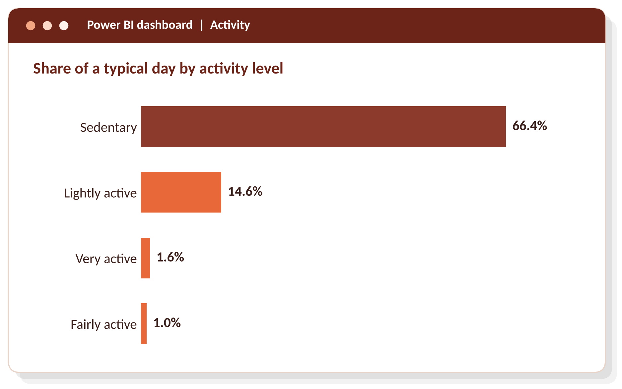
Two-thirds of the day is spent sedentary
8,319
average steps per day
956 min
sedentary per day, about 16 hours
2.6%
of the day very or fairly active
The four levels add up to 83.6% of the day. The rest is not assigned to a level, most likely because the tracker was off.
Notes:
The average user is sedentary for 956 minutes a day, about 16 hours. Very active and fairly active time together are only 2.6% of the day, under 40 minutes. Average steps are 8,319.

Slide 6
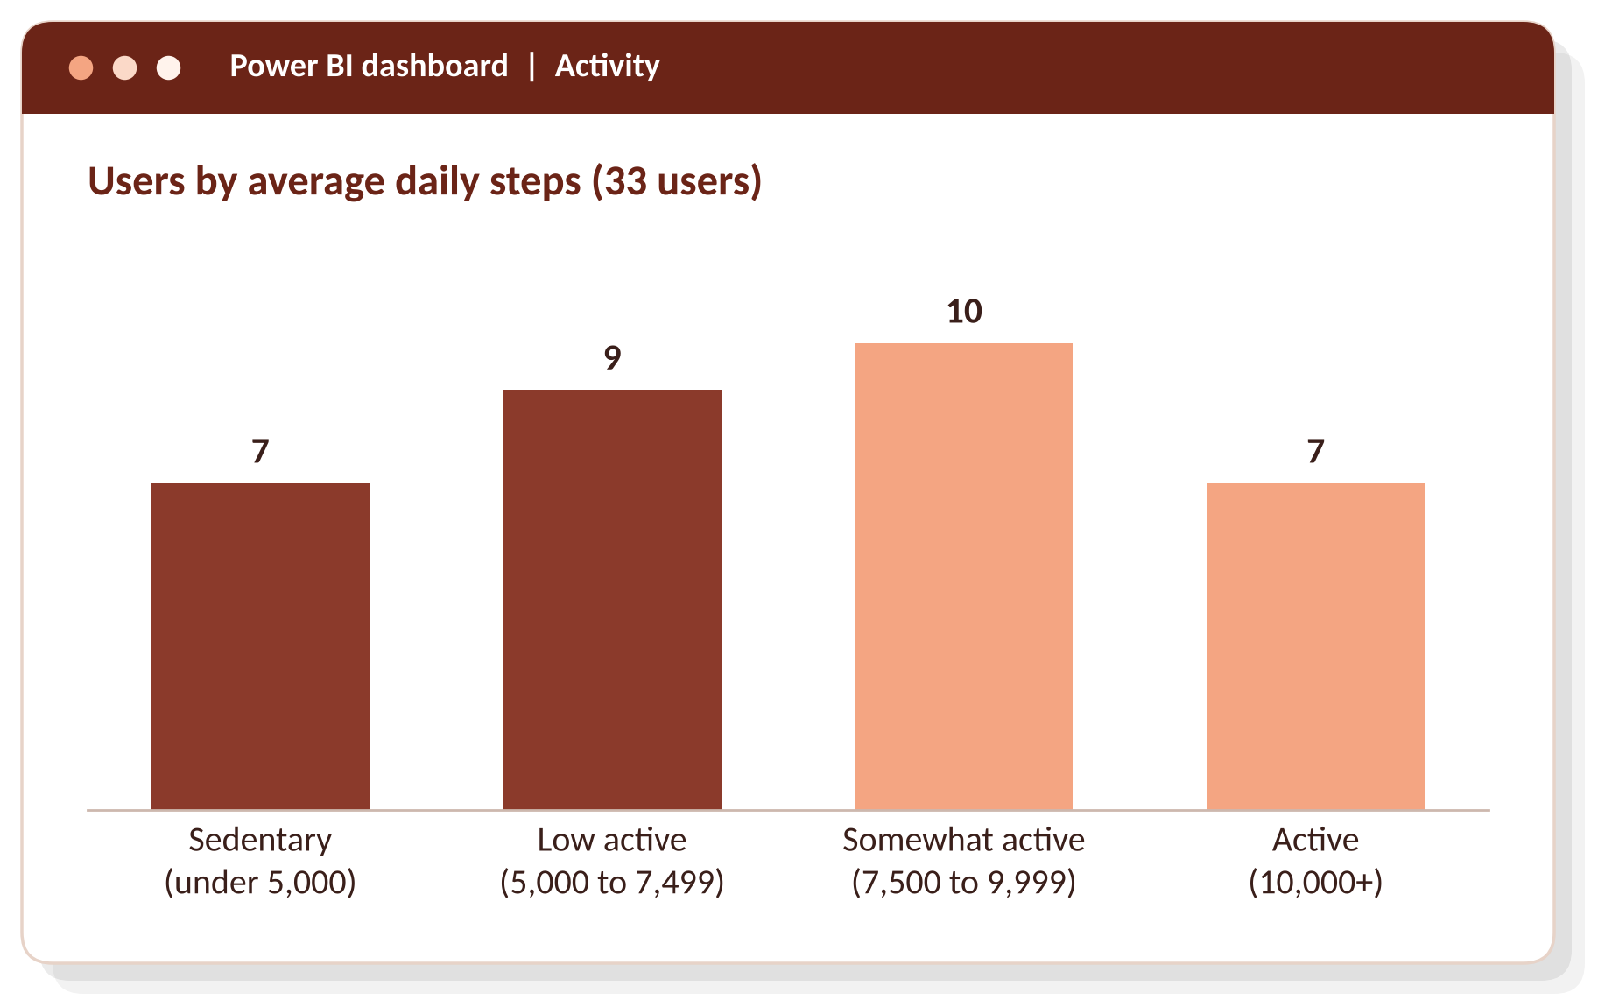
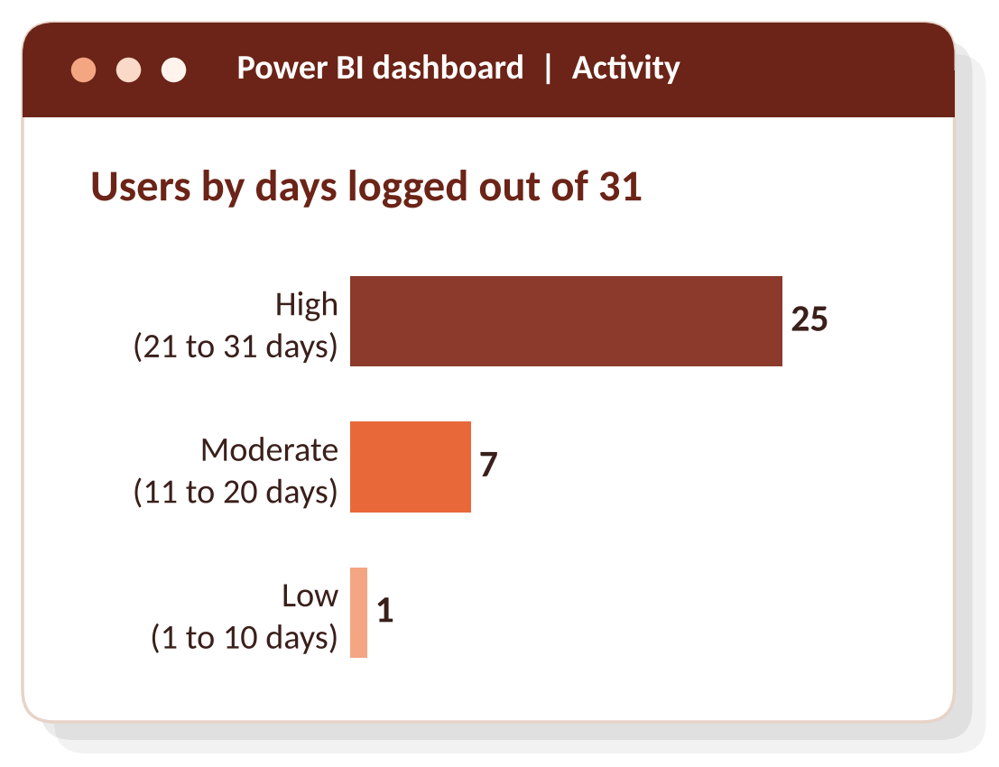
Almost half of users average under 7,500 steps
75.8%
of users logged activity on 21 or more of the 31 days
16 of 33 users (48.5%) average under 7,500 steps
Notes:
Users fall into four groups by average daily steps. Seven are sedentary, nine low active, ten somewhat active and seven active. Active users burn about 19% more calories than sedentary users. People do stick with their trackers: 25 of 33 logged activity on at least 21 of the 31 days.

Slide 7
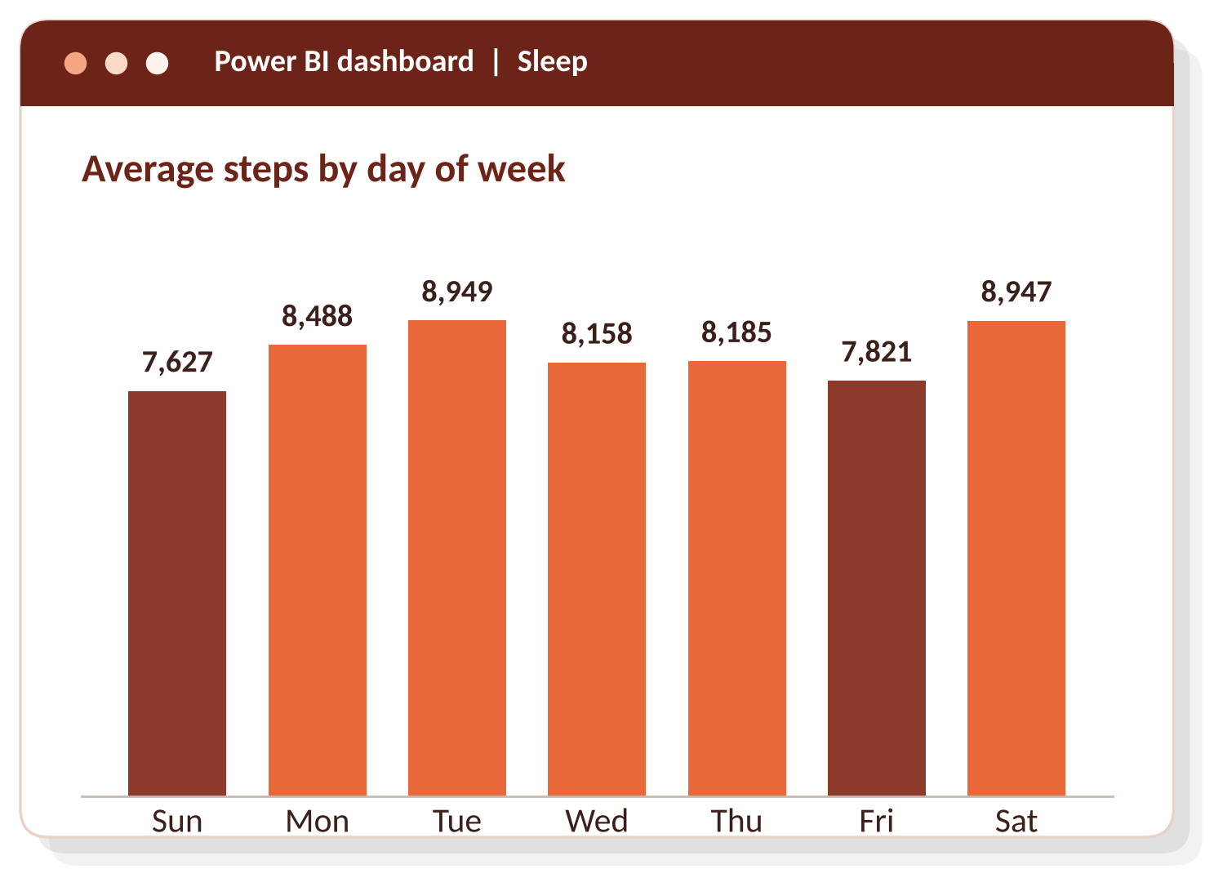
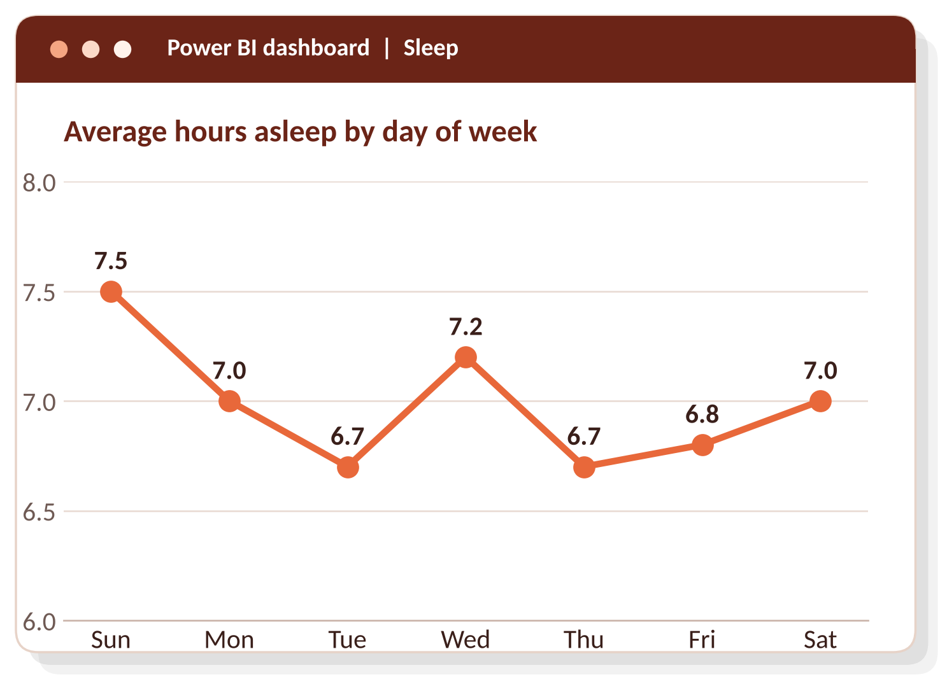
The week has a clear rhythm
Steps peak on Tuesday and Saturday (about 8,950) and are lowest on Sunday (7,627) and Friday (7,821).
Sleep is shortest midweek (6.7 hours on Tuesday and Thursday) and longest on Sunday (7.5 hours).
Notes:
Dark bars mark the two lowest step days, Sunday and Friday. Monday has the most sedentary time at 990 minutes. Sleep dips on Tuesday and Thursday.

Slide 8
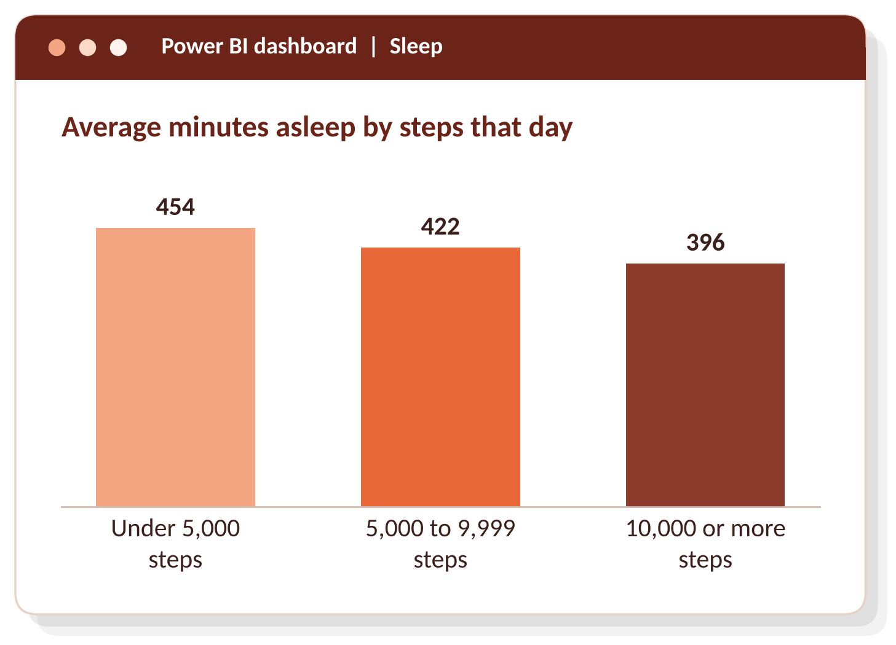
44% of nights are under 7 hours of sleep
7.0 h
44.1%
average sleep per night
of nights under 7 hours
91.4%
39 min
sleep efficiency (asleep divided by in bed)
awake in bed each night
More active days were not followed by more sleep, but the link is weak (correlation -0.19, 24 users). It is a pattern to test, not a promise to make.
Notes:
The 24 users with sleep data average 7.0 hours, but 44.1% of nights are under 7 hours. Higher-step days were followed by shorter sleep, but the correlation is only -0.19, so I would not build a message on it.

Slide 9
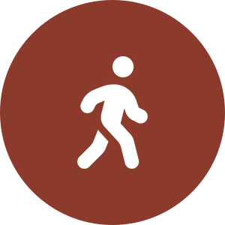
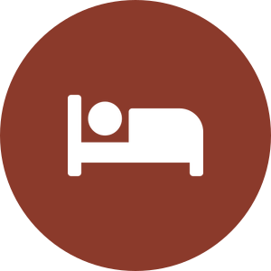

Three campaigns for the Bellabeat app
Make small movement the message
Coach sleep around the 7-hour mark
Get users wearing it overnight
66.4% of the day is sedentary; 48.5% of users average under 7,500 steps.
44.1% of nights are under 7 hours; users lie awake about 39 minutes.
27.3% of users have no sleep records; 75.8% already log on 21+ days.
Movement reminders and short daily challenges
Goals just above each user's own average
Nudges on Friday, Sunday and Monday
Bedtime reminders and wind-down content
Weekly sleep summary, with a midweek push
Promote membership sleep guidance
Overnight wear onboarding (Leaf: bracelet, necklace or clip)
Streaks and weekly summaries
Re-engage the 24.2% with moderate or low use
Notes:
The app is the right product because it connects to Leaf, Time and Spring, and membership is where personalized guidance lives. I would not claim that more steps lead to better sleep, because this data shows the opposite pattern.

Slide 10
Takeaways and limitations
WHAT THE DATA SAYS
WHAT IT CANNOT TELL US
Most of the day is sedentary, and only 21% of users average 10,000+ steps
People stick with their trackers: 75.8% log activity on 21+ days
Sleep sits right at 7 hours, with 44.1% of nights falling short
Small sample: 33 users, 24 with sleep data
31 days in 2016, with no age or gender data
Fitbit users, not Bellabeat customers
Correlations show patterns, not causes
Thank you | Gbenga Rahman A.
Notes:
Close with the three takeaways, then be upfront about the limits: a small, short, 2016 sample from Fitbit users, so these findings point to opportunities rather than prove them.

