Slide 1
Project Firm
George. B
12/20/2022

Slide 2
Summary
Countries Annual Income and Corrupt Index
Countries Tourism GDP and Tourism Receipt in Billion
Countries Monthly Income and Cost of Living per Day
What is the GDP per Capita of Countries
Countries Unemployment Rate

Slide 3
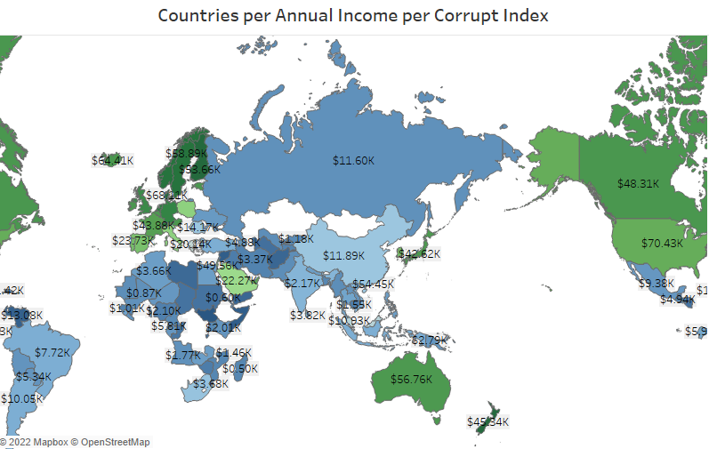
Countries Annual Income and Corrupt Index.
The map is showing the annual income/salaries of employees of various countries in the world.
While the corruption index is been shown by the colors in map, the countries in green color indicate that these countries are ranked below 50, While the blue indicate that those countries are ranked above 50.

Slide 4
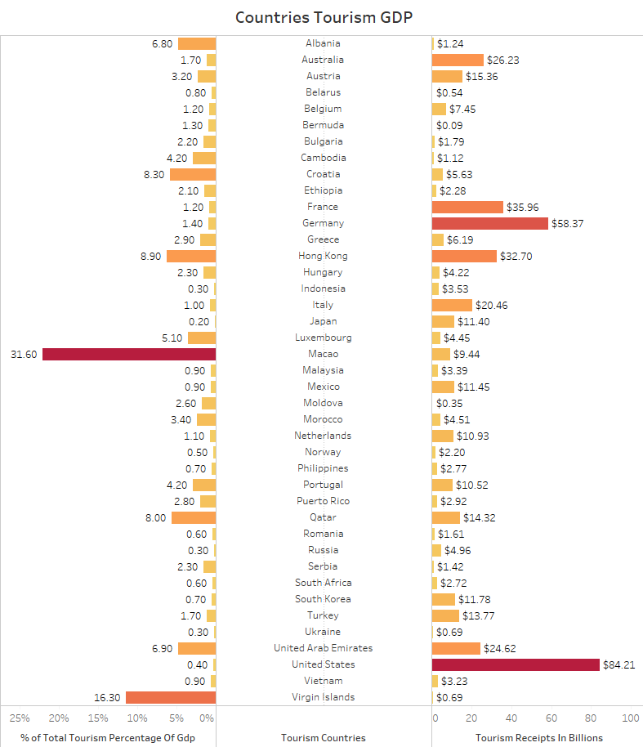
Countries Tourism GDP and Tourism Receipt in Billion
This bar chart shows the countries with tourism site, how much these countries make from tourist visitation and the countries GDP on tourism.

Slide 5
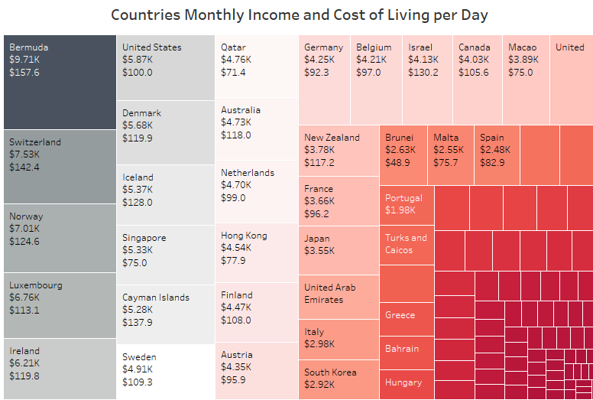
Countries Monthly Income and Cost of Living per Day
The chart showcase the countries monthly income/salaries of employees in each countries.
It also show the cost of daily living in these countries below the monthly income.

Slide 6
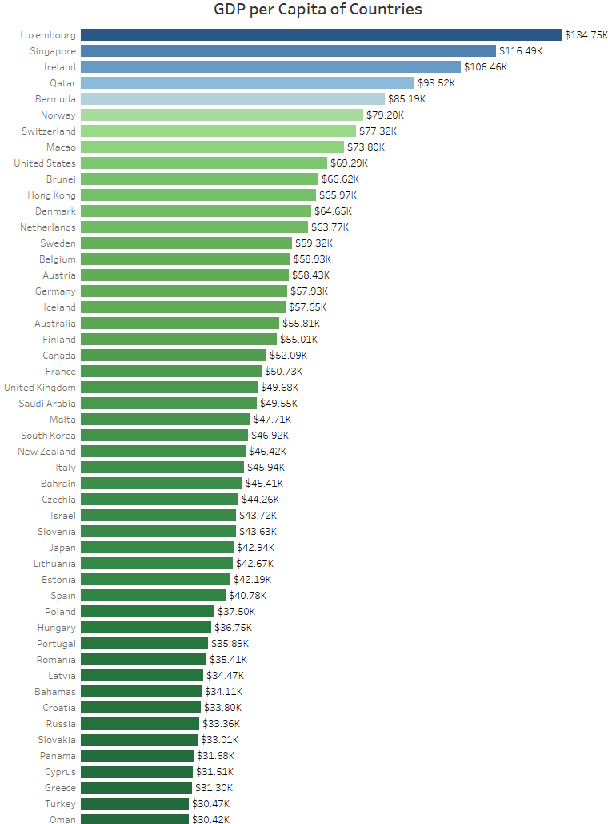
What is the GDP per Capita of Countries
The bar chart shows the GDP per capita of countries from top to bottom, currently Luxembourg has the highest GDP per capita.

Slide 7
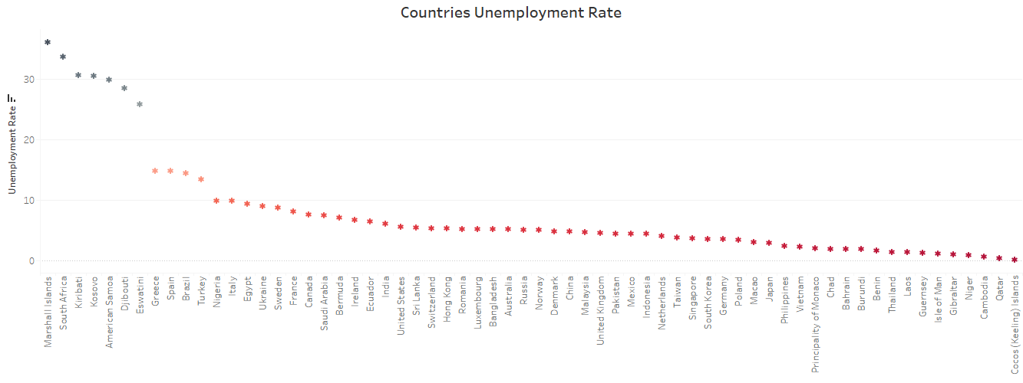
Countries Unemployment Rate
This chart shows the unemployment rate of countries around the world from the country with the highest unemployment rate to the country with the list unemployment rate.

