Slide 1
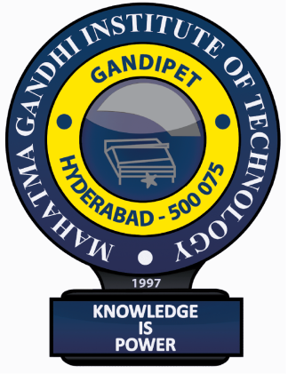
Industry Oriented Mini Project (CB652PC)
On
GestureArt: AI-Powered Virtual Drawing Platform
By
AMRUTHA DUBEY (22261A3201)
GUMMADAVELLI BHANU TEJA (22261A3222)
Under the guidance of
Dr. D. Vijaya Lakshmi – Professor & HoD(IT)
Department of Information Technology
MAHATMA GANDHI INSTITUTE OF TECHNOLOGY (A)
2024 – 2025

Slide 2
Introduction
In the evolving world of digital creativity, the need for intuitive and accessible tools has become paramount. Traditional digital art tools often require specialized hardware, creating barriers for aspiring artists and casual users. This uses Artificial Intelligence and addresses this demand by providing an innovative solution for digital art creation. This tool allows users to draw and paint using natural hand gestures, eliminating the need for external devices.
By leveraging computer vision and AI technologies, it captures and interprets hand movements, translating them into digital strokes in real-time.
This project aims to revolutionize human-computer interaction by making digital art more accessible and user-friendly.

Slide 3
Existing System
Traditional digital painting tools have long been the standard for digital artists, but they come with significant limitations. These tools often require expensive devices like graphic tablets and styluses, creating a barrier for beginners and casual users. Moreover, the complexity of these tools can deter creativity and slow down the learning process. The dependency on external hardware not only increases costs but also limits the portability and flexibility of digital art creation.
Steep learning curve for non-professionals.
Dependence on costly and specialized devices.
Limited accessibility for casual users.
Lack of intuitive, gesture-based interaction.

Slide 4
Proposed System
How GestureArt Solves Existing Challenges?
Removes hardware dependency by eliminating the need for expensive devices like styluses or graphic tablets.
Introduces gesture-based controls where users can draw using natural hand movements.
Converts real-time hand movements into on-screen drawings smoothly and accurately.
Simplifies the creative process, making digital art more accessible even for beginners.
Requires only a webcam and basic computing resources, without the need for specialized hardware.
Provides a cost-effective and user-friendly alternative to traditional digital art creation tools.

Slide 5
Applications
Virtual Art Creation: Artists can draw in the air to create digital paintings without touching screens.
Education: Teachers can draw diagrams or notes in online classes hands-free.
Rehabilitation Therapy: Patients recovering from hand injuries can practice motor skills through gesture-based drawing.
Interactive Exhibitions: Museums or art galleries can allow visitors to "paint" on big screens without physical contact.
Corporate Presentations: Professionals can sketch ideas live during meetings or brainstorming sessions.

Slide 6
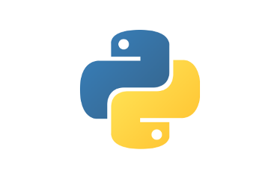
Software and Hardware Requirements
Operating System: Windows 10/11
Programming Language: Python 3.10.7
Libraries: OpenCV, MediaPipe
IDE: Visual Studio Code
Hardware: Camera/Webcam

Slide 7
Literature Survey
S . No. | Author & Title | Journal Name | Year | Key Findings | Limitations
1 | Jungpil Shin, Abu Saleh Musa Miah, Md. Humaun Kabir, Md. Abdur Rahim, Abdullah Al Shiam — "A Methodological and Structural Review" | IEEE Journals & Magazines Vol-12 | 2024 | Conducts a comprehensive review of hand gesture recognition focusing on dataset quality, evaluation metrics, and reproducibility of research. Points out the shift toward standardized benchmarking. | Less emphasis on real-time deployment issues and hardware limitations

Slide 8
S . No. | Author & Title | Journal Name | Year | Key Findings | Limitations
2 | Abdirahman Osman Hashi, Siti Zaiton Mohd Hashim, Azurah Bte Asamah — "A Systematic Review of Hand Gesture Recognition" | IEEE Journals & Magzines Vol-12 | 2024 | Summarizes advancements in machine learning and deep learning methods for hand gesture recognition, noting trends towards efficient, lightweight models. | Does not sufficiently explore the impact of multimodal systems or tactile feedback technologies​

Slide 9
S. No. | Author & Title | Journal Name | Year | Key Findings | Limitations
3 | Jan Warchocki, Mikhail Vlasenko, Yke Bauke Eisma - "GRLib: An Open-Source Hand Gesture Detection and Recognition Python Library" | arXiv Journal arxiv Id: 2310.14919v1 | 2023 | Developed GRLib, an open-source library for static and dynamic hand gesture recognition; it outperforms MediaPipe Solutions on several datasets, supports few-shot learning, and works well even with low-quality cameras. | Struggles with complex dynamic gestures and occasionally double-detects simple gestures; needs improvement in keyframe extraction and trajectory encoding.

Slide 10
S. No. | Author & Title | Journal Name | Year | Key Findings | Limitations
4 | Max Graf, Mathieu Barthet- “Combining Vision and EMG Based Hand Tracking for Extended Reality Musical Instruments” | arXiv Journal arxiv ID- 2307.10203v1 | 2023 | Proposed a multimodal hand tracking system combining vision-based tracking and sEMG data to improve finger tracking accuracy, especially under self-occlusion, significantly enhancing XR musical instrument interaction. | Model requires user-specific fine-tuning due to variability in sEMG signals; tested only on a single XR headset and Myo armband.

Slide 11
S. No. | Author & Title | Journal Name | Year | Key Findings | Limitations
5 | Mohammed Gamal Ragab, Said Jadid Abdulkadir, Amgad Muneer, Alawi Alqushaibi, Sawan Mahmood Al-Selwnoi, and Hitham Alhussian - "A Comprehensive Systematic Review of YOLO-based Deep Learning Models for Medical Object Detection (2018 to 2023)" | IEEE Journals & Magazines Vol-12 | 2023 | Reviewed YOLO model evolution and applications in medical imaging, showing advances in accuracy and processing speed across medical object detection tasks. | Challenges include need for more clinical validation, dependence on large annotated datasets, and difficulty generalizing across diverse medical conditions.

Slide 12
Problem Statement
Develop a gesture-based interactive drawing platform where users can control a virtual brush or marker using hand gestures detected through a webcam, enabling them to create digital drawings and sketches without the need for a physical interface like a mouse or touch screen

Slide 13
Objectives of the project
The primary goal of the GestureArt is to democratize digital art by removing technical and financial barriers. By using AI-driven hand gesture recognition, the project aims to provide a seamless and enjoyable creative experience for users of all skill levels. This project seeks to advance human-computer interaction and open new possibilities for digital creativity.
Enhance human-computer interaction through AI.
Simplify the creative process for users of all skill levels.
Integrate advanced computer vision techniques.
Foster creativity and accessibility in digital art.
Minimize costs associated with digital art tools.

Slide 14
Module Description
1. Hand Tracking (hand_tracking.py)
Captures live video frames and detects hands using computer vision.
Identifies key landmarks like fingertips, wrist, etc., enabling precise gesture recognition.
2. Gesture Recognition (gesture_recognition.py)
Analyzes hand landmarks to classify gestures such as Draw, Select, Clear, Undo, Redo, Save, and Tool Change.
Supports real-time recognition with adjustable confidence thresholds for accuracy.

Slide 15
3. Canvas Engine (canvas_engine.py)
Manages a dynamic drawing canvas where gestures are converted into brush strokes.
Supports multiple brush types, color selection, brush properties (size, opacity, hardness, flow), and undo/redo functionality.
4. UI Manager (ui.py)
Provides an intuitive user interface with buttons, sliders, and color palettes.
Handles user interactions for tool switching, color selection, saving artwork, and more.

Slide 16
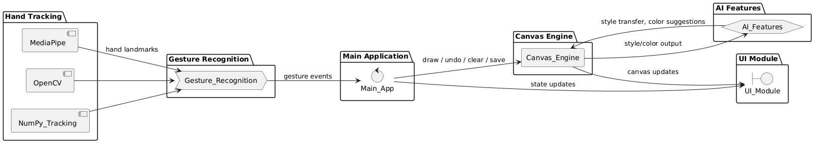
System Architecture
Fig. 10.1: System Architecture

Slide 17
Physical / Mathematical Models
BlazePalm Detection Model:
Focuses only on the hand area, ignoring the background and unnecessary parts of the frame.
Speeds up the next stage (landmark detection) by reducing the area that needs to be processed.
To efficiently locate the hand so that landmark detection becomes faster and more accurate.
Bounding Box Prediction: (x_min, y_min, x_max, y_max)
Normalization formulas: x_norm = x_pixel / W y_norm = y_pixel / H

Slide 18
II. Hand Landmark Model:
After detecting the palm, the Hand Landmark Model identifies 21 critical keypoints on the hand.
Provides precise coordinates (x, y) for each point, updated in real-time for every frame.
Allows fine analysis of finger positions — like detecting if a finger is bent, extended, or touching another finger.
Input Crop of Hand (from Bounding Box): I_crop ∈ ℝ^(h × w × 3)
Confidence Score Calculation: confidence = sigmoid(raw_score) where, sigmoid(x) = 1 / (1 + e^(-x))

Slide 19
Mathematical Model
BlazePalm Detection Model
Bounding Box Prediction: (x_min, y_min, x_max, y_max)
Normalization formulas: x_norm = x_pixel / W y_norm = y_pixel / H
Input Image as Matrix: I ∈ ℝ^(H × W × 3)
Landmark Prediction (21 Points): landmark_i = (x_i, y_i, z_i), where i = 1, 2, ..., 21

Slide 20
Hand Landmark Model
Input Crop of Hand (from Bounding Box): I_crop ∈ ℝ^(h × w × 3)
Normalization (Coordinates Between 0 and 1): x_norm = x_pixel / w y_norm = y_pixel / h
Distance Between Landmarks : d = √((x₂ - x₁)² + (y₂ - y₁)²)
Confidence Score Calculation: confidence = sigmoid(raw_score) where, sigmoid(x) = 1 / (1 + e^(-x))

Slide 21
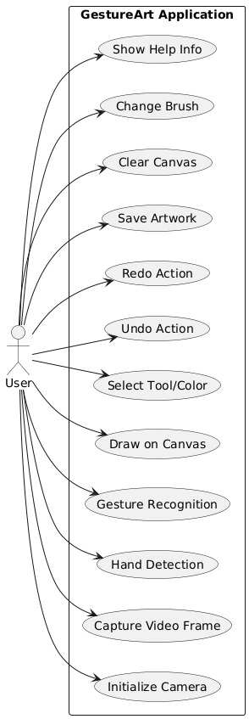
UML Diagrams
Fig. 12.1: Use Case Diagram

Slide 22
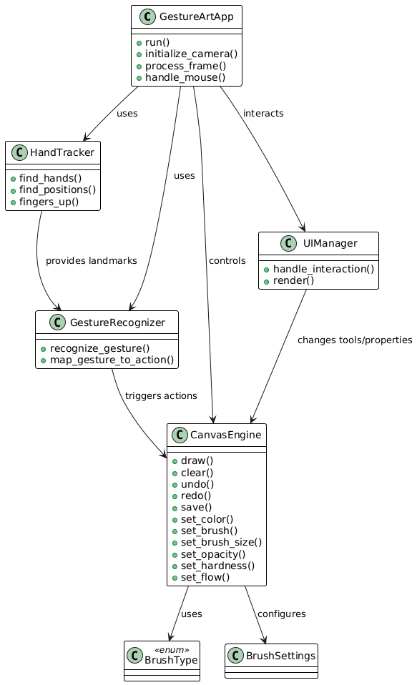
Fig. 12.2: Class Diagram

Slide 23
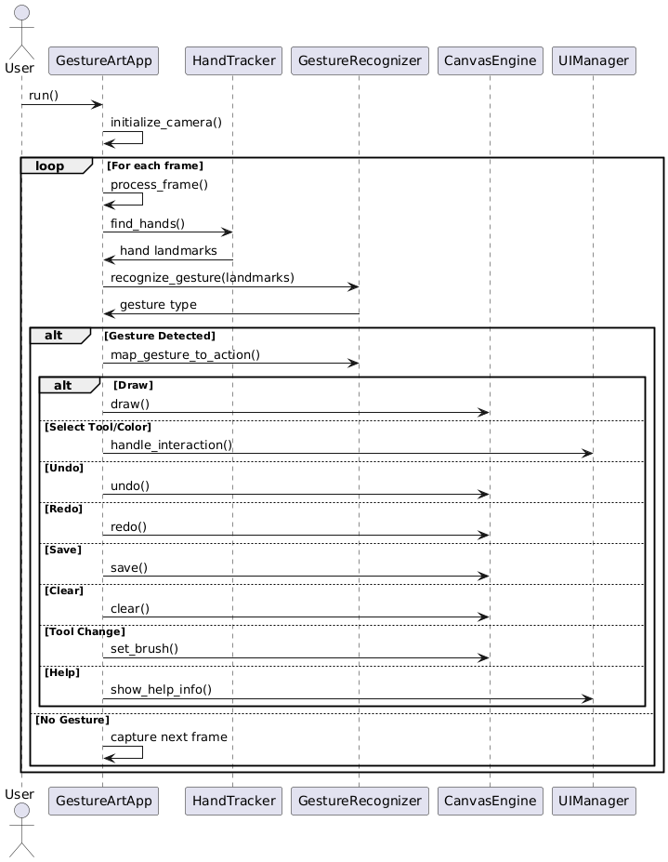
Fig. 12.3: Sequence Diagram

Slide 24
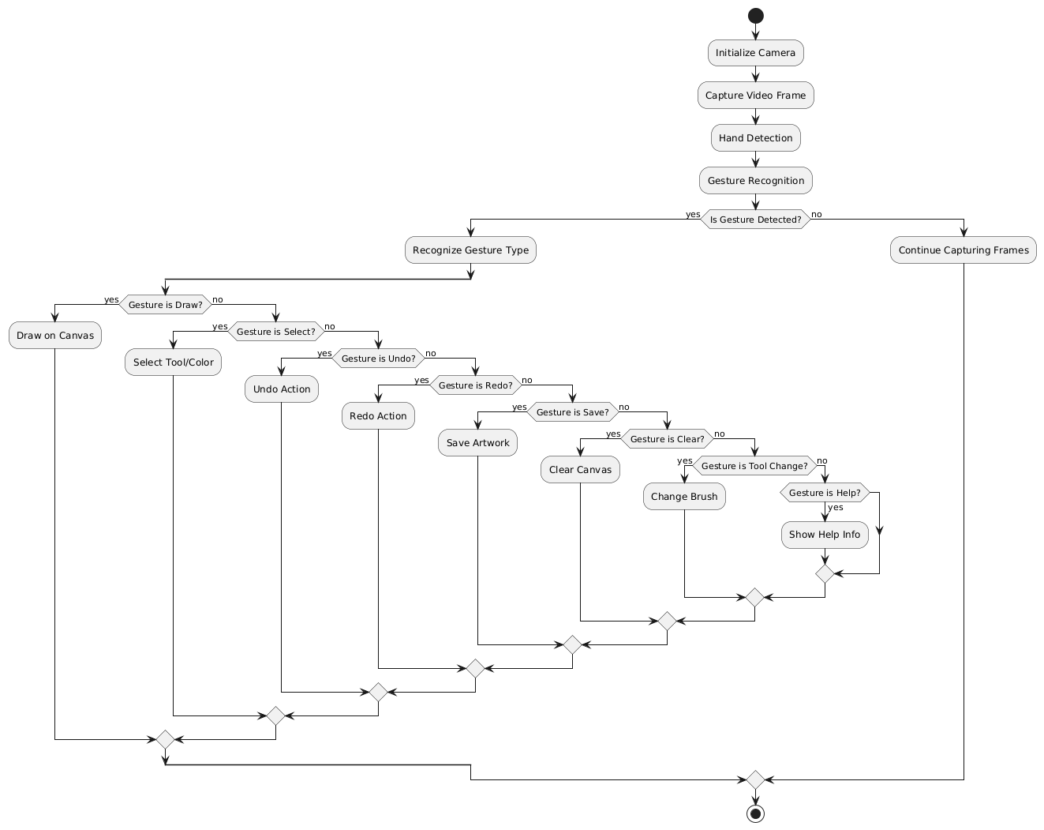
Fig. 12.4: Activity Diagram

Slide 25
Thank You!!

