Slide 1
REVERSIBLE DATA HIDING IN ENCRYPTED IMAGES BASED ON MULTI-MSB PREDICTION AND HUFFMAN CODING
GUIDE
Dr.B.HEMANTHA KUMAR
TEAM-1
G VISHNU KAIVALYA-Y21IT040
G B HARSHA VARDHAN-Y21IT039
K KIRAN –L22IT138

Slide 2
CONTENTS
Abstract
Keywords
List of Literature Survey
Existing Method 1
Existing Method 2
Proposed Method
Results & Discussion
Conclusion
References

Slide 3
ABSTRACT
With the development of cloud storage and privacy protection, reversible data hiding in encrypted images (RDHEI) has attracted increasing attention as a technology that can embed additional data in the image encryption domain, ensure that the embedded data can be extracted error-free, and the original image can be restored losslessly. In this paper, a high-capacity RDHEI algorithm based on multi-MSB (most significant bit) prediction and Huffman coding is proposed. At first, multi-MSB of each pixel was predicted adaptively and marked by Huffman coding in the original image. Then, the image was encrypted by a stream cipher method. At last, the vacated space can be used to embed additional data by multi-MSB substitution. Experimental results show that our method achieved higher embedding capacity while comparing with the state-of-the-art methods.

Slide 4
KEYWORDS
Reversible data hiding
Encrypted images
Privacy protection
Huffman Coding

Slide 5
REVERSIBLE DATA HIDING:
This technique allows additional data to be embedded within an image while ensuring that the original image can be perfectly restored without any loss. The embedded data can be extracted without error, maintaining the integrity of the image.

Slide 6
ENCRYPTED IMAGES:
Encrypted images are images that have been transformed using encryption algorithms, making them unreadable to unauthorized parties. This ensures the security and privacy of the image content during storage or transmission.

Slide 7
PRIVACY PROTECTION:
Privacy protection refers to measures taken to safeguard sensitive or personal information from unauthorized access or exposure. In the context of RDHEI, it involves securing the embedded data and image content through encryption.

Slide 8
HUFFMAN CODING:
Huffman coding is a lossless data compression technique that assigns shorter binary codes to more frequent data symbols and longer codes to less frequent ones, efficiently compressing the data while allowing for perfect reconstruction of the original data.

Slide 9
LITERATURE SURVEY
CONTEXT | METHOD-1 | METHOD-2
Name | An Efficient MSB Prediction-Based Method for High-Capacity Reversible Data Hiding in Encrypted Images | Separable and Reversible Data Hiding in Encrypted Images using Parametric Binary Tree Labeling
Author | P. Puteaux & W. Puech | S .Yi & Y. Zhou
Uses | Privacy protection Secure data communication | Reversible data hiding Secure water marking

Slide 10
EXISTING METHODS
HIGH - CAPACITY REVERSIBLE DATA HIDING IN ENCRYPTED IMAGES
PARAMETRIC BINARY TREE LABELING- (RDHEI)

Slide 11
HIGH - CAPACITY REVERSIBLE DATA HIDING IN ENCRYPTED IMAGES
EXISTING METHOD 1

Slide 12
01. HIGH - CAPACITY REVERSIBLE DATA HIDING IN ENCRYPTED IMAGES
EXISTING METHOD 1
Block diagram
Algorithm
Pros
Cons

Slide 13
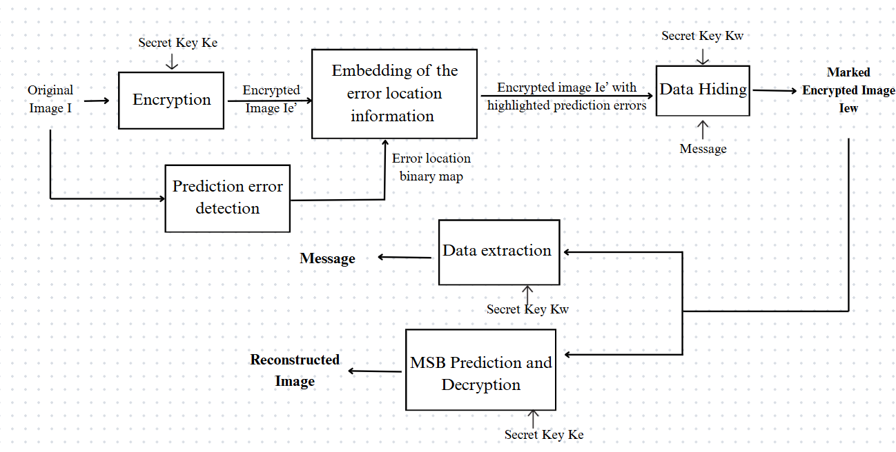
BLOCK DIAGRAM
EXISTING METHOD 1
HIGH - CAPACITY REVERSIBLE DATA HIDING IN ENCRYPTED IMAGES

Slide 14
ALGORITHM
EXISTING METHOD 1
HIGH - CAPACITY REVERSIBLE DATA HIDING IN ENCRYPTED IMAGES
Input : Original Image I , Encryption key Ke , Data hiding key Kw , Secret Message
01.Prediction error detection
for i ← 1 to m do
for j ← 1 to n do
if i = 1 or j = 1 then
Special processing for boundary pixels
else
pred (i, j) ← (p (i-1, j) + p (i, j-1)) / 2
end if
Δ ← |pred (i, j) – p (i, j) |
Δinv ← |pred (i, j) - ((p (i, j) + 128) mod 256) |
if Δ ≥ Δinv then
Mark p (i, j) as a prediction error in binary map
end if
end for
end for

Slide 15
EXISTING METHOD 1
HIGH - CAPACITY REVERSIBLE DATA HIDING IN ENCRYPTED IMAGES
02.Image encryption
Generate pseudo-random sequence s (i, j) using chaotic map with K_e
for i ← 1 to m do
for j ← 1 to n do
pe (i, j) ← p (i, j) XOR s (i, j)
end for
end for
03.Embedding prediction error information
Divide pe into blocks of size 8 pixels
for each block B do
if block contains prediction errors then
Add flags to preceding and succeeding blocks
for each pixel in B do
if pixel is a prediction error then
Replace MSB with 1
else
Replace MSB with 0
end if
end for
end if
end for

Slide 16
EXISTING METHOD 1
HIGH - CAPACITY REVERSIBLE DATA HIDING IN ENCRYPTED IMAGES
04.Data Hiding
for each block B in encrypted_image do
if B is not flagged or contains prediction errors then
for each pixel (i, j) in B do
pew(i, j) = bk × 128 + (pe(i, j) mod 128)
end for
end if
end for
05.(a)Data extraction
for each pixel pew (i, j) in Iew do
Extract MSB bit to retrieve message
end for

Slide 17
05.(b)Image recovery Generate pseudo-random sequence s (i, j) using K_e for each pixel pew (i, j) in Iew do Decrypt pixel: p'(i, j) ← pew (i, j) XOR s (i, j) Predict MSB using adjacent pixels: Δ0 ← |pred (i, j) - p'(i, j) MSB=0| Δ1 ← |pred (i, j) - p'(i, j) MSB=1| if Δ0 < Δ1 then Assign p'(i, j) ← p'(i, j) MSB=0 else Assign p'(i, j) ← p'(i, j) MSB=1 end if end for Output: Recovered Image , Extracted Message
EXISTING METHOD 1
HIGH - CAPACITY REVERSIBLE DATA HIDING IN ENCRYPTED IMAGES

Slide 18
PROS
EXISTING METHOD 1
HIGH - CAPACITY REVERSIBLE DATA HIDING IN ENCRYPTED IMAGES
Lossless Image Recovery: The original image can be perfectly restored without any quality loss, ensuring the integrity of the image.
High Embedding Capacity :The method enables higher data embedding capacity compared to traditional techniques, allowing more data to be hidden within the image without degrading its quality

Slide 19
CONS
EXISTING METHOD 1
HIGH - CAPACITY REVERSIBLE DATA HIDING IN ENCRYPTED IMAGES
Key Dependency: Both the encryption key and data-hiding key are required for successful data extraction and image recovery, meaning that loss of either key renders the process impossible.
Complexity and Computational Overhead: The process involves multiple steps such as prediction error detection and encryption, which can be computationally expensive, especially for large images.

Slide 20
RDHEI USING PARAMETRIC BINARY TREE LABELING
EXISTING METHOD 2

Slide 21
02.RDHEI USING PARAMETRIC BINARY TREE LABELING
Block diagram
Algorithm
Pros
Cons

Slide 22
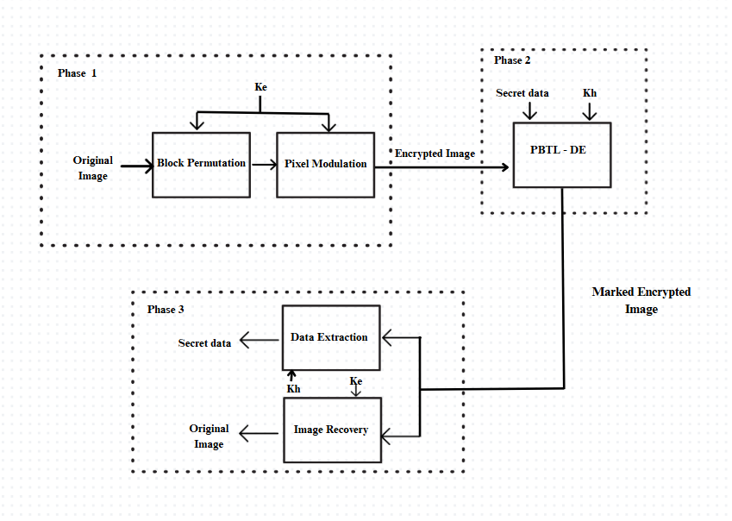
BLOCK DIAGRAM
EXISTING METHOD 2
PARAMETRIC BINARY TREE LABELING

Slide 23
ALGORITHM
EXISTING METHOD 2
PARAMETRIC BINARY TREE LABELING
Input: Original image O, Secret data M, Encryption Key Ke, Data Hiding key Kh , parameters α and β
Phase 1: Image Encryption
for i ← 0 to M/s - 1 do
for j ← 0 to N/s - 1 do
Extract block B_{ij} from O.
Generate random integer R_{ij} using K_e.
Permute blocks using permutation sequence P generated from K_e.
for each pixel O (p, q) ∈ B_{ij} do
Encrypt: E p, q) ← (O (p, q) + R_{ij}) mod 256.
end for
end for
end for

Slide 24
Phase 2:PBTL-DE Divide I into equal size non-overlapping blocks. Classify pixels into four groups: Pr, Ps, Pe, and Pn. Label P_e using PBTL with parameters α and β Construct the payload P, consisting of: - The secret data M, - The first β bits of each pixel in Pn, - 8 bits in Ps. for each pixel in Pe do: a. Calculate the difference value e. b. Reconstruct the pixel by replacing α labeling bits and (8 - α) payload bits. end for for each pixel in Pn do: a. Replace the first β bits with '0...0' (β zeros). b. Keep the remaining (8 - β) bits unmodified. end for Convert α and β into binary bits. Store the binary bits of α and β into Ps by bit replacement. Output the marked image Î.
EXISTING METHOD 2
PARAMETRIC BINARY TREE LABELING

Slide 25
EXISTING METHOD 2
PARAMETRIC BINARY TREE LABELING
Phase 3:Data Extraction and Image Recovery
Data Extraction
1. Extract parameters α, β from P_s.
2. Separate P_e, P_n using labels.
3. Retrieve S from P_e.
Image Recovery
1. Restore P_s, P_n using auxiliary data.
2. Reconstruct O (p, q) using P_r and difference values.
3. Reverse encryption: O (p, q) ← (E (p, q) – R_{ij}) mod 256.
4. Undo block permutation using P.
Output: Recovered Image , Extracted Message

Slide 26
PROS
EXISTING METHOD 2
PARAMETRIC BINARY TREE LABELING
Lossless Image Restoration: The original image can be completely restored without any loss in quality, maintaining the image's integrity.
Enhanced Security: The method ensures high security by embedding data in encrypted images, protecting both the image and the hidden information from unauthorized access.

Slide 27
CONS
EXISTING METHOD 2
PARAMETRIC BINARY TREE LABELING
Computational Complexity: The process involves multiple steps such as pixel grouping, labeling, and encryption, which can be computationally expensive and slow, particularly for large images.
Key Dependency: Successful data extraction and image recovery depend on having both the encryption key and data-hiding key. If either key is lost, data recovery becomes impossible.

Slide 28
REVERSIBLE DATA HIDING IN ENCRYPTED IMAGES BASED ON MULTI-MSB PREDICTION AND HUFFMAN CODING
PROPOSED METHOD

Slide 29
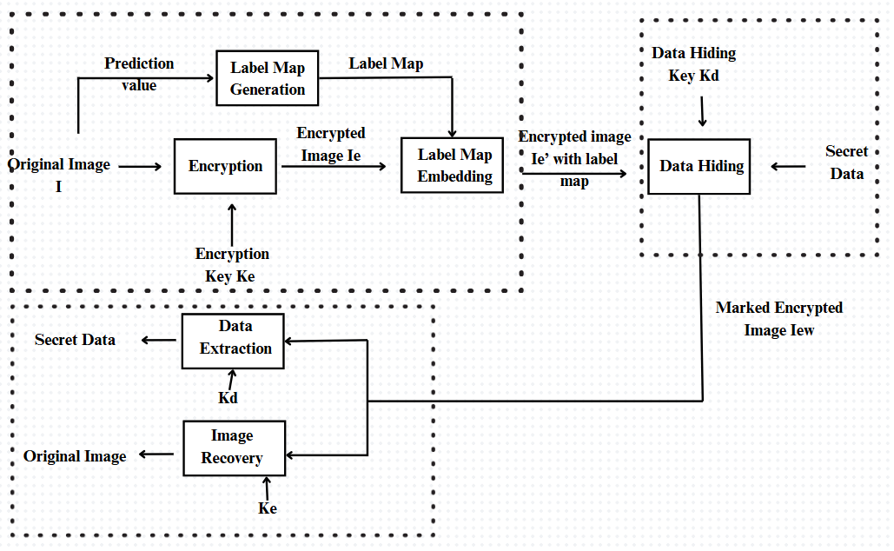
BLOCK DIAGRAM
RDHEI based on Multi-MSB & Huffman Coding

Slide 30
MODULES
RDHEI based on Multi-MSB & Huffman Coding
The proposed Reversible Data Hiding in Encrypted Images (RDHEI) method consists of three main phases:
INPUT: Original Image, Encryption Key Ke, Data Hiding Key Kd, Secret Message
Image Encryption Phase (by the Content-Owner)
Data Embedding Phase(by the Content-Hider)
Data Extraction & Image Decryption Phase (by the Receiver)
OUTPUT: Recovered Image , Extracted Message

Slide 31
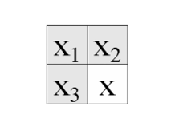
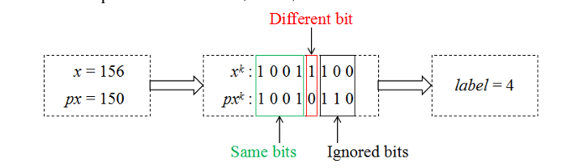
01.Image Encryption Phase (by the Content-Owner)
RDHEI based on Multi-MSB & Huffman Coding
01. Label Map Generation
For each pixel x(i, j):
i. Predict the pixel value using the Median Edge Detector (MED) predictor:
px(i, j) =
⎧ max(x2, x3), if x1 ≤ min(x2, x3)
⎪ min(x2, x3), if x1 ≥ max(x2, x3)
⎩ x2 + x3 − x1, otherwise
ii. Convert x(i, j) and px(i, j) into an 8-bit binary sequence:
xk(i, j) = ⌊ (x(i, j) mod 2^(9-k)) / 2^(8-k) ⌋ , k = 1,2,...,8
iii. Compare bits from MSB to LSB until a difference is found.
iv. Assign label t based on the number of identical MSBs:
t = arg max_t (x(i, j)_tMSB = px(i, j)_tMSB), t = 0,1,2,...,8
subject to:
x(i, j)_tMSB = x(i, j) − (x(i, j) mod 2^(8−t))
px(i, j)_tMSB = px(i, j) − (px(i, j) mod 2^(8−t))
Store the label map.

Slide 32
01.Image Encryption Phase (by the Content-Owner)
RDHEI based on Multi-MSB & Huffman Coding
02. Image Encryption: a. Generate a pseudo-random matrix r of size m × n using the encryption key Ke. b. Convert each pixel x(i, j) and r(i, j) into an 8-bit binary sequence. c. Encrypt pixel using bitwise XOR operation: x_enc_k(i, j) = x_k(i, j) ⊕ r_k(i, j), k = 1,2,...,8 d. Compute the encrypted pixel value: x_enc(i, j) = ∑ (x_enc_k(i, j) × 2^(8−k)), k = 1,2,...,8 e. Store encrypted image Ie. 03. Compress Label Map using Huffman Coding: a. Assign shorter codes to frequently occurring labels. b. Convert label map into a binary sequence: LM = ∑ (n_t × c_t), t = 0,1,2,...,8 where n_t is the number of pixels with label t, and c_t is the length of the Huffman code.

Slide 33
01.Image Encryption Phase (by the Content-Owner)
RDHEI based on Multi-MSB & Huffman Coding
04. Embed Label Map into Encrypted Image: a. Convert the Huffman-encoded label map into a binary sequence. b. Store Huffman coding rule and label map in reference pixels. c. Embed the remaining auxiliary information using multi-MSB substitution: x'_enc(i, j) = ⎧ x_enc(i, j) mod 2^(7−t) + ∑(b_s × 2^(7−s)), 0 ≤ t ≤ 6 ⎩ ∑(b_s × 2^(8−s)), 7 ≤ t ≤ 8 where b_s represents auxiliary information bits.

Slide 34
02.Data Embedding Phase(by the Content-Hider)
RDHEI based on Multi-MSB & Huffman Coding
01. Hide Secret Data: a. Extract the Huffman coding rule and label map. b. Compute the embedding capacity based on the label map. c. Encrypt the additional data using the data hiding key Kd. d. Embed data in encrypted image pixels using multi-MSB substitution. e. Store the marked encrypted image Iew.

Slide 35
03.Data Extraction & Image Decryption Phase (by the Receiver)
RDHEI based on Multi-MSB & Huffman Coding
01.Extract Data: a. Extract Huffman coding rule and label map from Iew. b. Extract embedded data by the data hiding key Kd. 02. Recover Original Image: a. Decrypt the encrypted pixels using Ke: x_k(i, j) = x_enc_k(i, j) ⊕ r_k(i, j), k = 1,2,...,8 b. Use the extracted label map and MED predictor to reconstruct the original pixel: x(i, j) = ⎧ px(i, j)_tMSB + b_(t+1) × 2^(7−t) + x'_enc(i, j) mod 2^(7−t), 0 ≤ t ≤ 7 ⎩ px(i, j), t = 8 c. Recover the MSBs of each pixel: b_(t+1) = ⎧ 0, if px_(t+1)(i, j) = 1 ⎩ 1, if px_(t+1)(i, j) = 0 d. Restore the original image losslessly.

Slide 36
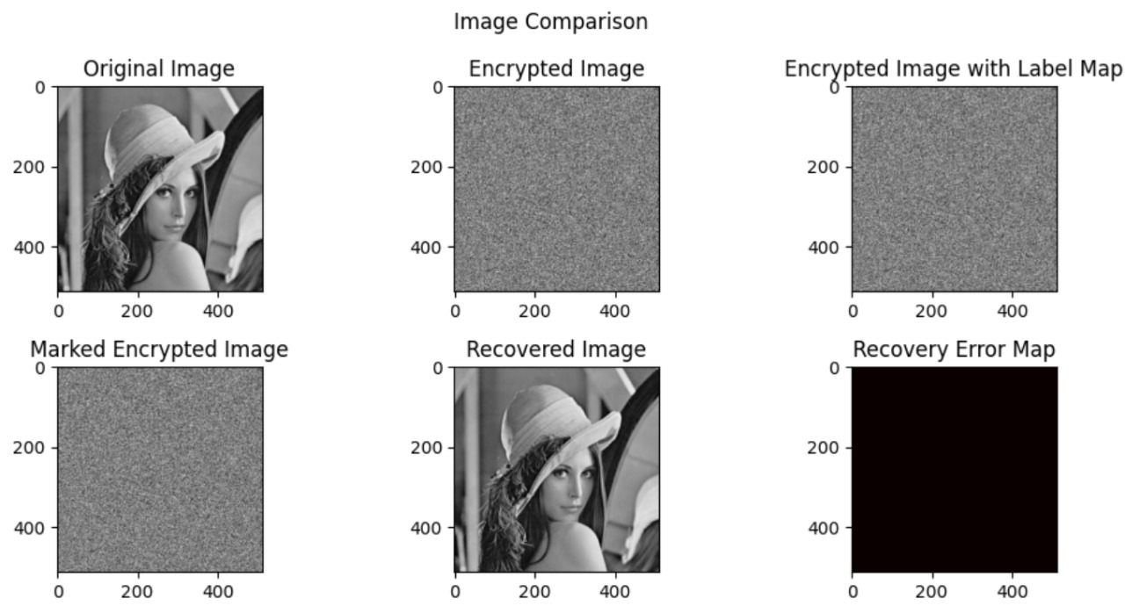
RESULTS & DISCUSSION
RDHEI based on Multi-MSB & Huffman Coding

Slide 37
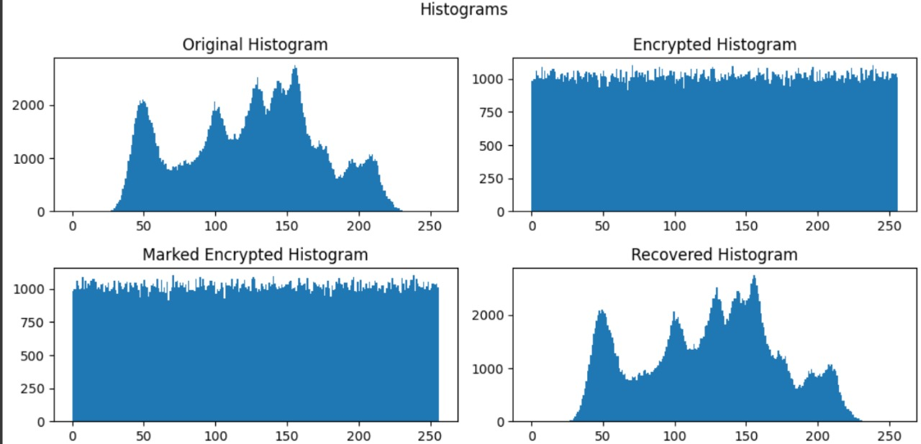
HISTOGRAMS OF LENA IMAGE
RDHEI based on Multi-MSB & Huffman Coding

Slide 38
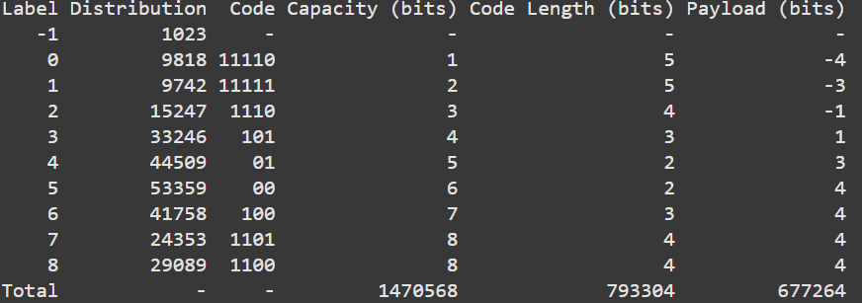
LABEL HUFFMAN CODING FOR THE LENA IMAGE Capacity (bits) = Label +1 if Label< 7 Label if Label = 8 Code Length (bits) = Length of the Huffman Code of Label Payload (bits) = Capacity (bits) – Code Length (bits)
RDHEI based on Multi-MSB & Huffman Coding

Slide 39
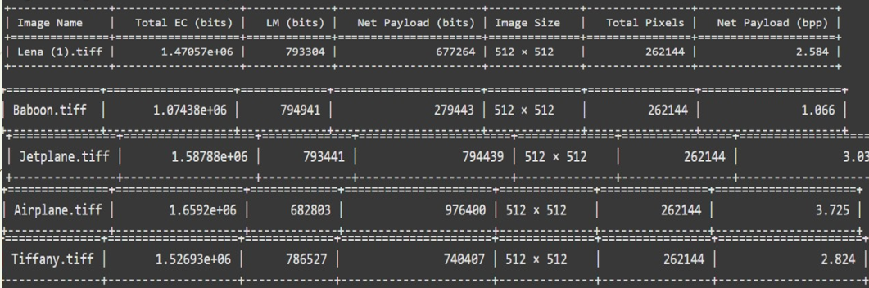
THE EMBEDDING CAPACITY AND AUXILIARY INFORMATION OF DIFFERENT TEST IMAGES Total Embedding Capacity = Sum( Distribution * Capacity(bits)) Label Map Length = Sum (Distribution * Code length(bits)) Net Payload(bpp) = Total Embedding Capacity – Label Map Length
RDHEI based on Multi-MSB & Huffman Coding

Slide 40
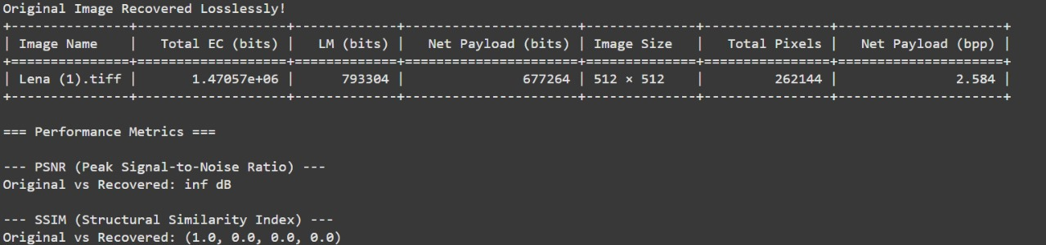
PERFORMANCE METRICS OF LENA IMAGE 01.PSNR : Peak Signal - to – Noise Ratio 02.SSIM : Structural Similarity Index
RDHEI based on Multi-MSB & Huffman Coding
PSNR = 10 × log₁₀(MAX²/MSE) Db MSE = (1/(m×n)) × ∑∑[I(i,j) - R(i,j)]² where MSE is Mean Square Error
cv2.quality.QualitySSIM_compute(original, recovered)[0]
(Built-in function)

Slide 41
CONCLUSION
The proposed RDHEI method effectively enhances embedding capacity by utilizing multi-MSB prediction and Huffman coding. It ensures error-free data extraction and perfect image recovery while significantly improving payload performance. By compressing auxiliary data efficiently, the method maximizes the space available for embedding.

Slide 42
REFERENCES
P. Puteaux and W. Puech, “An efficient MSB prediction-based method for high-capacity reversible data hiding in encrypted images,” IEEE Trans. Inf. Forensics Secur., vol. 13, no. 7, pp. 1067–1681, Jan. 2018.
P. Puteaux and W. Puech, “EPE-based huge-capacity reversible data hiding in encrypted images,” in Proc. IEEE Int. Workshop Inf. Forensics Secur., Dec. 2018, pp. 1–7.
Y. Puyang, Z. Yin, and Z. Qian, “Reversible data hiding in encrypted images with two-MSB prediction,” in Proc. IEEE Int. Workshop Inf. Forensics Secur., Dec. 2018, pp. 1–7
S .Yi and Y. Zhou, “Separable and reversible data hiding in encrypted images using parametric binary tree labeling,” IEEE Trans. Multimedia, vol. 21, no. 1, pp. 51–64, Jan. 2019.
K. Chen and C. C. Chang, “High-capacity reversible data hiding in encrypted images based on extended run-length coding and block-based MSB plane rearrangement,” J. Vis. Commun. Image Representation, vol. 58, pp. 334–344, 2019.

Slide 43
THANK YOU

