Slide 1
REVERSIBLE DATA HIDING IN ENCRYPTED IMAGES BASED ON MULTI-MSB PREDICTION AND HUFFMAN CODING
GUIDE
Dr.B.HEMANTHA KUMAR
TEAM-1
G VISHNU KAIVALYA-Y21IT040
G B HARSHA VARDHAN-Y21IT039
K KIRAN –L22IT138

Slide 2
CONTENTS
Problem Statement
Keywords
Existing Methods
Proposed Method
References

Slide 3
PROBLEM STATEMENT
Reversible Data Hiding in Encrypted Images (RDHEI) allows embedding secret data into encrypted images while ensuring lossless recovery of both the original image and the hidden data. However, existing methods suffer from limited embedding capacity, data extraction errors, and inefficient space utilization. To address these issues, a Multi-MSB Prediction and Huffman Coding-based RDHEI method is proposed, which enhances embedding capacity and guarantees error-free data extraction and image recovery.

Slide 4
KEYWORDS
Reversible data hiding
Encrypted images
Privacy protection
Huffman Coding

Slide 5
REVERSIBLE DATA HIDING:
This technique allows additional data to be embedded within an image while ensuring that the original image can be perfectly restored without any loss. The embedded data can be extracted without error, maintaining the integrity of the image.

Slide 6
ENCRYPTED IMAGES:
Encrypted images are images that have been transformed using encryption algorithms, making them unreadable to unauthorized parties. This ensures the security and privacy of the image content during storage or transmission.

Slide 7
PRIVACY PROTECTION:
Privacy protection refers to measures taken to safeguard sensitive or personal information from unauthorized access or exposure. In the context of RDHEI, it involves securing the embedded data and image content through encryption.

Slide 8
HUFFMAN CODING:
Huffman coding is a lossless data compression technique that assigns shorter binary codes to more frequent data symbols and longer codes to less frequent ones, efficiently compressing the data while allowing for perfect reconstruction of the original data.

Slide 9
LITERATURE SURVEY
CONTEXT | METHOD-1 | METHOD-2
Name | An Efficient MSB Prediction-Based Method for High-Capacity Reversible Data Hiding in Encrypted Images | Separable and Reversible Data Hiding in Encrypted Images using Parametric Binary Tree Labeling
Author | P. Puteaux & W. Puech | S .Yi & Y. Zhou
Uses | Privacy protection Secure data communication | Reversible data hiding Secure water marking
Advantages | Lossless image recovery High embedding capacity | Lossless image restoration Enhanced security
Disadvantages | Key dependency Complexity | Key dependency Computational complexity

Slide 10
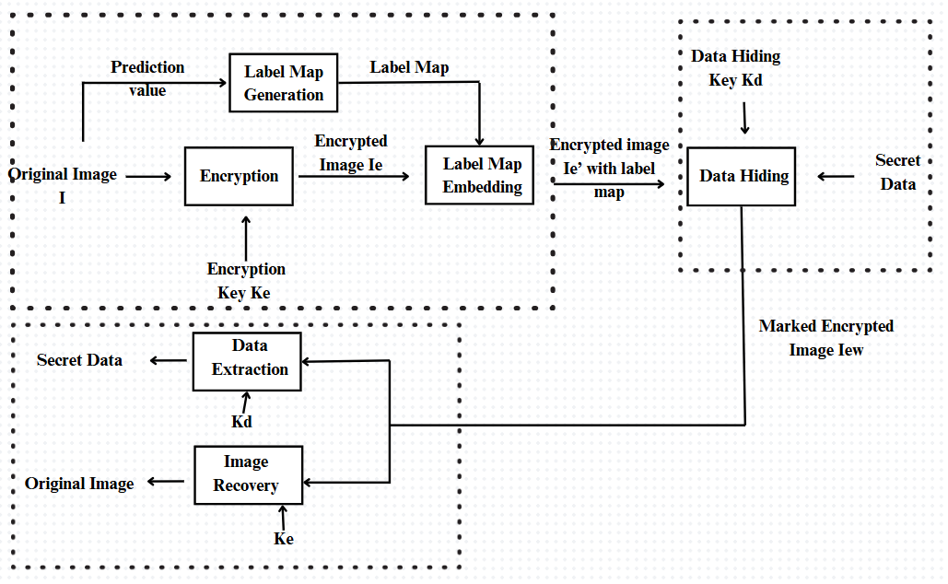
PROPOSED METHOD

Slide 11
REFERENCES
P. Puteaux and W. Puech, “An efficient MSB prediction-based method for high-capacity reversible data hiding in encrypted images,” IEEE Trans. Inf. Forensics Secur., vol. 13, no. 7, pp. 1067–1681, Jan. 2018.
S .Yi and Y. Zhou, “Separable and reversible data hiding in encrypted images using parametric binary tree labeling,” IEEE Trans. Multimedia, vol. 21, no. 1, pp. 51–64, Jan. 2019.
K. Chen and C. C. Chang, “High-capacity reversible data hiding in encrypted images based on extended run-length coding and block-based MSB plane rearrangement,” J. Vis. Commun. Image Representation, vol. 58, pp. 334–344, 2019.

Slide 12
THANK YOU

