Slide 1
REVERSIBLE DATA HIDING IN ENCRYPTED IMAGES BASED ON MULTI-MSB PREDICTION AND HUFFMAN CODING
GUIDE
Dr.B.HEMANTHA KUMAR
TEAM-1
G VISHNU KAIVALYA-Y21IT040
G B HARSHA VARDHAN-Y21IT039
K KIRAN –L22IT138

Slide 2
CONTENTS
Problem Statement
Literature Survey
Existing Methods
Implementation of Existing Method 1
Results and Discussion
References

Slide 3
PROBLEM STATEMENT
Reversible Data Hiding in Encrypted Images (RDHEI) allows embedding secret data into encrypted images while ensuring lossless recovery of both the original image and the hidden data. However, existing methods suffer from limited embedding capacity, data extraction errors, and inefficient space utilization. To address these issues, a Multi-MSB Prediction and Huffman Coding-based RDHEI method is proposed, which enhances embedding capacity and guarantees error-free data extraction and image recovery.

Slide 4
LITERATURE SURVEY
CONTEXT | METHOD-1 | METHOD-2
Name | An Efficient MSB Prediction-Based Method for High-Capacity Reversible Data Hiding in Encrypted Images | Separable and Reversible Data Hiding in Encrypted Images using Parametric Binary Tree Labeling
Author | P. Puteaux & W. Puech | S .Yi & Y. Zhou
Uses | Privacy protection Secure data communication | Reversible data hiding Secure water marking

Slide 5
EXISTING METHODS
HIGH - CAPACITY REVERSIBLE DATA HIDING IN ENCRYPTED IMAGES
PARAMETRIC BINARY TREE LABELING- (RDHEI)

Slide 6
HIGH - CAPACITY REVERSIBLE DATA HIDING IN ENCRYPTED IMAGES
EXISTING METHOD 1

Slide 7
01. HIGH - CAPACITY REVERSIBLE DATA HIDING IN ENCRYPTED IMAGES
EXISTING METHOD 1
Block diagram
Algorithm
Pros
Cons

Slide 8
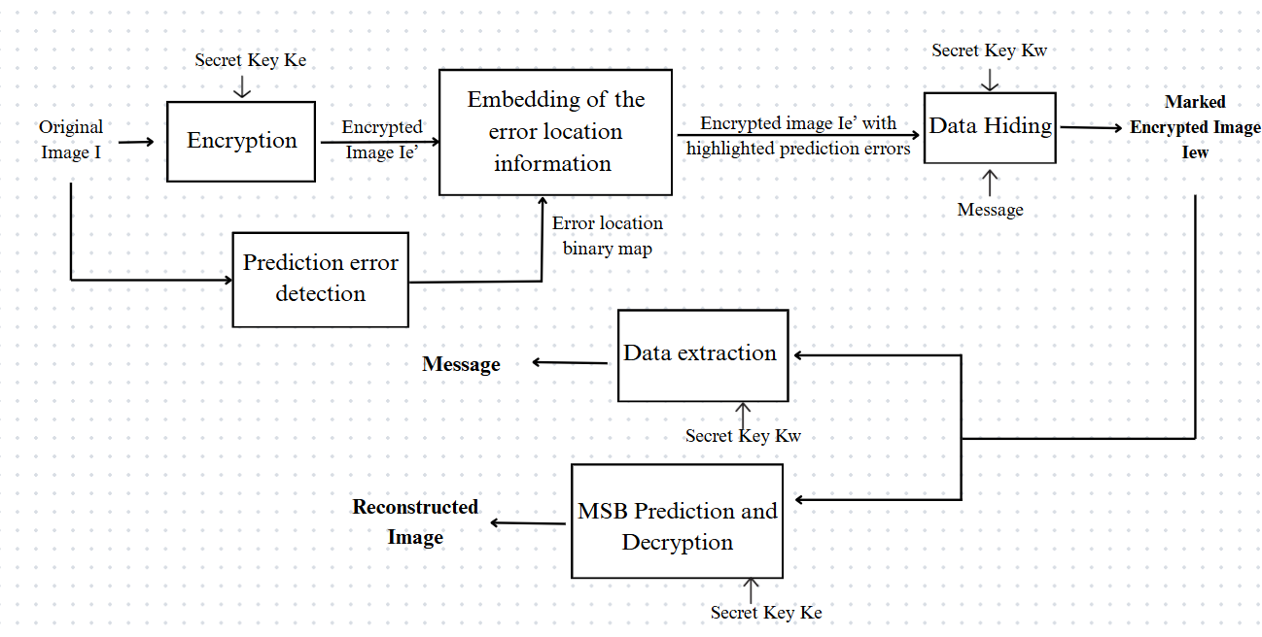
BLOCK DIAGRAM
EXISTING METHOD 1
HIGH - CAPACITY REVERSIBLE DATA HIDING IN ENCRYPTED IMAGES

Slide 9
ALGORITHM
EXISTING METHOD 1
HIGH - CAPACITY REVERSIBLE DATA HIDING IN ENCRYPTED IMAGES
Input : Original Image I , Encryption key Ke , Data hiding key Kw , Secret Message
01.Prediction error detection
for i ← 1 to m do
for j ← 1 to n do
if i = 1 or j = 1 then
Special processing for boundary pixels
else
pred (i, j) ← (p (i-1, j) + p (i, j-1)) / 2
end if
Δ ← |pred (i, j) – p (i, j) |
Δinv ← |pred (i, j) - ((p (i, j) + 128) mod 256) |
if Δ ≥ Δinv then
Mark p (i, j) as a prediction error in binary map
end if
end for
end for

Slide 10
EXISTING METHOD 1
HIGH - CAPACITY REVERSIBLE DATA HIDING IN ENCRYPTED IMAGES
02.Image encryption
Generate pseudo-random sequence s (i, j) using chaotic map with K_e
for i ← 1 to m do
for j ← 1 to n do
pe (i, j) ← p (i, j) XOR s (i, j)
end for
end for
03.Embedding prediction error information
Divide pe into blocks of size 8 pixels
for each block B do
if block contains prediction errors then
Add flags to preceding and succeeding blocks
for each pixel in B do
if pixel is a prediction error then
Replace MSB with 1
else
Replace MSB with 0
end if
end for
end if
end for

Slide 11
EXISTING METHOD 1
HIGH - CAPACITY REVERSIBLE DATA HIDING IN ENCRYPTED IMAGES
04.Data Hiding
for each block B in encrypted_image do
if B is not flagged or contains prediction errors then
for each pixel (i, j) in B do
pew(i, j) = bk × 128 + (pe(i, j) mod 128)
end for
end if
end for
05.(a)Data extraction
for each pixel pew (i, j) in Iew do
Extract MSB bit to retrieve message
end for

Slide 12
05.(b)Image recovery Generate pseudo-random sequence s (i, j) using K_e for each pixel pew (i, j) in Iew do Decrypt pixel: p'(i, j) ← pew (i, j) XOR s (i, j) Predict MSB using adjacent pixels: Δ0 ← |pred (i, j) - p'(i, j) MSB=0| Δ1 ← |pred (i, j) - p'(i, j) MSB=1| if Δ0 < Δ1 then Assign p'(i, j) ← p'(i, j) MSB=0 else Assign p'(i, j) ← p'(i, j) MSB=1 end if end for Output: Recovered Image , Extracted Message
EXISTING METHOD 1
HIGH - CAPACITY REVERSIBLE DATA HIDING IN ENCRYPTED IMAGES

Slide 13
PROS
EXISTING METHOD 1
HIGH - CAPACITY REVERSIBLE DATA HIDING IN ENCRYPTED IMAGES
Lossless Image Recovery: The original image can be perfectly restored without any quality loss, ensuring the integrity of the image.
High Embedding Capacity :The method enables higher data embedding capacity compared to traditional techniques, allowing more data to be hidden within the image without degrading its quality

Slide 14
CONS
EXISTING METHOD 1
HIGH - CAPACITY REVERSIBLE DATA HIDING IN ENCRYPTED IMAGES
Key Dependency: Both the encryption key and data-hiding key are required for successful data extraction and image recovery, meaning that loss of either key renders the process impossible.
Complexity and Computational Overhead: The process involves multiple steps such as prediction error detection and encryption, which can be computationally expensive, especially for large images.

Slide 15
RDHEI USING PARAMETRIC BINARY TREE LABELING
EXISTING METHOD 2

Slide 16
02.RDHEI USING PARAMETRIC BINARY TREE LABELING
Block diagram
Algorithm
Pros
Cons

Slide 17
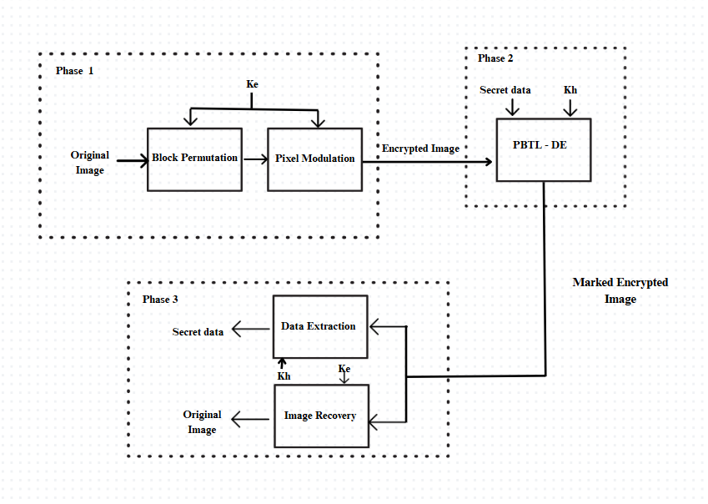
BLOCK DIAGRAM
EXISTING METHOD 2
PARAMETRIC BINARY TREE LABELING

Slide 18
ALGORITHM
EXISTING METHOD 2
PARAMETRIC BINARY TREE LABELING
Input: Original image O, Secret data M, Encryption Key Ke, Data Hiding key Kh , parameters α and β
Phase 1: Image Encryption
for i ← 0 to M/s - 1 do
for j ← 0 to N/s - 1 do
Extract block B_{ij} from O.
Generate random integer R_{ij} using K_e.
Permute blocks using permutation sequence P generated from K_e.
for each pixel O (p, q) ∈ B_{ij} do
Encrypt: E p, q) ← (O (p, q) + R_{ij}) mod 256.
end for
end for
end for

Slide 19
Phase 2:PBTL-DE Divide I into equal size non-overlapping blocks. Classify pixels into four groups: Pr, Ps, Pe, and Pn. Label P_e using PBTL with parameters α and β Construct the payload P, consisting of: - The secret data M, - The first β bits of each pixel in Pn, - 8 bits in Ps. for each pixel in Pe do: a. Calculate the difference value e. b. Reconstruct the pixel by replacing α labeling bits and (8 - α) payload bits. end for for each pixel in Pn do: a. Replace the first β bits with '0...0' (β zeros). b. Keep the remaining (8 - β) bits unmodified. end for Convert α and β into binary bits. Store the binary bits of α and β into Ps by bit replacement. Output the marked image Î.
EXISTING METHOD 2
PARAMETRIC BINARY TREE LABELING

Slide 20
EXISTING METHOD 2
PARAMETRIC BINARY TREE LABELING
Phase 3:Data Extraction and Image Recovery
Data Extraction
1. Extract parameters α, β from P_s.
2. Separate P_e, P_n using labels.
3. Retrieve S from P_e.
Image Recovery
1. Restore P_s, P_n using auxiliary data.
2. Reconstruct O (p, q) using P_r and difference values.
3. Reverse encryption: O (p, q) ← (E (p, q) – R_{ij}) mod 256.
4. Undo block permutation using P.
Output: Recovered Image , Extracted Message

Slide 21
PROS
EXISTING METHOD 2
PARAMETRIC BINARY TREE LABELING
Lossless Image Restoration: The original image can be completely restored without any loss in quality, maintaining the image's integrity.
Enhanced Security: The method ensures high security by embedding data in encrypted images, protecting both the image and the hidden information from unauthorized access.

Slide 22
CONS
EXISTING METHOD 2
PARAMETRIC BINARY TREE LABELING
Computational Complexity: The process involves multiple steps such as pixel grouping, labeling, and encryption, which can be computationally expensive and slow, particularly for large images.
Key Dependency: Successful data extraction and image recovery depend on having both the encryption key and data-hiding key. If either key is lost, data recovery becomes impossible.

Slide 23
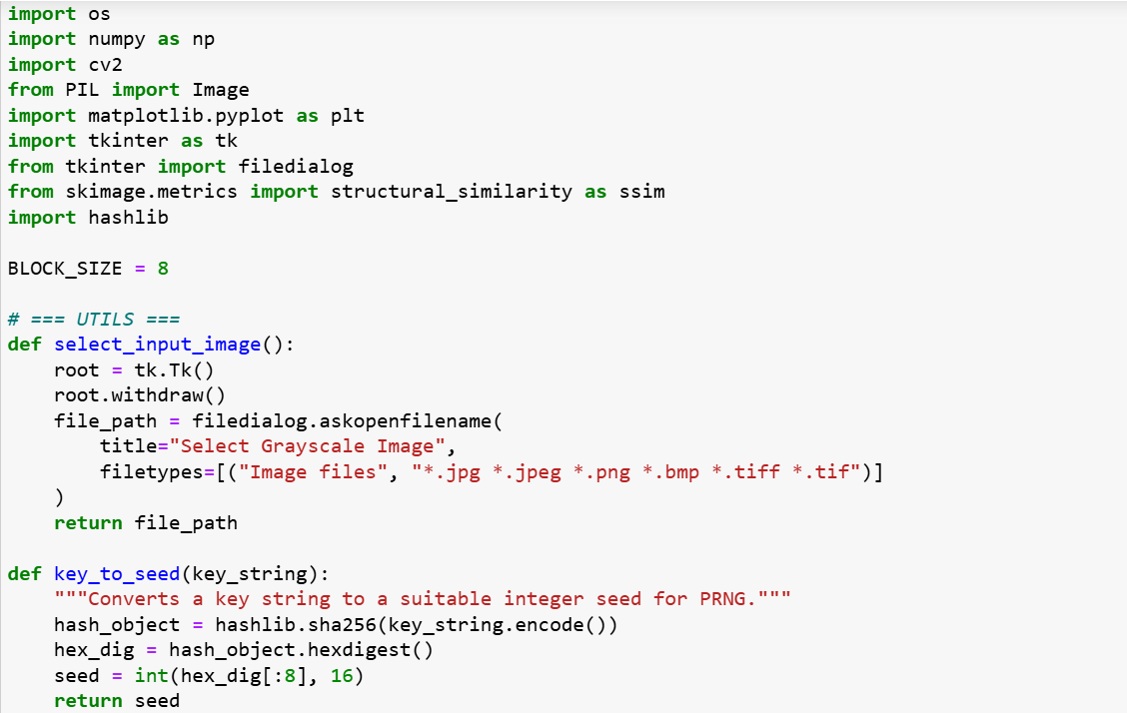
IMPLEMENTATION OF METHOD 1
HIGH - CAPACITY REVERSIBLE DATA HIDING IN ENCRYPTED IMAGES

Slide 24
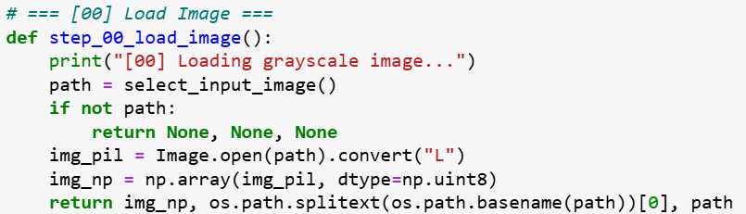
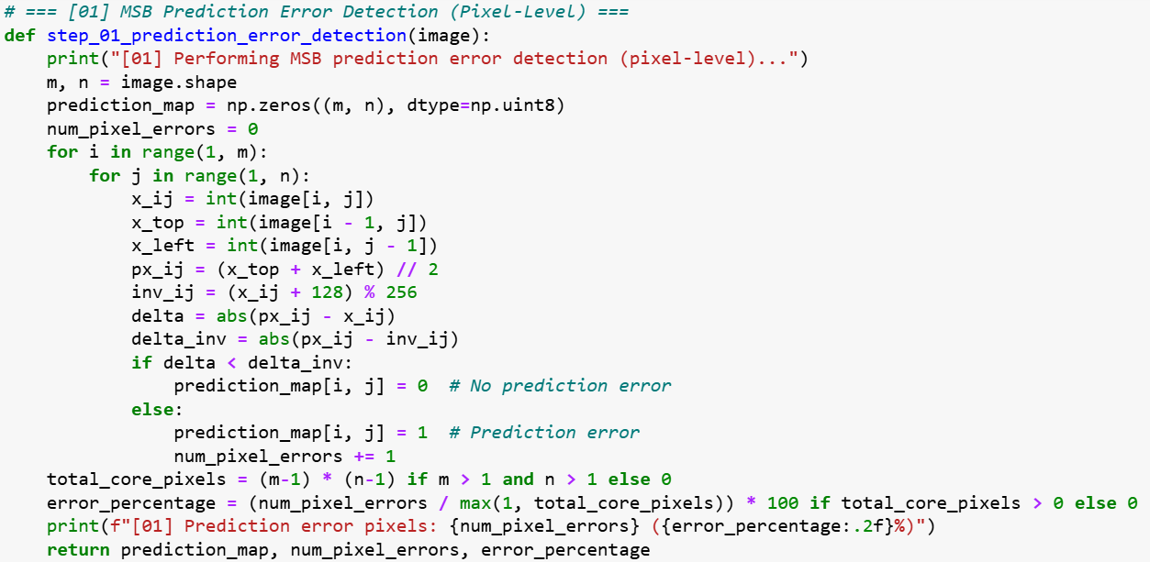
HIGH - CAPACITY REVERSIBLE DATA HIDING IN ENCRYPTED IMAGES

Slide 25
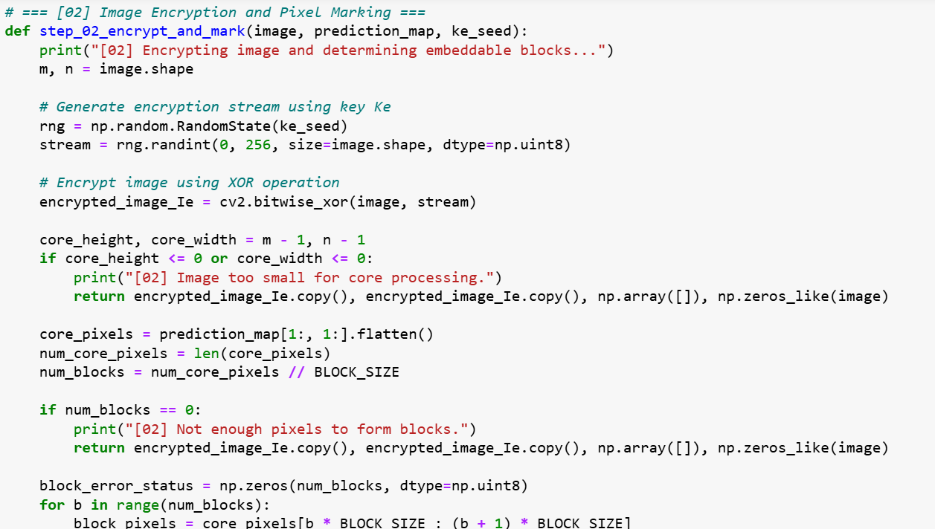
HIGH - CAPACITY REVERSIBLE DATA HIDING IN ENCRYPTED IMAGES

Slide 26
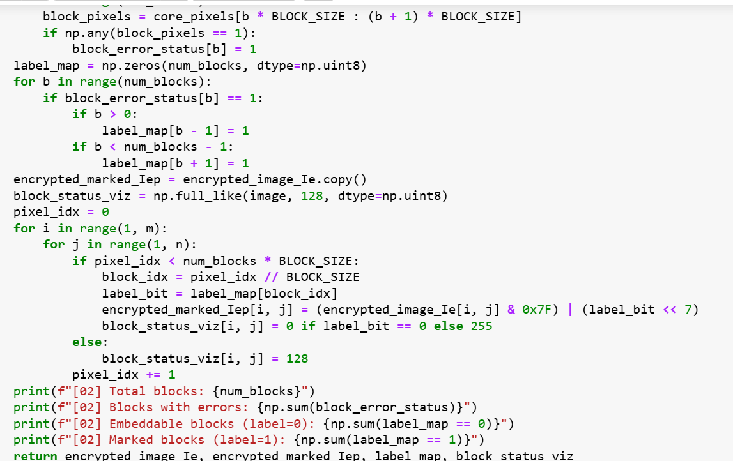
HIGH - CAPACITY REVERSIBLE DATA HIDING IN ENCRYPTED IMAGES

Slide 27
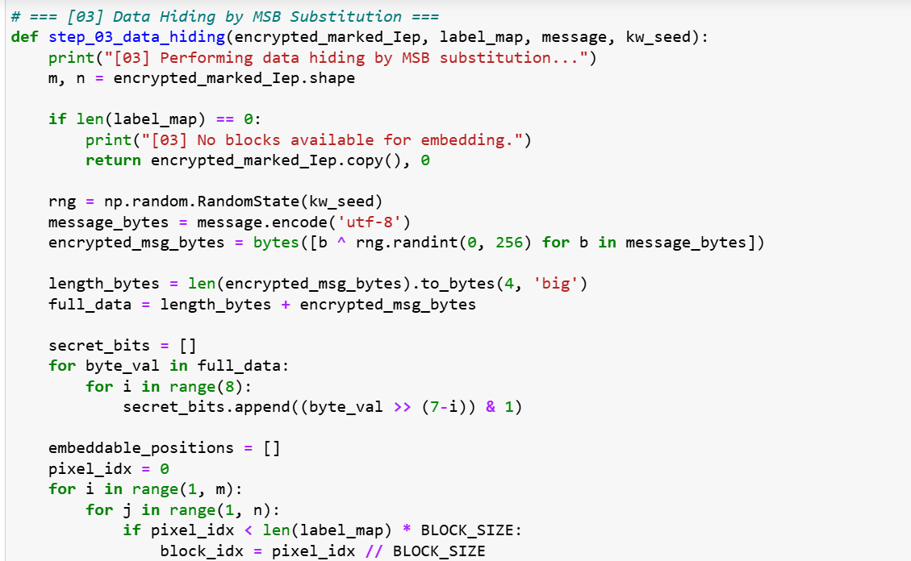
HIGH - CAPACITY REVERSIBLE DATA HIDING IN ENCRYPTED IMAGES

Slide 28
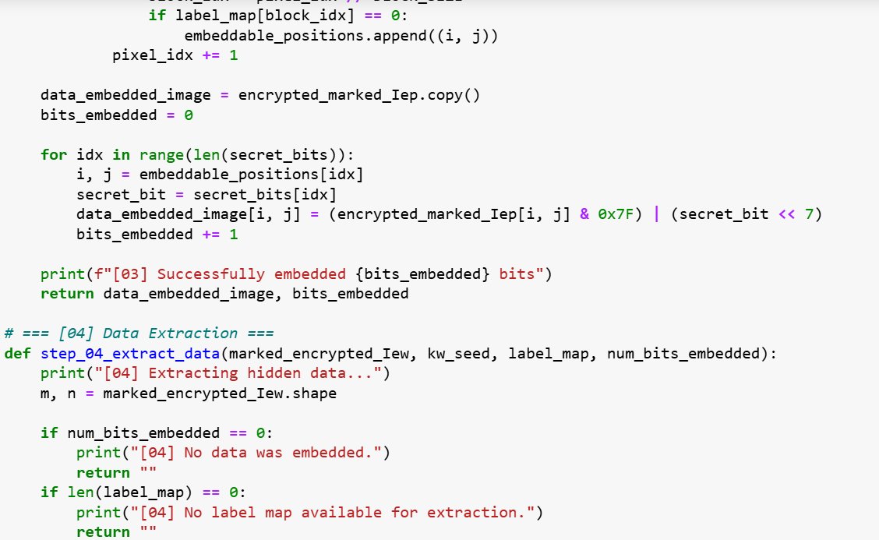
HIGH - CAPACITY REVERSIBLE DATA HIDING IN ENCRYPTED IMAGES

Slide 29
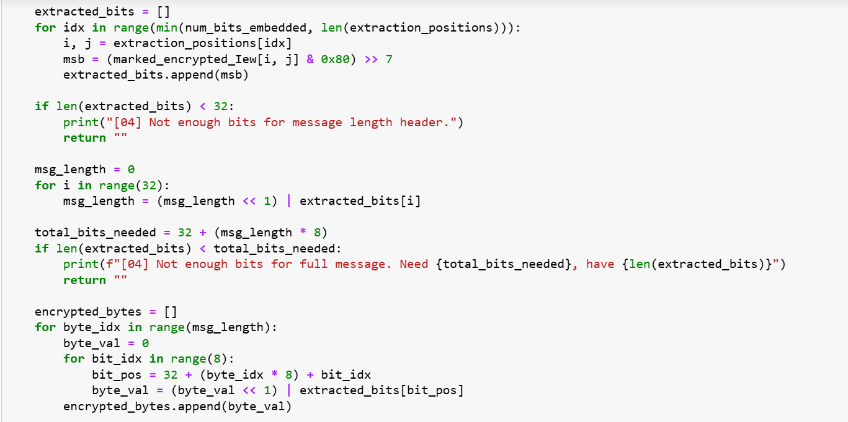
HIGH - CAPACITY REVERSIBLE DATA HIDING IN ENCRYPTED IMAGES

Slide 30
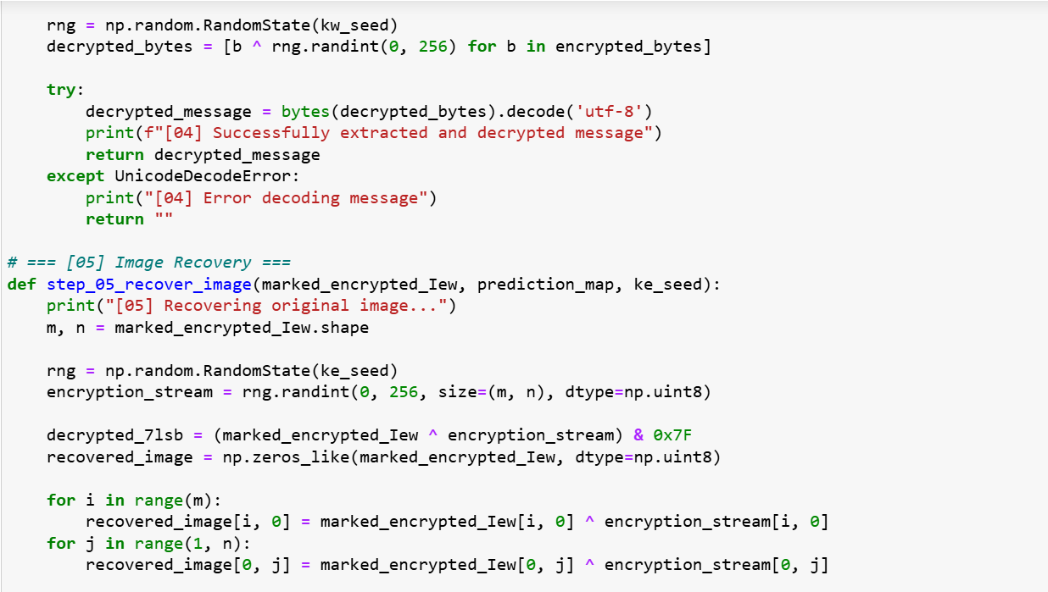
HIGH - CAPACITY REVERSIBLE DATA HIDING IN ENCRYPTED IMAGES

Slide 31
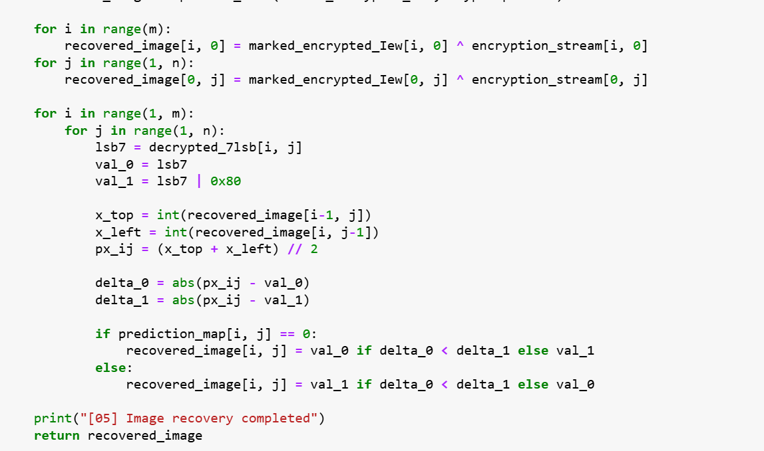
HIGH - CAPACITY REVERSIBLE DATA HIDING IN ENCRYPTED IMAGES

Slide 32
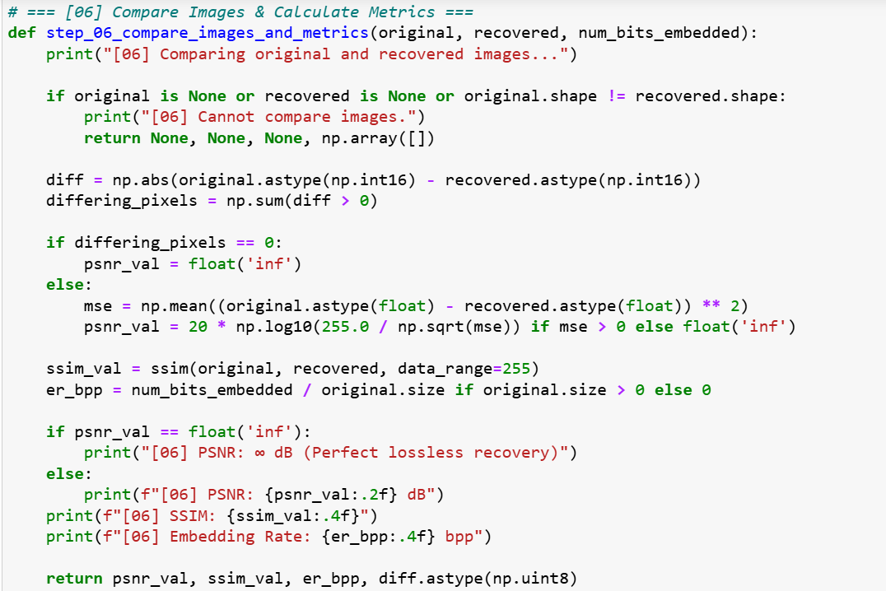
HIGH - CAPACITY REVERSIBLE DATA HIDING IN ENCRYPTED IMAGES

Slide 33
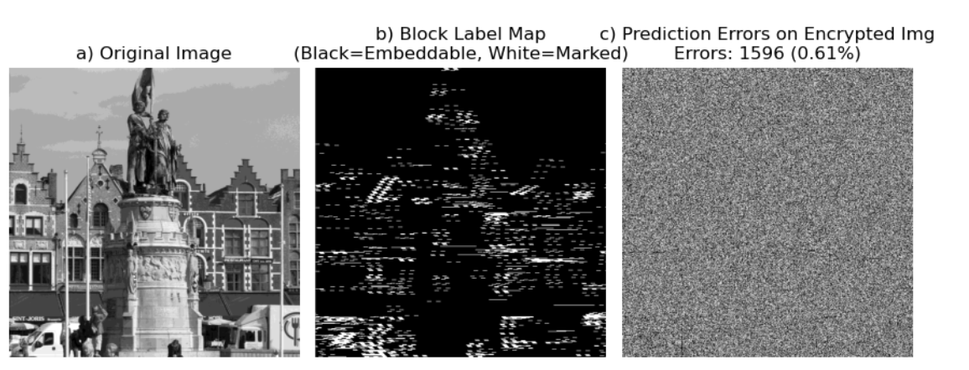
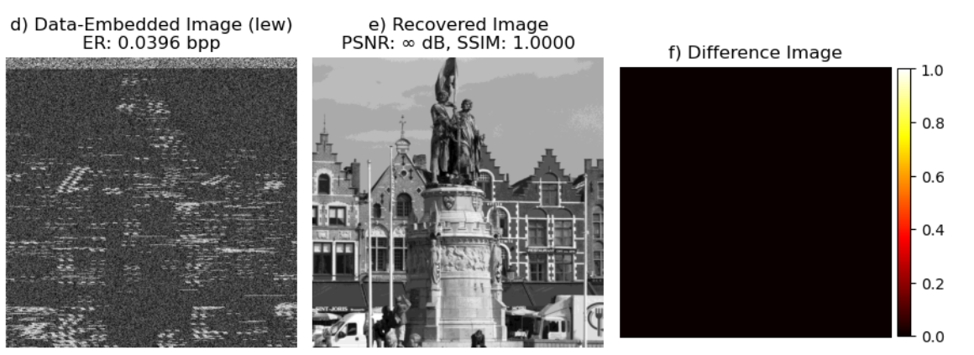
RESULTS & DISCUSSION
HIGH - CAPACITY REVERSIBLE DATA HIDING IN ENCRYPTED IMAGES

Slide 34
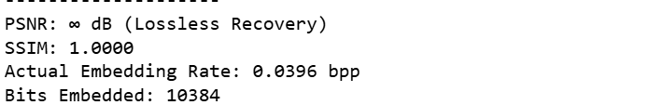
PSNR (Peak Signal-to-Noise Ratio) SSIM (Structural Similarity Index) PSNR&SSIM metrics determines that the image is recovered losslessly or not. PSNR Inf dB and SSIM value 1 indicates the image is recovered successfully.
HIGH - CAPACITY REVERSIBLE DATA HIDING IN ENCRYPTED IMAGES

Slide 35
REFERENCES
P. Puteaux and W. Puech, “An efficient MSB prediction-based method for high-capacity reversible data hiding in encrypted images,” IEEE Trans. Inf. Forensics Secur., vol. 13, no. 7, pp. 1067–1681, Jan. 2018.
P. Puteaux and W. Puech, “EPE-based huge-capacity reversible data hiding in encrypted images,” in Proc. IEEE Int. Workshop Inf. Forensics Secur., Dec. 2018, pp. 1–7.
Y. Puyang, Z. Yin, and Z. Qian, “Reversible data hiding in encrypted images with two-MSB prediction,” in Proc. IEEE Int. Workshop Inf. Forensics Secur., Dec. 2018, pp. 1–7
S .Yi and Y. Zhou, “Separable and reversible data hiding in encrypted images using parametric binary tree labeling,” IEEE Trans. Multimedia, vol. 21, no. 1, pp. 51–64, Jan. 2019.
K. Chen and C. C. Chang, “High-capacity reversible data hiding in encrypted images based on extended run-length coding and block-based MSB plane rearrangement,” J. Vis. Commun. Image Representation, vol. 58, pp. 334–344, 2019.

Slide 36
THANK YOU

