Slide 1
REVERSIBLE DATA HIDING IN ENCRYPTED IMAGES BASED ON MULTI-MSB PREDICTION AND HUFFMAN CODING
GUIDE
Dr.B.HEMANTHA KUMAR
TEAM-1
G VISHNU KAIVALYA-Y21IT040
G B HARSHA VARDHAN-Y21IT039
K KIRAN –L22IT138

Slide 2
CONTENTS
Problem Statement
Modules
Block diagram
Algorithm
Conclusion
References

Slide 3
PROBLEM STATEMENT
Reversible Data Hiding in Encrypted Images (RDHEI) allows embedding secret data into encrypted images while ensuring lossless recovery of both the original image and the hidden data. However, existing methods suffer from limited embedding capacity, data extraction errors, and inefficient space utilization. To address these issues, a Multi-MSB Prediction and Huffman Coding-based RDHEI method is proposed, which enhances embedding capacity and guarantees error-free data extraction and image recovery.

Slide 4
MODULES
RDHEI based on Multi-MSB & Huffman Coding
The proposed Reversible Data Hiding in Encrypted Images (RDHEI) method consists of three main phases:
INPUT: Original Image, Encryption Key Ke, Data Hiding Key Kd
01. Image Encryption Phase (by the Content-Owner)
Label Map Calculation: The content-owner generates a label map using multi-MSB prediction.
Image Encryption: The original image is encrypted using a stream cipher.
Label Map Embedding: The label map is compressed using Huffman coding and embedded into the encrypted image.
02.Data Embedding Phase(by the Content-Hider)
Label Map Extraction: The data-hider extracts the label map from the encrypted image.
Secret Data Embedding: Multi-bit secret information is embedded in each encrypted pixel using adaptive multi-MSB substitution.

Slide 5
03. Data Extraction & Image Decryption Phase (by the Receiver)
RDHEI based on Multi-MSB & Huffman Coding
Data Extraction : By using Data hiding key the data can be extracted.
Image Recovery: By using Encryption Key the image is recovered losslessly.

Slide 6
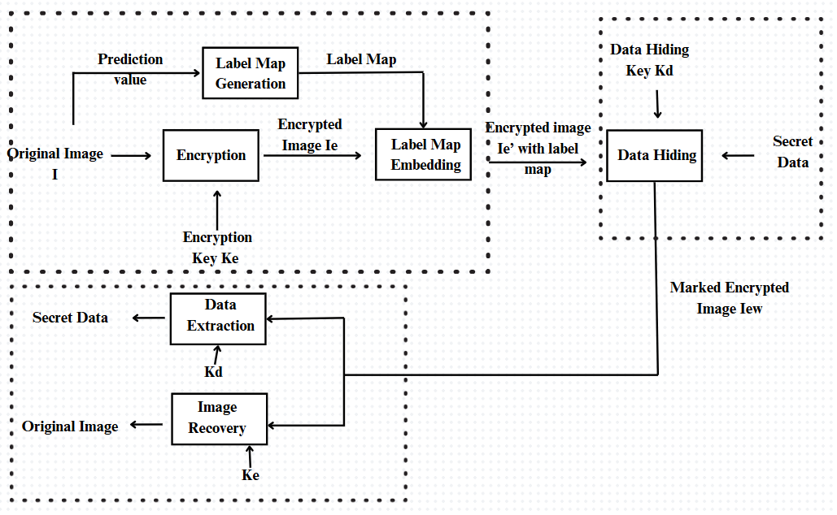
BLOCK DIAGRAM
RDHEI based on Multi-MSB & Huffman Coding

Slide 7
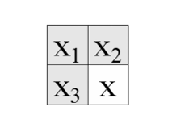
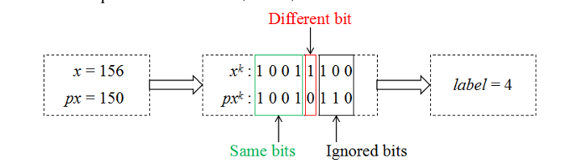
ALGORITHM
RDHEI based on Multi-MSB & Huffman Coding
01. Label Map Generation
a. for each pixel x(i, j):
i. Predict the pixel value using the Median Edge Detector (MED) predictor:
px(i, j) =
⎧ max(x2, x3), if x1 ≤ min(x2, x3)
⎪ min(x2, x3), if x1 ≥ max(x2, x3)
⎩ x2 + x3 − x1, otherwise
ii. Convert x(i, j) and px(i, j) into an 8-bit binary sequence:
xk(i, j) = ⌊ (x(i, j) mod 2^(9-k)) / 2^(8-k) ⌋ , k = 1,2,...,8
iii. Compare bits from MSB to LSB until a difference is found.
iv. Assign label t based on the number of identical MSBs:
t = arg max_t (x(i, j)_tMSB = px(i, j)_tMSB), t = 0,1,2,...,8
subject to:
x(i, j)_tMSB = x(i, j) − (x(i, j) mod 2^(8−t))
px(i, j)_tMSB = px(i, j) − (px(i, j) mod 2^(8−t))
b. Store the label map.

Slide 8
02. Image Encryption: a. Generate a pseudo-random matrix r of size m × n using the encryption key Ke. b. Convert each pixel x(i, j) and r(i, j) into an 8-bit binary sequence. c. Encrypt pixel using bitwise XOR operation: x_enc_k(i, j) = x_k(i, j) ⊕ r_k(i, j), k = 1,2,...,8 d. Compute the encrypted pixel value: x_enc(i, j) = ∑ (x_enc_k(i, j) × 2^(8−k)), k = 1,2,...,8 e. Store encrypted image Ie. 03. Compress Label Map using Huffman Coding: a. Assign shorter codes to frequently occurring labels. b. Convert label map into a binary sequence: LM = ∑ (n_t × c_t), t = 0,1,2,...,8 where n_t is the number of pixels with label t, and c_t is the length of the Huffman code.
RDHEI based on Multi-MSB & Huffman Coding

Slide 9
04. Embed Label Map into Encrypted Image: a. Convert the Huffman-encoded label map into a binary sequence. b. Store Huffman coding rule and label map in reference pixels. c. Embed the remaining auxiliary information using multi-MSB substitution: x'_enc(i, j) = ⎧ x_enc(i, j) mod 2^(7−t) + ∑(b_s × 2^(7−s)), 0 ≤ t ≤ 6 ⎩ ∑(b_s × 2^(8−s)), 7 ≤ t ≤ 8 where b_s represents auxiliary information bits. 05. Hide Secret Data: a. Extract the Huffman coding rule and label map. b. Compute the embedding capacity based on the label map. c. Encrypt the additional data using the data hiding key Kd. d. Embed data in encrypted image pixels using multi-MSB substitution. e. Store the marked encrypted image Iew.
RDHEI based on Multi-MSB & Huffman Coding

Slide 10
06. Extract Data: a. Extract Huffman coding rule and label map from Iew. b. Extract embedded data by the data hiding key Kd. 07. Recover Original Image: a. Decrypt the encrypted pixels using Ke: x_k(i, j) = x_enc_k(i, j) ⊕ r_k(i, j), k = 1,2,...,8 b. Use the extracted label map and MED predictor to reconstruct the original pixel: x(i, j) = ⎧ px(i, j)_tMSB + b_(t+1) × 2^(7−t) + x'_enc(i, j) mod 2^(7−t), 0 ≤ t ≤ 7 ⎩ px(i, j), t = 8 c. Recover the MSBs of each pixel: b_(t+1) = ⎧ 0, if px_(t+1)(i, j) = 1 ⎩ 1, if px_(t+1)(i, j) = 0 d. Restore the original image losslessly.
RDHEI based on Multi-MSB & Huffman Coding

Slide 11
CONCLUSION
The proposed RDHEI method enhances embedding capacity by utilizing multi-MSB prediction and Huffman coding. It ensures error-free data extraction and perfect image recovery while significantly improving payload performance. By compressing auxiliary data, the method maximizes the space available for embedding.

Slide 12
REFERENCES
P. Puteaux and W. Puech, “An efficient MSB prediction-based method for high-capacity reversible data hiding in encrypted images,” IEEE Trans. Inf. Forensics Secur., vol. 13, no. 7, pp. 1067–1681, Jan. 2018.
P. Puteaux and W. Puech, “EPE-based huge-capacity reversible data hiding in encrypted images,” in Proc. IEEE Int. Workshop Inf. Forensics Secur., Dec. 2018, pp. 1–7.
Y. Puyang, Z. Yin, and Z. Qian, “Reversible data hiding in encrypted images with two-MSB prediction,” in Proc. IEEE Int. Workshop Inf. Forensics Secur., Dec. 2018, pp. 1–7
S .Yi and Y. Zhou, “Separable and reversible data hiding in encrypted images using parametric binary tree labeling,” IEEE Trans. Multimedia, vol. 21, no. 1, pp. 51–64, Jan. 2019.
K. Chen and C. C. Chang, “High-capacity reversible data hiding in encrypted images based on extended run-length coding and block-based MSB plane rearrangement,” J. Vis. Commun. Image Representation, vol. 58, pp. 334–344, 2019.

Slide 13
THANK YOU

