Slide 1
REVERSIBLE DATA HIDING IN ENCRYPTED IMAGES BASED ON MULTI-MSB PREDICTION AND HUFFMAN CODING
GUIDE
Dr.B.HEMANTHA KUMAR
TEAM-1
G VISHNU KAIVALYA-Y21IT040
G B HARSHA VARDHAN-Y21IT039
K KIRAN –L22IT138

Slide 2
CONTENTS
Problem Statement
Block Diagram
Modules
Code for Image Encryption phase
Results & Discussion
Conclusion
References

Slide 3
PROBLEM STATEMENT
Reversible Data Hiding in Encrypted Images (RDHEI) allows embedding secret data into encrypted images while ensuring lossless recovery of both the original image and the hidden data. However, existing methods suffer from limited embedding capacity, data extraction errors, and inefficient space utilization. To address these issues, this work proposes an RDHEI method based on Multi-MSB Prediction and Huffman Coding, which improves embedding capacity and ensures error-free data extraction and image recovery.

Slide 4
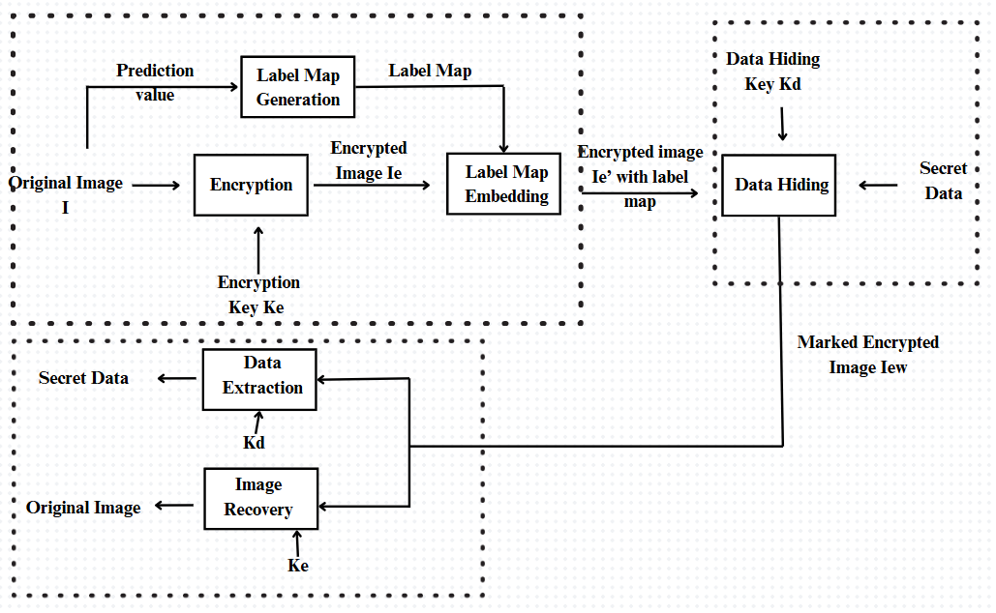
BLOCK DIAGRAM
RDHEI based on Multi-MSB & Huffman Coding

Slide 5
MODULES
RDHEI based on Multi-MSB & Huffman Coding
The proposed Reversible Data Hiding in Encrypted Images (RDHEI) method consists of three main phases:
INPUT: Original Image, Encryption Key Ke, Data Hiding Key Kd, Secret Message
Image Encryption Phase (by the Content-Owner)
Data Embedding Phase(by the Content-Hider)
Data Extraction & Image Decryption Phase (by the Receiver)
OUTPUT: Recovered Image , Extracted Message

Slide 6
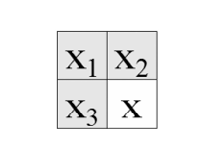
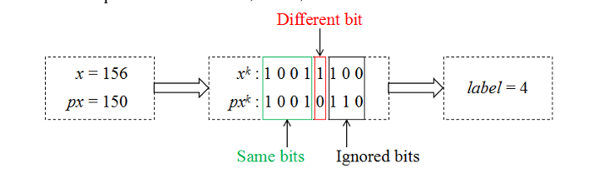
01.Image Encryption Phase (by the Content-Owner)
RDHEI based on Multi-MSB & Huffman Coding
01. Label Map Generation
For each pixel x(i, j):
i. Predict the pixel value using the Median Edge Detector (MED) predictor:
px(i, j) =
⎧ max(x2, x3), if x1 ≤ min(x2, x3)
⎪ min(x2, x3), if x1 ≥ max(x2, x3)
⎩ x2 + x3 − x1, otherwise
ii. Convert x(i, j) and px(i, j) into an 8-bit binary sequence:
xk(i, j) = ⌊ (x(i, j) mod 2^(9-k)) / 2^(8-k) ⌋ , k = 1,2,...,8
iii. Compare bits from MSB to LSB until a difference is found.
iv. Assign label t based on the number of identical MSBs:
t = arg max_t (x(i, j)_tMSB = px(i, j)_tMSB), t = 0,1,2,...,8
subject to:
x(i, j)_tMSB = x(i, j) − (x(i, j) mod 2^(8−t))
px(i, j)_tMSB = px(i, j) − (px(i, j) mod 2^(8−t))
Store the label map.

Slide 7
01.Image Encryption Phase (by the Content-Owner)
RDHEI based on Multi-MSB & Huffman Coding
02. Image Encryption: a. Generate a pseudo-random matrix r of size m × n using the encryption key Ke. b. Convert each pixel x(i, j) and r(i, j) into an 8-bit binary sequence. c. Encrypt pixel using bitwise XOR operation: x_enc_k(i, j) = x_k(i, j) ⊕ r_k(i, j), k = 1,2,...,8 d. Compute the encrypted pixel value: x_enc(i, j) = ∑ (x_enc_k(i, j) × 2^(8−k)), k = 1,2,...,8 e. Store encrypted image Ie. 03. Compress Label Map using Huffman Coding: a. Assign shorter codes to frequently occurring labels. b. Convert label map into a binary sequence: LM = ∑ (n_t × c_t), t = 0,1,2,...,8 where n_t is the number of pixels with label t, and c_t is the length of the Huffman code.

Slide 8
01.Image Encryption Phase (by the Content-Owner)
RDHEI based on Multi-MSB & Huffman Coding
04. Embed Label Map into Encrypted Image: a. Convert the Huffman-encoded label map into a binary sequence. b. Store Huffman coding rule and label map in reference pixels. c. Embed the remaining auxiliary information using multi-MSB substitution: x'_enc(i, j) = ⎧ x_enc(i, j) mod 2^(7−t) + ∑(b_s × 2^(7−s)), 0 ≤ t ≤ 6 ⎩ ∑(b_s × 2^(8−s)), 7 ≤ t ≤ 8 where b_s represents auxiliary information bits.

Slide 9
02.Data Embedding Phase(by the Content-Hider)
RDHEI based on Multi-MSB & Huffman Coding
01. Hide Secret Data: a. Extract the Huffman coding rule and label map. b. Compute the embedding capacity based on the label map. c. Encrypt the additional data using the data hiding key Kd. d. Embed data in encrypted image pixels using multi-MSB substitution. e. Store the marked encrypted image Iew.

Slide 10
03.Data Extraction & Image Decryption Phase (by the Receiver)
RDHEI based on Multi-MSB & Huffman Coding
01.Extract Data: a. Extract Huffman coding rule and label map from Iew. b. Extract embedded data by the data hiding key Kd. 02. Recover Original Image: a. Decrypt the encrypted pixels using Ke: x_k(i, j) = x_enc_k(i, j) ⊕ r_k(i, j), k = 1,2,...,8 b. Use the extracted label map and MED predictor to reconstruct the original pixel: x(i, j) = ⎧ px(i, j)_tMSB + b_(t+1) × 2^(7−t) + x'_enc(i, j) mod 2^(7−t), 0 ≤ t ≤ 7 ⎩ px(i, j), t = 8 c. Recover the MSBs of each pixel: b_(t+1) = ⎧ 0, if px_(t+1)(i, j) = 1 ⎩ 1, if px_(t+1)(i, j) = 0 d. Restore the original image losslessly.

Slide 11
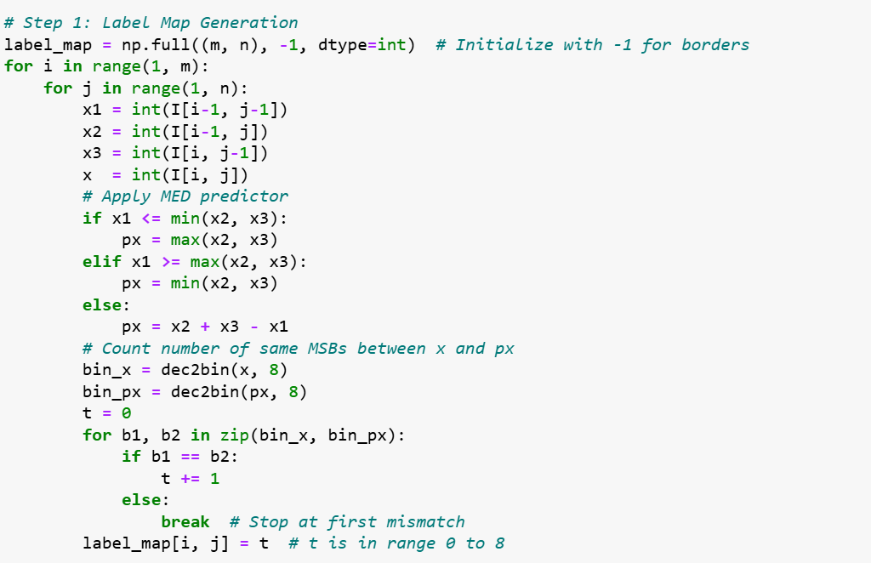
CODE FOR IMAGE ENCRYPTION PHASE
RDHEI based on Multi-MSB & Huffman Coding

Slide 12
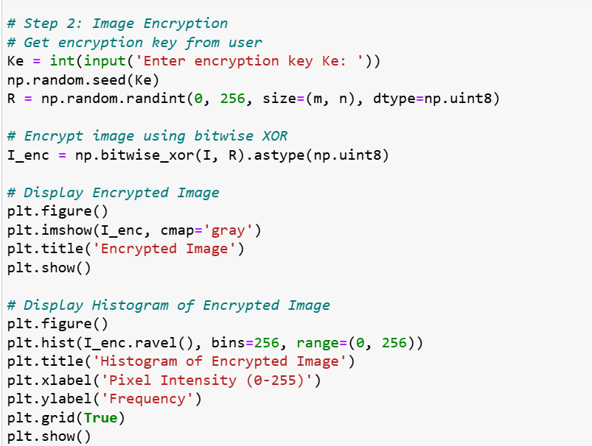
RDHEI based on Multi-MSB & Huffman Coding

Slide 13
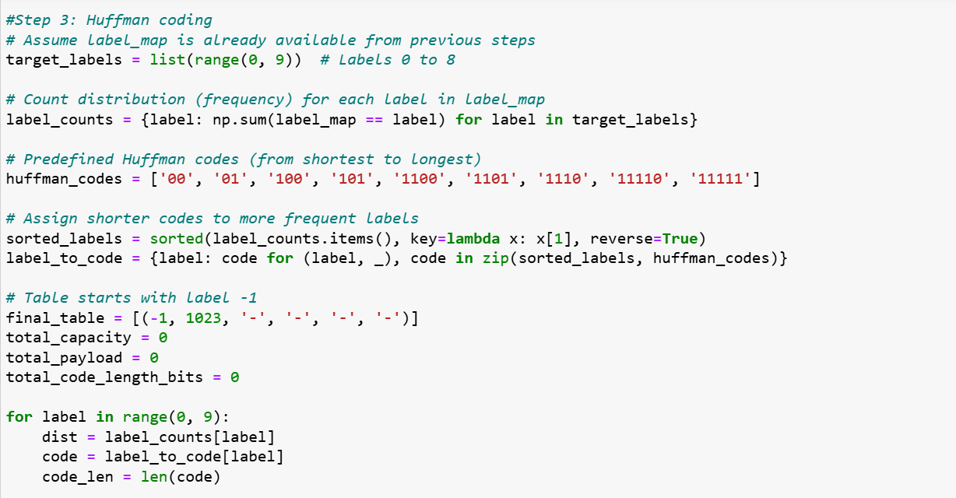
RDHEI based on Multi-MSB & Huffman Coding

Slide 14
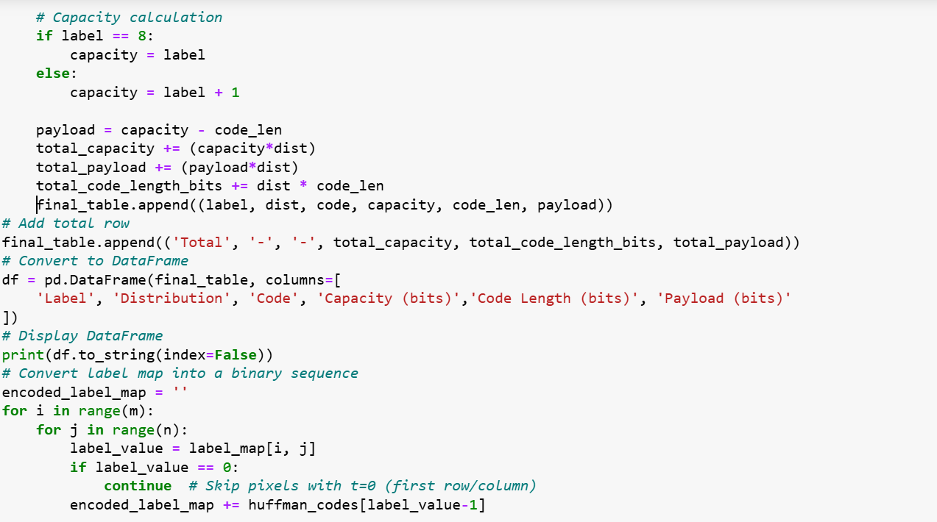
RDHEI based on Multi-MSB & Huffman Coding

Slide 15
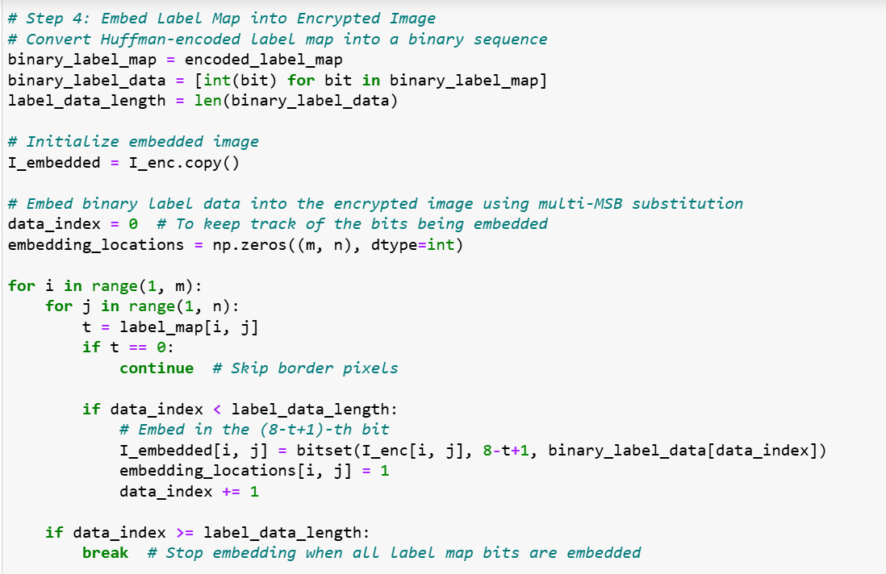
RDHEI based on Multi-MSB & Huffman Coding

Slide 16
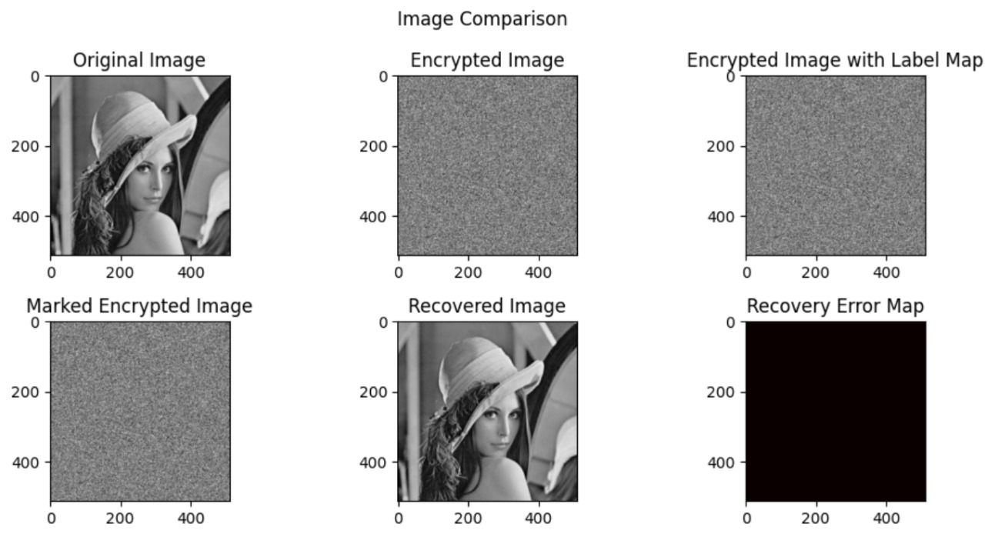
RESULTS & DISCUSSION
RDHEI based on Multi-MSB & Huffman Coding

Slide 17
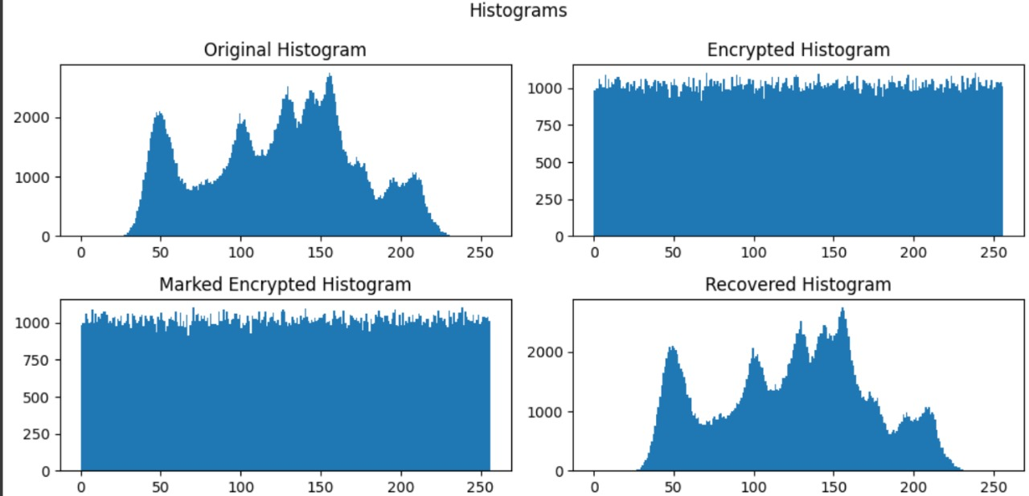
HISTOGRAMS OF LENA IMAGE
RDHEI based on Multi-MSB & Huffman Coding

Slide 18
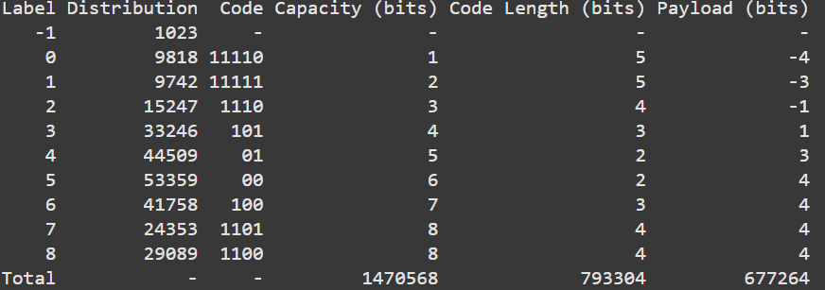
LABEL HUFFMAN CODING FOR THE LENA IMAGE Capacity (bits) = Label +1 if Label< 7 Label if Label = 8 Code Length (bits) = Length of the Huffman Code of Label Payload (bits) = Capacity (bits) – Code Length (bits)
RDHEI based on Multi-MSB & Huffman Coding

Slide 19
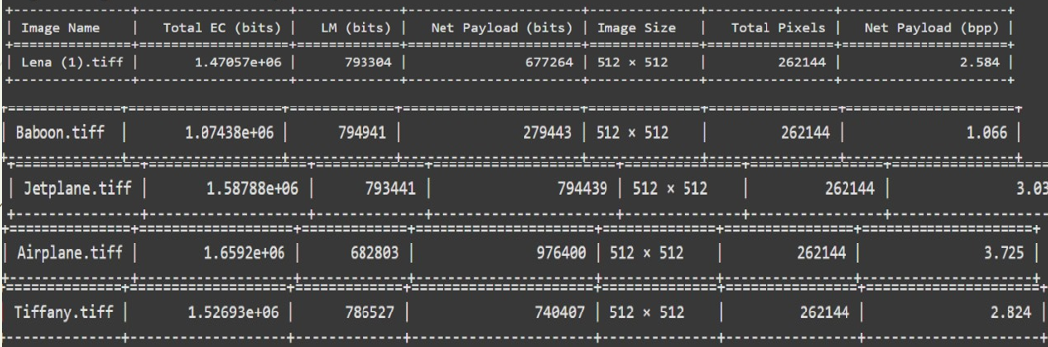
THE EMBEDDING CAPACITY AND AUXILIARY INFORMATION OF DIFFERENT TEST IMAGES Total Embedding Capacity = Sum( Distribution * Capacity(bits)) Label Map Length = Sum (Distribution * Code length(bits)) Net Payload(bpp) = Total Embedding Capacity – Label Map Length
RDHEI based on Multi-MSB & Huffman Coding

Slide 20
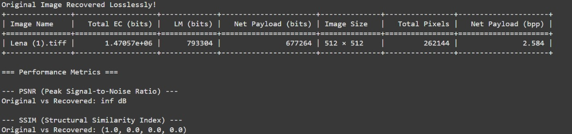
PERFORMANCE METRICS OF LENA IMAGE 01.PSNR : Peak Signal - to – Noise Ratio 02.SSIM : Structural Similarity Index
RDHEI based on Multi-MSB & Huffman Coding
PSNR = 10 × log₁₀(MAX²/MSE) Db MSE = (1/(m×n)) × ∑∑[I(i,j) - R(i,j)]² where MSE is Mean Square Error
cv2.quality.QualitySSIM_compute(original, recovered)[0]
(Built-in function)

Slide 21
CONCLUSION
The proposed RDHEI method effectively enhances embedding capacity by utilizing multi-MSB prediction and Huffman coding. It ensures error-free data extraction and perfect image recovery while significantly improving payload performance. By compressing auxiliary data efficiently, the method maximizes the space available for embedding.

Slide 22
REFERENCES
P. Puteaux and W. Puech, “An efficient MSB prediction-based method for high-capacity reversible data hiding in encrypted images,” IEEE Trans. Inf. Forensics Secur., vol. 13, no. 7, pp. 1067–1681, Jan. 2018.
P. Puteaux and W. Puech, “EPE-based huge-capacity reversible data hiding in encrypted images,” in Proc. IEEE Int. Workshop Inf. Forensics Secur., Dec. 2018, pp. 1–7.
Y. Puyang, Z. Yin, and Z. Qian, “Reversible data hiding in encrypted images with two-MSB prediction,” in Proc. IEEE Int. Workshop Inf. Forensics Secur., Dec. 2018, pp. 1–7
S .Yi and Y. Zhou, “Separable and reversible data hiding in encrypted images using parametric binary tree labeling,” IEEE Trans. Multimedia, vol. 21, no. 1, pp. 51–64, Jan. 2019.
K. Chen and C. C. Chang, “High-capacity reversible data hiding in encrypted images based on extended run-length coding and block-based MSB plane rearrangement,” J. Vis. Commun. Image Representation, vol. 58, pp. 334–344, 2019.

Slide 23
THANK YOU

