Slide 1
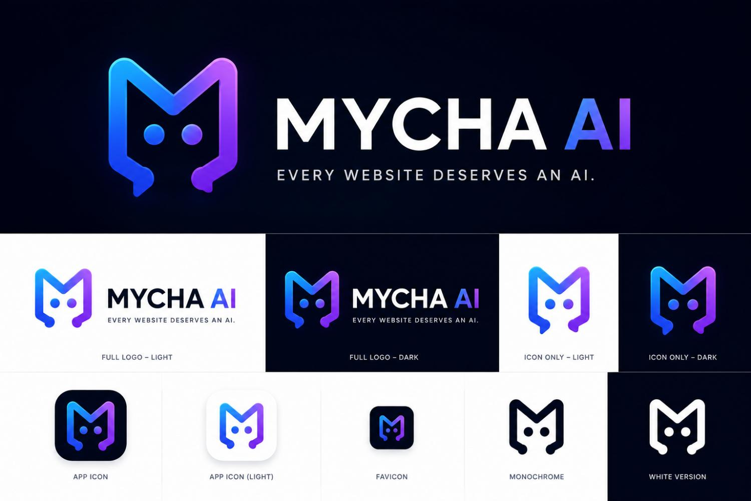
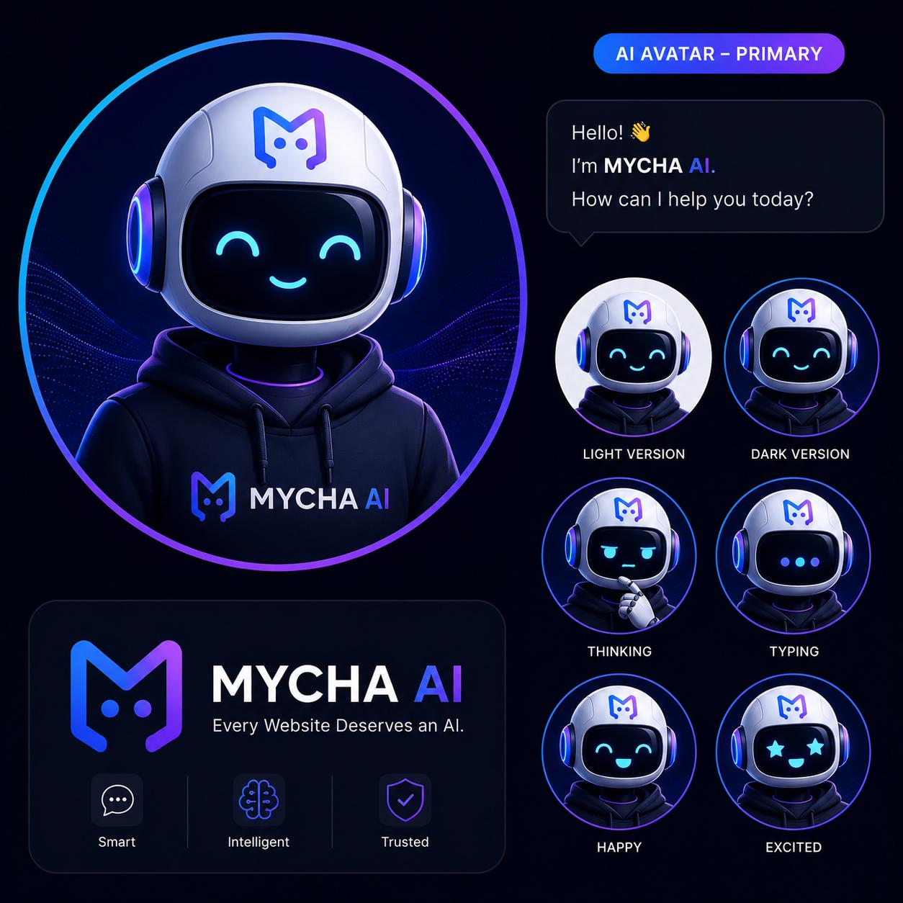
MYCHA AI
Every Website Deserves an AI.
An AI Website Agent designed to understand website-specific
information and help users interact with it.

Slide 2
THE PROBLEM
The web is full of information.
Finding it is a different story.
Cluttered Pages & Menus
Endless FAQs & PDFs
Outdated Announcements
Users get lost navigating complex structures
Critical info buried in documents
Hard to find current, relevant updates
This leads to wasted time, user frustration, repeated support questions, and missed opportunities.
"The information may already exist. The problem is getting the right information to the right user at the right moment."
MYCHA AI
2 / 18

Slide 3
THE IDEA
What if the website could just understand the question?
Instead of searching, users simply ask.
User: "How much is Computer Science 300 level?"
MYCHA AI: Accesses specific fee information → Answer
User: "How do I apply for admission?"
MYCHA AI: Accesses application process → Step-by-step guide
MYCHA AI
3 / 18

Slide 4
WHAT IS MYCHA AI?
An AI Website Agent.
An intelligent layer integrated directly into a website. It understands the information belonging to that specific website.
01
02
03
04
05
UNDERSTAND
SEARCH
ANSWER
GUIDE
ACT
User's question
Website knowledge
Clear response
Next actions
Future: approved actions
Current Project: A working prototype establishing the foundation for this vision.
MYCHA AI
4 / 18

Slide 5
WHY MYCHA AI IS DIFFERENT
Not just another chatbot.
Feature | Traditional Website | Normal Chatbot | MYCHA AI
Interaction | User searches & reads | User asks questions | User asks questions
Knowledge | Static pages | General knowledge | Website-specific knowledge
Guidance | User figures it out | Limited, generic | Intelligent, contextual
Key Difference: "MYCHA AI is designed to understand the specific website it belongs to."
MYCHA AI
5 / 18

Slide 6
PROJECT OBJECTIVES
What are we trying to achieve?
1
Website-Specific Intelligence
Answer questions using only information from a specific website.
2
Knowledge Retrieval
Search stored website information before generating a response.
3
AI Communication Layer
Provide a flexible API for any website or client to communicate with the AI.
4
Better User Experience
Dramatically reduce the time and effort needed to find information.
5
Future-Ready Architecture
Solid foundation for crawling, semantic search, and RAG.
MYCHA AI
6 / 18

Slide 7
SYSTEM ARCHITECTURE
How MYCHA AI Works
A question flows through a structured pipeline to find the right answer.
User
Website
/ Client
API
Chat
Controller
AI
Engine
Knowledge
Engine
Knowledge
Base
→
→
→
→
→
→
Asks
POST /chat
Receives
Routes
Processes
Searches
Returns info
The user's question is processed → knowledge is searched → a relevant, structured response is returned as JSON → displayed to the user.
MYCHA AI
7 / 18

Slide 8




TECHNOLOGY STACK
The technology behind the prototype.
Backend
API
Node.js + Express.js
Fast, scalable server
REST API
HTTP POST + JSON
Knowledge
Testing
Custom Knowledge Engine
Structured JSON Base
VS Code + Postman
Reliable API validation
MYCHA AI
8 / 18

Slide 9
KNOWLEDGE ENGINE & BASE
MYCHA AI's Internal Librarian
Knowledge Engine
Knowledge Base
1. User asks a question
Current State
Structured JSON information,
manually curated for the prototype.
School name • Fees • Results
Admission • Contact info
2. Engine examines the question
3. Searches the Knowledge Base
4. Identifies the best match
5. Returns relevant information
Future: Crawling • PDF/Word
Semantic Search • Vector DB • RAG
MYCHA AI
9 / 18

Slide 10
THE API & PIPELINE
The Communication Bridge
Client (Website) → POST /chat {"message": "hello"} → MYCHA AI Backend → {"reply": "Hello! I'm MYCHA AI..."} → Client
Reusable communication layer — embeddable into any website or application, regardless of frontend technology.
1. User Asks
2. API Receives
3. Chat Controller
4. AI Engine
5. Knowledge Engine
6. Match Found
7. MYCHA Responds
8. User Receives
MYCHA AI
10 / 18

Slide 11

FROM CONCEPT TO WORKING PROTOTYPE
What was actually built?
Node.js backend server
Knowledge engine
Express application
JSON knowledge base
Chat API (/chat endpoint)
Basic question processing
Chat controller
Knowledge-based responses
AI engine
Postman API testing
MYCHA AI
11 / 18

Slide 12
TESTING & RESULTS
Does it actually work? Yes.
01
"hello"
✓ Response generated successfully
02
"What is the school name?"
✓ Relevant stored information returned
03
"What are the school fees?"
✓ Relevant fee information returned
04
"How do I apply for admission?"
✓ Relevant stored information returned
MYCHA AI
12 / 18

Slide 13
LIMITATIONS & ROADMAP
Current Limitations
Future Roadmap
• Manually structured knowledge
01
Foundation ✓
API, Engines, KB, Testing
• Simple keyword-based matching
• No automatic site crawling yet
02
Intelligent Knowledge
Crawler, PDF, Semantic Search
• No large-scale PDF/Word ingestion
03
Advanced AI
• Deeper LLM integration future work
LLM, RAG, Context-Aware
04
Website Agent
Navigation, Actions
05
Platform
Embeddable for all sites
MYCHA AI
13 / 18

Slide 14





REAL-WORLD APPLICATIONS
One architecture. Many possibilities.
Universities
Hospitals
E-Commerce
Government
Companies
Fees, Admission, Courses, Results, Registration
Departments, Services, Appointments, Locations
Products, Delivery, Returns, Orders
Services, Requirements, Applications, Documents
Products, Services, Support, Policies
MYCHA AI
14 / 18

Slide 15
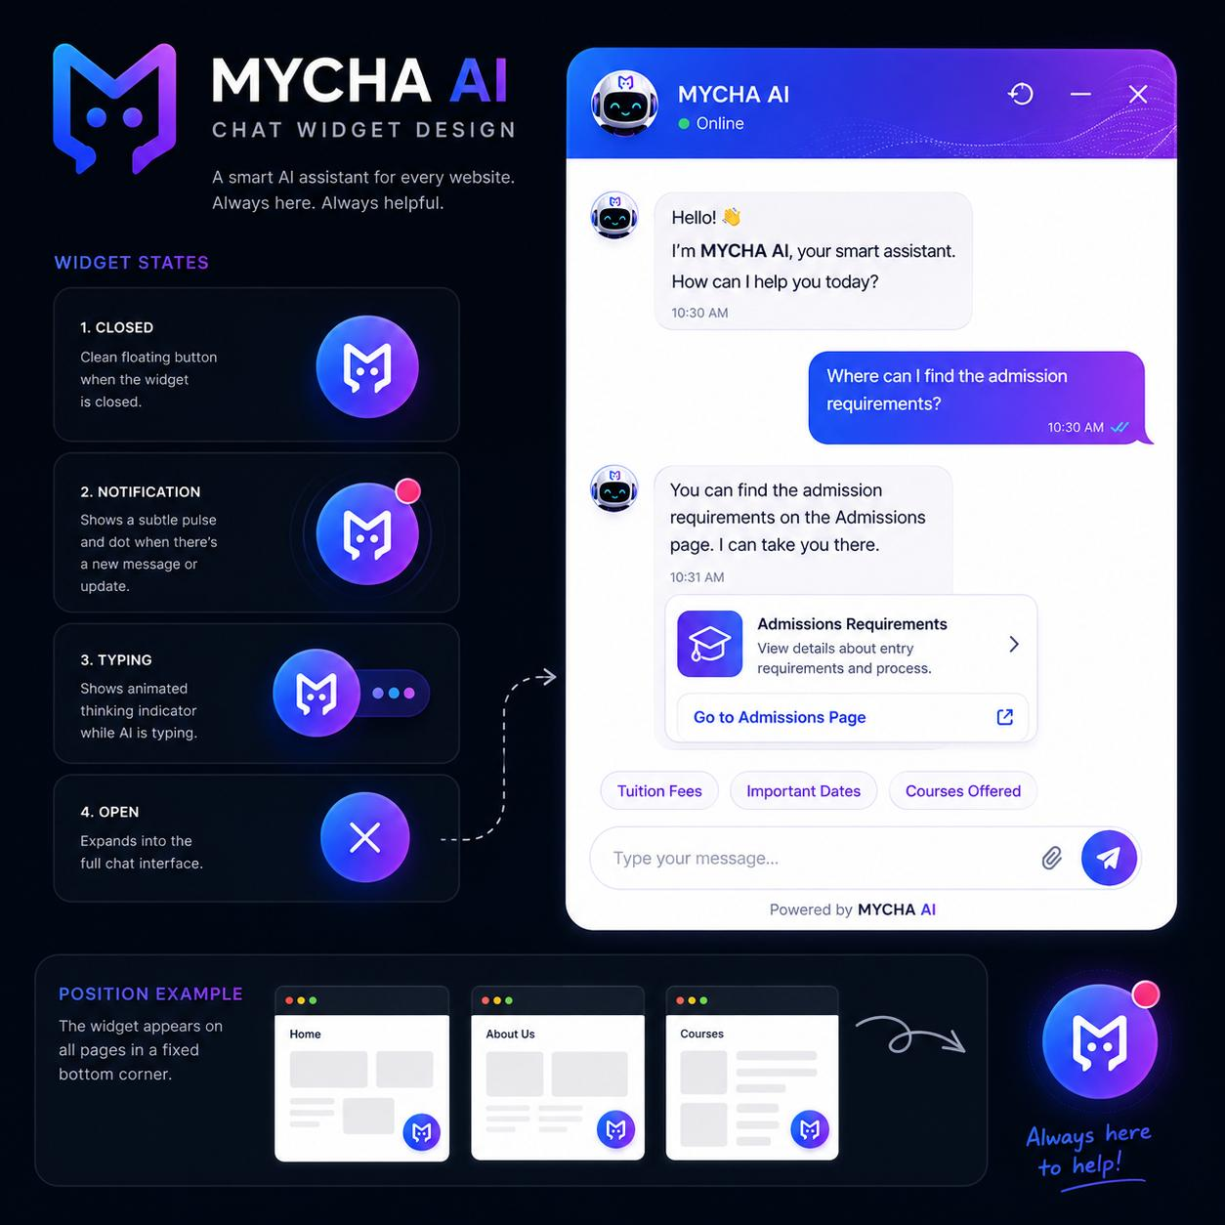
CHAT WIDGET DESIGN
Always here. Always helpful.
MYCHA AI
15 / 18

Slide 16
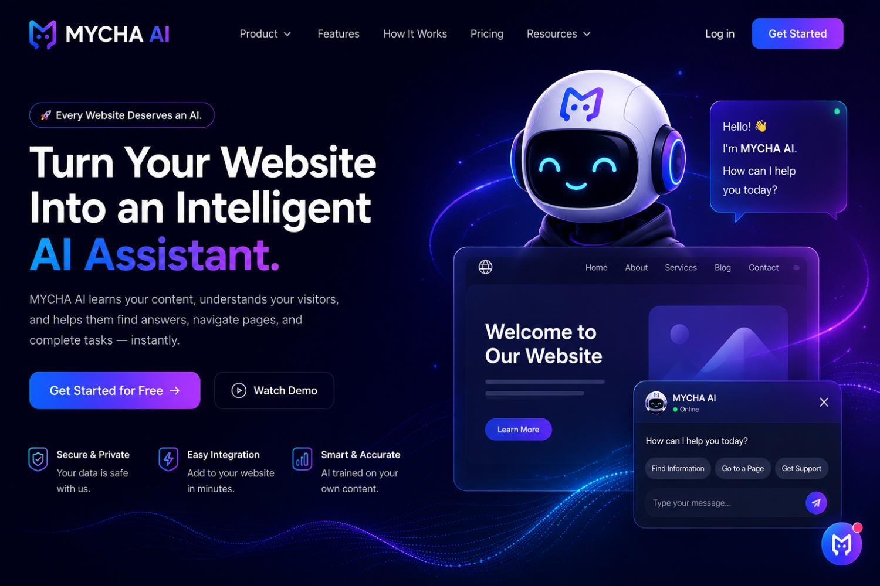
PRODUCT VISION
Turn any website into an intelligent AI assistant.
MYCHA AI
16 / 18

Slide 17
IMPACT & SIGNIFICANCE
From static websites to intelligent experiences.
For Users
For Organizations
For Developers
• Faster access to information
• Fewer repetitive support questions
• Reusable architecture for AI
• Less searching & frustration
• Better digital service & accessibility
• Scalable & adaptable foundation
• Better understanding of complex sites
• Improved engagement & satisfaction
• Simpler navigation
MYCHA AI
17 / 18

Slide 18
MYCHA AI
Every Website Deserves an AI.
The goal is not to put AI beside the website.
The goal is to make AI part of the website.
Thank You
MYCHA AI • 2026

