Slide 1
CSH 227
System Analysis & Design

Slide 2
Recommended Books
Systems Analysis and Design, 11th Edition, 2017, Course Technology, Cengage Learning, Scott Tilley & Harry J. Rosenblatt
Systems Analysis and Design in a Changing World, 7th Edition, 2016. Course Technology, Cengage Learning. John W. Satzinger, Robert B. Jackson, Stephen D. Burd

Slide 3
PART 1 ■ Introduction to System Development
Chapter ONE
An Overview of Systems Analysis and Design
Chapter One Outline
Software Development and Systems Analysis and Design
The Analyst as a business problem solver (Agent of Change)
Tasks performed by Systems Analyst
Required skills of the Systems Analyst
Systems that solve business problems

Slide 4
You are required to develop a game and submit the package form. Duration is 2 weeks.
Do you have any concern?
Who will use the game/system?
What will the game/system do?
Where will the game/system be used?
When will the game/system be used?

Slide 5
Group students for the following exercise
Student admission system – GROUP 1
Automated Teller Machine (ATM) – GROUP 2
Virtual class – GROUP 3
Library management system – GROUP 4
Who will use the system?
What will the system do?

Slide 6
1.1 Software Development
and
Systems Analysis and Design

Slide 7
Almost all organizations have information systems, and use them for operational, tactical, and strategic advantage.
For information systems to remain effective, these systems must efficiently capture, store, process, and distribute information according to business objectives.

Slide 8
The modern information systems service emphasis changes from being merely an enabler of services to also being a driver of change.
Information systems have become a necessary component in any organisation with increasing strategic significance.
Business continuity is a key aspect as 99.5% of system availability is no longer acceptable with increased reliance on information systems.

Slide 9
The information systems discipline is dynamic and always changing.
More complex system requirements have necessitated a whole new set of tools.
System, product, or service should be delivered without latent defects, on schedule, and within budget.

Slide 10
These information systems should be developed.
The key to successful system development is thorough systems analysis and design.
Systems analysts and designers perform information systems analysis and design.

Slide 11
Successful system development is based on:
understanding an organization’s objectives, structure, and processes
the analyst’s knowledge of how to exploit information technology

Slide 12
What is Analysis?
The Oxford Dictionary defines analysis as follows: separation of a substance into parts for study and interpretation; detailed examination.
In the case of systems analysis:
the ‘substance’ is the business system under investigation, and
the parts are the various subsystems that work together to support the business.

Slide 13
It is important that the nature of the business and the way it currently operates are clearly understood.
Detailed examinations provide the design team with the specific data they require in order to ensure that all the client’s requirements are fully met.
The investigation or study conducted during the analysis phase results in the production of a document called requirements specification or functional specification.

Slide 14
Systems analysis is the process of understanding and specifying in detail what the information system should accomplish.
This deals with analysis of sets of interacting entities prior to their automation as computer systems, and the interactions within those systems.
The analysis phase answers the questions of who will use the system, what the system will do, and where and when it will be used.

Slide 15
Systems design is the process of specifying in detail how the many components of the information system should be physically implemented.
This is concerned with:
the hardware, software, and network infrastructure;
the user interface, forms, and reports that will be used;
the specific programs, databases, and files that will be needed

Slide 16
Systems analysis and design is a systematic approach to:
Identifying problems, opportunities, and objectives.
Analysing the information flows in organizations.
Designing computerized information systems to solve a problem within organizations.

Slide 17
Why is systems analysis and design important?
Success of information systems depends on good SAD
It is proven techniques and widely used in computing industry
It is part of career growth in IT - lots of interesting and well-paying jobs.
Because of the increasing demand for systems analysis skills

Slide 18
System Analyst: A professional who uses analysis and design techniques to solve business problems using information technology.

Slide 19
1.2 The Analyst as a business problem solver (Agent of Change)

Slide 20
A systems analyst is someone who solves business problems using information technology.

Slide 21
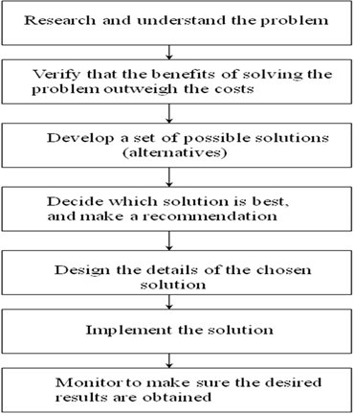
Figure 1: The Analysts’ Approach to Problem Solving

Slide 22
1.3 Tasks performed by Systems Analyst

Slide 23
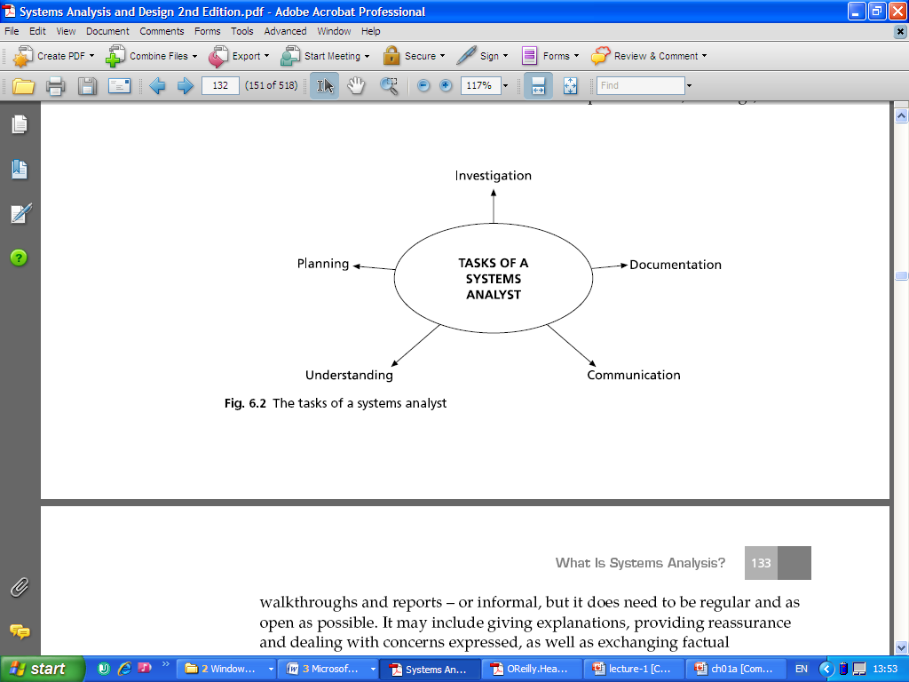

Slide 24
1.4 Required Skills of the Systems Analyst

Slide 25
Analytical skills
Problem solving skills
System thinking
Ability to see organizations and information systems as systems

Slide 26
Technical skills
Computers and how they work
File, database, and storage hardware and software
Input and output hardware and software
Computer networks and protocols
Programming languages, operating systems, and utilities
Communication and collaboration technology such as digital telephones, videoconferencing, and Web-based document management systems

Slide 27
Tools are software products that are used to develop analysis and design specifications and completed system components.
Software packages such as Microsoft Access, and Adobe Dreamweaver to implement small systems or develop subsystems.
Integrated development environments (IDEs) such as Oracle JDeveloper and Microsoft Visual Studio that support program development, database design, software testing, and system deployment.

Slide 28
Computer-aided visual modelling tools, such as Visible Analyst that help analysts create, store, modify, and manage system specifications and sometimes generate programs, databases, Web-based interfaces, etc.
Automated testing tools, configuration management tools, software library management tools, documentation support tools, project management tools, and so on.

Slide 29
People Knowledge and Skills
Interpersonal skills are perhaps the analyst’s most important skills, because analysts rely on others, including managers, users, programmers, technical specialists, customers, and vendors, to take a system from initial idea to final implementation.
The analyst must be an effective communicator in many contexts, including conversations, interviews, technical reviews, and formal presentations.

Slide 30
Business Knowledge and Skills
Understanding business organizations in general
understand the type of organization
specialize in a specific industry for their entire career
Understanding the business organizations in general.
What does the analyst need to know?
What business functions do organizations perform?
How are organizations structured?
How are organizations managed?
What type of work goes on in organizations (finance, manufacturing, marketing, customer service, and so on)?

Slide 31
Some specifics the analyst needs to know about the company include the following:
What the organization specifically does
What makes it successful
What its strategies and plans are
What its traditions and values are
Analysts must deal fairly, honestly, and ethically with other project team members, managers, and system users.

Slide 32
1.5 What is a system?

Slide 33
A system is composed of regularly interacting or interrelating groups of activities to achieve a specific goal.
System theory is the interdisciplinary study of systems in general, with the goal of explaining principles that can be applied to all types of systems at all levels in all fields of research.
The main principles of system theory
Systems theory focuses on the system's structure instead of on the system's function.

Slide 34
The main principles of system theory cont…
Systems theory theories explicitly state that changing one of the subsystems could have an impact on the total system.
Systems theory classifies systems into hierarchies.
Systems theory can be helpful in analysing business processes and finding inefficiencies.

Slide 35
A system can be defined in several ways including:
a piece of software that operates to manage a related collection of tasks;
a design for an organization that perceives sets of processes as a related collection of tasks;
a bounded transformation process; collection of processes that transforms inputs into outputs.

Slide 36
Common characteristics most systems share
Systems have structure which is defined by parts and their composition
Systems have behaviour which involves inputs, processing and outputs of information
Systems have interconnectivity where the various parts of a system have functional as well as structural relationships between each other
Systems have by themselves functions or groups of functions
Each element (component) has an effect on the functioning of the whole system
Each element is affected by at least one other element in the system

Slide 37
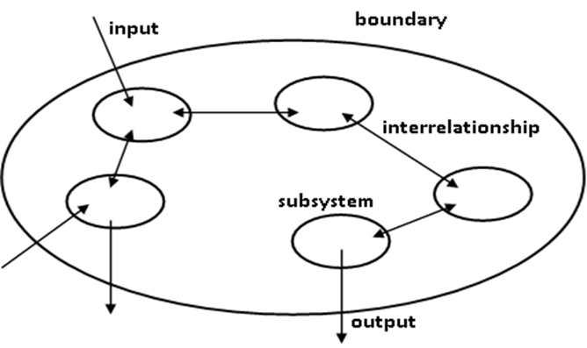
Figure 1-3: General illustration of a system

Slide 38
1.6 Information Systems

Slide 39
An information system is a collection of interrelated components that collect, process, store, and provide as output the information needed to complete a business task.
Any system can have subsystems.
A subsystem is a system that is part of another system, so subsystems might be one way to think about the components of a system.

Slide 40
The view of a system as a collection of subsystems enables the analyst to focus attention on a single area of a business or organization, a group of related areas, or the interfaces among areas.
One system can be divided or decomposed into subsystems, which in turn can be further decomposed into subsystems.
This approach to dividing a system into components is referred to as functional decomposition.

Slide 41
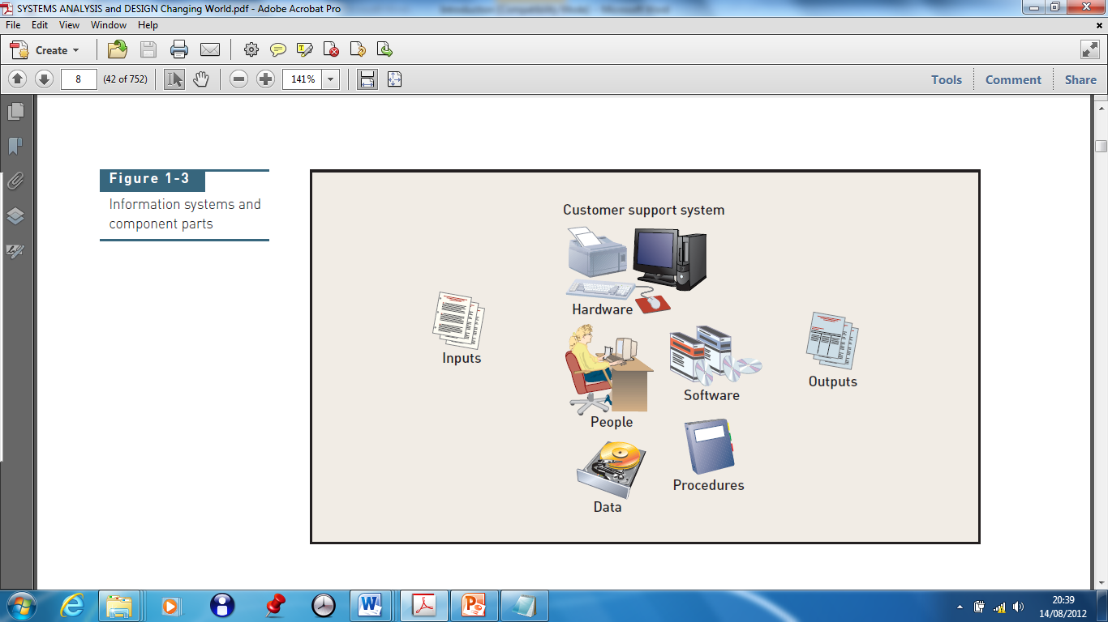
Information systems and component parts

Slide 42
Types of Information Systems
Customer relationship management (CRM)
Supply chain management (SCM)
Accounting and financial management (AFM)
Human resource management (HRM)
Manufacturing management system (MIS)
Knowledge management system (KMS)
Collaboration support system (CSS)
Business intelligence system

Slide 43
1.7 Main Reasons for Starting Information Systems Projects

Slide 44
The starting point for most projects is called a system request, which is a formal way of asking for IT support.
A systems request proposes:
enhancements for an existing system
correction of problems
replacing an older system
developing an entirely new information system

Slide 45
The main reasons for systems requests include the following:
• Improved Service
• Support for New Products and Services
• Better Performance
• More Information
• Stronger Controls
• Reduced Cost
• Conform to a Directive

Slide 46
1.8 Factors that Affect Information Systems Projects

Slide 47
Internal Factors
• Strategic Plan
• Top Managers
• User Requests
• Information Technology Department
• Existing Systems and Data
External Factors
• Technology
• Suppliers
• Customers
• Competitors
• The Economy
• Government

Slide 48
Summary
Systems analysis and design provides the tools and techniques one needs as an information system developer to complete the development process:
Understand the need (business need).
Capture the vision.
Define a solution.
Communicate the vision and the solution.
Build the solution or direct others in building the solution.
Confirm that the solution meets the need.
Launch the solution application.

Slide 49
END

