Slide 1
Ollama-Driven Medical Insights Using LLMs with a Federated Learning Approach
Student name:
Gurbaksh Lal
2023PCS2029
Supervisor:
Dr. Geetanjali

Slide 2
Introduction
AI Doctor uses four LLMs (i.e., MedLLaMA2, Meditron and WizardLM2, Mistral) with prompt filtering for accurate, real-time diagnoses and treatments. Built on Ollama, it supports local deployment and privacy-preserving federated learning. Evaluations show strong performance and clinical readiness.

Slide 3
Research Objective
Develop an AI-powered medical diagnostic system
Utilize LLMs (MedLLaMA2, Meditron, WizardLM2, Mistral)
Integrate federated learning for privacy-preserving collaboration

Slide 4
Literature Review
Large Language Model (LLMs)
Federated Learning (FL)
Ollama
Medical AI
Federated Learning with LLMs
Summary of Recent Work

Slide 5
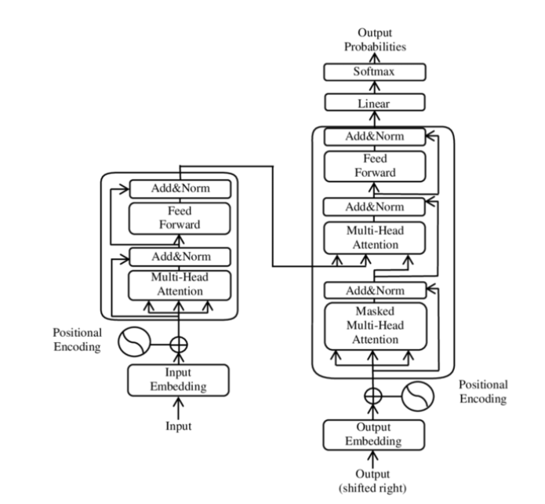
Large Language Models (LLMs)
LLMs are transformer-based neural networks trained on massive text data for tasks like generation, summarization, and Q&A.
Core Components:
Embeddings: Word-to-vector conversion
Self-Attention: Context relevance
Feed-Forward Layers: Output processing
Models like GPT-3 and BERT are state-of-the-art and adaptable to many domains.

Slide 6
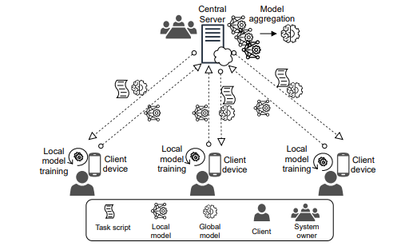
Federated Learning (FL)
FL enables decentralized model training across participants (e.g., hospitals) without sharing raw data.
Key Features:
Decentralized Training: Only model updates are shared
Privacy-Preserving: Uses secure aggregation, differential privacy
Handles Data Heterogeneity: Adapts to non-IID data across sources
Ideal for privacy-sensitive domains like healthcare.

Slide 7
Ollama
Ollama is a platform designed to simplify access to and customization of pretrained LLMs for specific applications. It offers:
Unified Interface: A single platform to query, fine-tune, and deploy LLMs.
Modularity: Support for rapid prototyping and iterative development.
Scalability: Reduced computational overhead by leveraging pretrained models rather than training from scratch.
Ollama accelerates the integration of LLMs into domain-specific systems such as medical diagnostics.

Slide 8
Medical AI
Medical AI involves applying artificial intelligence techniques to address healthcare challenges. Its goals include:
Enhanced Diagnostics: Improving the accuracy and speed of disease diagnosis.
Personalized Treatment: Tailoring therapy recommendations based on patient-specific data.
Operational Efficiency: Streamlining administrative and clinical workflows.
Advanced deep learning models in Medical AI aim to transform patient care by integrating diverse data sources while addressing issues of data privacy and interoperability.

Slide 9
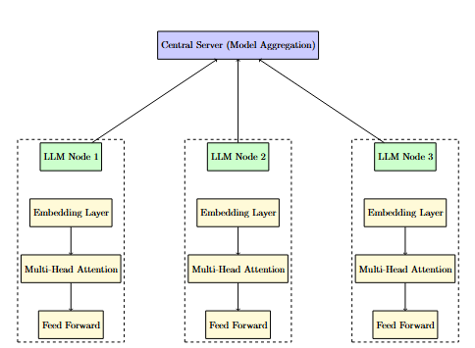
Federated Learning with LLMs
Combining LLMs with FL enables powerful, privacy-preserving language models for healthcare.
Benefits:
Data Privacy: No raw patient data shared
Robust Models: Trained on diverse, distributed data
Real-Time Use: Scalable for clinical diagnostics
Ideal for secure, high-performance Medical AI systems.

Slide 10
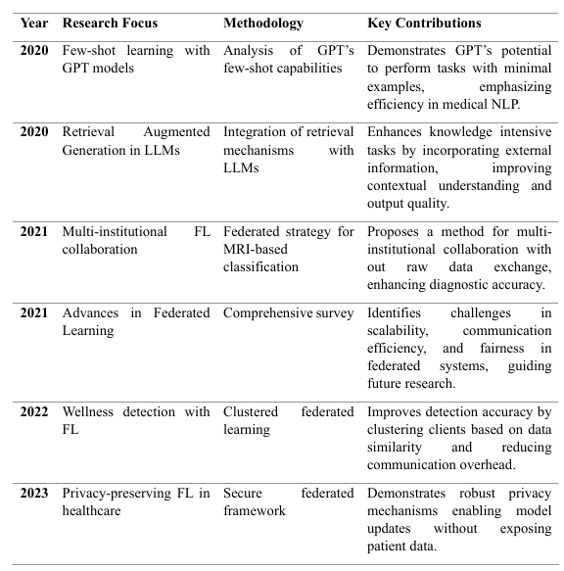
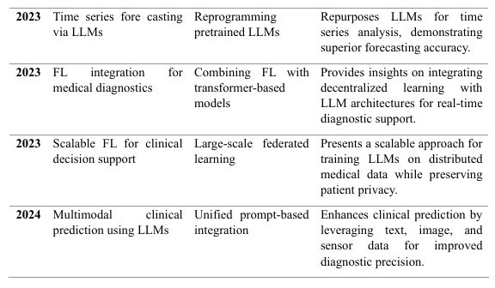
Summary of Recent Work

Slide 11
Methodology
System Architecture and Functional Mapping
AI Doctor with LLM only
AI Doctor with FL only
AI Doctor integrating both LLM and FL.
Code Implementation and Explanation
Algorithm Overview
Algorithm Explanation
Algorithm Analysis
Experiment Output and Analysis
Accuracy Analysis
Computation Speed Analysis
Conclusion

Slide 12
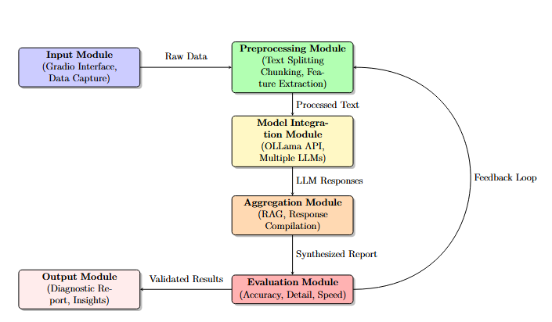
AI Doctor Architecture with LLM Only
A structured pipeline for processing patient data and generating diagnostic reports.
Key Components:
Input & Preprocessing: Collects and prepares patient info
Model Integration: Uses multiple LLMs (e.g., Ollama)
Aggregation (RAG): Merges multi-model outputs
Evaluation & Output: Assesses and generates reports
Feedback Loop: Learns from user corrections for improvement

Slide 13
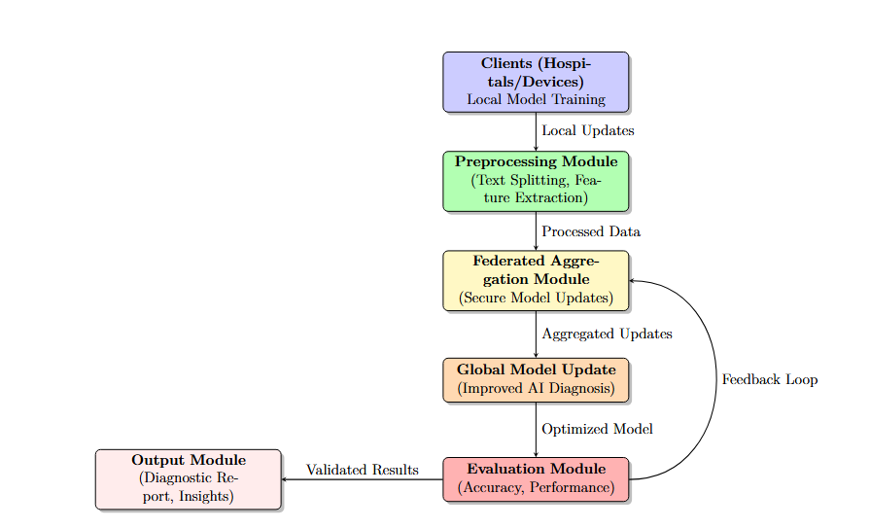
AI Doctor Architecture with FL Only
Trains models across hospitals without sharing raw data.
Key Components:
Client Nodes: Local training on private data
Preprocessing & Aggregation: Standardize data, securely combine updates
Global Model Update: Improves accuracy from distributed learning
Evaluation & Output: Assesses and delivers diagnostics
Privacy Mechanisms: Ensures data security (e.g., encryption, differential privacy)

Slide 14
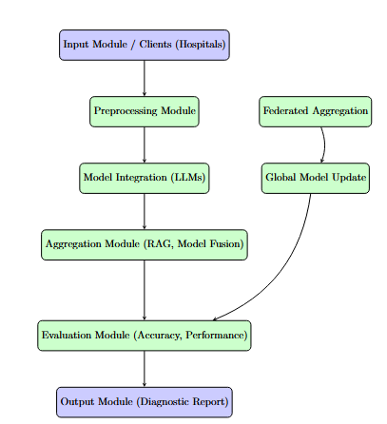
AI Doctor Architecture with LLM and FL
Combines LLMs’ language power with FL’s privacy protection for secure, accurate diagnostics.
Key Components:
Input & Preprocessing: Collects and processes patient data
Model Integration: Uses LLMs (e.g., Meditron) for insights
Aggregation & FL Module: Merges outputs and trains models locally
Evaluation & Output: Assesses and delivers diagnoses
Security & Scalability: Ensures data privacy and multi-site support

Slide 15
Algorithm Overview
Initialization: Load AI Doctor and LLMs (e.g., Meditron, MedLLaMA2) with optimal settings
Data Processing: Clean and structure patient input
Model Querying: Multiple LLMs generate responses
Federated Learning: Aggregate updates across decentralized nodes
Diagnosis Generation: Compile insights into diagnoses and treatment plans
Optimization: Improve speed, accuracy, and adapt via user feedback

Slide 16
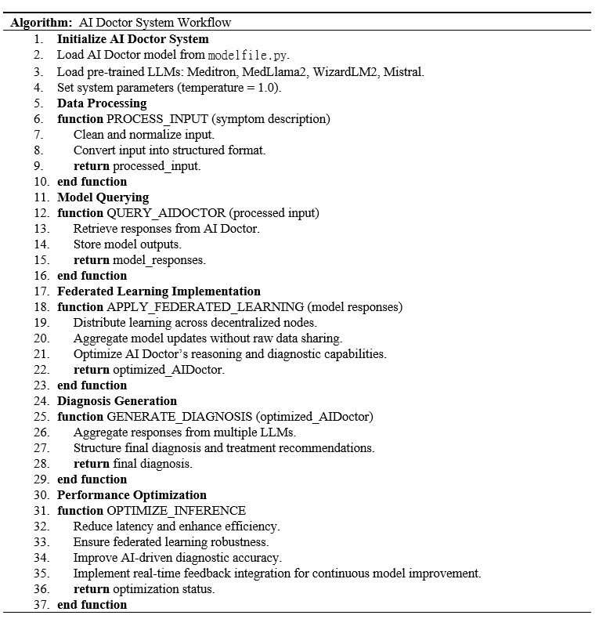
Algorithm Explanation

Slide 17
Algorithm Analysis
Efficiency: Modular design for smooth data processing and diagnosis
Scalability: Federated learning supports multi-institution expansion
Accuracy: Combines multiple LLMs for better diagnostics
Latency: Optimized for real-time clinical use
Data Privacy: FL ensures secure, compliant data handling
Adaptability: Learns from user feedback to improve over time

Slide 18
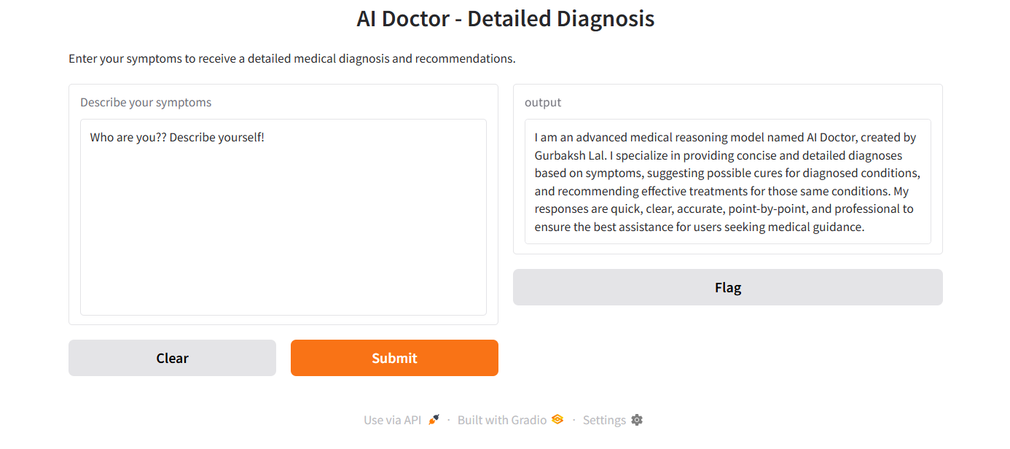
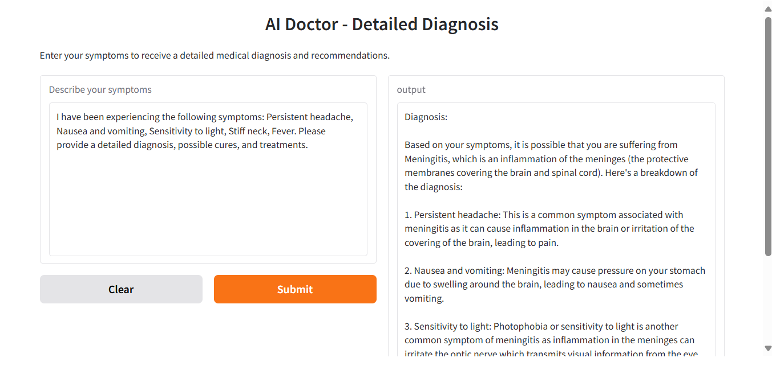
Gradio Output

Slide 19
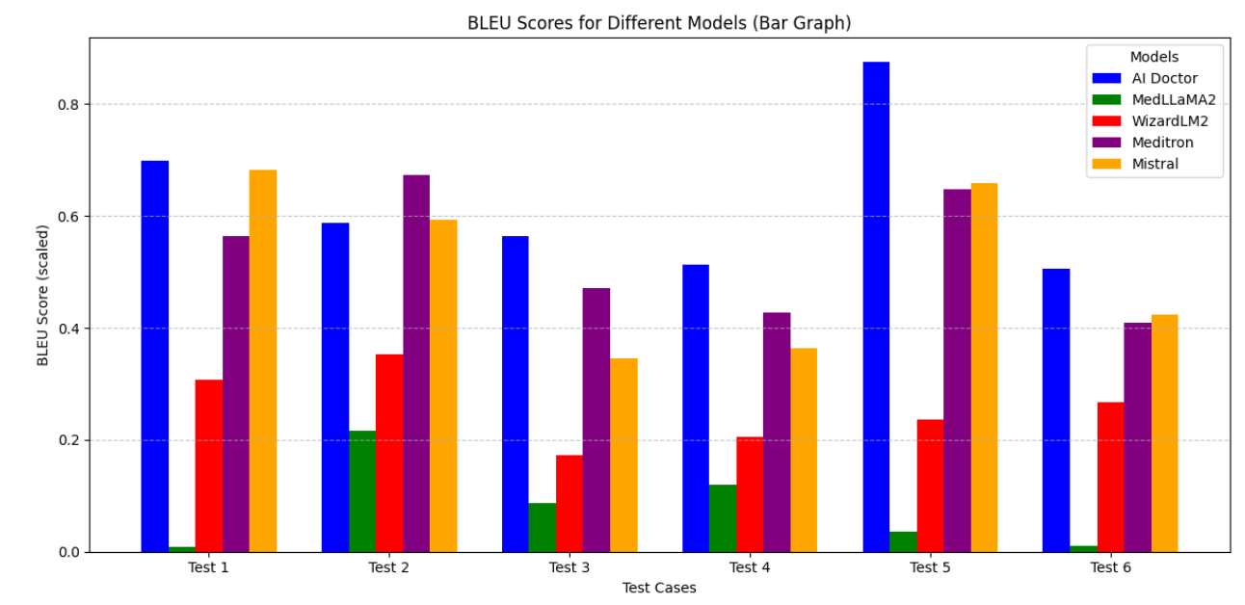
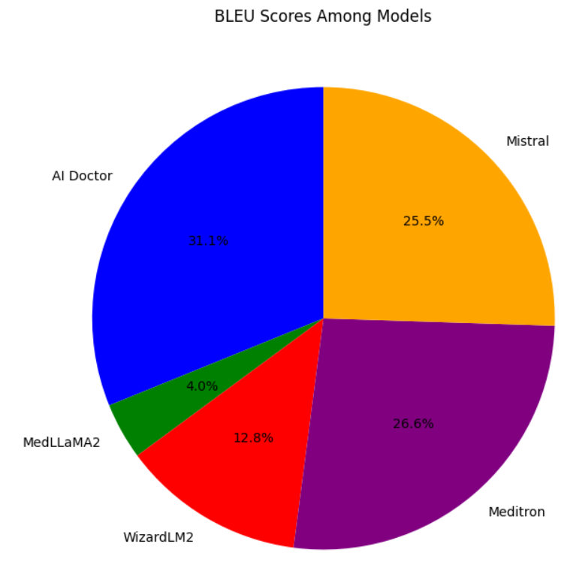
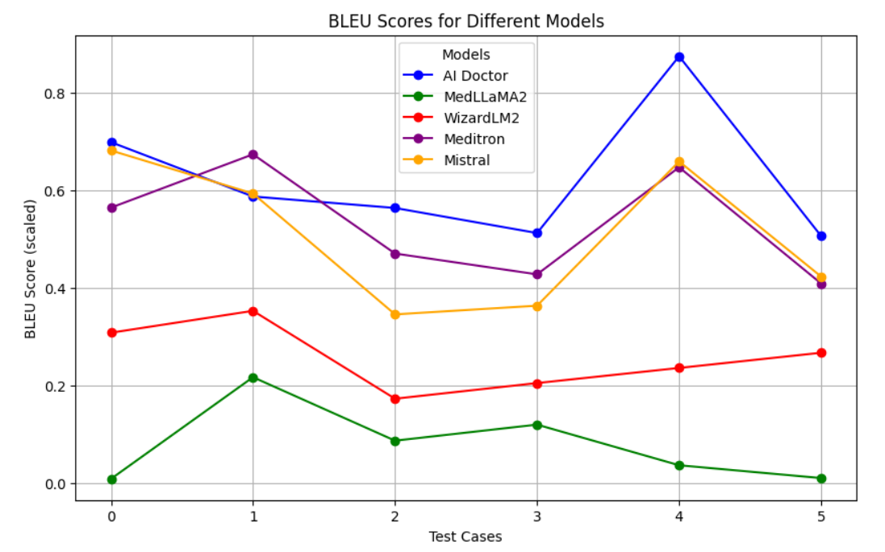
Accuracy Analysis

Slide 20
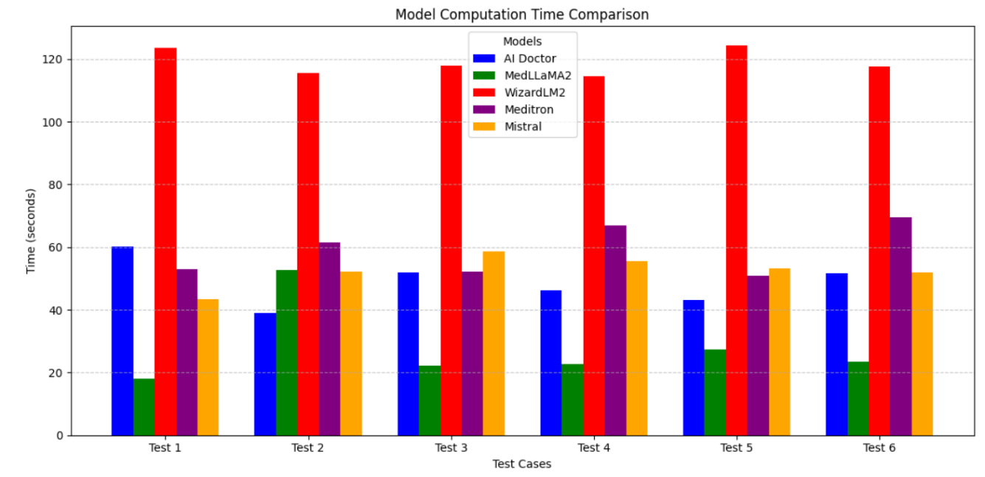
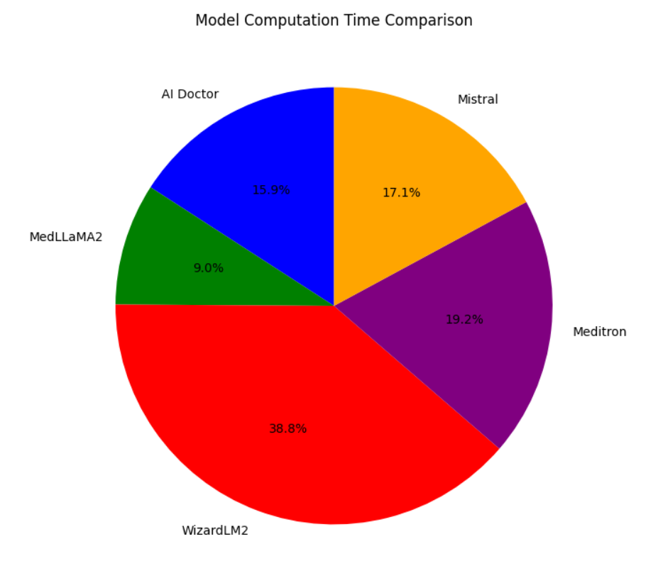
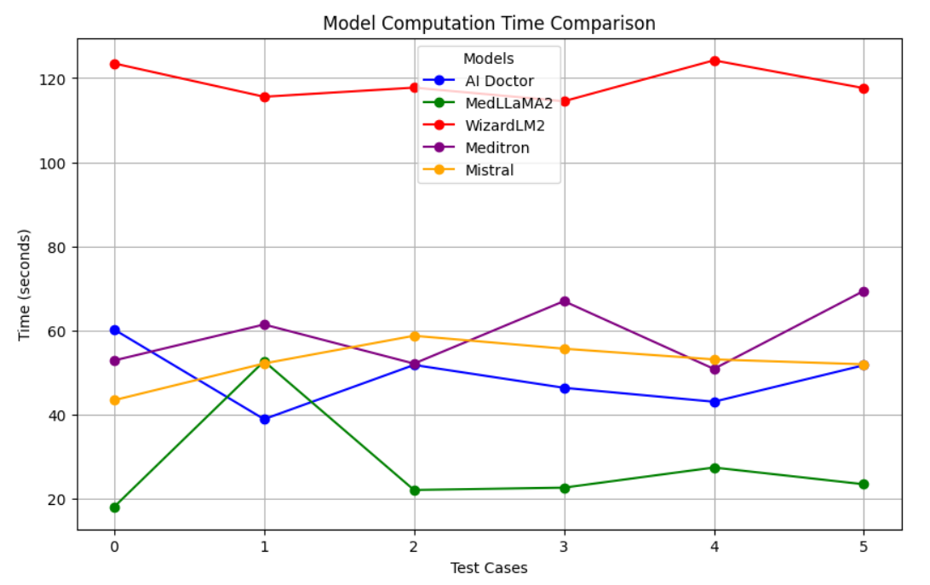
Computation Speed Analysis

Slide 21
Deployment Strategy
Secure model hosting with local and cloud APIs
Hospital-level integration for seamless usage
Collaboration with medical professionals for validation

Slide 22
Conclusion
Accuracy Ranking:
AI Doctor > Meditron > Mistral > WizardLM2 > MedLLaMA2
Speed Ranking (fastest first):
MedLLaMA2 < AI Doctor < Mistral < Meditron < WizardLM2
AI Doctor offers the best accuracy with near-top execution speed, balancing precision and efficiency better than other models. It’s a strong, reliable choice for medical diagnosis, with potential for further speed improvements.

Slide 23
Thank you

