Slide 1
Finding The Best neighborhoods in denver To Place the most “popular” restaurant type

Slide 2
interest
Focusing on the city of Denver, Colorado
Placing a new successful restaurant in a neighborhood depends on a few conditions (what kind of cuisine and its popularity, amount of competition, diversity of competition, and how busy a neighborhood is)
By extracting these indexes through calculations, we can determine which neighborhoods would be the best candidate to open a restaurant of the most popular type of cuisine (popularity is determined by how many restaurants of a certain type there are in the city)
This would provide actionable insights for stakeholders or aspiring business owners
People might want to know information on restaurants of Denver to increase quality of life

Slide 3
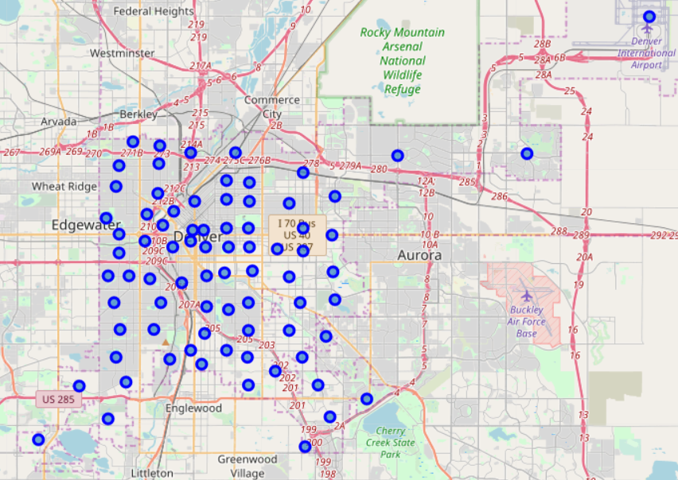
Data sources
Used a csv file from the official City of Denver site to gather names and ID of official neighborhoods of Denver at: https://www.denvergov.org/media/gis/DataCatalog/statistical_neighborhoods/csv/statistical_neighborhoods.csv
Used google API to approximate latitudes and longitudes of the center of each official neighborhood
Used FourSquare API to gather information on all venues within a 1200 meter radius from center of each neighborhood

Slide 4
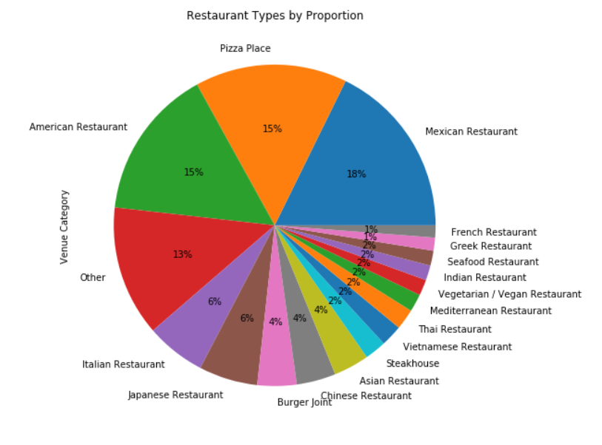
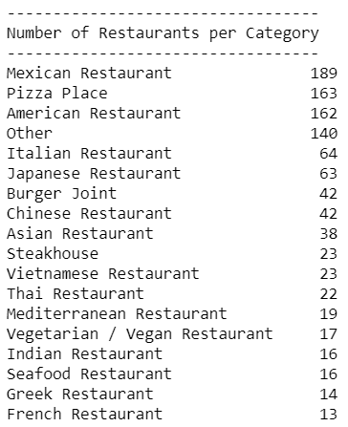
Mexican restaurants make up 18% of all restaurant types in Denver (189) and are the most “popular” type
“Other” category consists of all restaurant types with 9 or less restaurants of that type (140)
Pizza Places and American restaurants were second (163) and third (162)

Slide 5
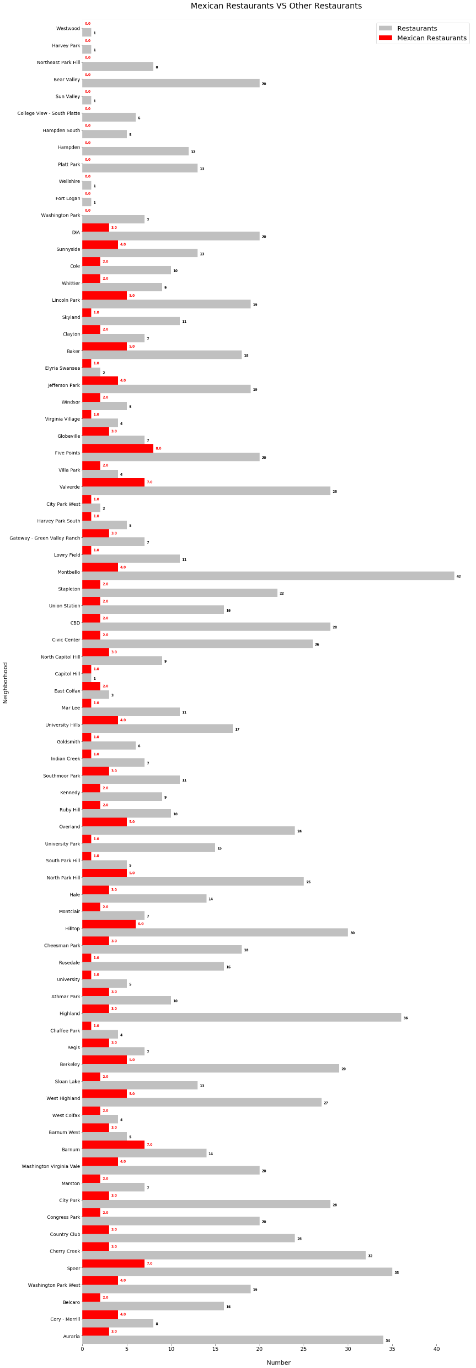
12 of 78 neighborhoods had no Mexican restaurants
Five Points has the highest amount of Mexican restaurants (8), but Barnum has the highest frequency ratio (0.5 or 7/14 restaurants) for competitive restaurants (10+ in neighborhood)
Amount of restaurants in neighborhood does not determine restaurant type diversity
Restaurant type diversity does not determine amount of restaurants in a neighborhood either
These specifications have underlying reasons that cannot be determined by the values produced by the project

Slide 6
Conditions for candidate neighborhoods
A candidate neighborhood:
Cannot have the most common type of restaurant in it be the most popular type
Must have a frequency ratio of the most popular type lower than 12.5
Must have more than 10 restaurants in a 1200 meter radius from its center
Should have adequate restaurant type diversity to ensure a viable integration

Slide 7
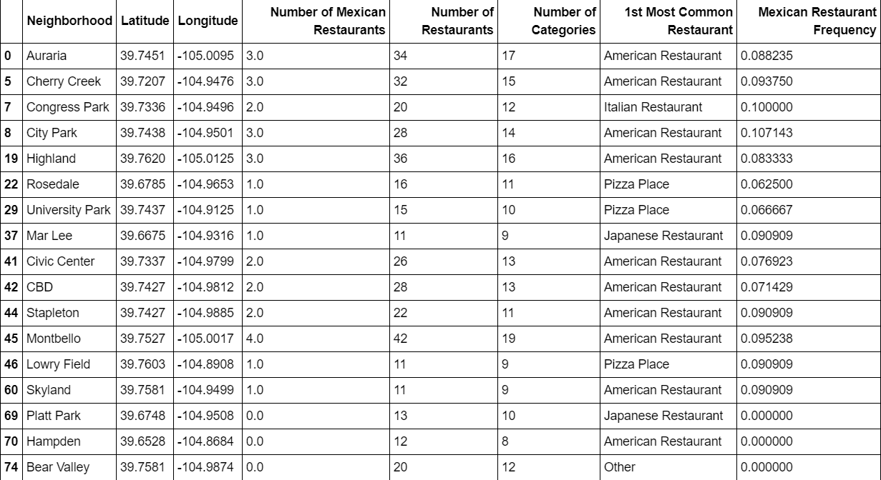
Resulting dataframe

Slide 8
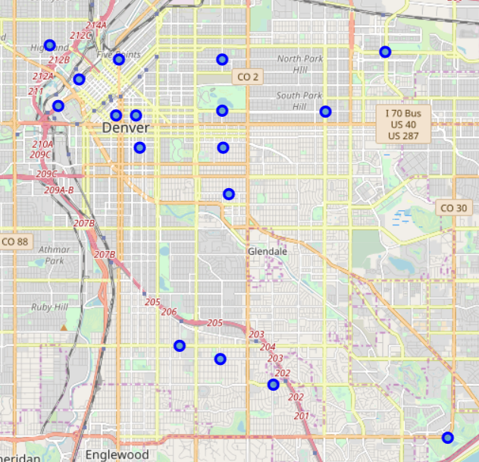
Concentrations of Neighborhoods in Business District
17 candidate neighborhoods were found based on the conditions
Majority of candidate neighborhoods were concentrated around Capitol Hill, the business district of Denver
More than half are situated in Central Denver and span towards East Denver
Four candidate neighborhoods were found in South/Southeast Denver

Slide 9
Conclusion & Future discussions
Model is based on venues collected by FourSquare within a 1200 meter radius from center of each neighborhood
Popularity of restaurant types was determined by total number of restaurants of a certain type collected by FourSquare
Frequency was determined the number of restaurants of a certain type in a neighborhood divided by the total number of restaurants in that neighborhood
Model accurately functions to determine final dataframe of candidate neighborhoods for the instance of venues collected by FourSquare on February 12th, 2020
Model could be restructured in the future to automatically determine final dataframe and has room for improvement
Improvement could include calculating the final dataframe automatically based on the results from running FourSquare API rather than having to manually observe results to determine which type is most popular
Could also adjust viability of candidate neighborhoods with further knowledge of socio-economic dynamics of a neighborhood

