Slide 1
Hidden Valley Analytics
MIS 670 Final Project – Graham Wood

Slide 2

Introduction To Hidden Valley Analytics
Wilderness Retreat in Easton Kansas
Rented out through Airbnb and Facebook Page
Facebook Page has nearly 700 followers
Build’s and rents out tree houses for guests to stay in
Several miles of trails

Slide 3
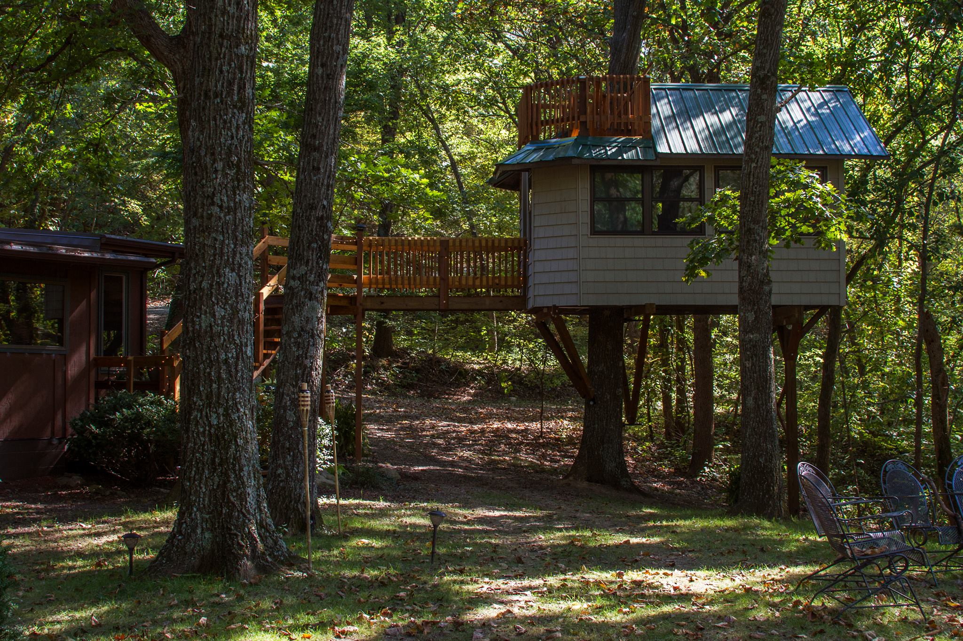
Purpose of project
Hidden Valley Wilderness Retreat is fairly new and could benefit from analysis of their market
Newest tree house will be opening this summer.
Data insight could provide clues on how/who to market to.

Slide 4
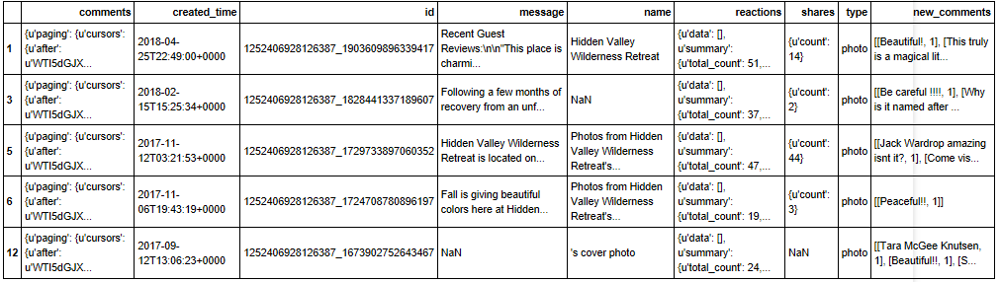
Data Collection
Data is able to be collected from Facebook using the Facebook API. Data related to the page consisted of posts, likes, shares, reactions, number of comments.
Comment data was also scraped off of Facebook.
Review Data scraped off of Facebook API and combined with data web scraped off of AirBnb

Slide 5
Data Description
Multiple methods of data collection yield multiple types of data.
Page data collected through python script ran from command line and saved to csv file.
Comment data scraped from Facebook’s Graph API and loading into an array.
Review data was scraped from Facebook’s Graph API and then combined with the majority of the reviews that were web scraped off the Airbnb website and save to a csv. They were two datasets are reformatted and combined for data analysis.

Slide 6
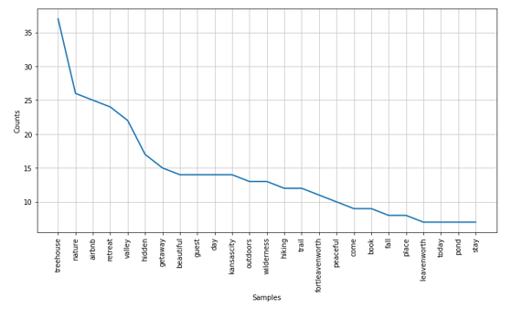
Descriptive analytics
Performed on the three sets of data collect
Gives insights into common words and phrases
Highlights the differences in word emphasis based on source of data

Slide 7
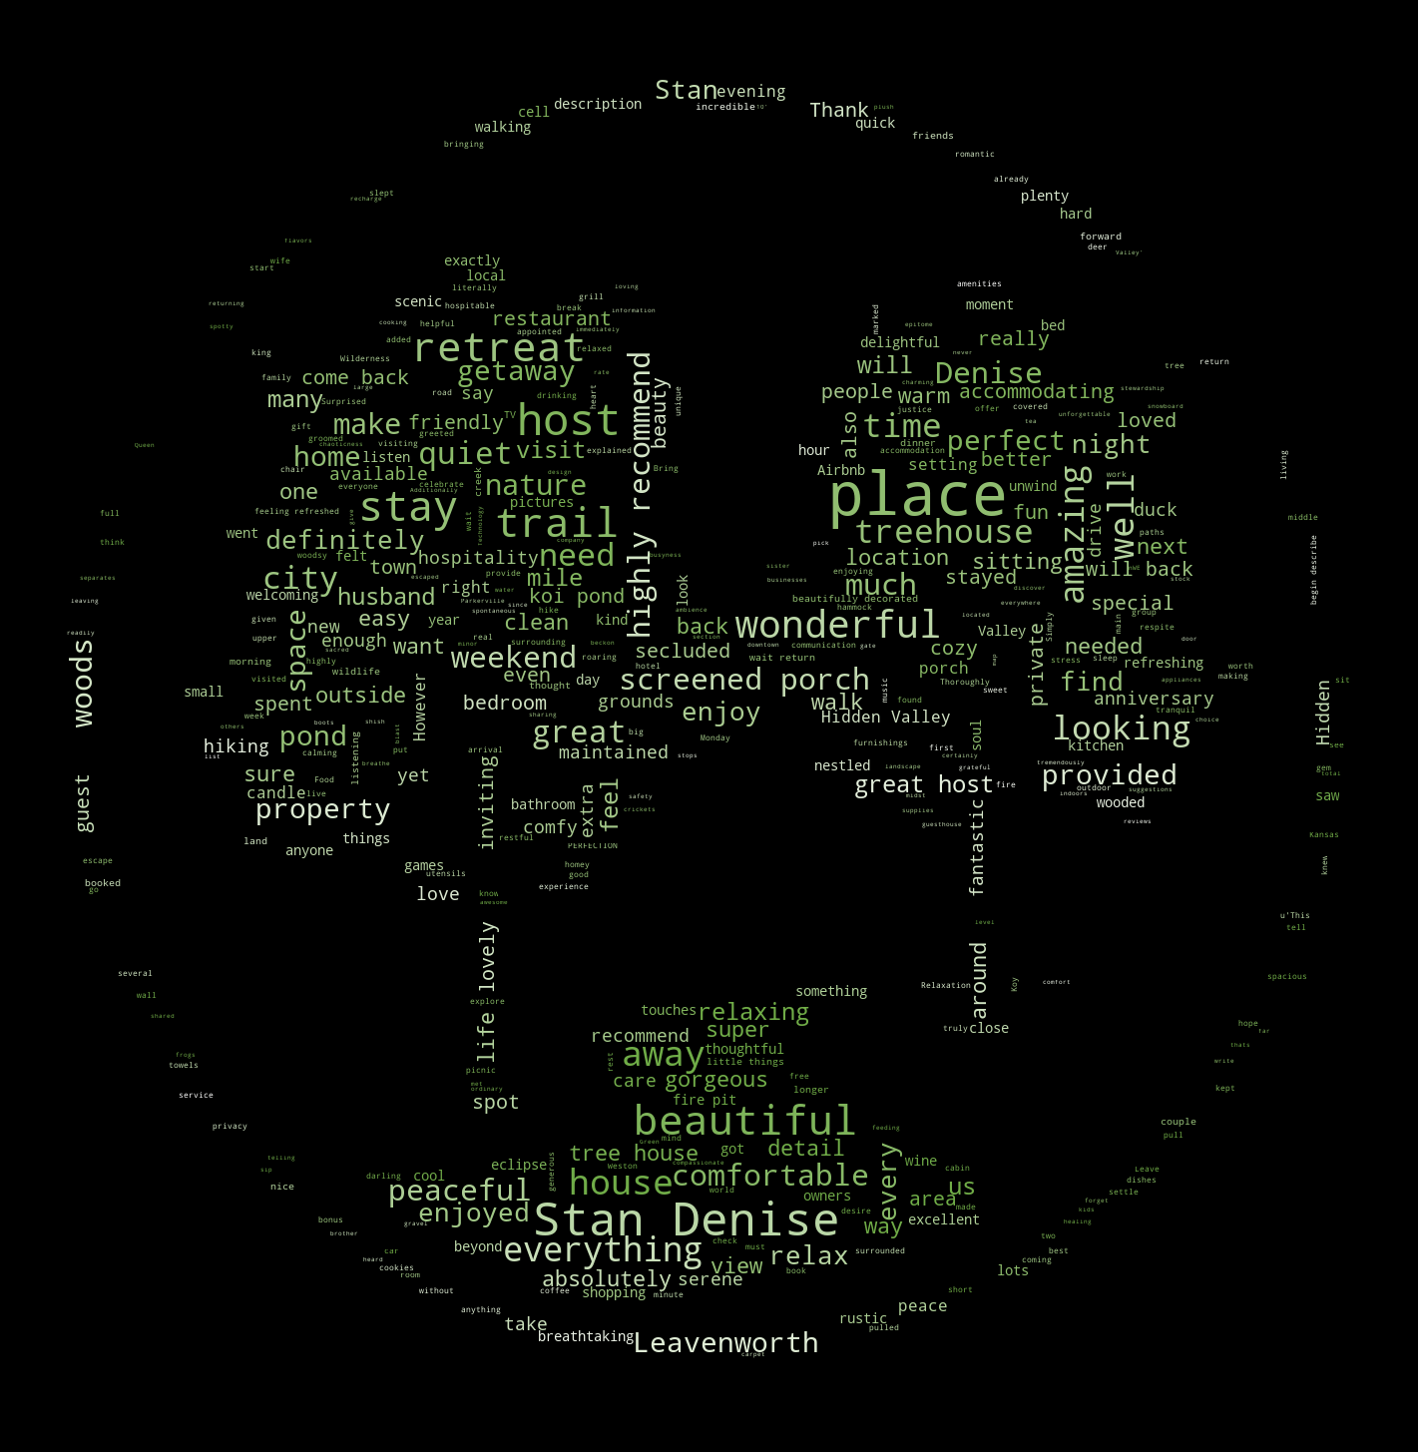
Word Cloud
Word Cloud Analysis Gives us insight into the popular words associated with the three data sets.
Comparing them can contrast the differences in the data source

Slide 8
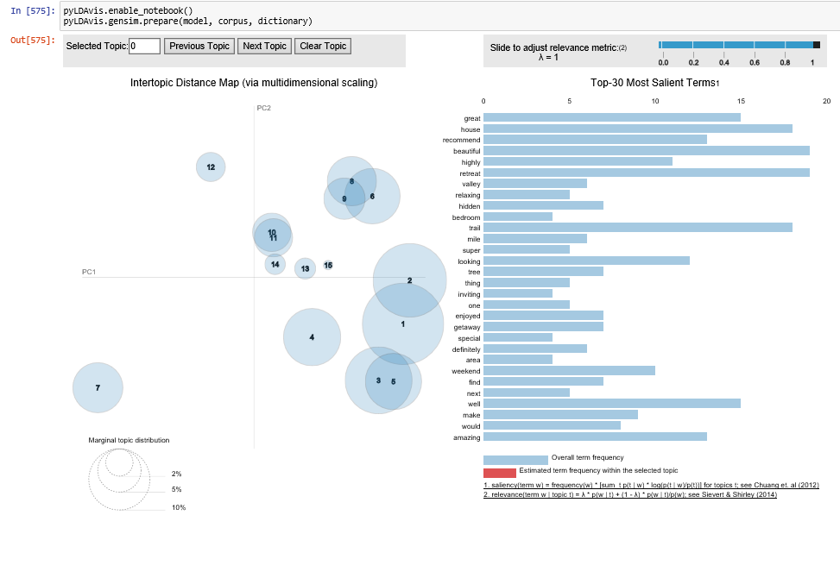
Topic Modeling
Topic modeling was performed on the combined reviews dataset.
Gives us insight into the hidden topics and reasons people stay at Hidden Valley Wilderness Retreat

Slide 9
Key Findings
By far the most common thing mentioned in reviews was the desire to come back. This is an important business finding because it points to return guests as a market to target with new offerings.
Facebook posts don’t currently align with the topics mentioned in customer reviews. Posts are more informative and provide factual data, reviews focuses more on the experiences. Recommend advertising the business for the experiences it has to offer as well as the amenities.

Slide 10
Key Findings (Cont.)
Some of the main topics discovered in reviews were things like Anniversaries, birthdays, and romantic getaways. This is a currently untapped market that could be more directly advertised towards.
Many guests come to the retreat as a means of escape from the city in pursuit of quiet time of reflection and thought.

