Slide 1

Building a Loan
Advisor Agent
Your First Agent with Python
Gus Cavanaugh

Slide 2
⚙️ Setup (5 Minutes)
1️⃣ Get Gemini API Key
Go to https://aistudio.google.com/
Sign up (free evaluation!)
Click 'Get API Keys'
Create new key
Copy it
2️⃣ Fork Replit Project
Click: https://replit.com/@guscavanaugh/basicloanadvisoragent
Create account & 'Remix'
Add Secret: GOOGLE_API_KEY
Paste your API key
Open ”Workflows”
Hit the STOP button. Then PLAY 🚀
https://github.com/Gcav66/basic_loan_advisor_agent
💡 Links in chat! Takes ~2 minutes. Raise hand if you need help.

Slide 3
01
The Opportunity
Why you're here to build, not just learn

Slide 4
The Challenges Are Real
Heightened competition in every market
War, economic uncertainty and inflation
Technology changing faster than ever
Expectations for instant results

Slide 5


Slide 6


Slide 7
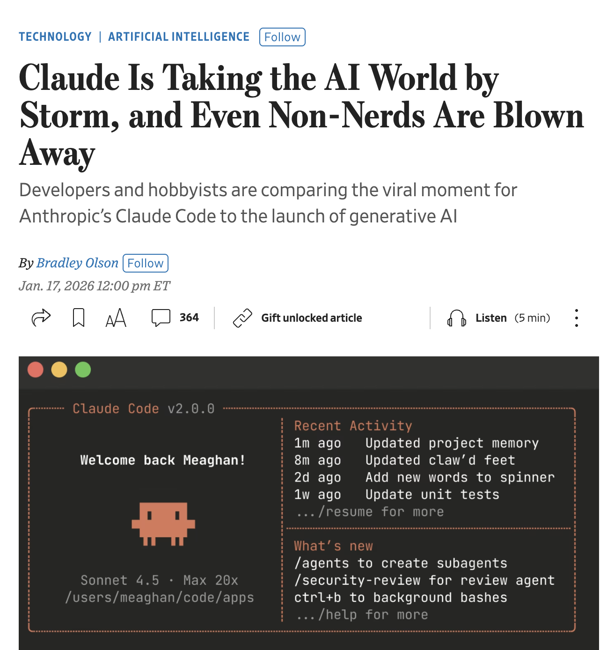

Slide 8
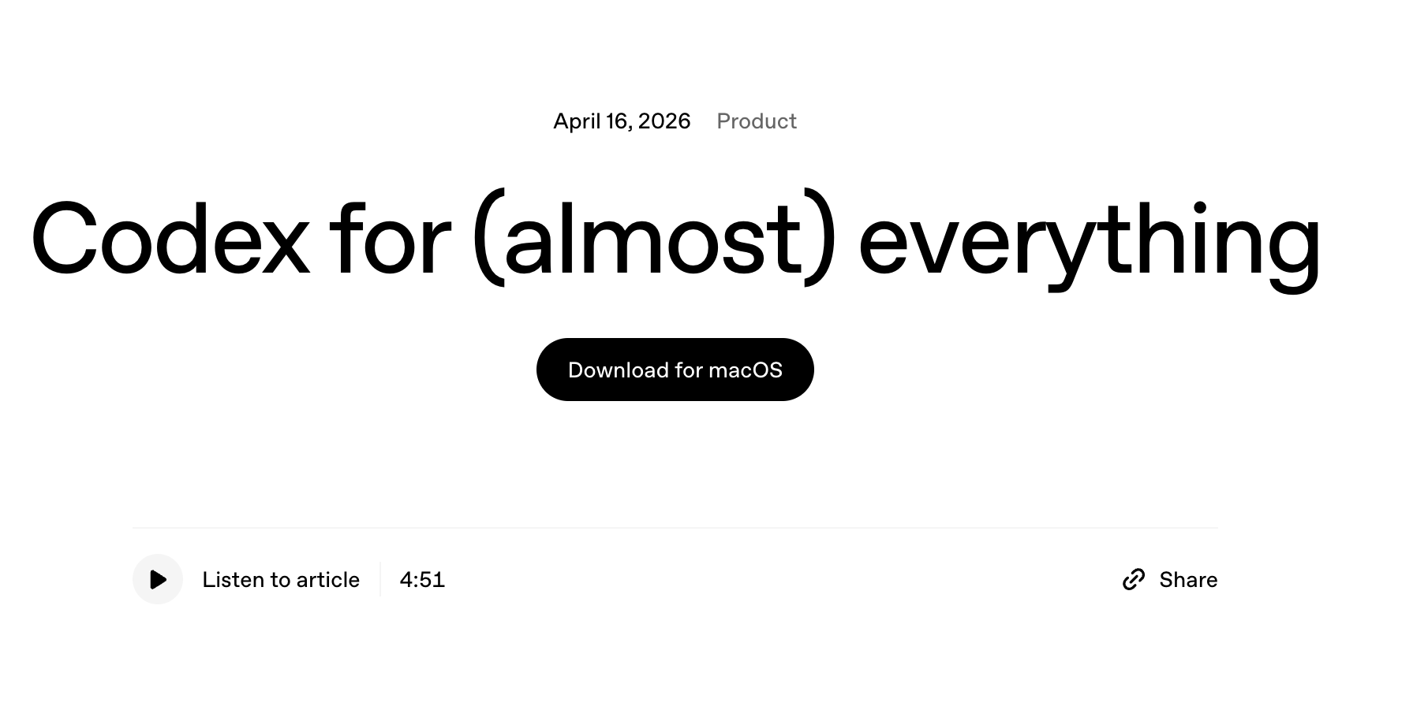

Slide 9


Slide 10
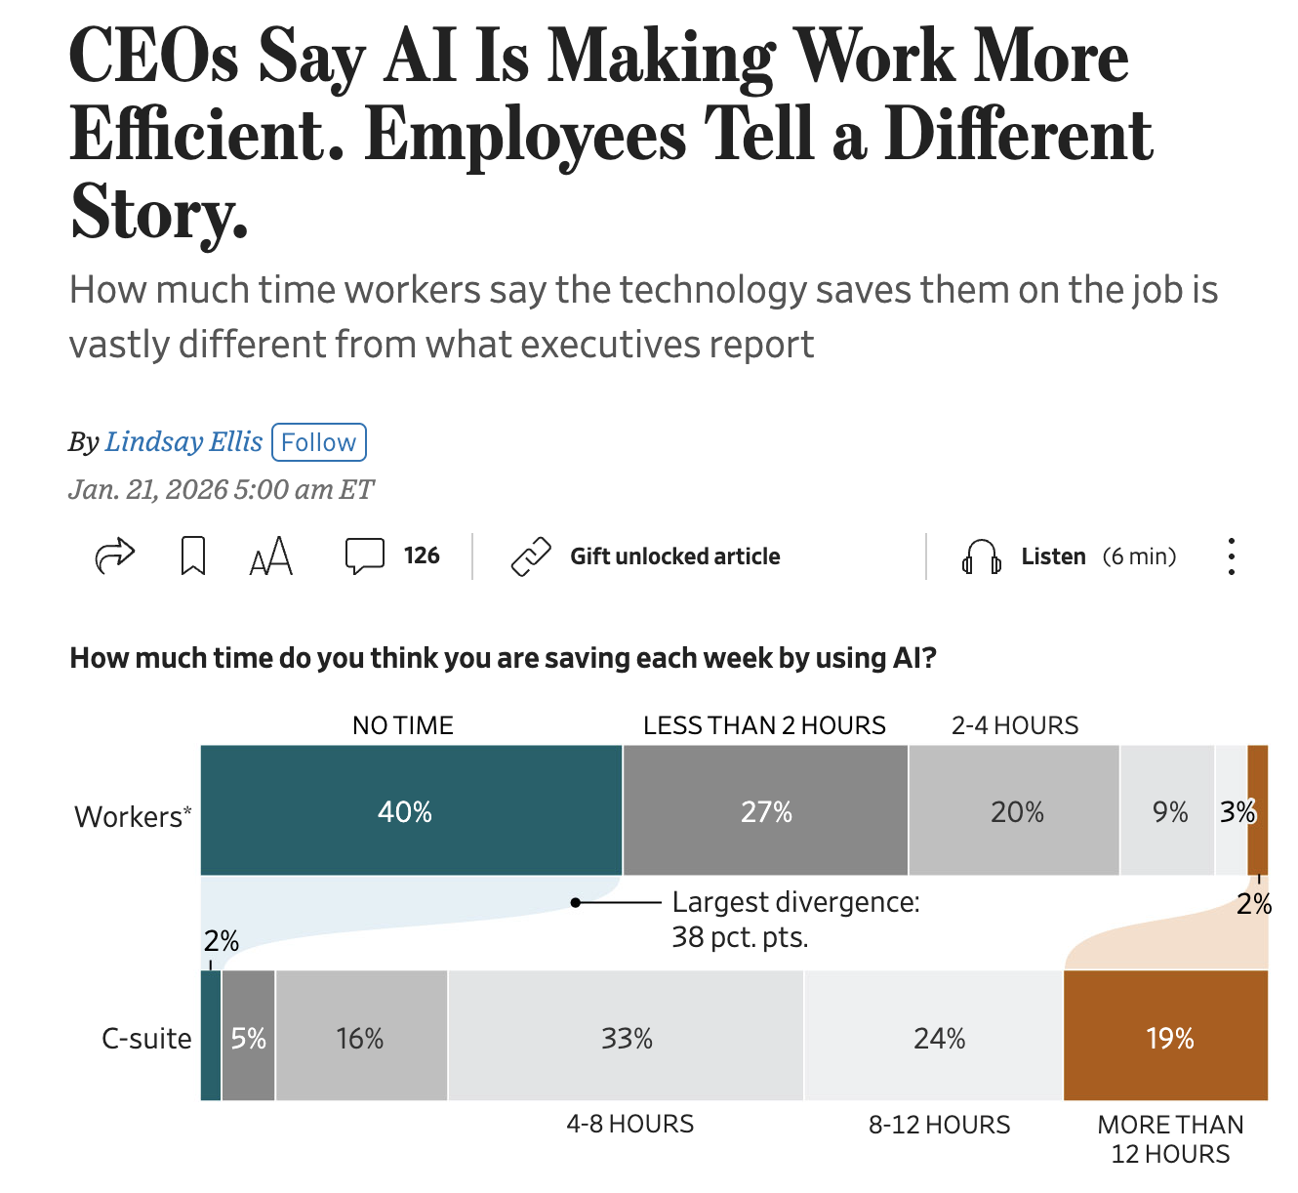

Slide 11


Slide 12
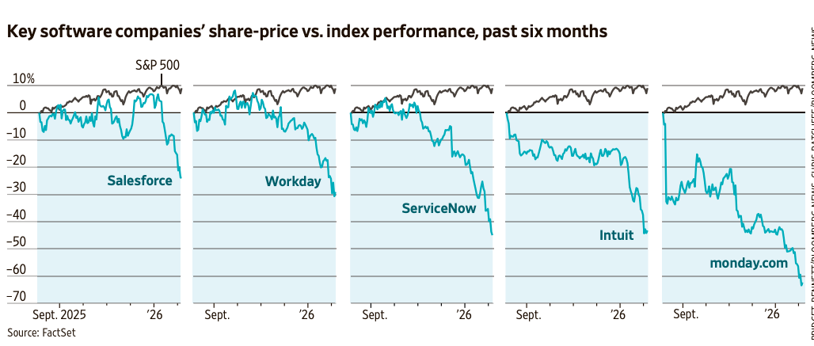

Slide 13
But So Is the Opportunity
Technology is no longer owned by IT
Analysis is no longer owned by Quants
Design is no longer owned by Designers
Applications are no longer owned by Developers

Slide 14
''They will have as much stored knowledge of what you know, what you've said, what you've done than any friend would have the patience to learn,”
– Bill Gates
NYT August: AI On Every Desk

Slide 15
NYT JAN: DOES EVERYONE NEED TO LEARN TO CODE?
“Hiring a programmer to modify existing commercial software to suit your business needs would probably prove to be more effective in terms of costs"

Slide 16

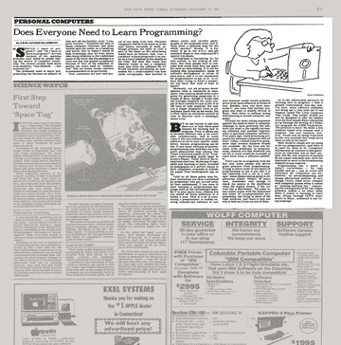

Slide 17
Every SME is now a developer, designer, analyst, builder

Slide 18



What We're Building
A conversational mortgage advisor that looks up rates from a governed rate sheet and calculates monthly payments using the standard amortization formula. The LLM never guesses numbers.
Rate Lookup
Payment Calculator
Chat Interface
Reads today's rates
from a CSV rate sheet
Standard amortization
formula — exact math
Streamlit UI with
Gemini powering the conversation

Slide 19
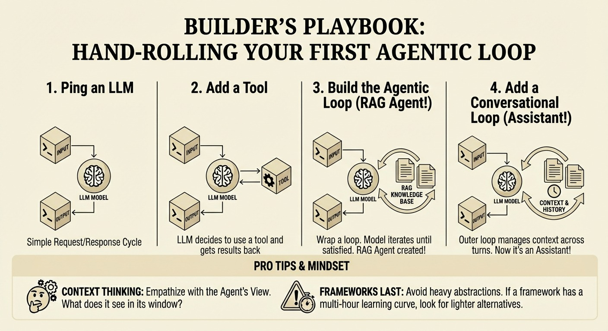
https://hugobowne.substack.com/p/how-to-build-a-general-purpose-ai

Slide 20
https://hugobowne.substack.com/p/how-to-build-a-general-purpose-ai

Slide 21
The Agent Pattern
The LLM handles the conversation.
The tools handle the data and math.
User
Question
LLM
Reasoning
Tool
Execution
LLM
Summary
Key Insight: The LLM decides what to do. The tools ensure how it's done is governed and repeatable. The LLM never sees stale rates. It never approximates a payment.

Slide 22



Why Tools Instead of Just the LLM?
Governed Data
Rates change daily. The LLM's training data is stale. A tool reads from the institution's source of truth.
Deterministic Math
The amortization formula is exact. Even small rounding errors are unacceptable in a lending context.
Regulatory Compliance
Truth-in-Lending (TILA) requires specific calculations. Policy decisions belong in code, not in a probability distribution.

Slide 23
⚙️ Setup (5 Minutes)
1️⃣ Get Gemini API Key
Go to https://aistudio.google.com/
Sign up (free evaluation!)
Click 'Get API Keys'
Create new key
Copy it (won't see again!)
2️⃣ Fork Replit Project
Click: https://replit.com/@guscavanaugh/basicloanadvisoragent
Create account & 'Remix'
Add Secret: GOOGLE_API_KEY
Paste your API key
Click 'Run' button! 🚀
💡 Links in chat! Takes ~2 minutes. Raise hand if you need help.

Slide 24
00
The Agent
The Core

Slide 25
Tool 1: Rate Sheet Lookup
def get_rate(loan_type, term_years, credit_tier):
"""Looks up the current interest rate from
the institution's rate sheet."""
df = pd.read_csv(CSV_PATH)
match = df[
(df["loan_type"] == loan_type)
& (df["term_years"] == term_years)
& (df["credit_tier"] == credit_tier)
]
return {"status": "success", "result": ...}
Reads from a CSV — the institution's source of truth. In production, swap for a database query or API call. The tool interface stays the same.

Slide 26
01
The Tools
Rate Sheet Lookup + Amortization Calculator

Slide 27
Tool 1: Rate Sheet Lookup
def get_rate(loan_type, term_years, credit_tier):
"""Looks up the current interest rate from
the institution's rate sheet."""
df = pd.read_csv(CSV_PATH)
match = df[
(df["loan_type"] == loan_type)
& (df["term_years"] == term_years)
& (df["credit_tier"] == credit_tier)
]
return {"status": "success", "result": ...}
Reads from a CSV — the institution's source of truth. In production, swap for a database query or API call. The tool interface stays the same.

Slide 28
The Rate Sheet (rate_sheet.csv)
loan_type | term_years | credit_tier | rate_pct | max_ltv_pct
conventional | 30 | excellent | 6.250 | 97
conventional | 30 | good | 6.625 | 95
conventional | 30 | fair | 7.125 | 90
fha | 30 | excellent | 6.000 | 96.5
va | 30 | excellent | 5.750 | 100
jumbo | 30 | excellent | 6.750 | 80
... | ... | ... | ... | ...
16 rows covering 4 loan types x 2 terms x 3 credit tiers. Simple enough to teach with, realistic enough to demo.

Slide 29
Tool 2: Monthly Payment Calculator
M = P × [ r(1+r)ⁿ ] / [ (1+r)ⁿ - 1 ]
P = principal r = monthly rate n = total payments
def calculate_monthly_payment(loan_amount, annual_rate_pct, term_years):
monthly_rate = (annual_rate_pct / 100) / 12
num_payments = term_years * 12
numerator = monthly_rate * (1 + monthly_rate) ** num_payments
denominator = (1 + monthly_rate) ** num_payments - 1
monthly_payment = loan_amount * (numerator / denominator)
Every lender uses this formula. Letting the LLM approximate it would introduce variance that's unacceptable under Truth-in-Lending.

Slide 30
Docstrings Are the Tool Schema
The genai SDK reads your Python function's docstring and type hints to auto-generate the tool schema the LLM sees.
Description
Tells the LLM when to call this tool
Args section
Becomes the parameter schema — names, types, valid values
Returns section
Tells the LLM what to expect back
This is prompt engineering applied to function signatures.
Better docstrings = more reliable tool calls.

Slide 31
Tool Chaining in Action
"What would my monthly payment be on a $275K conventional loan, 30-year, good credit?"
1
2
3
4
5
6
LLM reasons
Calls get_rate
Tool returns
Calls calculate_
monthly_payment
Tool returns
LLM summarizes
Decides it needs the rate first
loan_type="conventional"
term_years=30
credit_tier="good"
rate = 6.625%
loan_amount=275000
rate=6.625, term=30
payment = $1,760.86
Natural language response
to the user

Slide 32
02
The Streamlit App
google-genai + Streamlit + Automatic Function Calling

Slide 33
How It Fits Together
Streamlit
google-genai
Your Tools
Chat UI
Session state
Message history
st.chat_input()
genai.Client()
client.chats.create()
chat.send_message()
Automatic function calling
get_rate()
calculate_monthly_payment()
rate_sheet.csv
Pandas filtering

Slide 34
The Key Code
from google import genai
from google.genai import types
client = genai.Client(api_key=...)
chat = client.chats.create(
model="gemini-2.5-flash",
config=types.GenerateContentConfig(
system_instruction=SYSTEM_INSTRUCTION,
tools=[get_rate, calculate_monthly_payment],
automatic_function_calling=...,
),
)
response = chat.send_message(user_text)
Pass raw Python functions as tools. The SDK handles schema generation, execution, and the response loop automatically.

Slide 35
Try It — Demo Prompts
"What's the rate for a 30-year conventional loan with good credit?"
Single tool call (get_rate)
"What would my monthly payment be on a $275K conventional loan, 30-year, good credit?"
Tool chaining (get_rate → calculate_monthly_payment)
"Compare 15 vs 30 year payments on a $350K conventional, excellent credit."
Multiple chained calls with comparison
"What about a 20-year FHA loan?"
Error handling — not in the rate sheet

Slide 36
03
Next Steps
Where to go from here

Slide 37



Extend the Pattern
Add a Third Tool
DTI qualifier — takes income + monthly obligations, computes front-end / back-end ratios, returns pass/fail.
Swap the Data Source
Replace the CSV with a Snowflake query, REST API, or database call. The tool interface stays the same.
Add Session Memory
Use genai chat history or ADK sessions to remember user preferences across turns.
Deploy on Replit
Upload the project, add your API key as a Secret, hit Run. Share the URL with your team.

Slide 38
Thank You
https://github.com/Gcav66/
https://www.linkedin.com/in/gustafrcavanaugh/
All code available in the loan_advisor_project folder

