Slide 1
Maven
Build and Software Project Management Tool
WAHID M KHAN
VisualPath

Slide 2
Content
What is Maven
Build Tools
Various Build Tools
Ant Vs Maven Vs Gradle

Slide 3
Problem area
Adding set of Jars in each project
Creating the right project structure
Building and Deploying the project
Large software projects usually contain tens or even hundreds of projects/modules
Will become messy and incomprehensible the projects don’t adhere to some common principles
Will be time time-consuming consuming to build all projects manually

Slide 4
The preferred solution
Use a project management tool (like Ant,Maven,Gradle)
Maven helps you with various aspects:
Build process
Project structure
Dependency management
Access to information and documentation

Slide 5
What is Maven
A Java project management and integration build tool.
Based on the concept of XML Project Object Model (POM).
Originally developed for building Turbine.
A small core with numerous plugins (in Jelly).

Slide 6
What Maven does?
Apache Maven helps to manage
Builds (Build Process)
Documentation
Reporing
SCMs(Source Code Management)
Distribution

Slide 7
Build Process
The "Build" is a process that covers all the steps required to create a
deliverable product of your software into preproduction and production .
In the Java world, this typically includes:
Generating source.
Compiling sources.
Executing tests (unit tests, integration tests, etc).
Packaging (into jar, war, ejb-jar, ear).
Running health checks (static analyzers like CheckstylePMD, test coverage, etc).
Generating reports.
Note:
A defined build process is an essential part of any development cycle because it
helps close the gap between the development, integration, test, and
production environments.

Slide 8
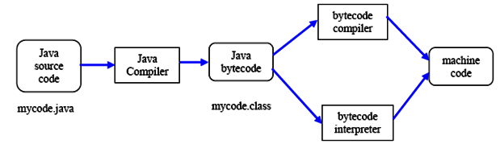
Compilation and Execution

Slide 9
Various build tools available:
For java – Ant,Maven,Gradle.
For .NET framework – Nant
c# - MsBuild.

Slide 10
SetUp and Installation for Maven
Note: Maven is Java based tool, so the very first requirement is to have JDK installed on your machine(for Maven Java is prerequisite).
Download Maven archive
https://maven.apache.org/download.cgi
OS | Archive name
Windows | apache-maven-3.5.0-bin.zip
Linux | apache-maven-3.5.0-bin.tar.gz or sudo apt-get install maven (debian based)
Mac | apache-maven-3.5.0-bin.tar.gz

Slide 11
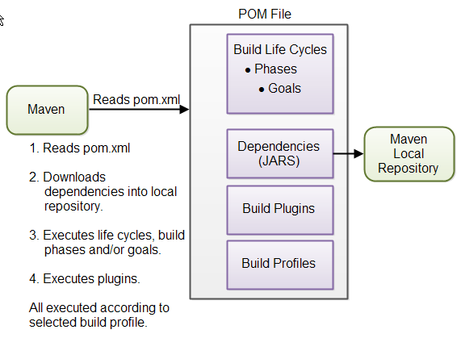
Working of maven

Slide 12
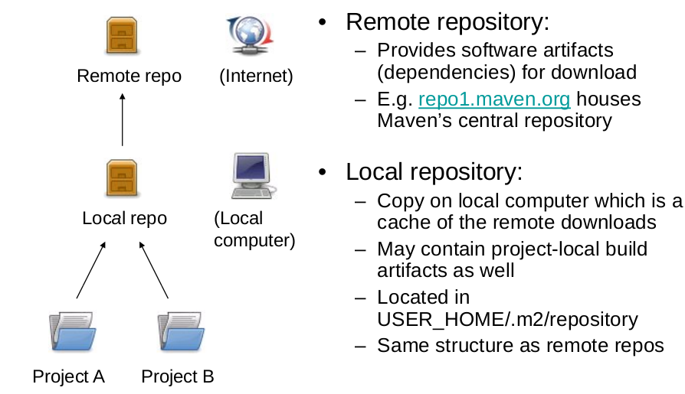
Repositories

Slide 13
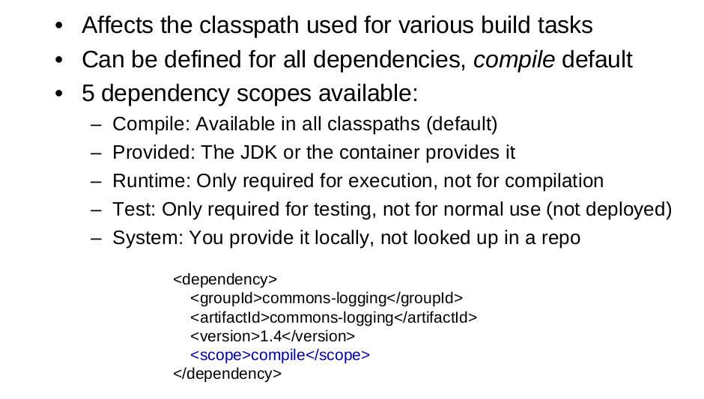
Dependencies

Slide 14
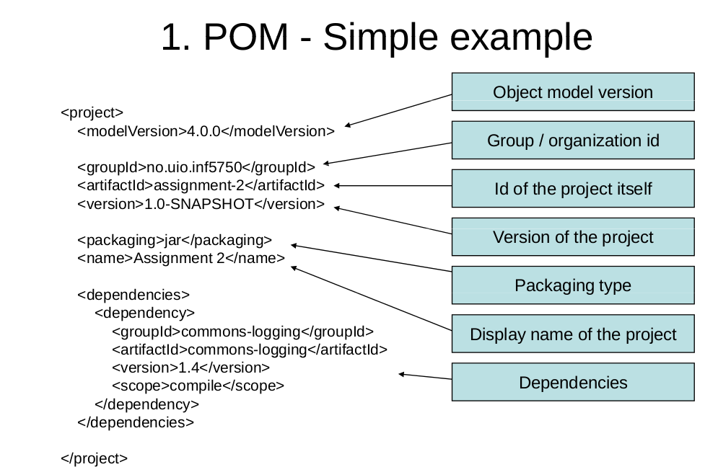
Pom.xml Structure

Slide 15
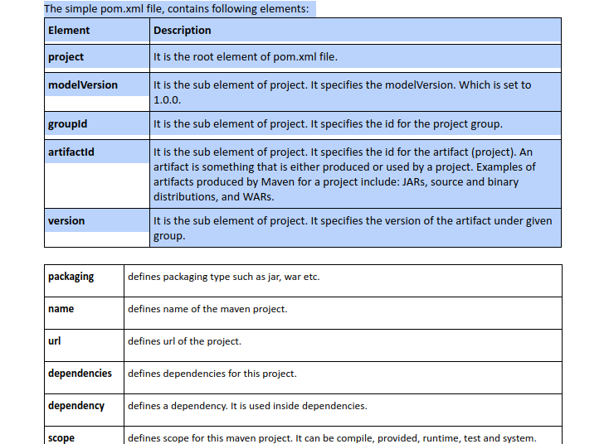
Pom.xml Description

Slide 16
Maven Build Lifecycle and Phases
The build lifecycle is the process of building and distributing an artifact
• A phase is a step in the build lifecycle
• Most important default phases:
Validate
Compile
Test
Package
Install
Deploy
• Some common phases not default:
Clean
Site
• For each step, step all previous steps are executed

Slide 17
Maven Build Phases
Validate - validate the project is correct and all necessary information is available
Compile - compile the source code of the project
test - test the compiled source code using a suitable unit testing framework. These tests should not require the code be packaged or deployed
Package - take the compiled code and package it in its distributable format, such as a JAR.
Verify - run any checks on results of integration tests to ensure quality criteria are met
Install - install the package into the local repository, for use as a dependency in other projects locally
Deploy - done in the build environment, copies the final package to the remote repository for sharing with other developers and projects.

Slide 18
Thank You !!

