Slide 1

Git
A Distributed Version Control System
By WAHID M KHAN
VisualPath

Slide 2
Agenda
What is a VCS And Why VCS ?
Centralize vs Distributed VCS
What is Git ?
Git repositories
Working tree
Installation & learning Git
Git Commands

Slide 3
Your Daily Task
Create things
Save things
Edit things
Save the things again

Slide 4
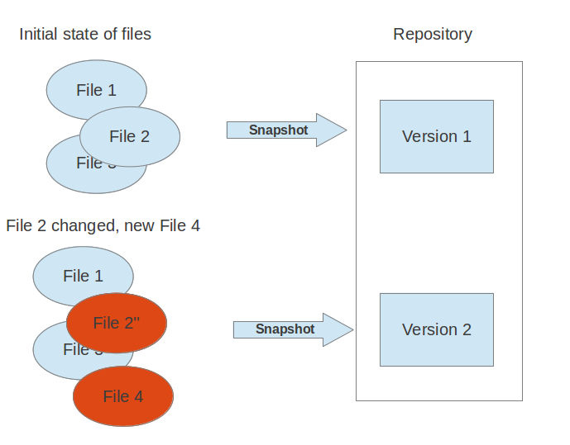
What is VCS ?
Version control System(or revision control, or source control) is all about managing multiple versions of documents, programs, web sites, etc.
A version control system (VCS) allows you to track the history of a collection of files.

Slide 5
Why VCS ?
For Individual Help:
Gives you a “time machine” for going back to earlier versions
Gives you great support for different versions (standalone, web app, etc.) of the same basic project
For Working with Team:
Greatly simplifies concurrent work, merging changes
For getting an internship or job:
Any company with a clue uses some kind of version control
Companies without a clue are bad places to work
Adv. : Management of changes to files.
Keep track of what changes occurred.
Allows People to work Together.

Slide 6
Localized and Centralized VCS
A localized version control system keeps local copies of the files. This approach can be as simple as creating a manual copy of the relevant files.
A centralized version control system provides a server software component which stores and manages the different versions of the files. A developer can copy (checkout) a certain version from the central sever onto their individual computer. Eg: CVS,SVN etc.
Both approaches have the drawback that they have one single point of failure. In a localized version control systems it is the individual computer and in a centralized version control systems it is the server machine. Both system makes it also harder to work in parallel on different features. Eg:Git,mercurial etc.

Slide 7
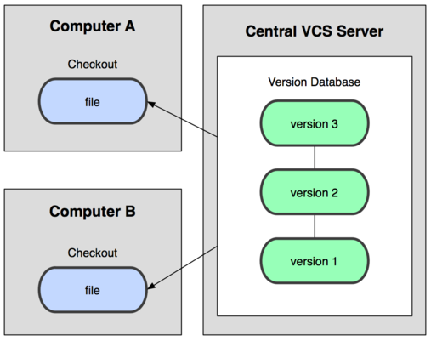
Centralized VCS
• In Subversion, CVS, Perforce, etc.
A central server repository (repo)
holds the "official copy" of the code
– the server maintains the sole
version history of the repo
• You make "checkouts" of it
to your local copy
– you make local modifications
– your changes are not versioned
• When you're done, you
"check in" back to the server
– your checkin increments the repo's version

Slide 8
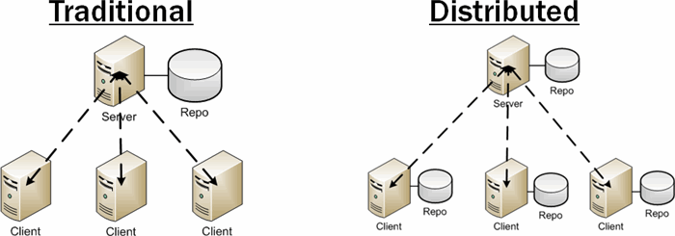
Distributed version control systems
In a distributed version control system each user has a complete local copy of a repository on his individual computer.

Slide 9
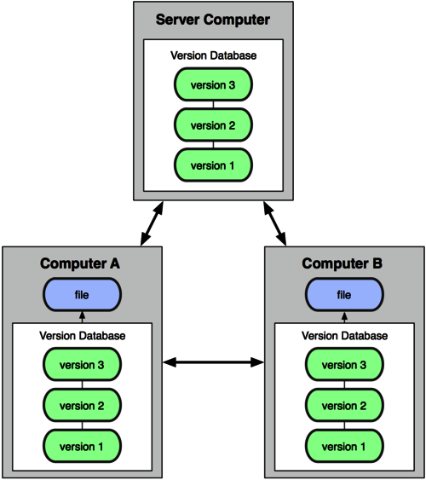
Distributed version control systems
In git, mercurial, etc., you don't "checkout"
from a central repo
– you "clone" it and "pull" changes from it
• Your local repo is a complete copy
of everything on the remote server
– yours is "just as good" as theirs
• Many operations are local:
– check in/out from local repo
– commit changes to local repo
– local repo keeps version history
• When you're ready, you can "push" changes back to server

Slide 10

What is Git ?
Git is a distributed version control sysytem
Git is a Tree History storage system
Git is content tracking management system
Goals of Git:
– Speed
– Support for non-linear development
(thousands of parallel branches)
– Fully distributed
– Able to handle large projects efficiently
Created by Linus Torvalds,
creator of Linux, in 2005
– Came out of Linux development community
– Designed to do version control on Linux kernel

Slide 11
Git repositories / Working tree
A Git repository contains the history of a collection of files starting from a certain directory. The process of copying an existing Git repository via the Git tooling is called _cloning.
A local repository provides at least one collection of files which originate from a certain version of the repository. This collection of files is called the working tree. It corresponds to a checkout of one version of the repository with potential changes done by the user.

Slide 12
Installing / learning Git
Git website: http://git-scm.com/
– Free on-line book: http://git-scm.com/book
– Reference page for Git: http://gitref.org/index.html
– Git tutorial: http://schacon.github.com/git/gittutorial.html
– Git for Computer Scientists: http://eagain.net/articles/git-for-computer-scientists/
• At command line: (where verb = config, add, commit, etc.)
– git help verb

Slide 13

Local git areas
In your local copy on git,
files can be:
– In your local repo
• (committed)
– Checked out and modified,
but not yet committed
• (working copy)
– Or, in-between, in
a "staging" area
• Staged files are ready
to be committed.
• A commit saves a snapshot of all
staged state.
Unmodified/modified Files
Staged Files
Committed Files

Slide 14
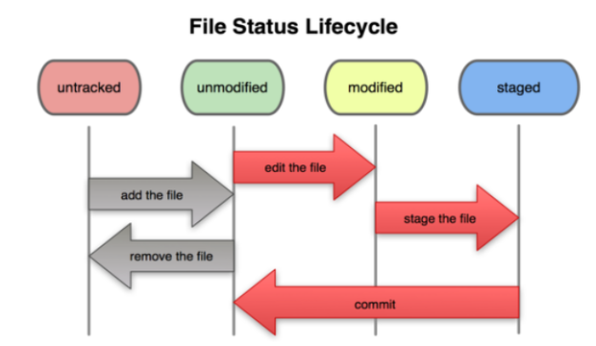
Basic Git workflow
• Modify files in your working directory.
Stage files, adding snapshots of them to your staging area.
• Commit, which takes the files in the staging area and stores that snapshot
permanently to your Git directory.

Slide 15
Initial Git configuration
Set the name and email for Git to use when you commit:
– git config --global user.name "Wahid Khan"
– git config --global user.email wahidkhan@gmail.com
– You can call git config –list to verify these are set.
• Set the editor that is used for writing commit messages:
– git config --global core.editor nano
• (it is vim by default)

Slide 16
Creating a Git repo
Two common scenarios: (only do one of these)
• To create a new local Git repo in your current directory:
– git init
• This will create a .git directory in your current directory.
• Then you can commit files in that directory into the repo.
– git add filename
– git commit –m "commit message"
• To clone a remote repo to your current directory:
– git clone url localDirectoryName
• This will create the given local directory, containing a working copy of
the files from the repo, and a .git directory (used to hold the
staging area and your actual local repo)

Slide 17
Git commit checksums
In Subversion each modification to the central repo increments
the version # of the overall repo.
– In Git, each user has their own copy of the repo, and commits
changes to their local copy of the repo before pushing to the
central server.
– So Git generates a unique SHA-1 hash (40 character string
of hex digits) for every commit.
– Refers to commits by this ID rather than a version number.
– Often we only see the first 7 characters:
• 1677b2d Edited first line of readme
• 258efa7 Added line to readme
• 0e52da7 Initial commit

Slide 18
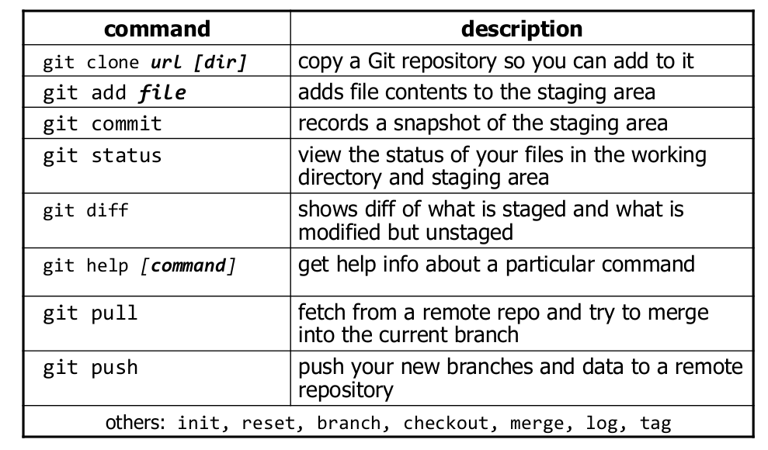
Git commands

Slide 19
Viewing/undoing changes
To view status of files in working directory and staging area:
or git status –s (short version)
– git status
• To see what is modified but unstaged:
– git diff
• To see a list of staged changes:
– git diff --cached
• To see a log of all changes in your local repo:
– git log
or git log --oneline (shorter version)
1677b2d Edited first line of readme
258efa7 Added line to readme
0e52da7 Initial commit
• git log -5 (to show only the 5 most recent updates), etc.

Slide 20
Branching and merging
Git uses branching heavily to switch between multiple tasks.
• To create a new local branch:
– git branch name
• To list all local branches: (* = current branch)
– git branch
• To switch to a given local branch:
– git checkout branchname
• To merge changes from a branch into the local master:
– git checkout master
– git merge branchname

Slide 21
Merge conflicts
The conflicting file will contain <<< and >>> sections to
indicate where Git was unable to resolve a conflict:
===============================
<<<<<<< HEAD:index.html
<div id="footer">todo: message here</div>
================================
<div id="footer">
thanks for visiting our site
</div>
>>>>>>> SpecialBranch:index.html
================================
• Find all such sections, and edit them to the proper state
(whichever of the two versions is newer / better / more
correct).
branch 1's version
branch 2's version

Slide 22
Interaction w/ remote repo
Push your local changes to the remote repo.
• Pull from remote repo to get most recent changes.
– (fix conflicts if necessary, add/commit them to your local repo)
• To fetch the most recent updates from the remote repo into
your local repo, and put them into your working directory:
– git pull origin master
• To put your changes from your local repo in the remote repo:
– git push origin master

Slide 23
GitHub
GitHub.com is a site for online storage of Git repositories.
– You can create a remote repo there and push code to it.
– Many open source projects use it, such as the Linux kernel.
– You can get free space for open source projects,
or you can pay for private projects.
• Free private repos for educational use: github.com/edu
• Question: Do I always have to use GitHub to use Git?
– Answer: No! You can use Git locally for your own purposes.
– Or you or someone else could set up a server to share files.
– Or you could share a repo with users on the same file system, as
long everyone has the needed file permissions).

Slide 24
Questions??
Any Questions ?

Slide 25
Thank You !!!

