Slide 1

Reproducible Research Essentials
FAIR Principles
(https://www.go-fair.org/fair-principles/)

Slide 2
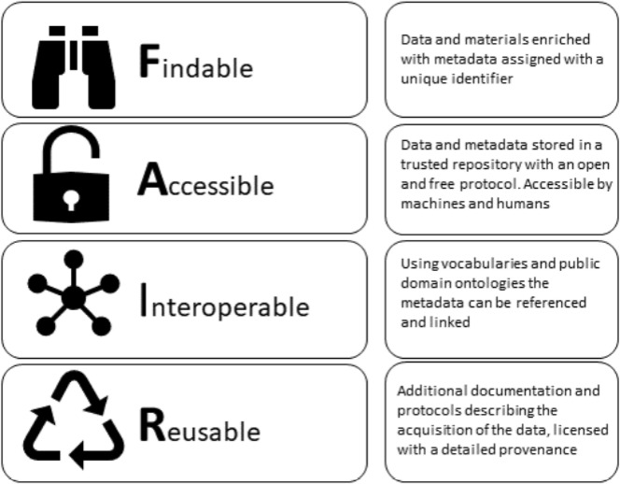
FAIR Principles
A set of principles to ensure that data are shared in a way that enables & enhances reuse by humans and machines
Image Credit: Petros Kalendralis, et al, Making radiotherapy more efficient with FAIR data,
Physica Medica, Volume 82, 2021, Pages 158-162, https://doi.org/10.1016/j.ejmp.2021.01.083.

Slide 3
Origins of FAIR
Emerged from life sciences at a workshop in 2014
Principles were issued by Force11 Community and published in Scientific Data (by Nature) in 2016
Wilkinson, M., Dumontier, M., Aalbersberg, I. et al. The FAIR Guiding Principles for scientific data management and stewardship. Sci Data 3, 160018 (2016). https://doi.org/10.1038/sdata.2016.18
Echoed prior work:
OECD Principles and Guidlines for Access to Research Data from Public Funding (2007)
Science as an Open Enterprise, Royal Society (2012)
G8 Science Ministers Statement (2013)

Slide 4
FAIR Principles
Not a strict standard or criteria
A spectrum/ continuum to be applied
Image Credit: Petros Kalendralis, et al, Making radiotherapy more efficient with FAIR data,
Physica Medica, Volume 82, 2021, Pages 158-162, https://doi.org/10.1016/j.ejmp.2021.01.083.

Slide 5
Applying the FAIR Data Principles starts from good data management and documentation practices used throughout your research.

Slide 6
FAIR vs Open
FAIR data does not have to be open
Data can be shared with restrictions and still be FAIR
Open Data is a subset of all the data shared
”As open as possible, as closed as necessary”

Slide 7
To be Findable
F1. (meta)data are assigned a globally unique and eternally persistent identifier.
F2. data are described with rich metadata.
F3. (meta)data clearly and explicitly specify the data identifier
F4. metadata are registered or indexed in a searchable resource
Google is great in general
Scholarly research data needs more explicit indexing
Checklist:
Persistent ID?
Metadata Online?

Slide 8
To be Accessible
A1 (meta)data are retrievable by their identifier using a standardized communications protocol.
A1.1 the protocol is open, free, and universally implementable. (e.g. http, ftp, smtp)
A1.2 the protocol allows for an authentication and authorization procedure, where necessary.
A2 metadata are accessible, even when the data are no longer available.
Accessible does not always mean the data is open and free
Rather it means a machine can automatically understand the requirements and either allow a user access or alert a user to the requirements for access.
Checklist:
Data online?
Restrictions where needed?

Slide 9
To be Interoperable
Data interoperability is the capacity to which data can be analyzed and/or merged with similar data. Data interoperability relies on data standards, data documentation, and metadata to indicate to researchers which data sets or variables are comparable.
I1. (meta)data use a formal, accessible, shared, and broadly applicable language for knowledge representation.
I2. (meta)data use vocabularies that follow FAIR principles.
I3. (meta)data include qualified references to other (meta)data.
Checklist:
Use standards and controlled vocabularies?
Common (open) formats?

Slide 10
To be Re-usable
R1. (meta)data have a plurality of accurate and relevant attributes.
R1.1. (meta)data are released with a clear and accessible data usage license.
R1.2. (meta)data are associated with their provenance.
R1.3. (meta)data meet domain-relevant community standards.
Checklist:
Rich documentation
Clear usage license

Slide 11
How FAIR is Your Data?
https://ardc.edu.au/resources/aboutdata/fair-data/fair-self-assessment-tool/

Slide 12
Data Management Planning + Data & Project Organization
https://data.library.arizona.edu/data-management

