Slide 1

Codeclan E36 Solo Ruby Project by Gary Clark
UX Design Findings
Initial Planning
Implementation/Re-Design
Demo
Project Learnings
Questions?

Slide 2
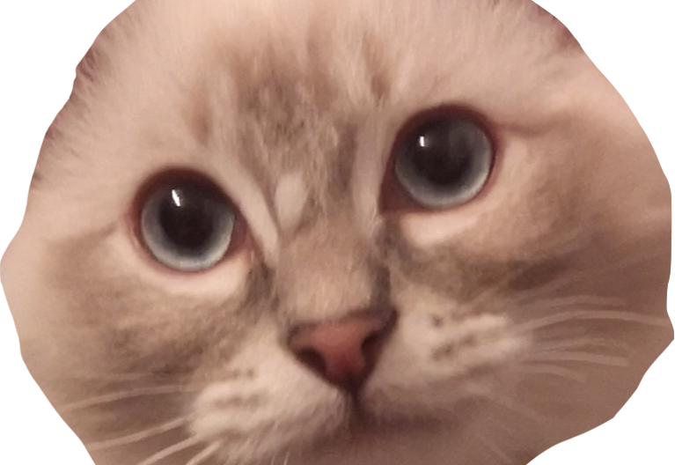
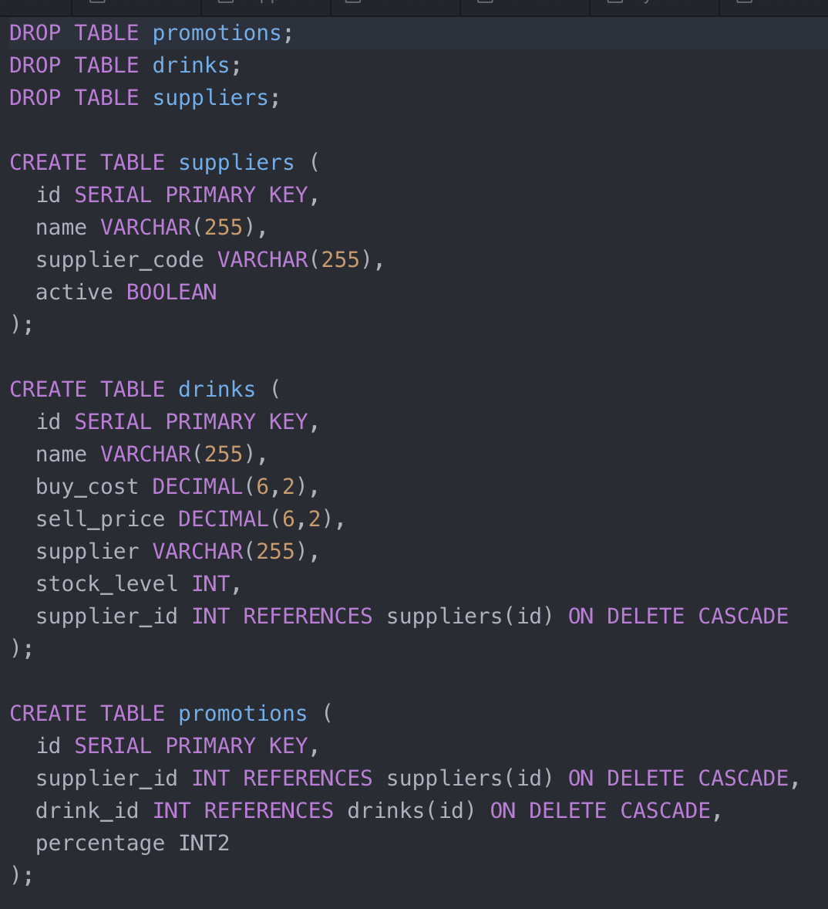
BREWCAT Bar Inventory Application

Slide 3

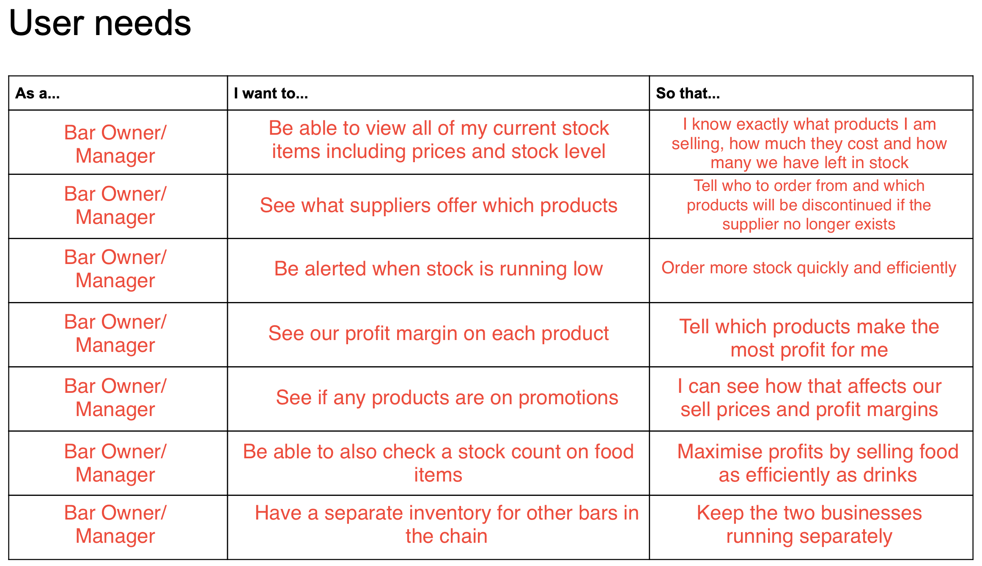
UX Design Findings
Created proto-personas
Mapped the user-journey
Thought about user needs
(Did not all work out as expected!)

Slide 4
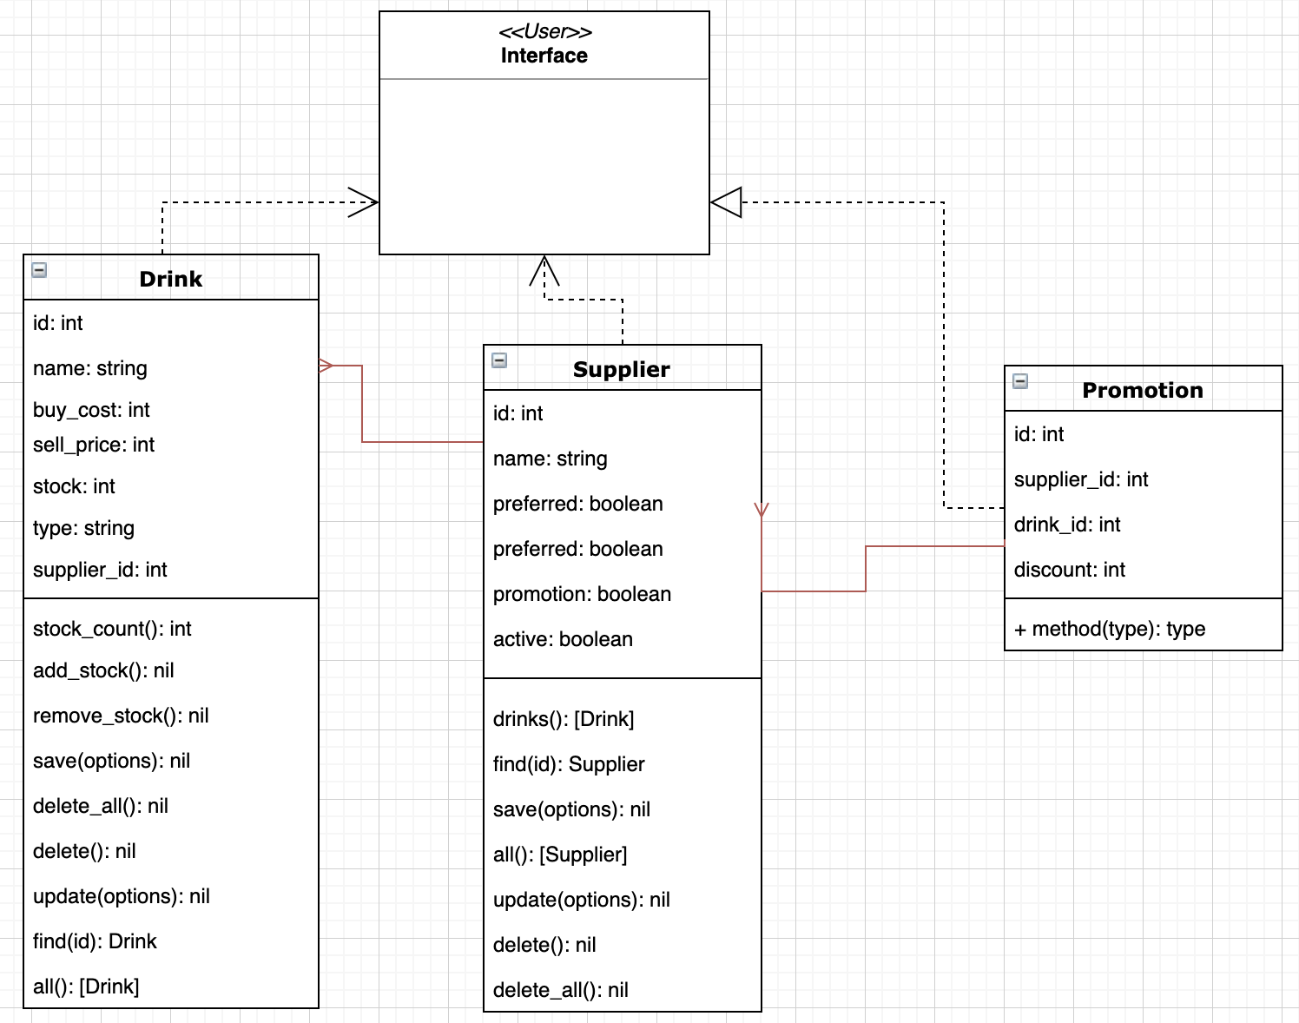
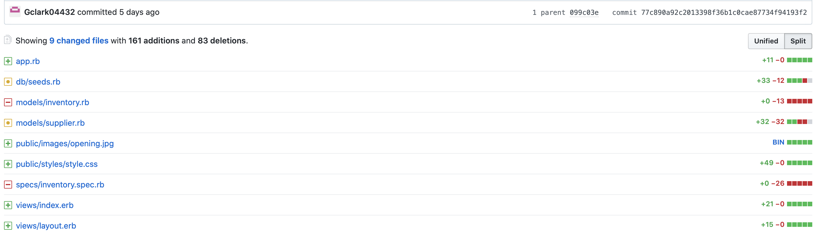
Implementation
Re-Design

Slide 5
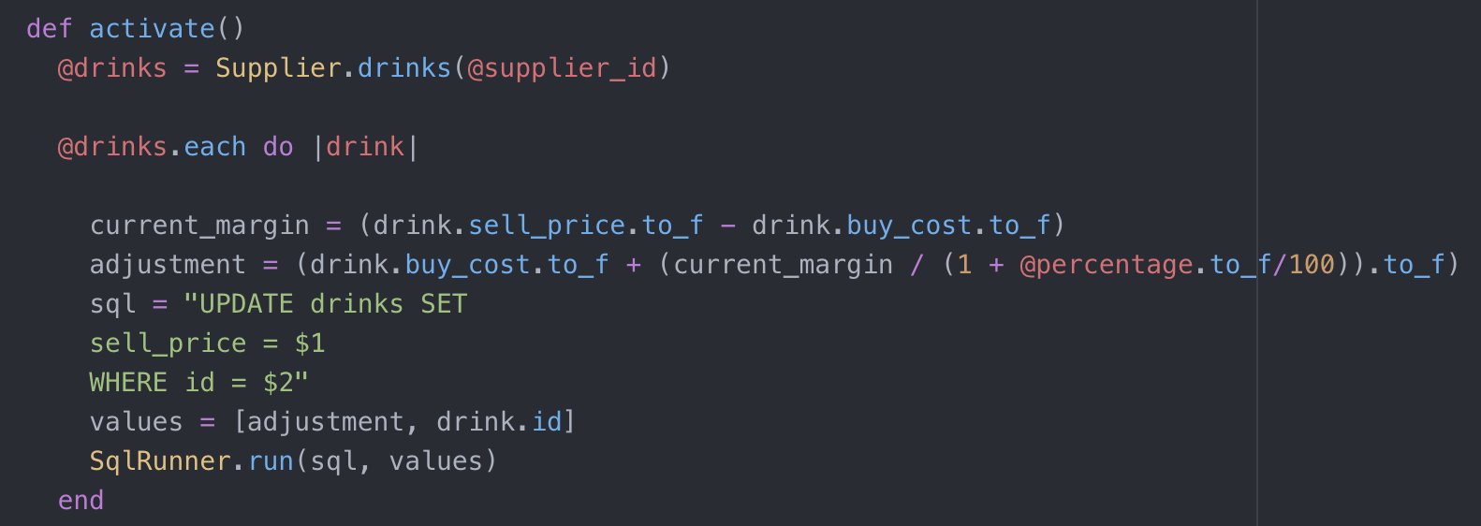

DEMO

Slide 6

Project Learnings
Start
Breaking problems down
Setting SMART targets
Taking more regular breaks
Continue
To be ambitious
Developing HTML/CSS
Utilizing online resources
Using github frequently
Stop
Stressing!
Attempting to view the end point of the project
Copy & Pasting (sorry instructors)

Slide 7
Thank you!!
Questions?

