Slide 1
nuvos: the Universal SDK
Write in Java; Run on iOS, Android, HTML 5, and JVM
Java Day Guatemala 2013
Saturday, November 9, 2:00pm CST

Slide 2
Session Content
Case Study
Problem Solving
Implementation

Slide 3

About Kevin McCarthy
Personal:
Java Developer: 12 years
Architect: 15 years
Executive: CEO/CTO 10 years
Founder at IntraMeta
maker of nuvos SDK
Offices in Denver and San Francisco
Small team of developers
Launching developer program now – sign up!

Slide 4
Case Study
Use Case: ThinkTank by GroupSystems
Results from the Field
Lessons Learned

Slide 5
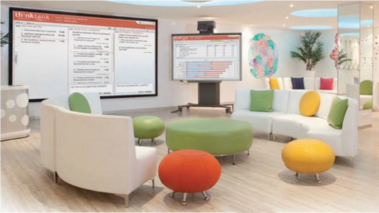
Case Study: ThinkTank by GroupSystems
Real-time collaboration tool
Brainstorm, discuss, rank, vote, comment, …
Risk Assessment, Strategic Planning, Six Sigma, Ideation
Single location or many locations
Same time or self-led
Top Consulting Firms
Deloitte, Accenture,
PwC, E&Y, Bain, …
Top Enterprise
Chevron, Wal-Mart,
P&G, Merck, …

Slide 6
Requirements
Real-time communication (push)
Low bandwidth
Works on bad networks (latency, loss, congestion)
Works offline with seamless data sync
Leverage existing Java code and developers
Works in desktop browser (IE7+) and tablet (iPad+)
Must be enterprise acceptable (client + server)
Run in the cloud or on customer equipment
No leader fails

Slide 7
Implementation
Case Study: ThinkTank

Slide 8
Architecture for ThinkTank
Client-side MVC framework, local data
Server-side object store and journals
Guaranteed Delivery Message Bus (Comet)
GWT/DHTML User Interface

Slide 9
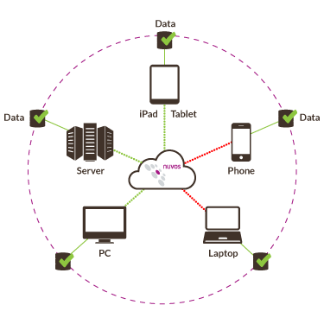
Message Bus
Message Queuing
Guaranteed Message Delivery
Server Migration / Failover
Message Handlers (logic)
RPC Framework

Slide 10
GWT
Tried to use GWT Component Library
Too Heavy (build time, download size, runtime)
Too Buggy
Still had to know HTML/CSS to debug and customize
Created custom UI widgets
Simpler CSS
Easier to debug and customize
Much lighter weight

Slide 11
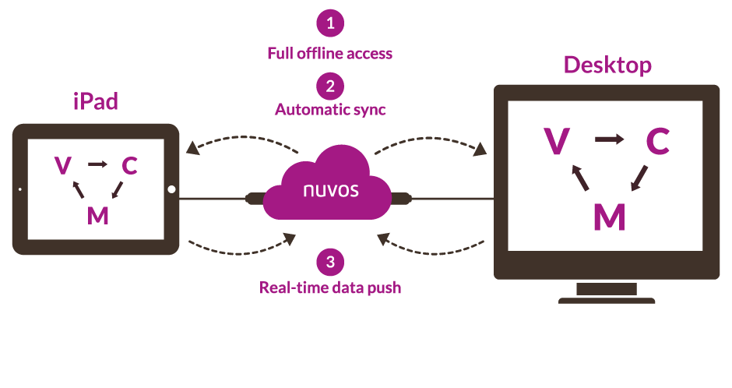
Architecture Overview

Slide 12
Success: New Features
Works offline; handles bad networks
Push data (no waiting for poll interval)
No plugins required (no Flash, Silverlight, etc.)
Much higher limits (# of users, app, data, etc.)
Headless Java clients:
Full unit testing (JUnit, TestNG) and CI (Hudson)
SMS Gateway

Slide 13
Success: Testimonial
We had a major coup this last two days, 850 people using ThinkTank to devise the next 20 years of telecom strategy for South Africa.
And let me tell you, day 1 was a total street fight.
The hotel’s wireless was absolute bollocks. We split into our groups, 6 breakouts. Kevin and I each served as a technographer, each in a session. Just as I was introduced in our session to explain the tech, the whole network came down and then the longest it would be up for the rest of the day was a minute at a time…
I stalled just long enough for my mac to reconnect, assign a couple others as co-leaders and start. Then the whole day the bars went red-green every 15 seconds or so. Sometimes we were out for up to 5 minutes then get 5 seconds and everything would synch.
We lost NO data.
There is no other technology on the planet that could have handled this. Nothing. The tech would have been over and they would have been unable to deliver full stop. Two features: network resilience and co-leaders were the stars of the show.
Even though fires were burning all around, I have never been more proud of our company. We made people look great in an environment as harsh as imaginable. It was like watching 300 but watching Sparta win in the end. The app was just pounded and pounded and pounded and we just kept going. It was awesome.
Awesome.
-- Matt Wenger, CEO

Slide 14


Success: Enterprise Acceptance
Multiple delivery methods:
Public Cloud
Virtual Private Cloud
Hosted
Constantly evaluated for security compliance
Simple failover / operations

Slide 15
Remaining Challenges
Browsers
Enterprise
Human Resources
User Experience

Slide 16

Browser Challenges
Inconsistencies
Rendering
Performance
Features
Performance
DOM
Hard to Profile
Security
XSS
Legacy Browsers won’t die
Runtime errors hard to debug and reproduce

Slide 17

Enterprise Challenges
Ancient standard configurations
Windows XP
IE6 / IE7
IE9 not available for old OS
Can’t use decent browsers
IE9 won’t run on XP
Many shops disallow Chrome,
Firefox, Opera
Hard to install desktop apps
Users are not PC admins
Lots of legwork to get app approved
BYOD
Users choose device, choose apps to run

Slide 18
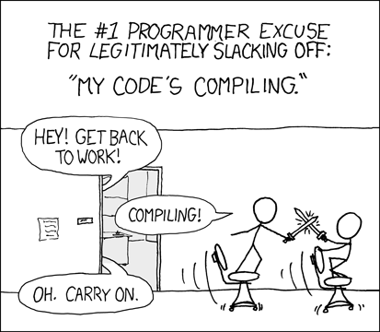
Human Resource Challenges
Rich Client: not your “normal” app
Most of code in client / UI packages (90%)
Most bugs in UI packages (90%)
Cross-functional skill set:
Java
HTML / JavaScript / CSS
GWT
Testing / QA: most in the browser
Functional testing
Load testing
Bug Reproduction
Dev environment
Hard to set up (GWT, code generator, …)
Compile / Test cycle too long (GWT)

Slide 19
User Experience Challenges
HTML4 only (IE7)
Limited access to device hardware
Inconsistent touch / gesture events
Can’t do vector graphics (scale, zoom, rotate)
Limited eye-candy (old browsers)
Hard to support big screens / small screens
Mobile HTML performance bottlenecks
Multi-touch controls difficult/limited

Slide 20
Problem Solving
In a perfect world...

Slide 21
Build on what worked well
Client side MVC on local storage
Guaranteed delivery message bus
Disconnected operation, cloud sync
Code in Java, run in JavaScript
Clean separations for client, server, services
Full test coverage (client, server, integration)
Minimal server side coding

Slide 22
Improve Development Environment
Replace code generation XML with annotations
Remove GWT from development cycle
Manage dependencies with maven
Shorten code / compile / run cycle
No more GWT devmode
Launch / profile inside Eclipse (no browsers)
Provide Eclipse plug-in
Annotation processing / validation
Simplify developer docs & standard processes

Slide 23
Improve User Experience
Graphics Engine
Vector-based graphics engine (Flash, Silverlight, JavaFX)
Pixel-perfect layout and rendering
Pan / scale / zoom to adapt to different screen sizes
Kinesthetic: momentum, smooth scrolling, animations, etc.
Adaptable Human Input
Handle mouse, touchscreen, smart board, etc.
Physical or virtual keyboard
Extensible events system (specialized sensors, etc.)
Branding and aesthetics
Custom artwork (SVG, PNG)
Custom fonts (TTF, WOFF)
Drop shadows, smooth corners, anti-aliasing
Skins: consistent L&F, or device-specific

Slide 24
Improve Service Integration
Service Definition Framework
Define APIs (models, exceptions, messages) in Pure Java
XML replaced by annotations
Package unit test along with service definition
Provide loopback implementation
Client-side service factory
Choose Local or Remote
Local: Native code integration point
Remote: direct implementation if possible (Java) or proxy (XSS)
Server-side
Can implement service API locally (standard servlet container)
Transparent proxy for client API calls (XSS workaround)
Custom service proxy (REST / SOAP / JSON)
Service Fabric
Runtime selection of service provider
Failover / Scaling / Authorization

Slide 25
Improve Operations Support
Continuous Integration, for all platforms
Build often, respond immediately
Distributed work queue
Vendor-specific SDKs mutually exclusive (OSX, Win8, ...)
Standardize logging and profiling
Get same information from all devices
Built-in instrumentation for performance monitoring
Same testing criteria / expected results from all platforms
Reduce IT overhead
No special equipment for developers, QA, operations
No vendor-specific SDKs (Android, iOS, GWT, Visual Studio)
Don’t need to worry about latest browsers

Slide 26

Improve API coverage
Expose device capabilities
Hardware: Camera, Accelerometer, GPS, NFC, Bluetooth, …
Apps: Contacts, Calendar, SMS, Notifications, ...
Beef up local storage
Object-based, async APIs (no SQL)
Search, page, filter, join
Clean up messy APIs
Time/Date/Calendar support, including TimeZone data
Localization

Slide 27
Improve Distribution
Publish to app stores
Native app method:
convert source code to vendor-specific form
compile and sign using vendor-provided tools
Webview / shim:
Compile native shim (PhoneGap, etc)
Load app as DHTML into webview
Bypass the app stores
Publish to HTML5, with exactly same UI/UX (same vectors)
Host on website, avoiding marketing fees to app store
Package using HTML5 manifest or device-specific wrapper (Chromebook, etc.)
Java
Applet or JNLP (Java SE 1.6 or above) – Graphics2D
JavaFX, Java SE Compact1 (Raspberry Pi)

Slide 28
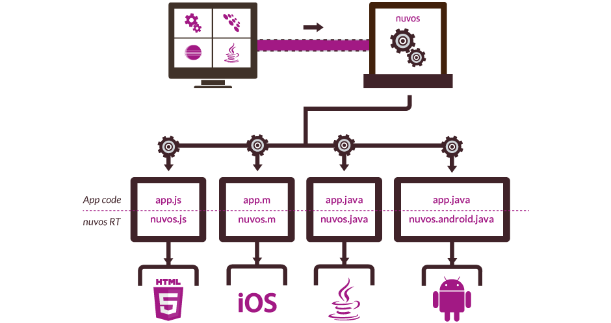
Solution Overview

Slide 29
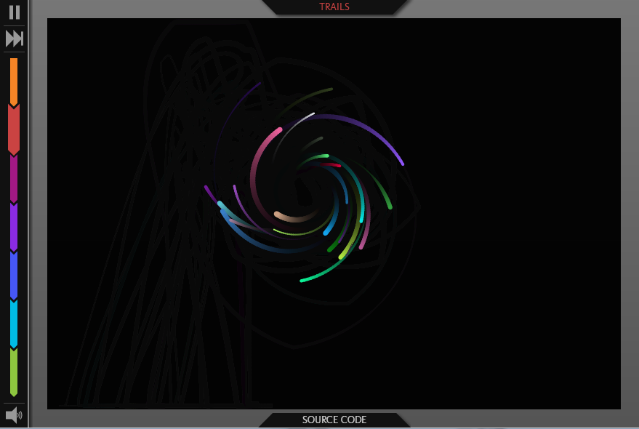
Product Demo
http://demo.nuvos.com

Slide 30
Thank you!
Questions / Answers

