Slide 1






Am I your younger brother?

Slide 2

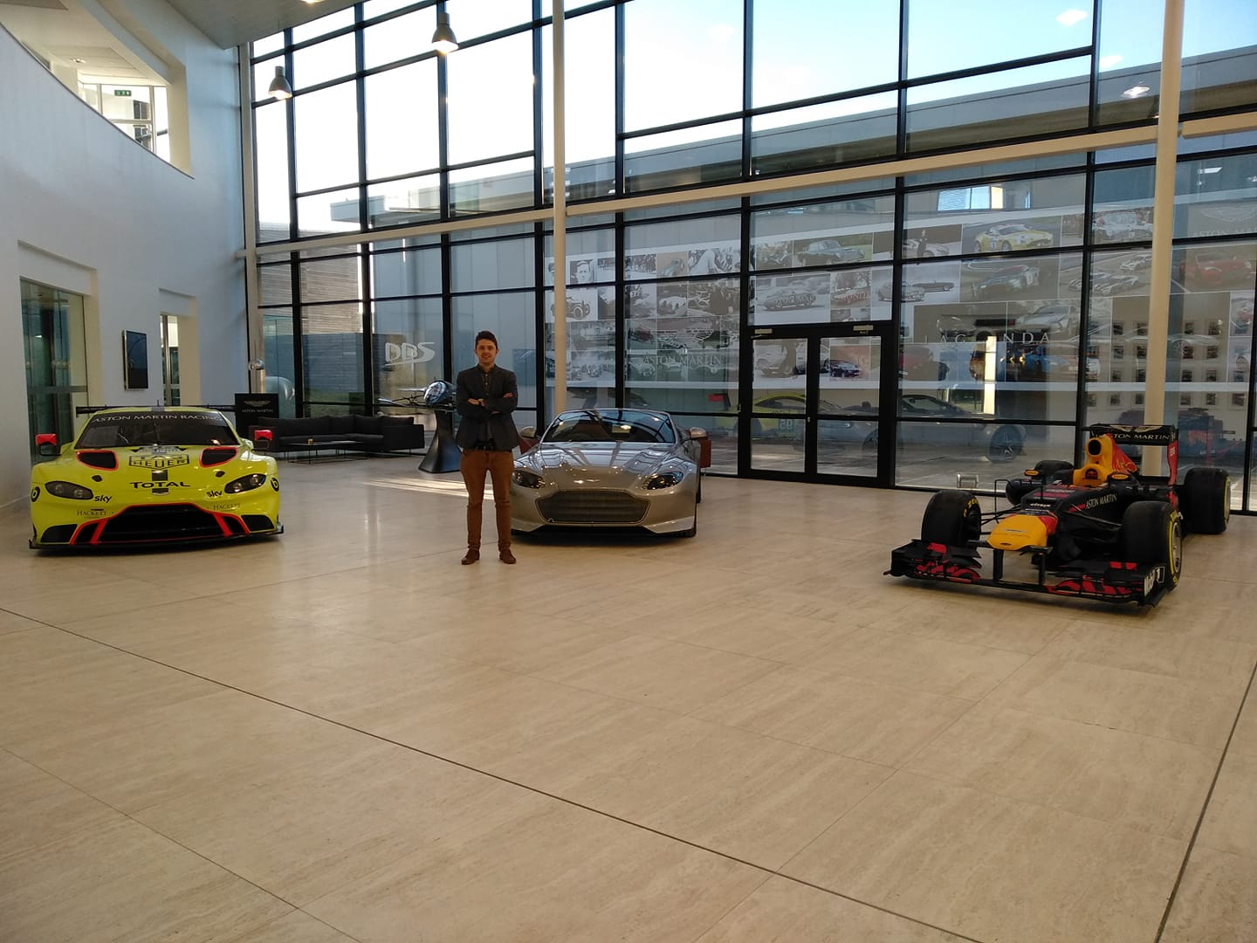
Hello world!
I AM SZYMON JESIONEK
Amateur* of Cybersecurity
* from French amateur "one who loves, lover"
Notes:
Formalne wykształcenie w electronice i cybersecurity.
R&D automotive. Znacznie słowa amator.

Slide 3




Network Map
'With these maps, the general can consider how to defend and attack a castle’
Attack Surface
‚Even castles with strong fortifications should be guarded, paying particular attention to the recessed corners’
TIME
'You should start your attack with no delay and not prematurely but perfectly on time’
Locks
'There is no padlock that you cannot open. However, this all depends on how skilled you are; therefore, you should always get hands-on practice’

Slide 4
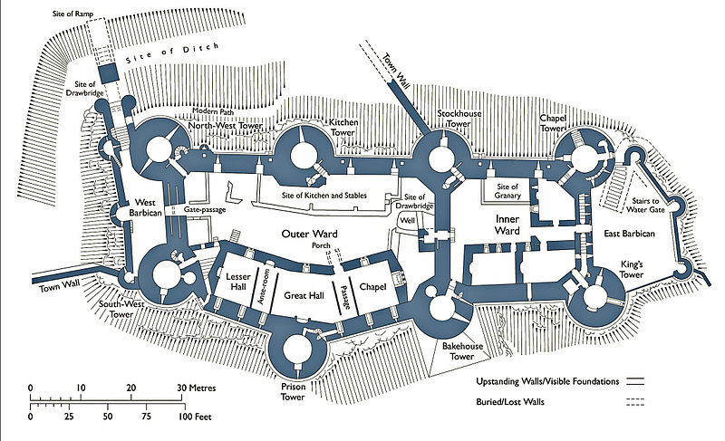
„With these maps, the general can consider how to defend and attack a castle”
.
Notes:
Consider the scenario in which you are the ruler of a medieval castle with valuable information, treasure, and people within your stronghold. You receive credible threat intelligence that a ninja has thoroughly mapped your castle and surrounding area, though it is unclear whether this activity was part of active targeting or just passive reconnaissance. You don’t know what the map looks like or how detailed it is. Your only map of the castle is an architectural design plan that was used during initial construction—and was designed for the builders and not for other users—but has since become out of date. Mapping Networks 13 What does the ninja’s map likely include that your map doesn’t? What would the ninja know about your castle that you don’t, and how could that information be used for infiltration? Who in your fiefdom would benefit from access to the ninja’s map? Whom would you trust to map your castle in the same way the ninja did, allowing you to see what the ninja sees?

Slide 5








Internet
Core Router
Gigabyte ethernet
Firewall
ethernet
Gateway / Switch
Wi-Fi
ethernet
VLAN 10
VLAN 20
VLAN 30
simplified enterprise network map

Slide 6
Diagnostcs Port
Ethernet Backbone
Body and Comfort
Chassis Gateway
Infotainment
Gateway
Powertrain
Gateway
CAN / LIN
CAN / LIN / FlexRay
CAN / Ethernet
CAN / FlexRay
Automotive Electronic Components
An oversimplified in-vehicle network

Slide 7

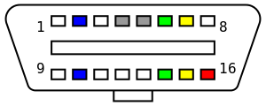

CAM1
CAM2
Sens 1
Sens 3
Telematics Unit
Display Front
Antenna
CAM4
CAM3
Sens 2
Sens 4
Display Rear
Remote Tuner
Surround view
Radar Unit
Display Rear
Amplifier
ADAS Unit
Head Unit
Gateway / Body Control Module
Dashboard
Powertrain / Chassis Unit
Immobil
Start stop
Rain sensor
Lighting switch
Engine Control
Cruise control
Door control front left
Door control front right
Mirror
Wiper
Front power module left
Front power module right
Window
Transmission Control
Headlight control
Door control rear left
Door control rear right
Seat control
Energy manager
Stability Control
ABS
Park heating
Ambient lighting
Car access control
HVAC rear
Damping Control
BMS
Steering sensors angle tourqe
Park assistant
TPMS
AirBag
Control
Steering column module
HVAC main
Heater left
Heater right
Flapper 1
Roof module
Fan left
Fan right
Flapper …
Ethernet
FlexRay
CAN / CAN FD
LIN
A simplified vehicle network map

Slide 8
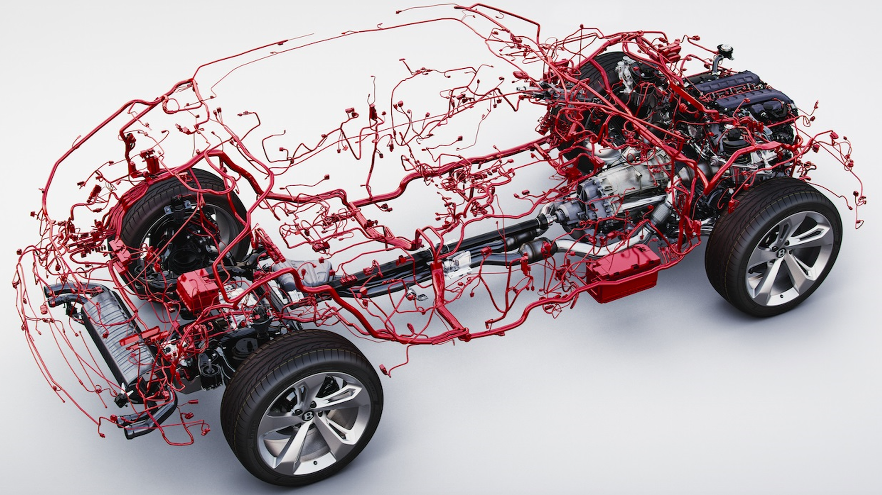

Slide 9



Why CAN ?
1.2 Bilion
CAN nodes In 2014
800 Million
WI-Fi controllers in 2014
400 milion
Wired ethernet ports in 2014
Source:Automotive Ethernet – the Defifnitive Guide

Slide 10

Tampered OBDII device
Tampered directly attached node
Remotely compromised directly attached node
Target ECU
Microconroller
TxD
RxD
Microconroller
Re-flashed microcontroler with bypassed CAN Controller
Microconroller
CAN
Transceiver
TxD
RxD
TxD
RxD
TxD
RxD
CAN
Transceiver
CAN
Transceiver
CAN
Transceiver
OBDII Port
CANH
CANL
Maliciously crafted directly attached node
Notes:
First, any device connected to the CAN bus is allowed to read and write without any regulation. There is no authentication or access control mechanism.
Secondly, all data coming from the CAN bus is trusted because the security model assumes that an attacker will never gain unauthorized access to the CAN bus.
Lastly, there is no way to distinguish a genuine error message from a crafted one. In other words, it's impossible to know whether a device (e.g., infotainment) is truly faulty or if it's been compromised and is now going "off bus" because of an attacker's command. All together, these design issues have more serious consequences. Any device on the CAN bus can craft messages such that any other one would be cut off from any communication. This is like a selective denial-of-service (DoS) attack.
Authentication does not exist – each ECU connected to the bus is considered as a trusted party allowed to send messages to all other nodes on the bus. As there is no procedure for proving the authenticity of the message source, the masquerade attacks are possible (when a node imitates behavior of another node). The lack of the source address in messages also contributes to the masquerade attacks (there is only an ID number which is used to identify message function as well as for message arbitration). – Unencrypted traffic during communication – encryption mechanisms are not included in the protocol due to a significant encryption overhead (which cannot be avoided) that requires a larger bandwidth. In other words, encryption contradicts the initial idea of a CAN that the communication should be fast and lightweight. Although the formats and interpretations of data payload fields in messages are proprietary and kept confidential by the producers of a CAN hardware, low-price components (i.e., ECUs) that could be used for manipulation when connected to the CAN of a vehicle can still be found at the aftermarket. Namely, since there is no encryption mechanism, the traffic from such components (i.e., the payload of their messages) could be easily sniffed by applying some of the reverse engineering techniques, and the “extracted information” could be used by an attacker for performing malicious activities [60–63]. – Small payload capacity (bandwidth) – maximal size of the data payload field is only 64 bits (8 bytes). This length is too small for the implementation of any robust authentication procedure or a cryptographic overhead, and there are no other fields in the message structure that could be exploited for security purposes. – Communication by message broadcasting – since every node on the bus is flooded with the messages from all other nodes, a passive attacker can listen and/or collect all the messages from the bus, once he/she physically connects a “spying ECU” to the bus or accesses the bus via diagnostic (OBD-II) port [64]. Also, an active attacker who has the access to a CAN can potentially target any node on the bus. – OBD-II – all CAN networks in a car can be accessed through this single point of entry. Although very useful for diagnostic and maintenance purposes, this port represents a security risk at the same time since, when an attacker connects to the diagnostic port, it becomes practically unpredictable which systems connected to any of the CANs in a vehicle, and in which way can be affected when the attack takes place. On the other hand, physical access to the ODB-II port (or to the internal wiring of a CAN) in a car represents a (more or less difficult) challenge to potential attackers. Unfortunately, physical isolation of a CAN (as a security benefit) is becoming even less significant barrier against attacks, 4.1 Intrusion Detection Systems 117 since almost all new cars have some form of wireless connection to the outside world (Wi-Fi, 3G/4G mobile, Bluetooth, etc.) but completely implemented without security features. – Message arbitration procedure – an elegant way in which the CAN bus protocol resolves conflict situations of simultaneously sending messages by two or more nodes: the message with a lower binary value of an ID number has higher priority on the bus. On the other hand, this rule makes denial of service (DoS) attacks possible. An attacker, for example, some corrupted node, can simply continuously send the messages with the highest priority (i.e., with the lowest ID), and the bus will be occupied by those malicious messages all the time, causing the functional blockade of all systems on the bus.

Slide 11
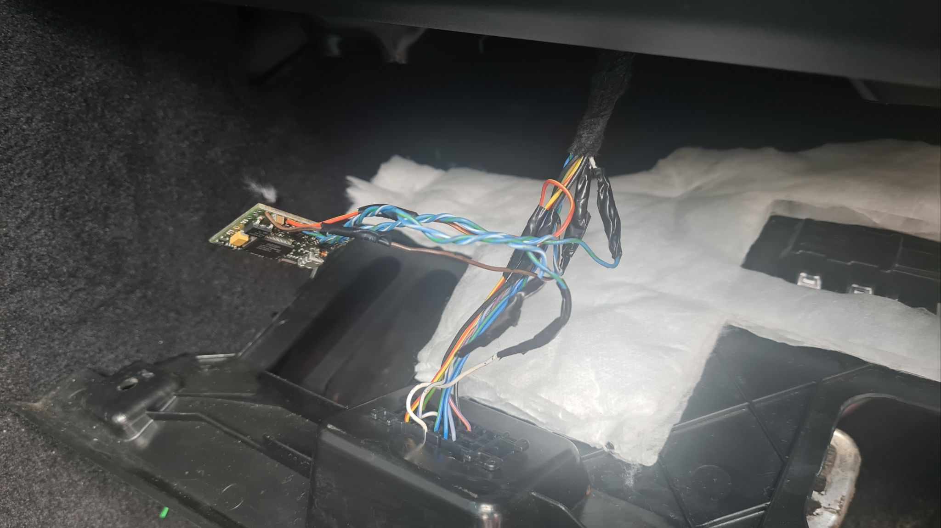
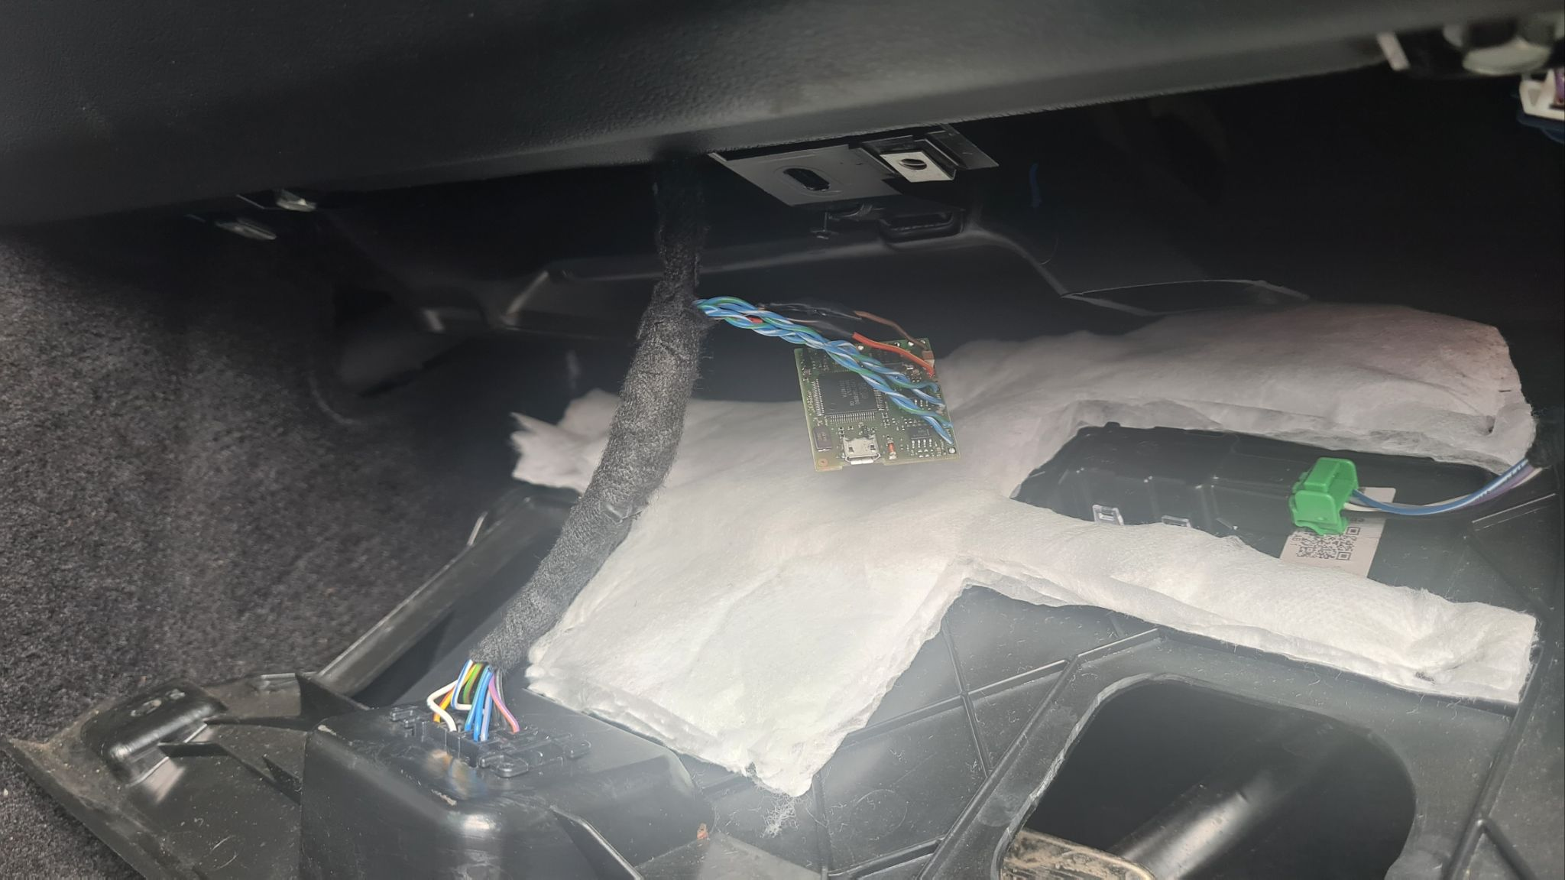
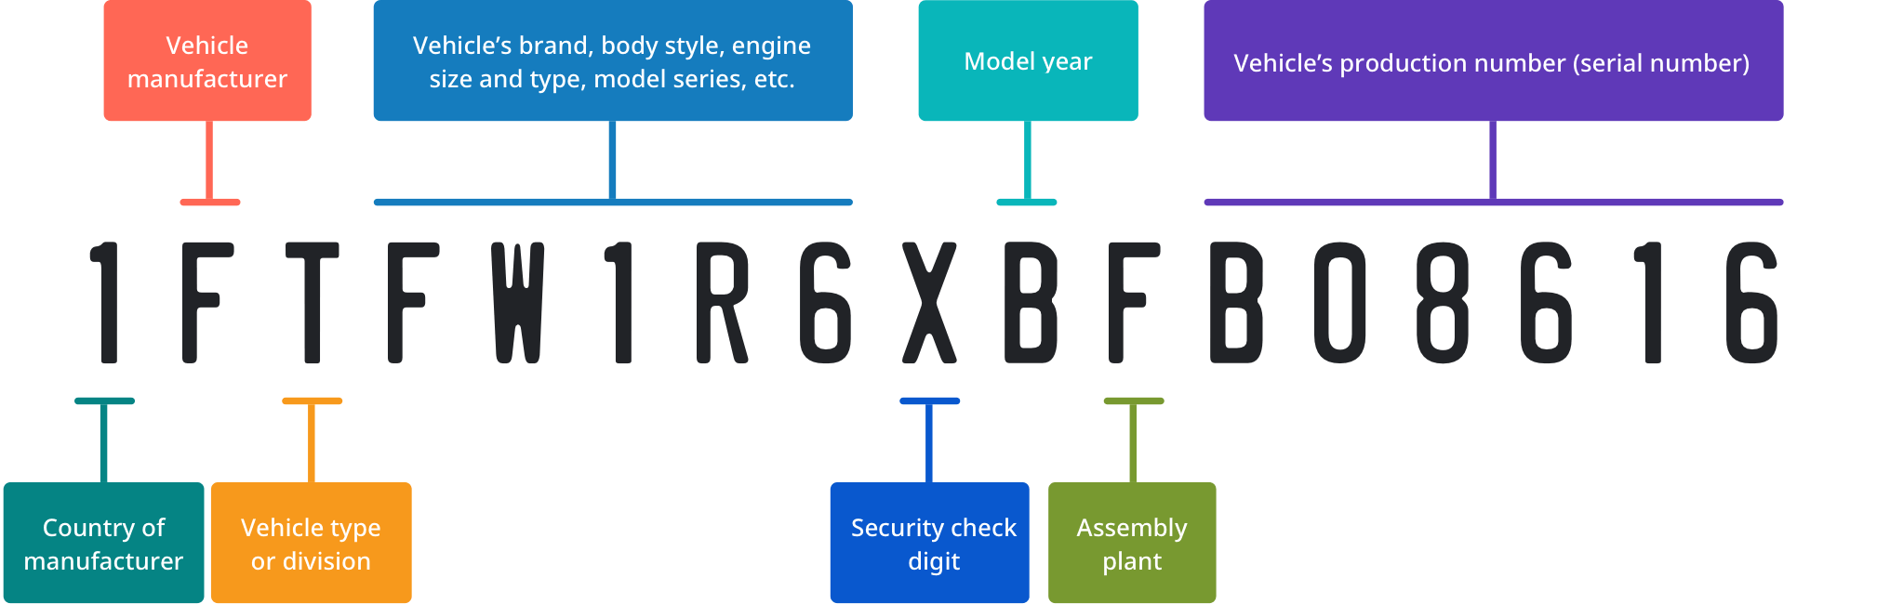
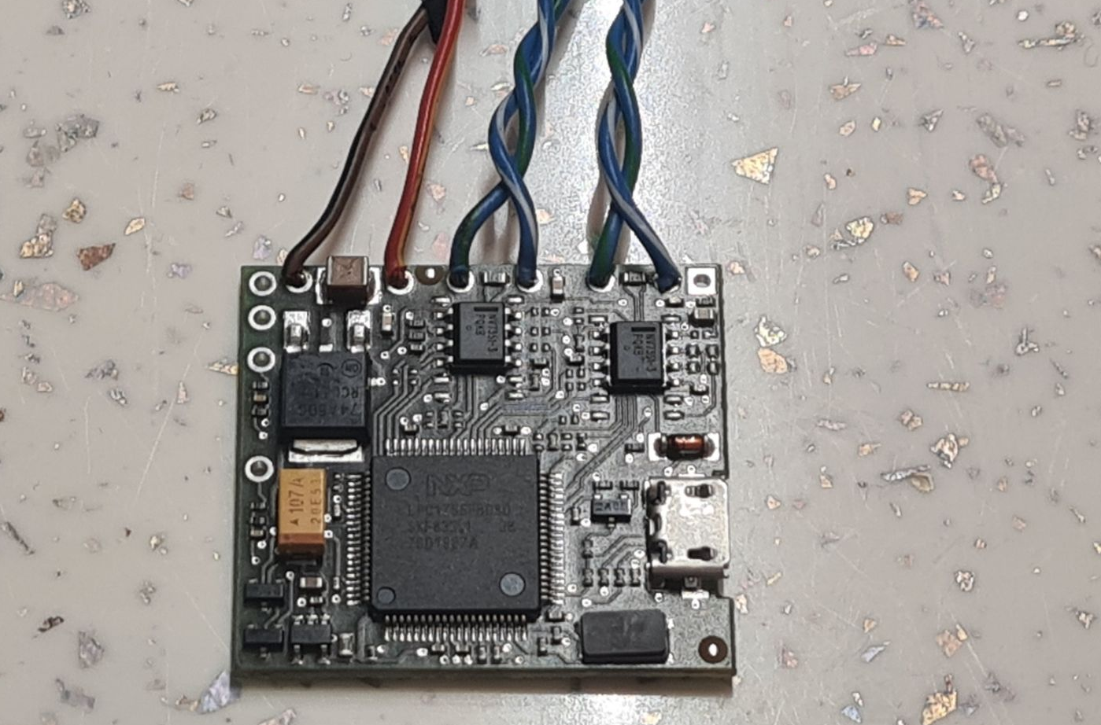

Tampered OBDII device

Slide 12
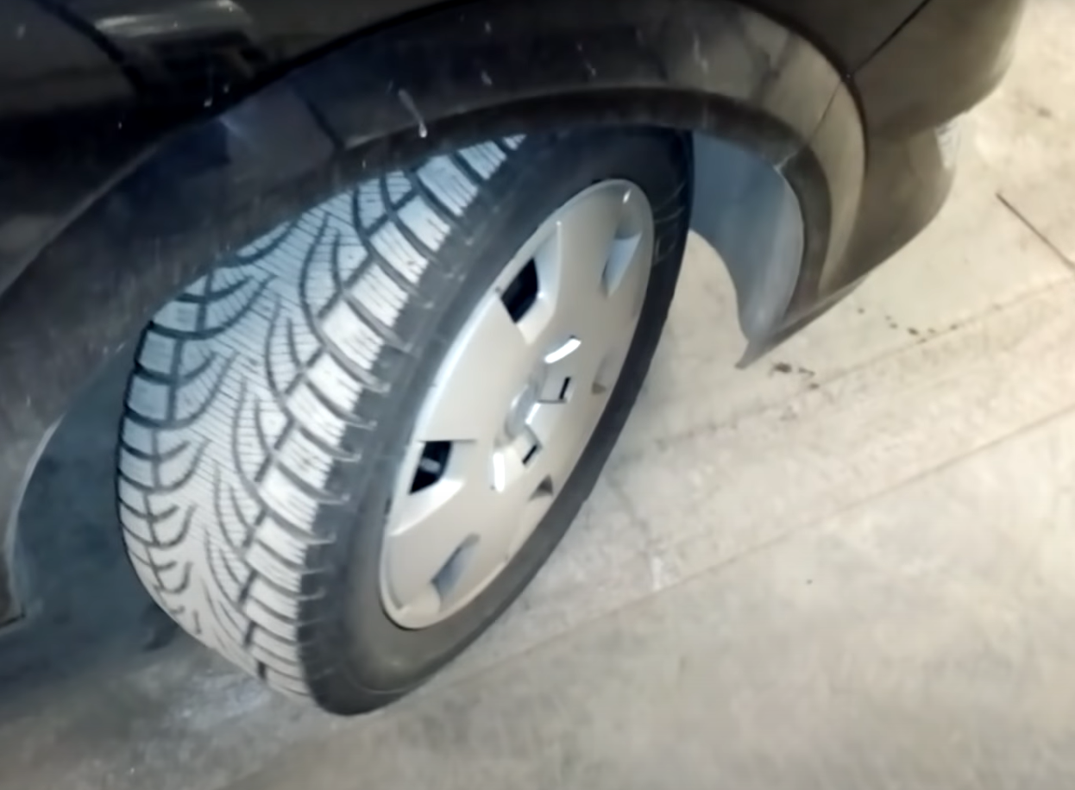
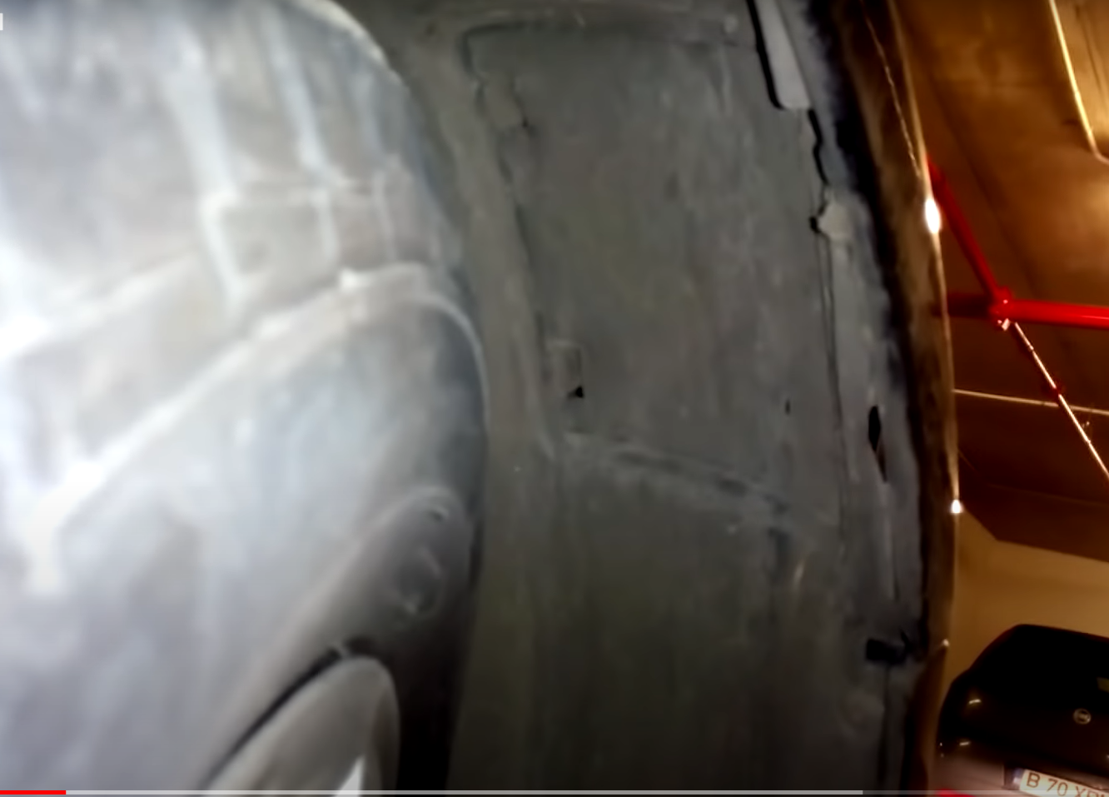
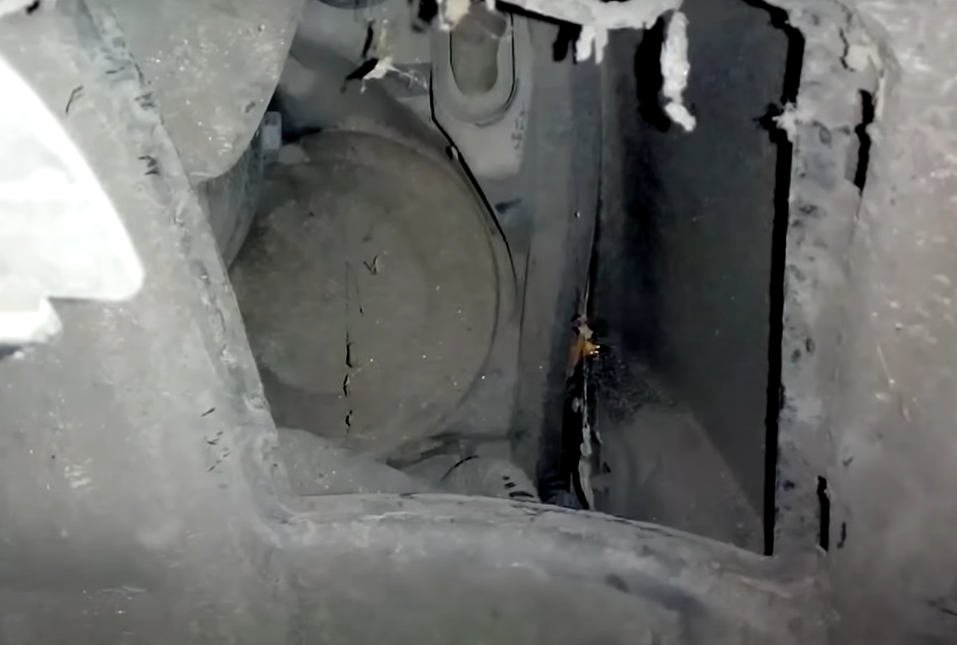
Maliciously crafted directly attached

Slide 13
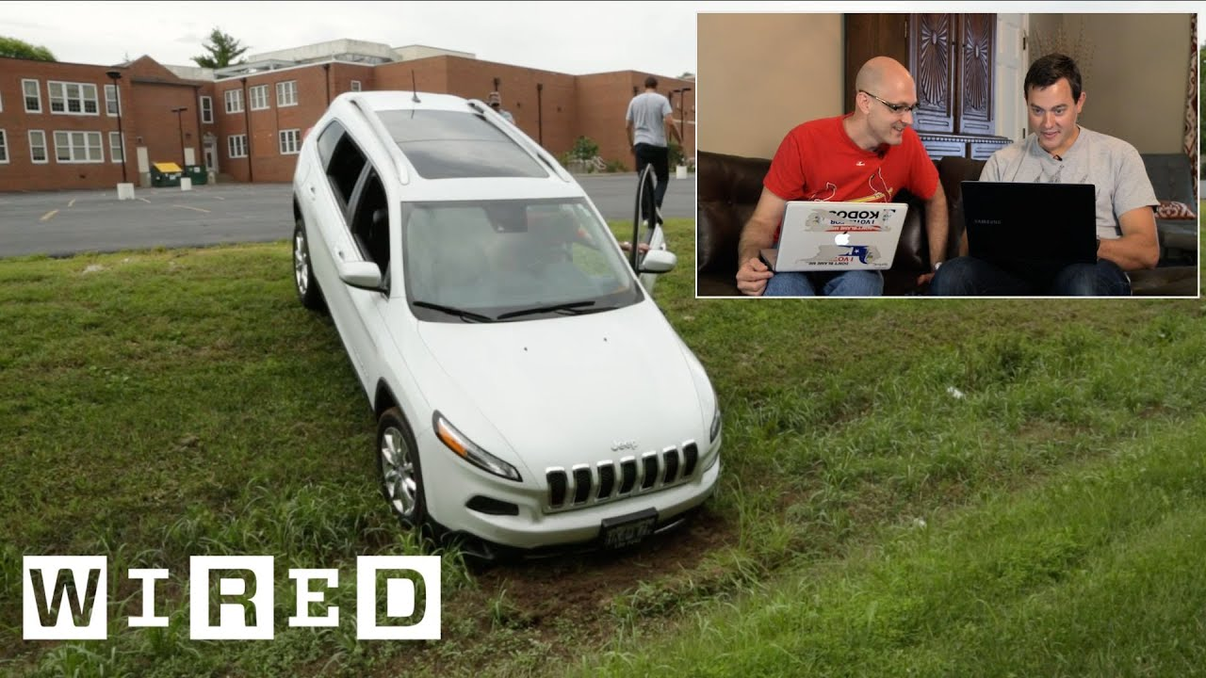
The Jeep Hack

Slide 14
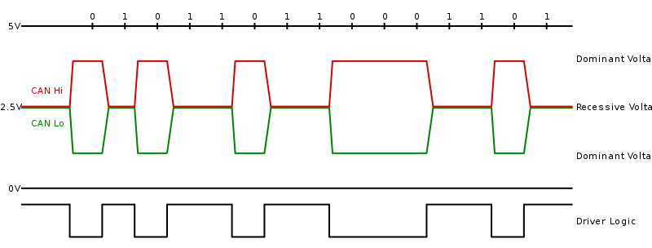

1
11
1
6
64
16
2
7
CRC
Cyclic Redundancy Check
ACK
Acknowledgement
EOF
End of Frame
SOF
Start of Frame
ID
Standard Identifier
RTR
Remote Transmission request
Control
Data
7 layer OSI model
Application
Presentation
Session
Transport
Network
Data link
ISO 11898-2
Bit encoding/decoding, bit timing,
synchronization, ...
Notes:
SOF: The Start of Frame is a 'dominant 0' to tell the other nodes that a CAN node intends to talk
ID: The ID is the frame identifier - lower values have higher priority
RTR: The Remote Transmission Request indicates whether a node sends data or requests dedicated data from another node
Control: The Control contains the Identifier Extension Bit (IDE) which is a 'dominant 0' for 11-bit. It also contains the 4 bit Data Length Code (DLC) that specifies the length of the data bytes to be transmitted (0 to 8 bytes)
Data: The Data contains the data bytes aka payload, which includes CAN signals that can be extracted and decoded for information
CRC: The Cyclic Redundancy Check is used to ensure data integrity
ACK: The ACK slot indicates if the node has acknowledged and received the data correctly
EOF: The EOF marks the end of the CAN frame
High noise tolerance (the physical layer and protocol support noise robustness)
Supports long single buses (tens of feet) without especially careful design
Superior performance for use case to UART/K-Line, I2C/TWI or SPI
Native multicast and broadcast
Built-in frame priorities
Non-destructive collision resolution
100% distributed in operation (no bus master(s))
CANnot Do: Error Handling

Slide 15






„CAN” it be secure ?
Authentication does not exist
Unencrypted traffic during communication
Small payload capacity
Communication by message broadcasting
OBD-II – Single point of entry
Message arbitration procedure

Slide 16



Remember it's not your fault

Slide 17
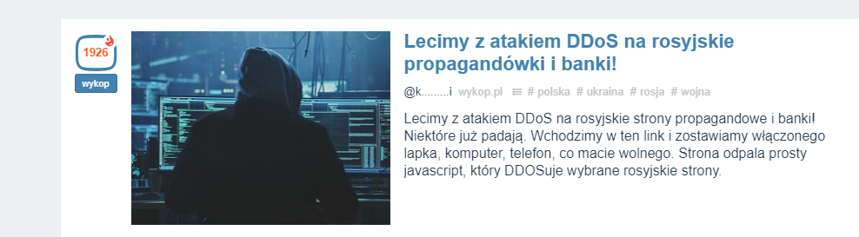

Slide 18




Denial of Service (DoS) Attack
Flodded HTTP Requests
Legitmate HTTP Requests
Notes:
Application layer

Slide 19
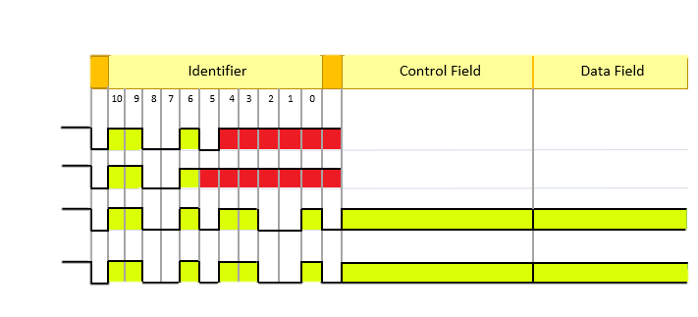
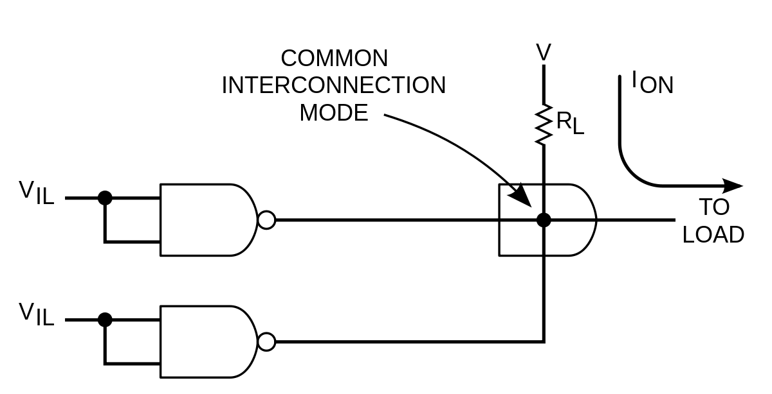
CAN ARBITRATION
Node 1 ID - 11001011111
Node 2 ID - 110011111111
Node 3 ID - 110010110010
Bus Level
Notes:
Iloczyn na drucie polaga to na tym ze logiczne zero czyli zwarcie do masy zawsze potrafi przykryc logigiczna jedynke zwykle podciagana rezystorem do zasil;ania rezystorem
The "arbitration" guarantees a smooth/proper message transfer on the CAN bus. During an "arbitration phase" it is determined which of the simultaneously transmitted messages has the highest priority. Only the network node sending this message, may proceed with the transmission of its message after the arbitration. The message with the lowest value of the message identifier has the highest priority. During the arbitration phase – it includes the sending of the message identifier and the so-called RTR bit ("remote transmission request" bit) – each node monitors the signal level on the bus. If a network node – himself having a recessive level (a recessive bit) – detects a dominant bus level (a dominant bit) it interrupts its transmission process immediately and switches into the receiving state. As with every bus arbitration, a message is sent, the procedure ensures "lossless" bus access.

Slide 20

„During a night attack, you may have the enemy follow you and get into the ranks of your allies. To prevent this, have aprearranged policy—a way to identify your allies”
.
Notes:
Consider the scenario in which you are the ruler of a medieval castle with valuable assets within. You successfully complete a raid on an enemy army and return to your castle. A soldier in your army wishes to approach you and present the severed head of an enemy commander you defeated in battle, as is traditional. This warrior wears your uniform and displays the correct crest, knows the password of the day, appears to know their way around the interior of your castle, and waits for permission to enter your inner stronghold to pay their respects. Consider how you might handle suspicious individuals who pass normal authentication checks requesting privileged access. What existing security protocols or authentication processes would help you determine whether this warrior is an enemy shinobi in disguise who intends to do you harm? Other than outright rejecting the warrior’s request, how might you mitigate the risk if you cannot verify their identity?

Slide 21
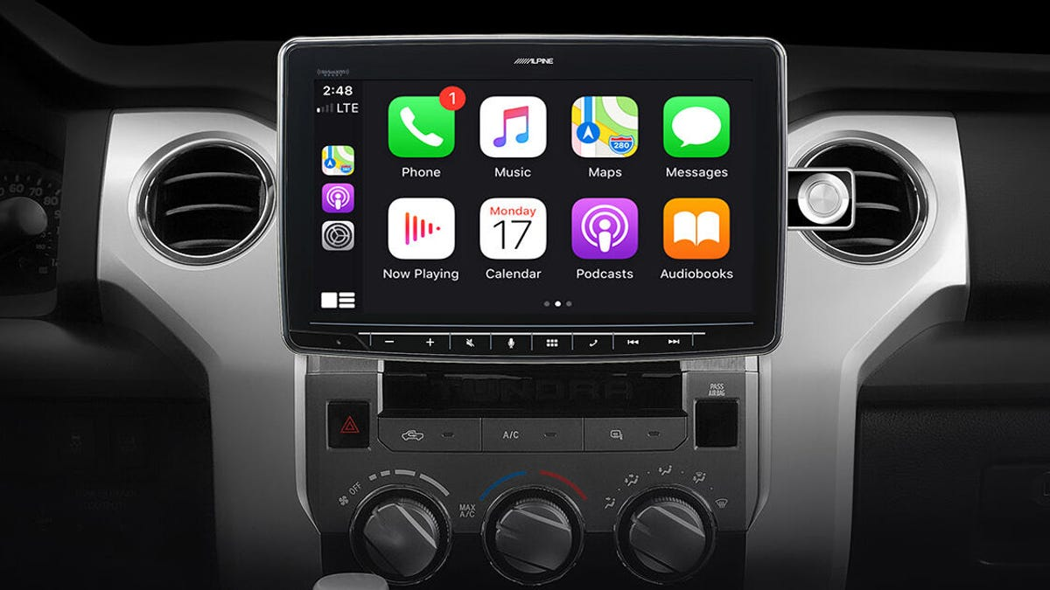

Login Password

Slide 22
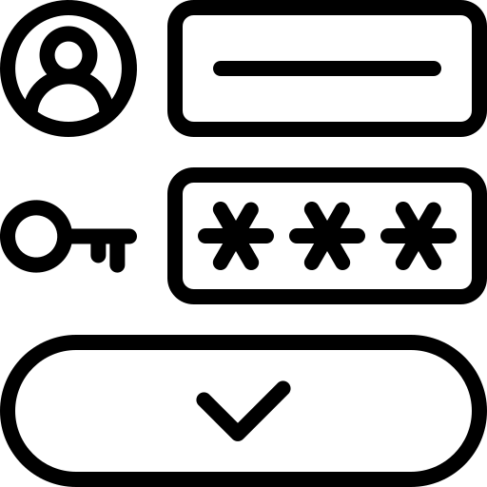







Common Authentication Types
Password-based authentication
Multi-factor authentication
Certificate-based authentication
Biometric authentication
Token-based authentication

Slide 23



Evolution of authentication methods to ECU
No Authentication
Challange-Response 0x27 Security Access
Certificate-Based Authentication
0x29 Authenticate

Slide 24
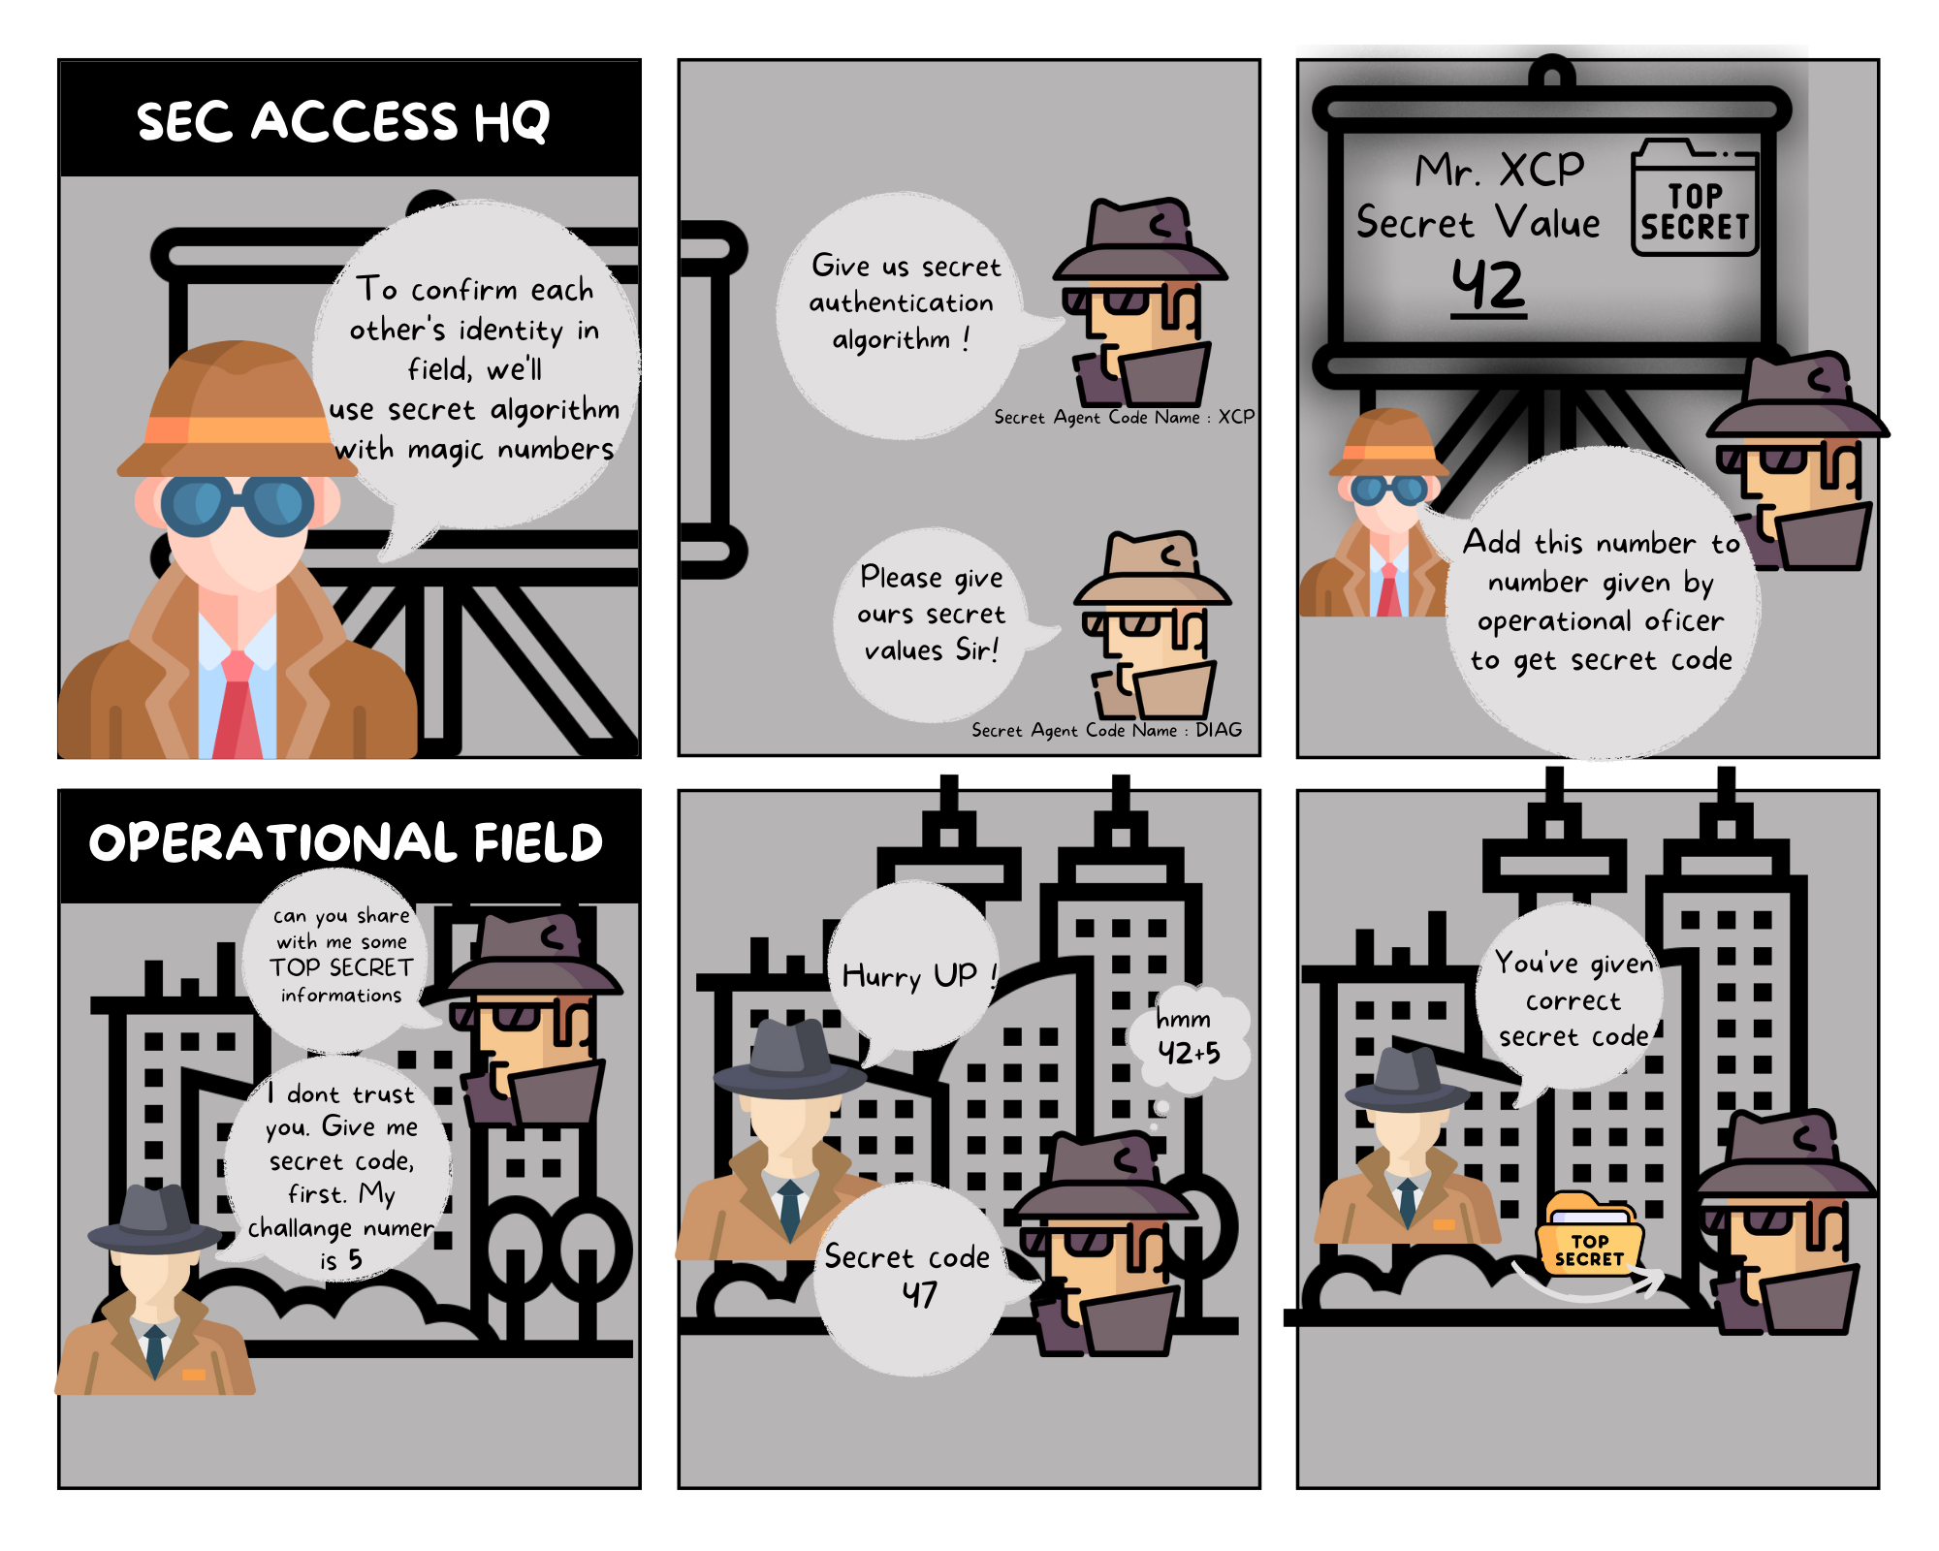

Slide 25


Algorithm
(Seed >> 1 ) ⊕ Secret = Key
Where: Seed is generated randomly by ECU
Secret is equal to 0x424242
Tester
ECU
Challange Request (27 01)
(0xA53429 >> 1) ⊕ 0x424242 -> 0x10D856
Challange Request / Seed (67 01 A5 34 29)
Response / Key (27 02 10 D8 56)
Success (67 02)

Slide 26


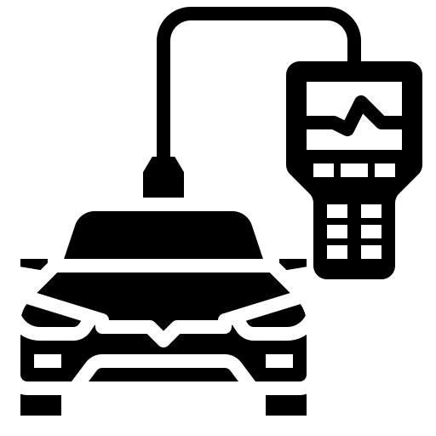
Bypassing Security access
Brute force attack
Extracting and reverse engineering the ECU firmware
Reverse engineering diagnostic software
Notes:
timing delays, use random seed,use long seed/ key to , use non propriaty crypto

Slide 27
Past Attacks – Security Access
Description | Reference | Attack Path | Vehicle
Brute force attack on security access lead to extraction of the key in 1.5 days. | Experimental Security Analysis of a Modern Automobile K. Koscher, et. Al | Physical access to ECU (removed from car). Supply Voltage applied to ECU. CAN-to-USB-Converter and oscilloscope connected to ECU. Brute forcing the seeds from the security access by sending of CAN diagnostic messages with varrying seeds. During brute force: powercycling of the ECU to reduce the brute force time because of sending intervall (see restrictions) | N/A
Extraction of the security access keys from the Parking Assistance Module or the Ford Integrated Diagnostic Software tool by Reverse Engineering of the firmware. | Adventures in Automotive Networks and Control Units C. Valasek, et. al. | Extraction of Park Assistance Module firmware or Ford Integrated Diagnostic Software tool (IDS). Reverse Engineering of the IDS. | Ford Escape 2010
Breaking the security access by reverse engineering the data traffic and reverse engineering the the security access algorithm with extracted seed and key pairs | Kommunikation mit dem Diagnosetester über CAN Interface T. Rensen | Capturing CAN data traffic while a diagnostic tester is doing the security access routine with a vehicles ECU. Sending different seeds to the diagnostic tester in order to capture the relating keys. Manual reverse engineering of the security access algorithm. | Toyota Prius 2010
Security access algorithm reverse enginered from the ECU(IC,BCM) firmware of four major automotive manufacturers | Beneath the Bonnet: a Breakdown of Diagnostic Security | Reverse enginere firmware Analyse seed key algorithm | Ford - Focus, Fiesta Volvo – V50 Fiat – Grande Punto

Slide 28
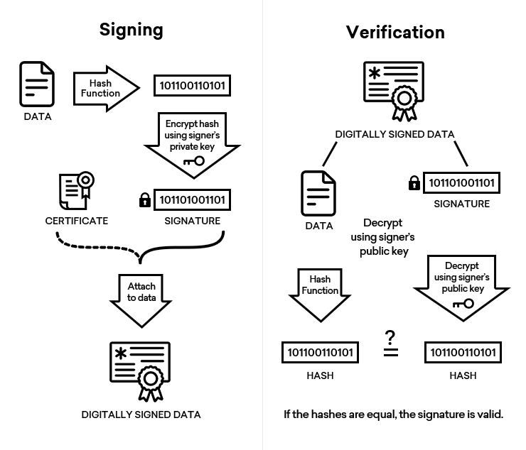

Slide 29

Chain of Trust
Root Certificate
Public Key CA Certificate
Intermediate Certificate
Public Key
Subject
Valid since. until.
Additional Content
Public Key CA Certificate
verify
Public Key
Subject
Valid since. until.
Additional Content
End User Certificate
Public Key CA Certificate
Signature
Public Key
Subject
Valid since. until.
Additional Content
Signature
Private Key
sign
Signature
Private Key
sign
Private Key

Slide 30

Role based Authentication Dynamic vs Static Authorization
...
Anybody
Supplier
After Sales
...
Development
...
...
Certifcate Mask 7 6 5 4 3 2 1 0
Certifcate #1
0
0
0
0
0
0
1
0
Certifcate #2
0
0
0
0
0
1
0
0
OBD II modes
01,02, ... 0A
1
1
1
1
1
1
1
1
Authentication
29 01
1
1
1
1
1
1
1
1
Read Data By ID
22 01 00,...
1
1
1
1
1
1
1
0
Write HW version
2E F1 50
0
0
0
0
0
0
1
0
Certificate custom extension contain whitelists for allowed services
Write Serial Nr
22 F1 8C
0
0
0
0
0
0
1
0

Slide 31
Tester
ECU
What Autentication method do you support?
I support Authentication with PKI CertificateExchange
Ok, here’s my PKI certificate
Prove your ownership: Sign this ‚Challange Data’ with private key
Here’s Proof of Ownership
Thank you! You are now authenticated
https://www.youtube.com/watch?v=k4JD2ZUHrXA

Slide 32

'You should start your attack with no delay and not prematurely but perfectly on time’
Notes:
Consider this scenario: you are the ruler of a medieval castle with valuable information, treasure, and people inside. You receive credible intelligence that a shinobi plans to infiltrate your castle. Imagine that your guards have perfect knowledge of time but can enforce only the following rules:
• When any gate or door (interior or exterior) can be locked and unlocked
• Curfews, after which anyone found in the halls will be detained
Consider what level of integrity, assurance, and security you might achieve with the strict exercise of only those two time-based controls. How would you train castle residents to operate within these strictures (how will they use latrines at night, clean the premises while others sleep, take night deliveries, and so on)? What compromises do you expect to make for your security controls to be functional? For this exercise, it is useful to draw a map of the imaginary castle or your office building. Or you can use an abstracted layout of your network map or data-flow diagram (DFD) as a “building,” where switches are hallways, routers/firewalls are doors, systems are rooms, and VPNs/egress points are gates

Slide 33
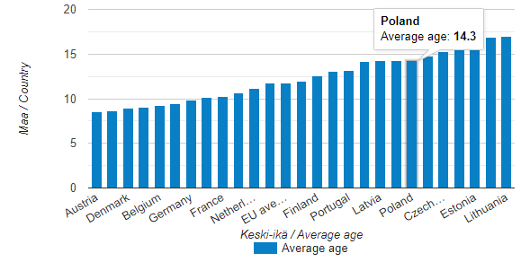
Average age of passenger cars in some European countries

Slide 34
Lengths for cryptographic primitivies depending on their year of use (in bits)
 | ~2024 | ~2025 - 2034 | ~2035
Symetric Crypto | 128 | 192 | 256
Asymetrical (RSA/Diffie-Hellman) | 3072 | 8192 | 16384
Asymetrical (Eliptic curves) | 256 | 384 | 512
Hash | 256 | 384 | 512

Slide 35


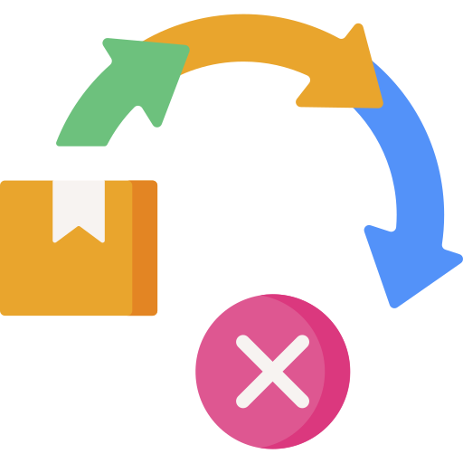

Operational risks of using open source code
Notes:
Furthermore, there are operational risks that could affect security when using open-source software. There exist many different open-source software projects, some which are actively maintained and updated by the open-source software community, and others where development may have stopped, or the projects have become obsolete. For automotive organizations it is important to understand the operational risks when selecting a certain open-source software to be used in a vehicle. Vehicles can be active in the field for 10–15 years and thus organizations must have an understanding of how well the selected open-source software will be maintained during this period of time. For example, some active open-source software projects may provide regular updates including bug fixes and added functionality. In contrast, other projects may have just a few active developers, or there may be long inactive periods between updates and releases, and therefore the software may not be updated in a timely manner. As a result, if a critical issue is found in this particular open-source software, the developers may not be able to patch the software quickly. Alternatively, if there is a need to support new functionality in the future, e.g. support for new cryptographic algorithms, the open-source software may not be updated to include such functionality if the project is no longer being actively maintained.

Slide 36
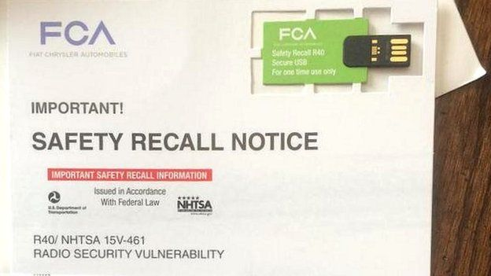

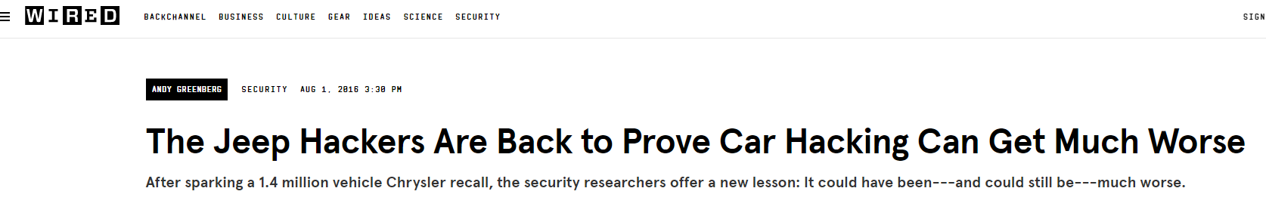
Incident response

Slide 37
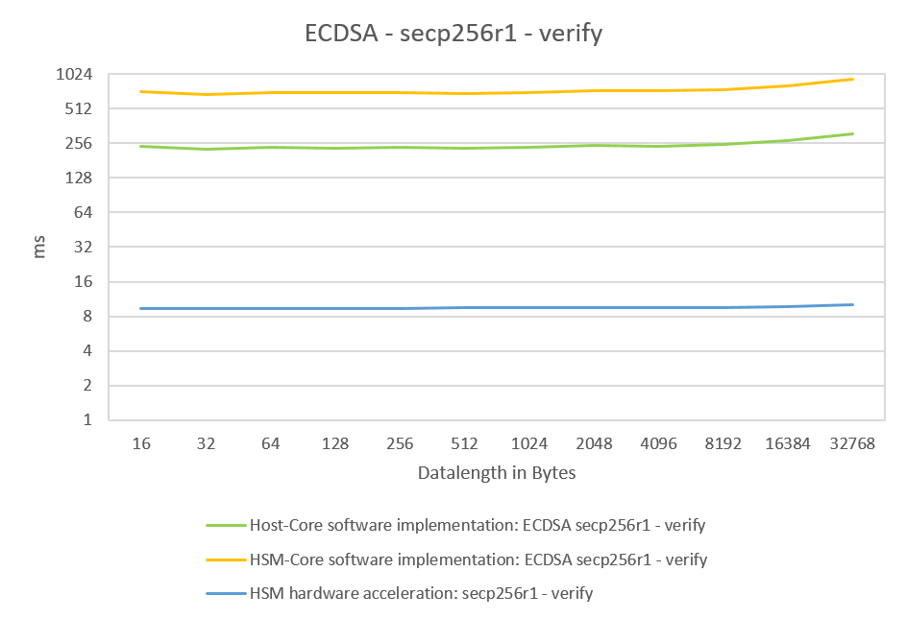

Wakeup !!
Infineon TC397
Notes:
For most stimulus and response actions such as using a key fob, that time is around 200 ms. For parking aid systems, the ISO 17368 specification recommends a 350 ms timeframe to boot and establish full video communication to the driver.

Slide 38

Window of oportunity

Slide 39
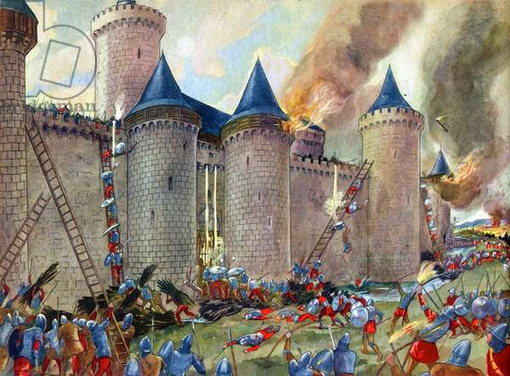
‚Even castles with strong fortifications should be guarded, paying particular attention to the recessed corners’
Notes:
Consider the scenario in which you are the ruler of a medieval castle with valuable assets within your stronghold. You receive credible threat intelligence that a ninja plans to infiltrate your castle and set fire to the food supply in your dungeon. The dungeon has multiple ingress/egress points whereby staff transport food, moving freely and without monitoring. Consider what measures guards could take to protect food from a fire in the basement. What staffing changes could you implement to control human interactions with the food and protect it from harm? What measures would ensure that guards could quickly observe, report, and respond to fire in the basement? How could guards detect a ninja infiltrating the basement, and what architectural changes could be made to mitigate blind spots that allow access to the food? Note that while it would be advisable to have backup food supplies in alternate locations or to store the food within fire-resistant material, for this exercise, consider how guards could control and protect the food rather than directly address the fire threat.

Slide 40
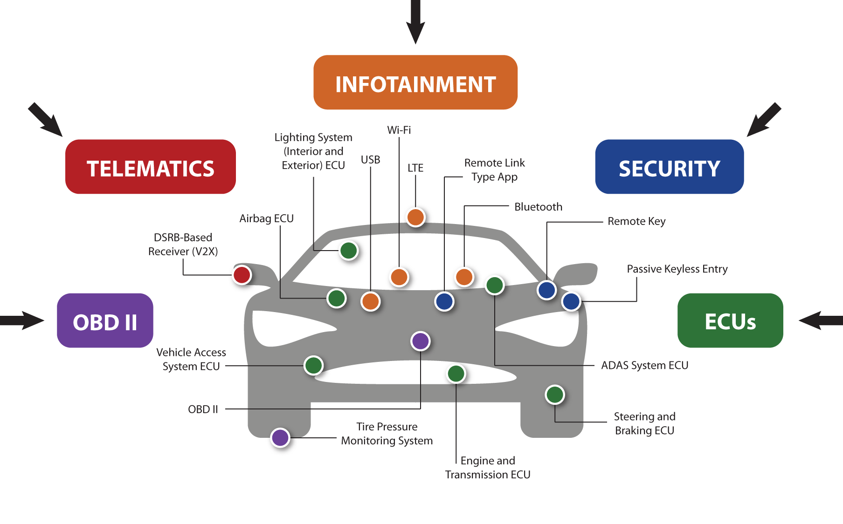

Slide 41
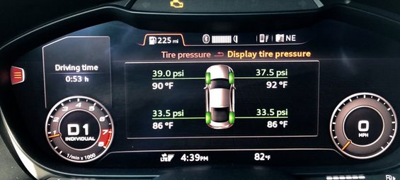
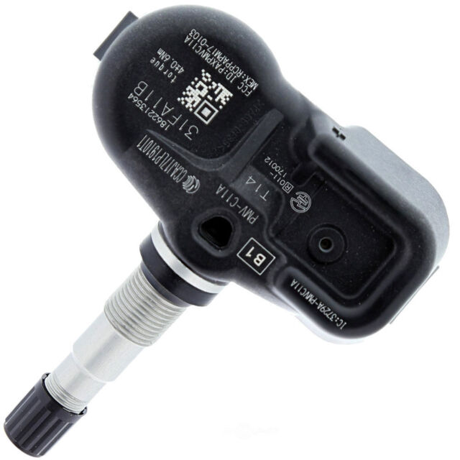

TPMS
Notes:
https://www.winlab.rutgers.edu/~gruteser/papers/xu_tpms10.pdf

Slide 42



TPMS - Tire Pressure Monitoring System
Frequency - 433 MHz or 315 MHz
Modulation - ASK or FSK
Range - 10 m ~ 40m
Transmit data once 60s – 90 s
Example Frame -
Preamble
Status
Preassure
Temperature
Checksum
ECU Receiver

Slide 43
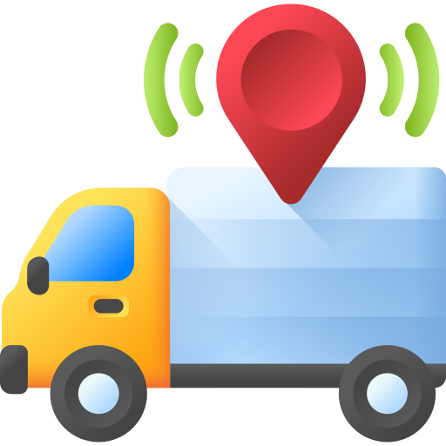



TPMS - attack scenarios
Vehicle tracking
Spoofing
Battery drain

Slide 44
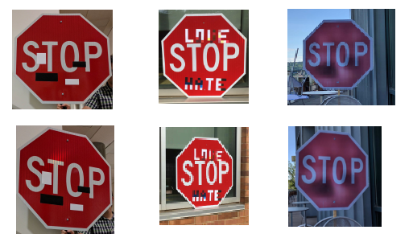
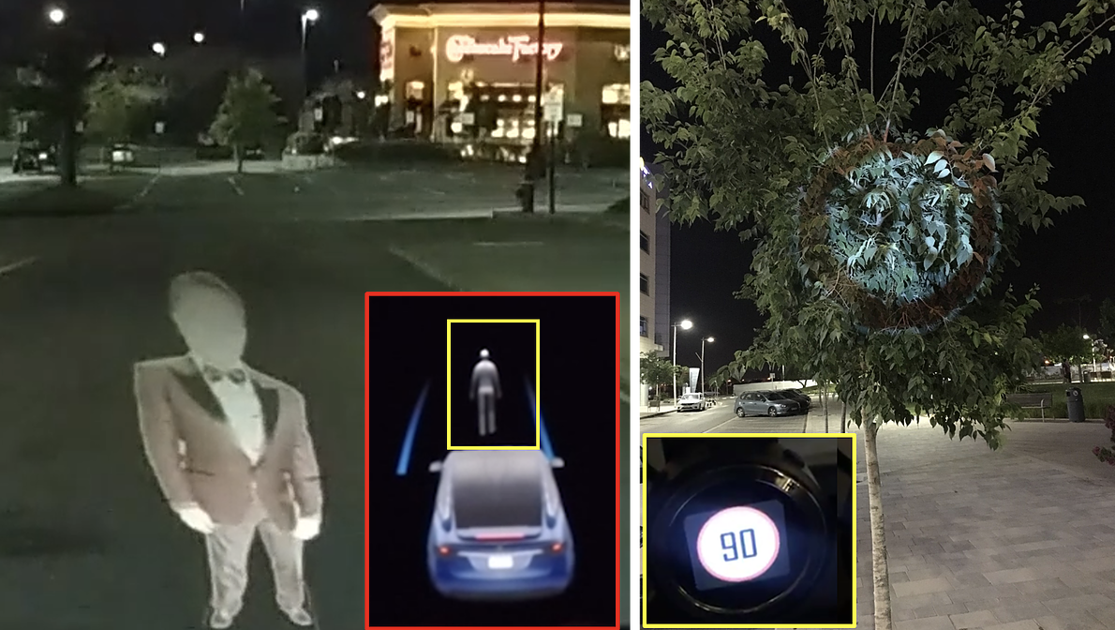
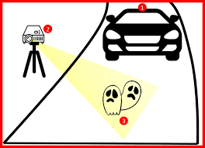
Attack on cameras

Slide 45
Thanks!
ANY QUESTIONS?

