Slide 1

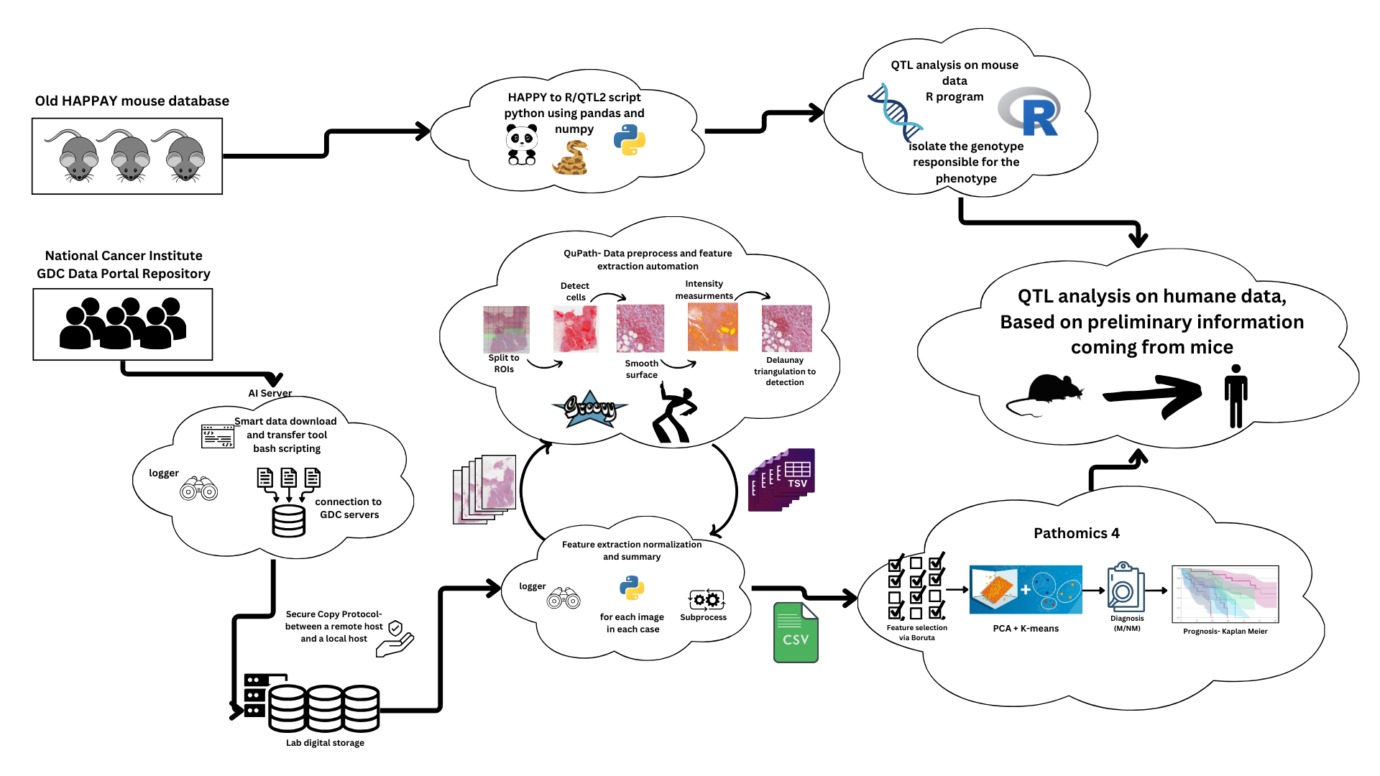
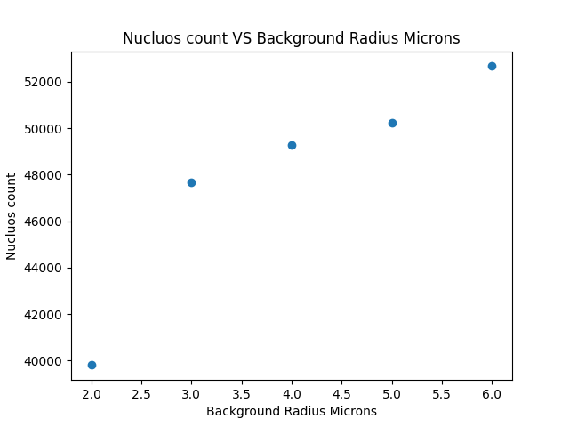
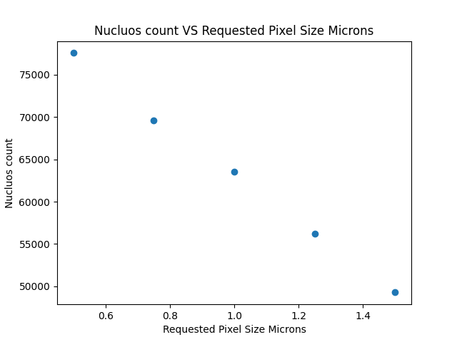
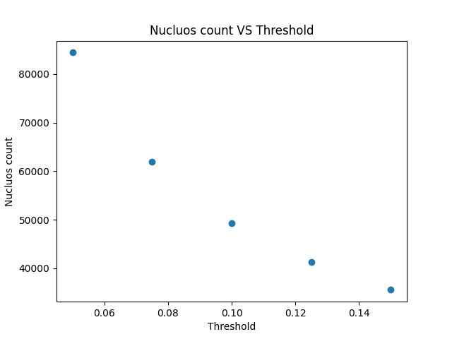
Multi-Omics 4
Project Number: 2541
Names: Lior Segal, Dor Fried
Advisor: Prof. Ilan Tsarfaty
Introduction Initially aimed to reproduce and enhance the MultiSurv model for cancer survival prediction Encountered challenges in replication, highlighting issues in AI research reproducibility Pivoted to develop a comprehensive pipeline integrating image processing and clinical data for Quantitative Trait Locus (QTL) analysis Motivation Breast cancer caused 670,000 deaths globally in 2022 and was the most common cancer in women in 157 out of 185 countries. Improve cancer prognosis prediction and personalized treatment strategies Address challenges in reproducibility of AI models in biomedical research Develop tools for integrating diverse data types in genetic cancer research. Implementation Our pipeline integrates multiple components: Smart Data Management Tool: Two-tier architecture: AI server for computation, local computer for storage • Parallel download-and-copy method for efficient data handling • Comprehensive logging system for data integrity Classical Image Processing: Utilizes QuPath for whole-slide image analysis • Automated script for consistent and efficient processing • Optimized parameters for cell detection and feature extraction QTL Analysis: Successful transition from HAPPY to R/qtl2 • Enhanced capabilities for complex multi-parental crosses • Improved detection of QTLs with smaller effect sizes | Pipeline flow chart Results MultiSurv Reproduction Attempt: Achieved C^td of 0.51, compared to reported 0.809 • Highlighted challenges in AI research reproducibility Smart Data Management Tool: AI computer: 10x faster download, 2-3x faster processing • 66% reduction in overall processing time • Efficient hybrid storage: AI (2.5TB) + Lab (200TB) Image Processing: Throughput increased from 16 to 288 images/day • calculated the optimal parameters for Qupath run QTL Analysis Upgrade: Successful HAPPY to R/qtl2 data transfer • Enhanced capabilities for complex genetic analyses • Consistent with previous HAPPY-based results Wrapper Script Performance: 99.7% success rate across image formats • Processes 100 images per batch • Reduced batch effects | a sample of optimal parameters experiment for qupath Conclusions Developed a robust pipeline for integrating image processing and genetic analysis in cancer research Demonstrated significant improvements in data management and processing efficiency Established a foundation for more advanced investigations into genetic underpinnings of complex traits and diseases Highlighted the importance of reproducibility in AI-driven biomedical research Future Work Further optimize data transfer and analysis processes Expand QTL analysis to diverse cancer types Develop open-source tools and conduct reproducibility workshops Bibliography [1] Vale-Silva L.A., Rohr K. (2021). Long-term cancer survival prediction using multimodal deep learning. Scientific Reports, 11, 13505. [2] Broman, K.W., et al. (2019). R/qtl2: Software for Mapping Quantitative Trait Loci with High-Dimensional Data and Multiparent Populations. Genetics, 211(2), 495-502. [3] Bankhead, P., et al. (2017). QuPath: Open source software for digital pathology image analysis. Scientific Reports, 7(1), 16878.

