Slide 1

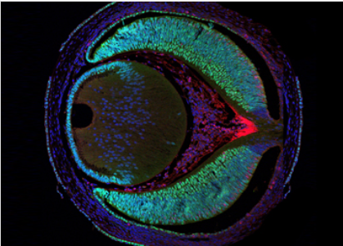
End-Project presentation -Multi- Omics 4
Project Name: Multi- Omics 4
Project Number: 2541
Student names: Dor Fried, Lior Segal
Mentor Name: Prof. Ilan Tsarfaty
Project Location: Faculty of Medical and Health Sciences
Tel Aviv University
Mentor signature:

Slide 2


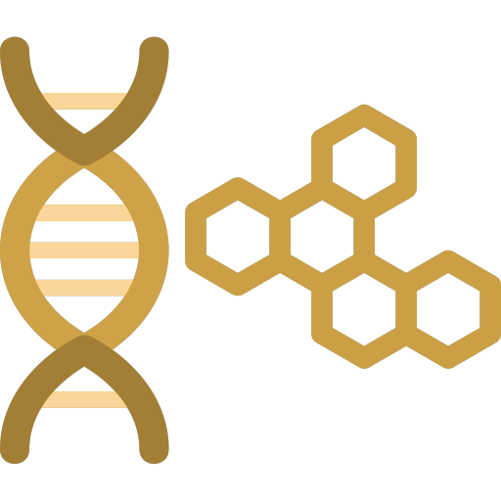
Introdaction
Initial intention – Multiserv improvment
After the reproduce attempts failed - Pivot the project
Develop a robust pipeline for integrating diverse biological data types
The main components of the pipe are:
Smart data management tool (SDMT)
Classical image processing using Qupath engine (CIP)
Upgrade QTL analysis capabilities to advanced program (QTL)
SDMT
CIP
QTL
Notes:
At first our project was around modifying and extend the MultiSurv deep learning model
After multiple and fruitless attempts, in which we failed to reproduce the original article, we pivot our project
The next phase of the project centered around develop a robust pipeline for integrating diverse biological data types
The main components of the pipe are:
Smart data management tool
Classical image processing using Qupath engine
Upgrade QTL analysis capabilities to advanced program

Slide 3
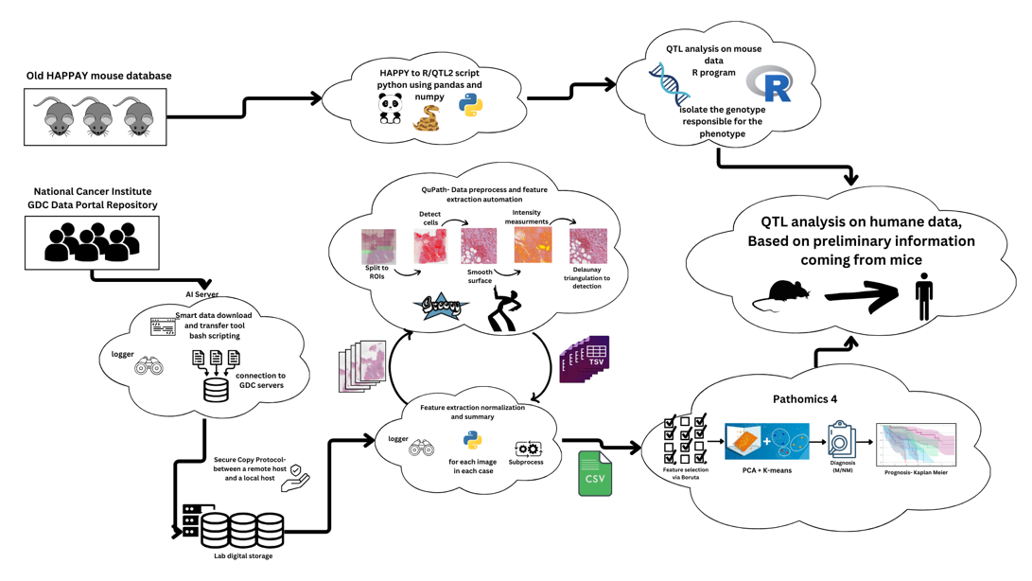
Block diagram

Slide 4
Motivation
Breast cancer: 670,000 deaths worldwide in 2022.
Current prognosis methods can be improved
AI promise the expected improvement
Another direction for improvement - in-depth genetic research
Learn from invasive genetic research in mice into humans
Notes:
Breast cancer: 670,000 deaths worldwide in 2022.
Current prognosis methods, mainly manual diagnosis by doctors, lack precision and repeatability
AI promise: Personalized prognosis using diverse data on the patient: clinical, genomic, and imaging data integration
MultiSurv model (2021): Initial breakthrough Non-linear, non-proportional survival prediction

Slide 5
Project Objectives
Our original objective was reproducing and enhance MultiSurv model
Revised Objectives was developing integrated pipeline for cancer genetic research
Create secure data management system
Enhance histopathological image analysis
Modernize genetic analysis methods
Notes:
Our original objective was reproducing and enhance MultiSurv model
Encountered significant reproducibility challenges
Revised Objectives was developing integrated pipeline for cancer genetic research
Create secure data management system
Enhance histopathological image analysis
Modernize genetic analysis methods

Slide 6
Multiserv - Challenges
AI reproducibility problems causes:
Hyperparameter discrepancies
Evolving software dependencies
Lack of detailed environment documentation
Attempts to Overcome Challenges:
Expert Consultation
Manual fixes for lines of code that didn't work
A study of a new library structure versus an old one

Slide 7
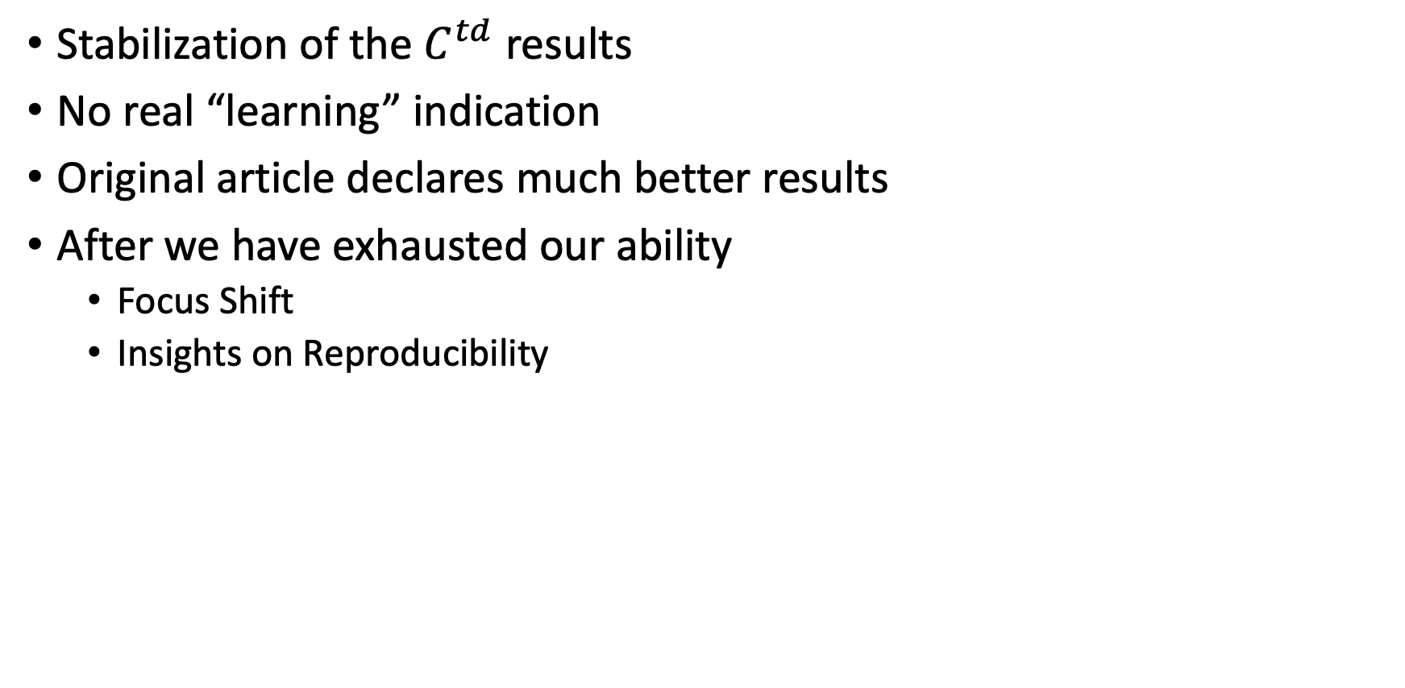
Multiserv - Results
Stabilization of the $C^{td}$ results
No real “learning” indication
Original article declares much better results
After we have exhausted our ability
Focus Shift
Insights on Reproducibility

Slide 8
Implamentation and Results
SDMT
CIP
QTL

Slide 9
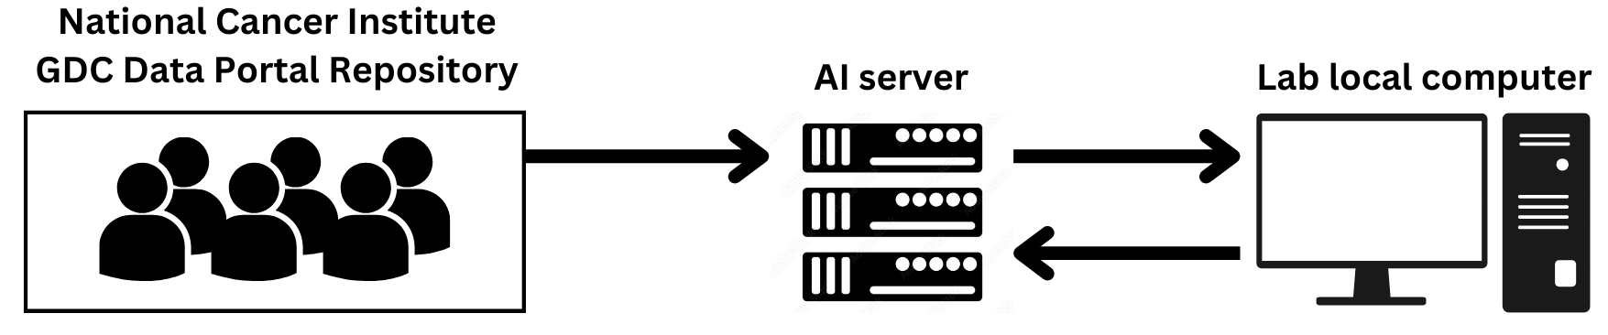
Smart Data Management Tool
Custom Python Utility
Main functions:
Control data downloaded flow
Implements Secure Copy Protocol (SCP)
Comprehensive Logging System
Manage the two-Tier System
Data Flow
SDMT
CIP
QTL
Notes:
NCI's GDC Data Portal → AI Server • Transfer: AI Server → Local Computer (via SCP) • Processing: Local Computer → AI Server → Local Computer

Slide 10
System HW description
Two-Tier System for Efficient Data Processing
AI Server (High-Performance Computation)
role: Complex computations, image processing, deep learning tasks
Local Computer (Data Management Hub)
role: Data preprocessing, storage, script execution
SDMT
CIP
QTL

Slide 11
SDMT - Tasks Comparison
Download Speed:
Ai server is 10x faster at download
Processing Speed:
Image Processing: 20 min/image vs 40-60 min/image
Storage Capacity:
The AI server can’t hold the whole DB
The use of Smart Data Management Tool save more then a month in worktime (estimated)
SDMT
CIP
QTL
Notes:
Processing Speed Comparison, AI Server vs Local Computer:
Image Processing: 20 min/image vs 40-60 min/image
1000 image dataset: ~14 days vs ~42 days
Time saved: ~28 days per 1000 images
The use of Smart Data Management Tool save more then a month in worktime (estimated)

Slide 12
Image Processing - QuPath
QuPath based processeing
We automate using QuPath using Groovy script
Key Algorithms:
Color Deconvolution: Separates H&E stains
Improved Watershed Algorithm: Enhanced cell segmentation
Feature Extraction: Intensity measurements, Haralick textures
Advanced Features (In Development) including
Dynamic parameter adjustment
Automatic ROI
Sliding window approach
SDMT
CIP
QTL
Notes:
QuPath is a powerful tool for analyzing whole slide images (WSIs)
Our pipeline automate using Qupath using Groovy script instead of the usual GUI based use
Key Algorithms:
Color Deconvolution: Separates H&E stains
Improved Watershed Algorithm: Enhanced cell segmentation
Feature Extraction: Intensity measurements, Haralick textures

Slide 13
Image Processing - Wrapper
A script that manages the calls for automation
Gathers and analyzes data for the next step
Throughput Improvements
288 images/day (automated) vs 16 images/day (manual)
Result Processing
Analysis 1.2 TB of pressed data to one phenotypes table
SDMT
CIP
QTL
Notes:
A Python script that sends images to QuPath automatically (back-to-back)
After running the Qupath gathers and analyzes data for the benefit of qtl software
Throughput Improvements: 288 images/day (automated) vs 16 images/day (manual)
Advanced Features (In Development) • Dynamic parameter adjustment based on tissue type • Automatic ROI detection for tumor/stromal regions • Sliding window approach for 40GB+ whole slide images

Slide 14
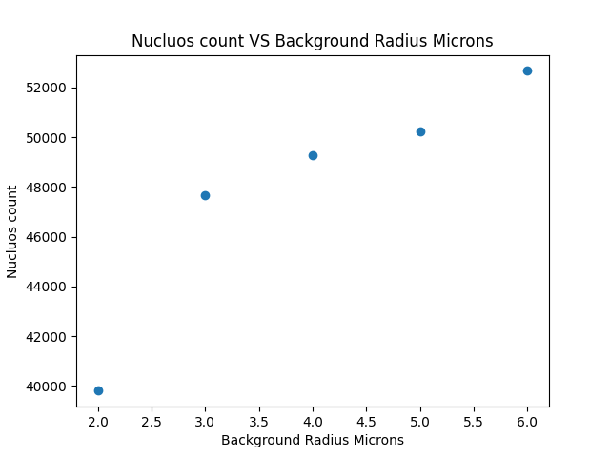
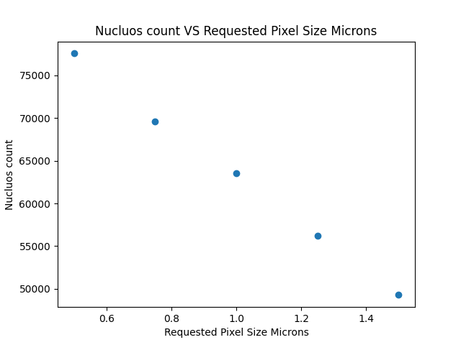
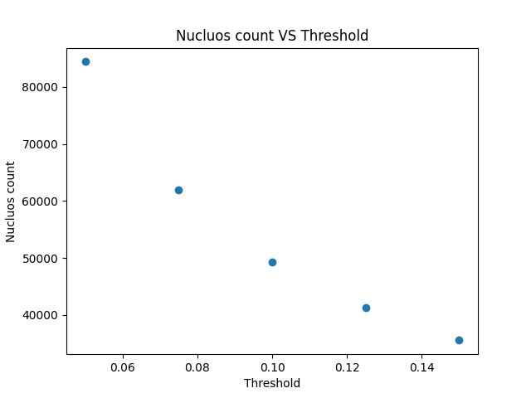
Image Processing - Optimization
Automation for Robust and Efficient Analysis
Accuracy: 99.7% success rate on the test sample
Parameter Optimization through Research and Experimentation
Over 20 parameters were studied and selected
Different parameters for different sources (?)
SDMT
CIP
QTL

Slide 15
Modernizing Genetic Analysis
QTL Analysis Modernizing
Transition HAPPY to R/qtl2
Enhanced analytical power for complex genetics
Converting legacy data format to new framework
Python scripting:
Mapped HAPPY genetic markers to R/qtl2 format
Translated probability matrices to R/qtl2 genotype encoding
Aligned phenotypic data with genetic information
Integrated additional cross-information data
SDMT
CIP
QTL
Notes:
QTL Analysis analysis is a statistical method used to identify the relationship between genetic markers and phenotypic traits
Transition HAPPY to R/qtl2
Motivation: Enhanced analytical power for complex genetics
Challenge: Converting legacy data format to new framework
Implementation in python using numpy and pandas, key Steps:
Mapped HAPPY genetic markers to R/qtl2 format
Translated probability matrices to R/qtl2 genotype encoding
Aligned phenotypic data with genetic information
Integrated additional cross-information data

Slide 16
Modernizing QTL - Results
TBD TBD TBD TBD TBD TBD
Successful Data Transfer
Adaptation to R/qtl2 Requirements
Initial QTL Analysis on Mouse Data
Statistical analysis - Proof that missing information is not necessary
SDMT
CIP
QTL

Slide 17
Conclusions and further work

Slide 18
We successfully pivoted the project.
Developed a comprehensive pipeline combining data management, genetic analysis, and image processing for enhanced cancer data analysis.
Transition to R/qtl2 and improved image processing greatly enhanced the ability to extract insights from complex biological data.
Notes:
1. Successful Pivot and Adaptation:
We effectively overcame initial challenges in reproducing MultiSurv by redirecting our efforts, which led to significant advancements in our cancer research tools.
2. Integrated Pipeline Development:
We successfully created a comprehensive pipeline combining data management, genetic analysis, and image processing, enhancing our cancer data analysis capabilities.
3. Enhanced Data Analysis Capabilities:
Our transition from HAPPY to R/qtl2 for QTL analysis, along with our improved image processing techniques, significantly boosted our ability to extract insights from complex biological data.
4. Advancing Reproducibility in AI Cancer Research:
We made important contributions to reproducibility in AI-driven cancer research through our meticulous documentation and open-source tool development.
These conclusions highlight our key achievements in tool development, data analysis improvement, and promoting reproducibility in cancer genetic research.

Slide 19
Further work
Finish the auto Parameter Management in Qupath automation
Assembling the missing information in the genetics of the mice through reverse engineering of the existing information
Data Versioning and Environment Control
Revisit Multiserv

Slide 20
Mischief (barely) managed

