Slide 1




IEEE-VESIT
VESIT
presents
  Domain: Education
  Problem Statement Title: Gamified Offline Learning Platform for Rural Students
  Team Name: HackingHavoc
  Team Members:
      Member 1 - Awwab Mhaiskar
      Member 2 – Alina Khan

Slide 2
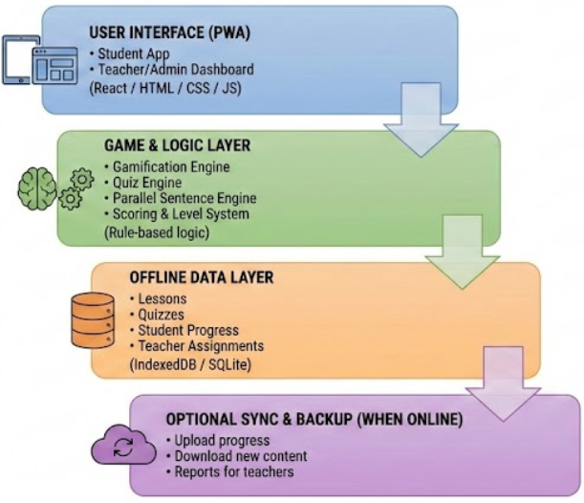
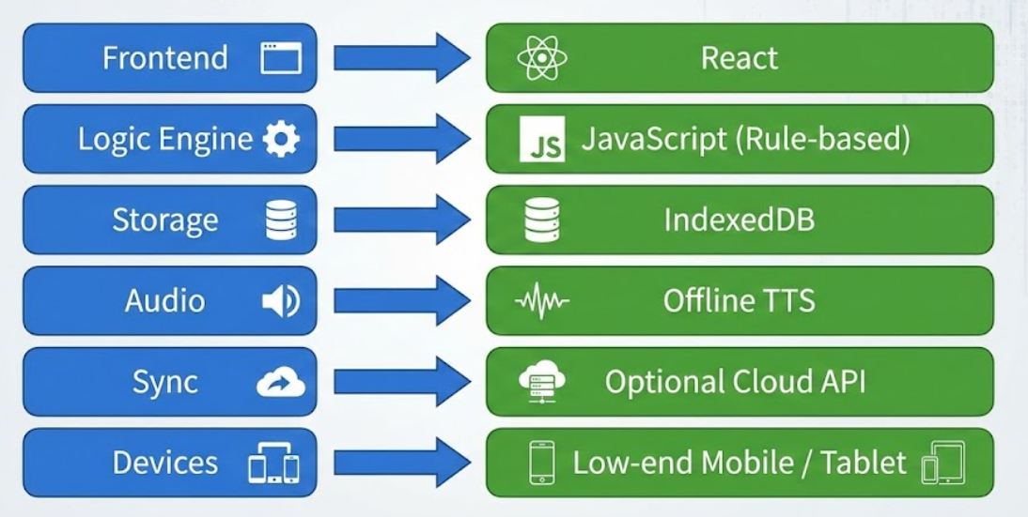
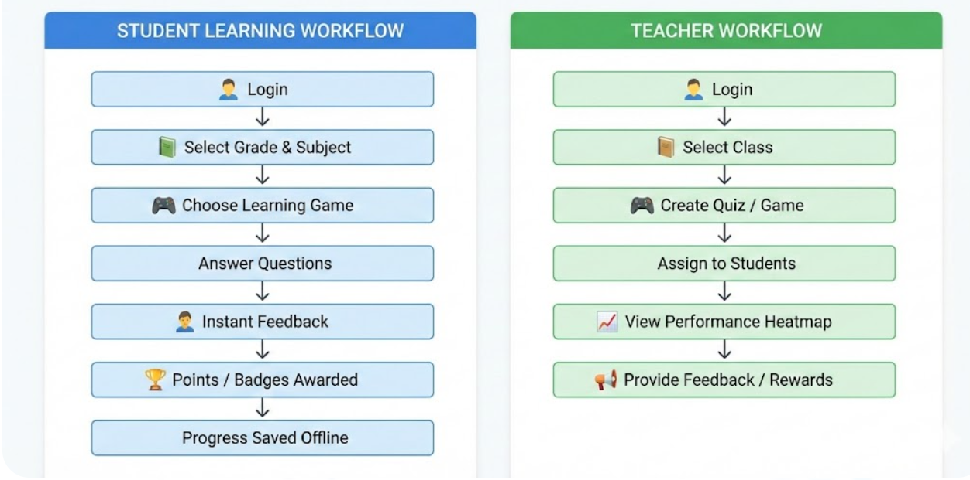
VESIT
System Architecture
Tech Stack
App Workflow
IEEE- VESIT

