Slide 1
Using Machine Learning and NLP to automate Crime Survey for England and Wales (CSEW) offence coding
Alessandra Sozzi and Shannan Greaney, ONS
Notes:
Today we are presenting a project we have developed in ONS, a collaboration between the Crime Stats Team and the Big Data Team, which is about Using Machine Learning and NLP to automate Crime Survey for England and Wales (CSEW) offence coding

Slide 2

Contents
What is the CSEW?
The current offence coding process
The purpose of the case study
OffenceCoder model
Results
Notes:
We will be talking a bit more on what is the crime survey, what is the current offence coding process and the purpose of this case study.
Then we will go in more details on the Offence coder model and what are the results so far

Slide 3
Contents
What is the CSEW?
The current offence coding process
The purpose of the case study
OffenceCoder model
Results
Notes:
The Crime Survey for England and Wales

Slide 4
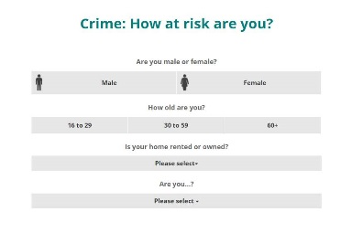
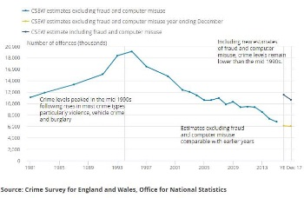
What is the Crime Survey for England and Wales (CSEW)?
The CSEW aims to measure the extent of various crimes experienced by the public. It asks respondents whether they have experienced crime in the last 12 months.
If YES, respondents are asked a series of detailed questions, known as the Victim Form (VF).
One respondent can complete up to 6 VFs
Hundreds of closed questions and a free text field (which summarises the crime) are used by the coder to assign an Offence code.
These are finally used to produce analysis and outputs
Notes:
The CSEW aims to measure the extent of various crimes experienced by the public. It asks respondents whether they have experienced crime in the last 12 months.
If yes, Respondents who have experienced a crime are asked a series of detailed questions, known as the Victim Form (VF) and One respondent can complete up to 6 VFs
VFs are composed of close questions (often simple Yes/no replies) and a free text field where the interviewer summarise the crime. Both these information are used by the coder to assign an Offence code to the VF
The VFs with final offence code are then used to produce ONS analysis and outputs

Slide 5
Contents
What is the CSEW?
The current offence coding process
The purpose of the case study
OffenceCoder model
Results
Notes:
The current offence coding process

Slide 6
Current process
The Crime Statistics team at ONS ‘dual code’ 10% (approx. 2,000 VFs per year) to check that the external company who manage the CSEW is coding correctly.
It’s 1 part-time person job for 1 year (in reality 2 EOs, 7 ROs and 7 SROs)
On average it takes 10-15 mins per VF
Ambiguous cases requires agreement of multiple persons in the team (a decision could take days and a sign-off by a G7)
Coders have to choose one of the 50+ offence codes
Ambiguous VFs might be:
- if the VF features more than one crime (e.g. a burglar breaks into someone’s house, beats up the occupants, steals the car and breaks some valuable belongings). A priority order is used.
- Duplicates: using the example above, the respondent (or interviewer) could record each of those crimes as separate VFs but because they belong to the same incident, one VF should have been completed and one offence code should be applied
Notes:
The Crime Statistics team at ONS ‘dual code’ 10% (approx. 2,000 VFs per year) of the survey VFs to check that the external company who manage the CSEW is coding correctly.
It’s 1 part-time person job for 1 year: in reality is spread across 2 EOs, 7 ROs and 7 SROs
On average, one response could take 10-15 mins
Coding of ambiguous cases might require the agreement of multiple persons in the team (a decision could take days and needs to be signed-off by a G7 )
Coders have to choose one of the 50+ offence codes
Ambiguous VFs might be:
- if the VF features more than one crime (e.g. a burglar breaks into someone’s house, beats up the occupants, steals the car and breaks some valuable belongings). A priority order is used here which crime takes precedence
- Duplicates: using the example above, the respondent (or interviewer) could record each of those crimes as separate VFs but because they belong to the same incident, one VF should have been completed and one offence code should be applied. The coder here often has to

Slide 7
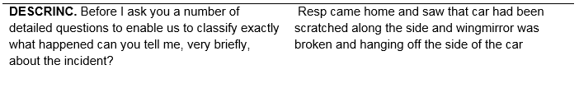
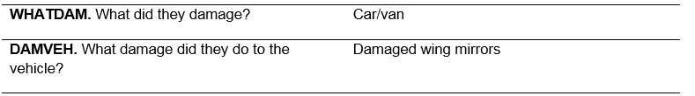
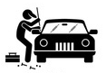
Example of current coding process
Coders read through the free text and the closed responses.
Please note, this is not a real VF.
They have to follow written guidance and flow charts (8 in total) to reach an Offence code
Notes:
This is how a snippet of the VF is presented to the coder
Coders read through the free text and the closed responses.
They have to follow written guidance and flow charts (like the one shown here, there are 8 in total) to reach an Offence code

Slide 8
Contents
What is the CSEW?
The current offence coding process
The purpose of the case study
OffenceCoder model
Results
Notes:
The purpose of the case study

Slide 9


The purpose of the case study
The purpose of the case study is to assess the feasibility of doing this automatically, using Natural Language Processing (NLP) and classification techniques.
Machine learning: explores the study and construction of algorithms that can learn from and make predictions on data.
We use 10 years of historic manually classified VFs to build a model that can predict the correct offence code for new unseen VFs.
NLP: is a field of computer science that deals with applying linguistic and statistical algorithms to text in order to extract meaning to make their information accessible to computer applications. We use NLP to convert text in new numeric features that can be used by the model to learn more information about the incident.
Notes:
The purpose of the case study is to assess the feasibility of doing this automatically, using Natural Language Processing (NLP) and classification techniques.
- Machine learning: explores the study and construction of algorithms that can learn from and make predictions on data.
We use 10 years of historic manually classified VFs to build a model that can predict the correct offence code for new unseen VFs.
- NLP: is a field of computer science that deals with applying linguistic and statistical algorithms to text in order to extract meaning to make their information accessible to computer applications. We use NLP to convert text in new numeric features that can be used by the model to learn more information about the incident (as the closed questions might not saying it all!)

Slide 10
Contents
What is the CSEW?
The current offence coding process
The purpose of the case study
OffenceCoder model
Results
Notes:
OffenceCoder model
I am now going to take you through our OffenceCoder Model

Slide 11





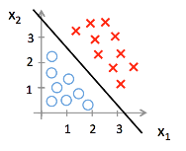

OffenceCoder model
Cleaner pipeline
End-to-end process
It’s composed of three parts
It’s built entirely in Python and scikit-learn
Questions
Text
Model pipeline
What is a pipeline? – A pipeline is simply a chains of steps. It allows you to perform sequence of different transformations or steps (find set of features, generate new features, select only some good features) to a raw dataset.
Thresholding System
Notes:
OffenceCoder is actually not just the model,
but an entire end-to-end process.
The process takes as input 10 years worth of survey data manually coded by both ONS and the external company
It’s composed of three parts which will discuss in detail in a minute:
A cleaner pipeline
The model pipeline
And a final thresholding system
OffenceCoder is built entirely in Python and scikit-learn, a popular Python library for machine learning. And is from scikit-learn where we take advantage of pipelines.
For those of you who might not know, a pipeline is simply a chains of steps. So, you build each one individually, they are perform one after the other. The output of one step becomes the input of the next one.
Now take you through each of these steps in more detail, starting with the cleaner pipeline

Slide 12
The cleaner pipeline
(~15000, ~900)
Cleaner pipeline
(~150000, ~130)
Responsible for taking on the raw .csv files and standardising them across the years. At output they can now be joined together in a single one.
Each file enters the pipeline individually and at the end they are joined together in a single big file
Examples of processing steps include:
Renaming columns that have changed over the years with a new common name
Feature selection based on expert knowledge
Feature combination
Filtering out invalid forms
Notes:
Cleaner Pipeline
The Cleaner pipeline is responsible for taking on the 10 raw .csv files, of varying size (~15000, ~900), and standardising them across the years.
As visualized here, at input each file enters the pipeline individually and at the end they are joined together producing our output in a single big file ready for modelling
Some examples of processing steps included within this pipeline are:
Renaming variables (columns) that have changed over the years with a new common name to standardize these across all years
Feature selection based on expert knowledge – so we have only chosen to include variables from the victim forms which are important for coding
Feature combination – so we combined relevant variables to reduce noise so the signal and information are more visible to the model
Filtering out invalid forms
So what does the cleaner pipeline ACTUALLY look like?

Slide 13
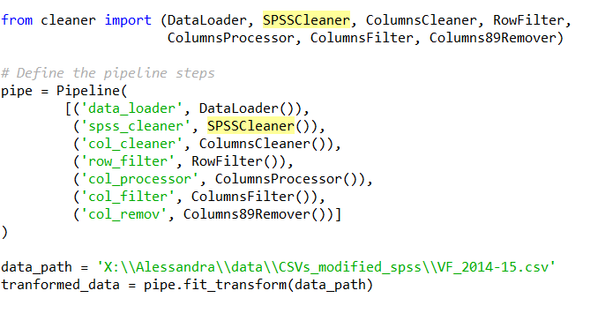
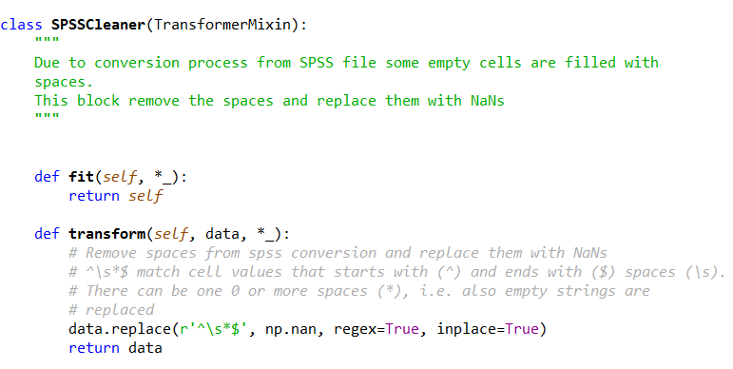
Example cleaner pipeline
Each step has a similar structure
Easy to change the number/order of the steps
We can combine common step built-in scikit-learn with our own custom built steps
Easier to maintain the code
Notes:
Here is a snippet of all of the steps which make up the cleaner pipeline. Here the cleaner pipeline has 7 different steps, including the columns cleaner, Columns89remover which are responsible for some of the jobs I just mentioned.
Each of these steps are defined separately in a separate file.
To build each step, we follow the template given by scikit-learn. This way only thing we need to customize is transform part here. Everything else is left as it is. Each of the steps follow a similar defining structure.
Then, once we have defined all of our steps, we put them in the order we want them to be performed and enclose in this scikit-leran function called pipeline
This is really powerful because at the end of this process we only need to call the variable ‘pipe’ which we just created and use its method ‘fit_transform’ on the input data.
Scikit-learn then takes care of everything else. This makes the process really flexible for us, we can:
easily change the number of steps or the order, delete or add a new one
combine common built-in scikit-learn steps with our own custom built steps
Easily maintain the code
So, now you have an idea of what’s going on inside the cleaner pipeline, lets move on to next part: the model pipeline.

Slide 14
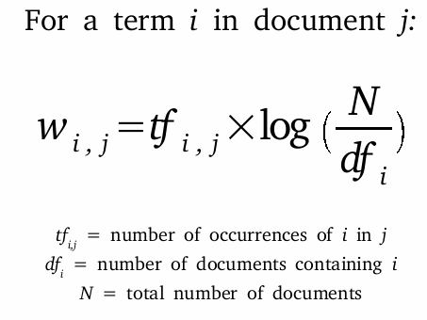
The model pipeline
Questions
Text
Model pipeline
Data is not quite ready yet for modelling. Closed questions and the Text description goes through additional but separate processing steps.
Questions
Text
Questions are further processed after the basic processing performed in the cleaning phase
The main tasks of this pipeline is to convert responses like ‘Yes/No’ into integers (eg 1/0). This is called One-Hot-Encoding
Some questions have more complex levels, so new dummy variables are created
We drop levels such as ”Don’t Know”/”Refused” to remove noise
Term frequency-inverse document frequency (TF-IDF) measures the importance of each word by comparing it to the frequency of terms in a large set of documents.
Each VF description is converted into a vectorised format
For each VF, each word is
scored based on its importance
within that VF and w.r.t
the whole set of VFs.
Notes:
Model Pipeline
So the output of our cleaner pipeline is a combined big csv file of our 10 years worth of CSEW data. However, our data is not quite ready for modelling just yet!
As Alessandra mentioned, the CSEW VF’s are comprised of open (free text descriptions) and closed (Yes/No). These need to go through an additional processing steps after the basic processing performed in the cleaning phase as part of the model pipeline.
First we will go through how we process the closed Yes/No questions.
For this task, the pipeline converts responses like ‘Yes/No’ into integers (e.g. 1/0s). This is called One-Hot-Encoding. In our case, Yes responses become 1’s and No responses 0’s.
Some questions have more complex levels, so new dummy variables are created. Creating a dummy variable means that for each response level, a new variable is created, but we don’t keep all of these, we discard the ones not relevant for coding.
We also drop levels such as ”Don’t Know”/”Refused”, again to remove noise
Now, to process the text!
The free text descriptions from each VF are processed using a method called TF-IDF.
Term frequency-inverse document frequency (TF-IDF) measures the importance of each word by comparing it to the frequency of terms in a large set of documents.
This is a very common method for handling text, and a method most used in practice.
For our case, Each VF text description is converted into a vectorised format (meaning each word becomes a feature of our model)
Then for each VF, each word is scored based on its importance within that VF and with the respect to the whole set of VFs. In summary TF-IDF reflects how important a word is.

Slide 15
The model pipeline
Questions
Text
Model pipeline
Data is not quite ready yet for modelling. Closed questions and the Text description goes through additional but separate processing steps.
We keep 9 years of data for training the model and test results in multiple batches of the latest year (2017)
Run a multinomial logistic regression and for each VF the model predict a probability for each of 50+ offence codes, i.e. for each of the possible outcomes. The predicted Offence Code is the one with the highest probability.
Overall, the model achieves a robust 86% of correctly classified cases.
However, this is far from the 97% of desired accuracy.
Notes:
So, now all of our processing is complete, the data is now ready for modelling.
We split our processed, big csv file into a training and training set. We keep 9 years of data for training the model and test results in multiple batches of the latest year (2017)
Then, we run a multinomial logistic regression. For each VF the model predicts a probability for each of 50+ offence codes, that is, for each VF it produces a probability for each of the possible outcomes. The final predicted Offence Code for each VF, is the one with the highest probability.
Overall, the model achieves a robust 86% of correctly classified cases. However, this is far from the 97% of desired accuracy.
So, a quick recap before we move on to the final step of the model - at this stage we have cleaned and processed our data and run our model. Our output from our model pipeline is probability estimates for each VF that each possible offence code is the correct class. In an ideal scenario, for each VF there will be one offence code with a very high, strong probability and the rest with low probabilities, making it very clear which offence has occurred in that VF. However, this wasn’t always the case. When we looked into the distribution of the probabilities for each class, the highest, and final offence code, was much less obvious in some cases.

Slide 16
The Thresholding System
Thresholding System
There is a large variance in the model performance between different offence codes.
As a solution, we select only some of the most successful (and robust) predicted classes and apply a class-informed threshold to each one of them.
Predictions are considered valid only where the probability on a specific class meets the class thresholds.
Results are exported as a csv file
Notes:
To overcome this limitation we added an additional step, The Thresholding system.
As mentioned we noticed that there is a large variance in the model performances between different offence classes.
So, as a solution to this, we decided to select only some of the most successful (and robust) predicted classes and apply a class-informed threshold to each one of them. This was around 10 of the 50+ offence codes.
After the thresholding system is in place, predictions are considered valid only where the probability on a specific class meets the class thresholds.
Results from this final step are then exported as a final csv file. This file holds the VF identifier number, the final predicted offence code and the corresponding probability or, models confidence in that code for all cases coded.
The model initially achieved a robust 86% accuracy, but what were our results after we added the thresholding system to our model?

Slide 17
Contents
What is the CSEW?
The current offence coding process
The purpose of the case study
OffenceCoder model
Results
Notes:
Results

Slide 18
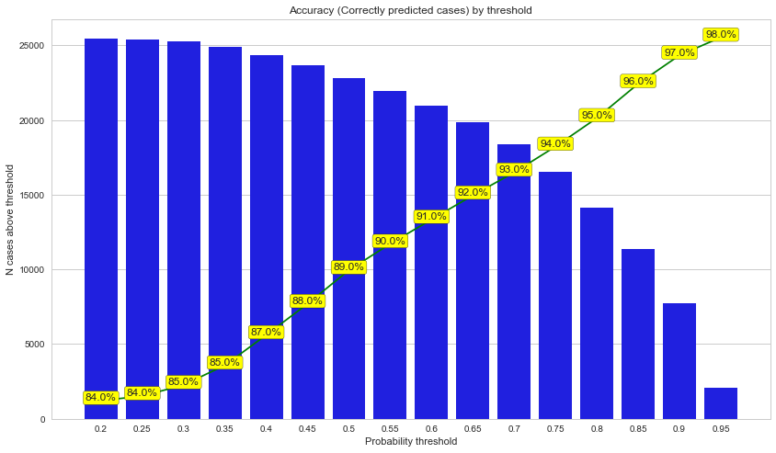
Results
After running the model on the test set, the thresholding components separates the selected predicted offence codes which meet the threshold.
This on average tends to constitute circa 40% of all VFs.
On this subset 40%, the model correctly predicts the offence code for 97% of the VFs
We aim now to trial it in production. From this:
Coding burden can be reduced from analysts
Saves time and money!
The process of building the model allowed for improvements to be made in the coding manual and guidelines for interviewers
Notes:
After running the model on the test set, for the selected predicted offence codes the thresholding component separates out the cases where the probabilities meet the threshold.
This subset of cases on average constitutes around 40% of all VFs and on that subset, the model correctly predicts the offence code for 97% of the VFs.
Albeit on a subset, this is a big improvement on our initial result of 86% before the implementation of a thresholding system and a figure that the Crime Stats team at ONS and our external survey managers Kantar are happy with.
Whilst this is still an ongoing process and we continue to refine the model by updating the selected variables used and testing on new datasets (2018) we do aim to trial the model in production.
From our model, we can reduce the burden of coding on analysts in the crime team which in turn saves time and money!
In addition, the process of building the model allowed for improvements to be made to the existing coding manual and guidelines produced for interviewers (for example the handling of duplicates and summarizing of crimes in text descriptions.

Slide 19

Thank you!
Questions
Alessandra.Sozzi@ons.gov.uk
Shannan.Greaney@ons.gov.uk
Notes:
Thank you for listening, we do have time for questions if there is anything anyone would like to ask. But our e-mails are also up here if anyone would like to get in touch after.

