Slide 1
Prototype of the project
Jiaojiao Gao

Slide 2
Administrator
Departments

Slide 3
Administrator

Slide 4

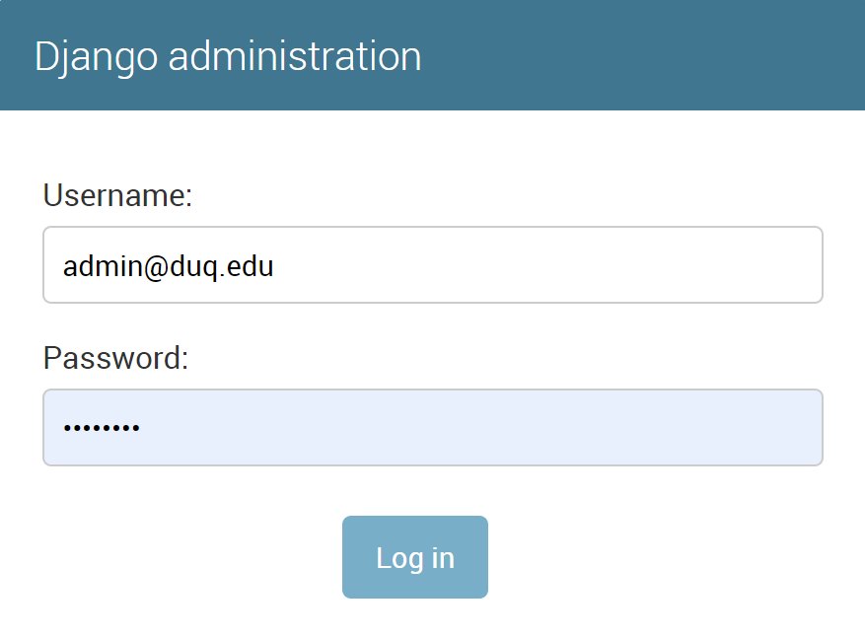


Slide 5






Manage System
Admin
Logout
Current playlist
Key works
Building | Floor | Start_time | End_time | File_name | Monitor_id
College Hall | Second | 3/21/2019 | 3/30/2019 | Introduce | 2
College Hall | First | 3/20/2019 | 3/30/2019 | news | 1
College Hall | Second | 3/19/2019 | 3/30/2019 | information | 2
College Hall | Second | 3/21/2019 | 3/30/2019 | activities | 2

Slide 6




Manage System
Admin
Logout
New application list
Key works
Department | Floor | Start_time | End_time | File | Description | priority
Math | Second | 3/29/2019 | 3/30/2019 | Events | This slide is used inform students the upcoming events | 1
Math | Second | 4/21/2019 | 4/30/2019 | Intro | This slide is used inform students the upcoming events | 1
Law | Second | 5/21/2019 | 5/30/2019 | News | This slide is used inform students the upcoming events | 1
Music | Second | 6/21/2019 | 6/30/2019 | Break | This slide is used inform students the upcoming events | 1
submit

Slide 7
Manage System
Admin
Logout
You have accept the application num 1 from math department with the file
name Introduction.

Slide 8



Manage System
Admin
Logout
Post slide
Building:
Floor:
Start_time:
mm/dd/yyyy
End_time:
mm/dd/yyyy
Upload_file:
Priority:
1
submit

Slide 9
Manage System
Admin
Logout
New slides
Building | Floor | Start_time | End_time | File_name | Monitor_id
College Hall | Second | 3/21/2019 | 3/30/2019 | Introduce | 2
College Hall | First | 3/20/2019 | 3/30/2019 | news | 1
College Hall | Second | 3/19/2019 | 3/30/2019 | information | 2
College Hall | Second | 3/21/2019 | 3/30/2019 | activities | 2
Force Fresh

Slide 10
Departments

Slide 11
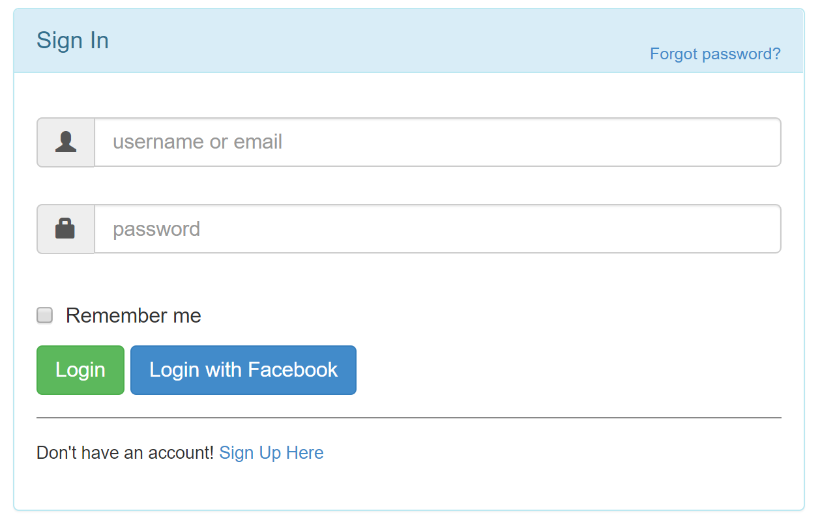


Slide 12
Manage System
Gaoj1
Logout
User manual and notes
The file type uploaded should be .pdf, ppt, pptx or jpeg.
The start_time means which day the slide will be showing in a monitor if the application be approved.
The end_time means the slide will not be shown in the monitor that day and after.
Make sure the information is correct, before submitting the application.
After you cancel one application, you need to create a new application if you want that slide shown again.

Slide 13
Manage System
Gaoj1
Logout
Your application has been accept with the file name Introduction.

Slide 14

Manage System
Gaoj1
Logout
My slides
Building | Floor | Start_time | End_time | File_name | Monitor_id | Status
College Hall | Second | 3/21/2019 | 3/30/2019 | Introduce | 2 | accepted

Slide 15
Manage System
Admin
Logout
Create an application
Building:
Floor:
Start_time:
mm/dd/yyyy
End_time:
mm/dd/yyyy
Upload_file:
Description:
submit

Slide 16
Thanks

