Slide 1
Efficient Deployment of
Virtual Network Services
Michael Till Beck
Ludwig-Maximilians-Universität München
05/27/2016

Slide 2
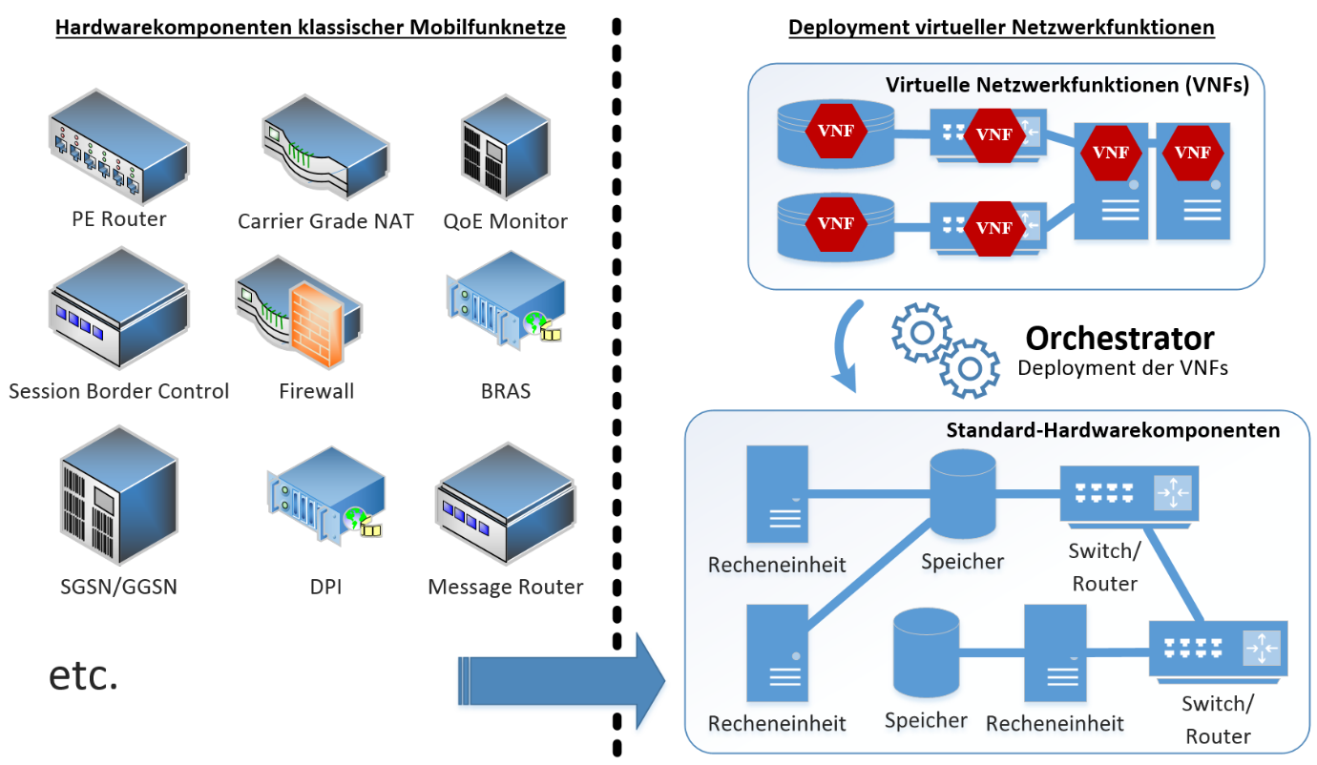
Network Function Virtualization
Classical Mobile Networks
NFV-enabled Networks
Virtual Network Functions
Orchestrator
Deployment of VNFs
Computing
Storage
Networking
Computing
Storage
Computing
Networking
| <number>

Slide 3
Network Function Virtualization
Classical Mobile Networks
NFV-enabled Networks
Virtual Network Functions
Orchestrator
Deployment of VNFs
Commodity
Hardware
| <number>
Notes:
Main idea behind NFV: integrate cloud technology into the mobile network infrastructure.

Slide 4

Embedding of Virtual Networks
Substrate/Physical Network
10
a
80
15
55
a
10
12
A
B
b
22
b
c
10
c
12
10
10
90
10
50
C
20
C
C
D
E
F
15
20
60
85
27
25
e
e
5
5
G
H
17
d
d
f
f
70
65
20
20
based on: www.mosharaf.com/wp-content/.../vineyard-talk-infocom09.pps
| <number>

Slide 5
Embedding of Virtual Networks
10
Substrate/Physical Network:
a
a
80
15
55
10
12
A
B
b
b
c
10
c
22
12
10
10
90
50
20
10
C
C
C
D
E
F
20
15
60
27
85
e
25
e
Optimization Objectives:
Minimize resource usage/cost
Maximize acceptance ratio
Many more (energy efficiency/…)
-> NP-hard optimization problem
5
5
G
H
d
17
d
f
f
70
65
20
20
| <number>

