Slide 1
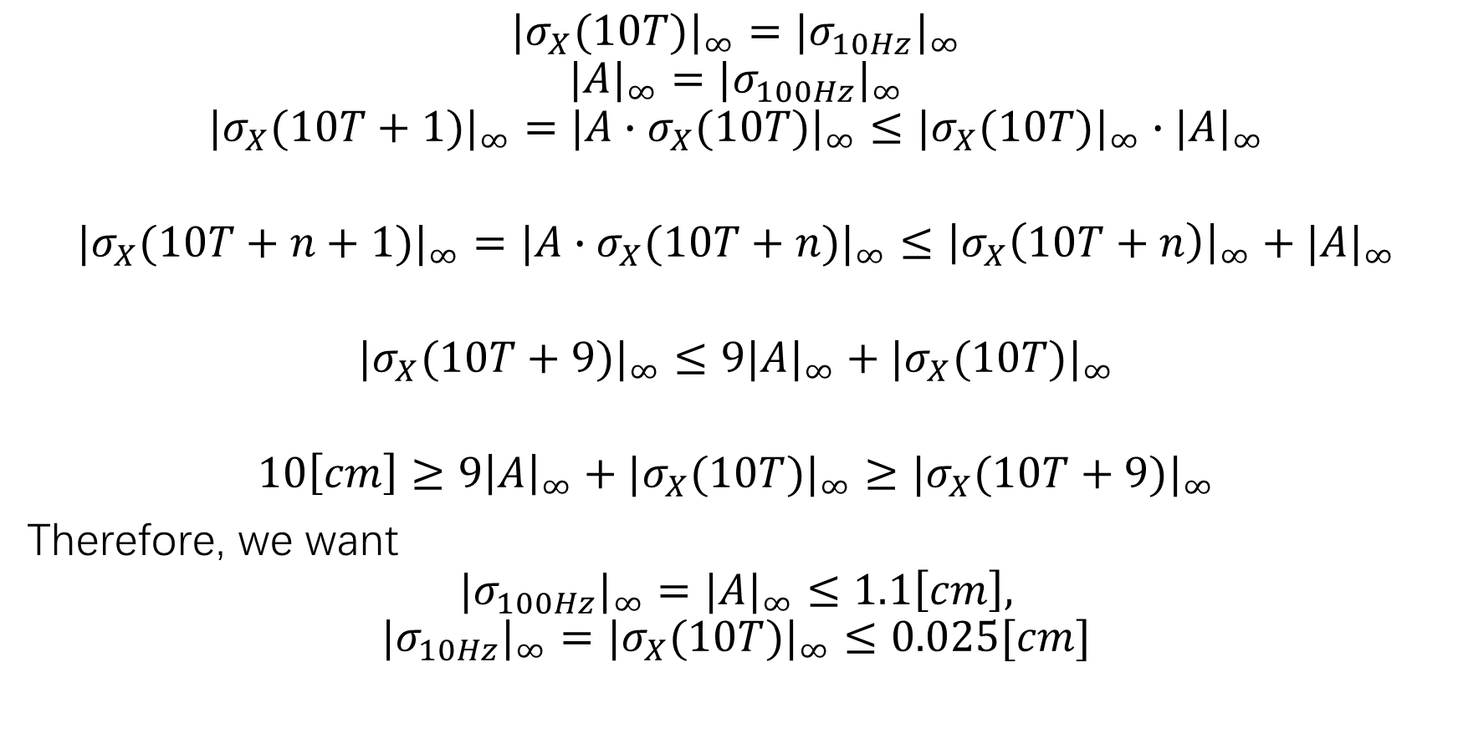
Specification Calculation
$${|σ_{X}(10T)|}_{∞}={|σ_{10Hz}|}_{∞}$$
$${|A|}_{∞}={|σ_{100Hz}|}_{∞}$$
$${|σ_{X}(10T+1)|}_{∞}={|{A∙σ}_{X}(10T)|}_{∞}≤{|σ_{X}(10T)|}_{∞}∙{|A|}_{∞}$$
$${|σ_{X}(10T+n+1)|}_{∞}={|A∙σ_{X}(10T+n)|}_{∞}≤{\left|σ_{X}\left(10T+n\right)\right|}_{∞}+{|A|}_{∞}$$
$${|σ_{X}(10T+9)|}_{∞}≤9{|A|}_{∞}+{|σ_{X}(10T)|}_{∞}$$
$$10\left[cm\right]≥9{\left|A\right|}_{∞}+{|σ_{X}(10T)|}_{∞}≥{|σ_{X}(10T+9)|}_{∞}$$
Therefore, we want
$${|σ_{100Hz}|}_{∞}={|A|}_{∞}≤1.1\left[cm\right],$$
$${|σ_{10Hz}|}_{∞}={|σ_{X}(10T)|}_{∞}≤0.025[cm]$$

Slide 2

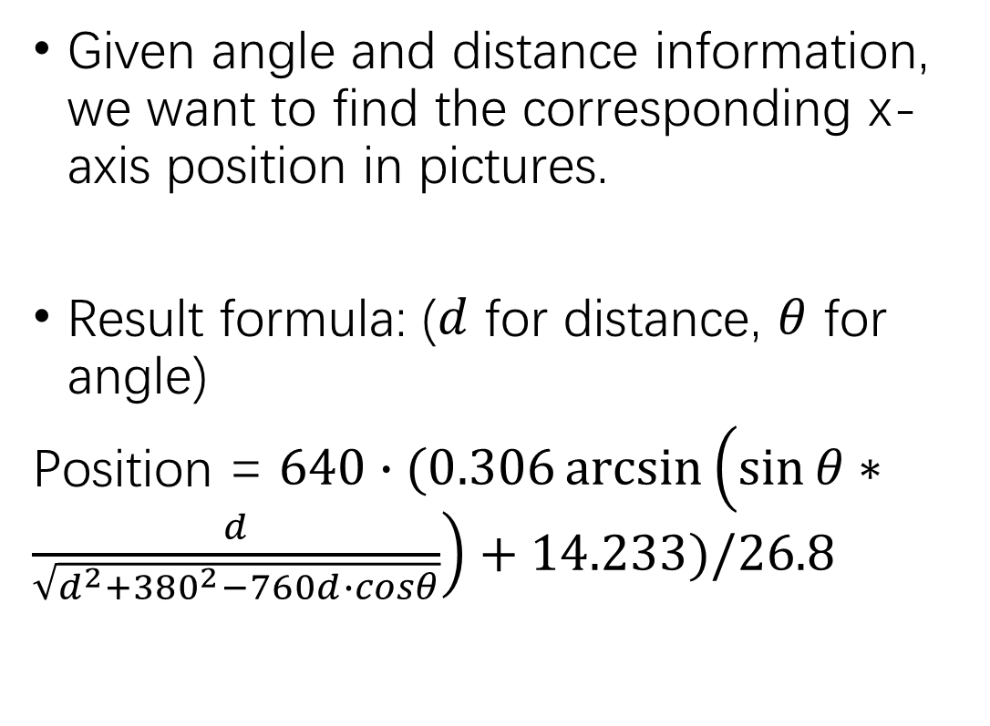
Experiment 3: Picture segmentation
Given angle and distance information, we want to find the corresponding x-axis position in pictures.
Result formula: ($d$ for distance, $θ$ for angle)
Position = $640∙(0.306\arcsin\left(\sin{θ}∗\frac{d}{\sqrt{d^{2}+{380}^{2}−760d∙cosθ}}\right)+14.233)/26.8$

Slide 3
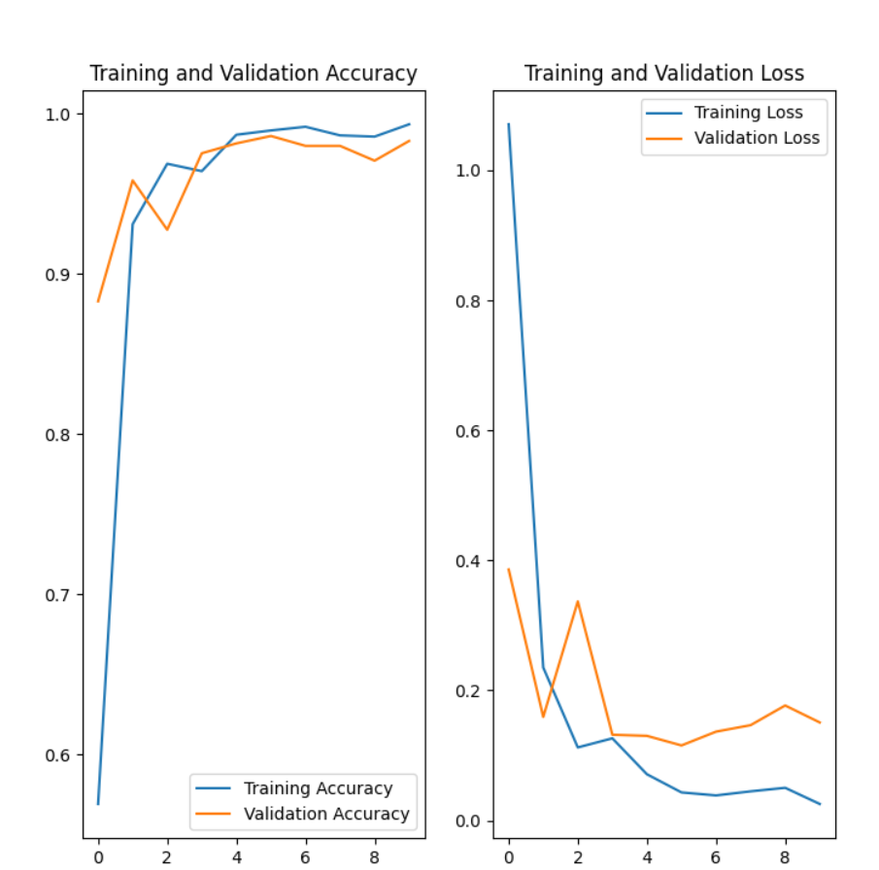
Experiment 4: Image identification
6000 images for training, 2000 images for validation.
Including many boundary conditions (like in extreme light environment).

Slide 4
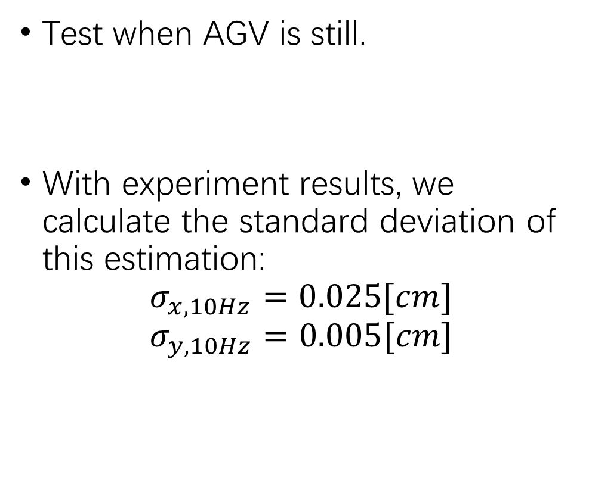
Experiment 5: Static Triangulation
Test when AGV is still.
With experiment results, we calculate the standard deviation of this estimation:
$$σ_{x,10Hz}=0.025[cm]$$
$$σ_{y,10Hz}=0.005[cm]$$

Slide 5
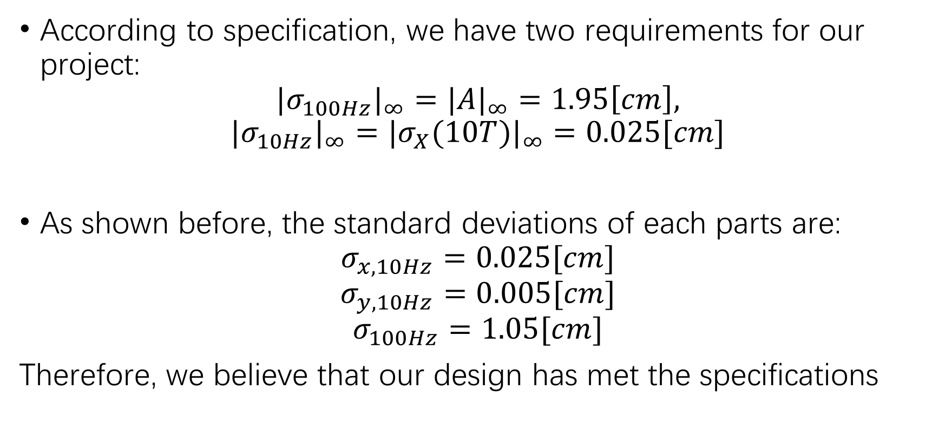
Verification
According to specification, we have two requirements for our project:
$${|σ_{100Hz}|}_{∞}={|A|}_{∞}=1.95\left[cm\right],$$
$${|σ_{10Hz}|}_{∞}={|σ_{X}(10T)|}_{∞}=0.025[cm]$$
As shown before, the standard deviations of each parts are:
$$σ_{x,10Hz}=0.025[cm]$$
$$σ_{y,10Hz}=0.005[cm]$$
$$σ_{100Hz}=1.05[cm]$$
Therefore, we believe that our design has met the specifications

