Slide 1
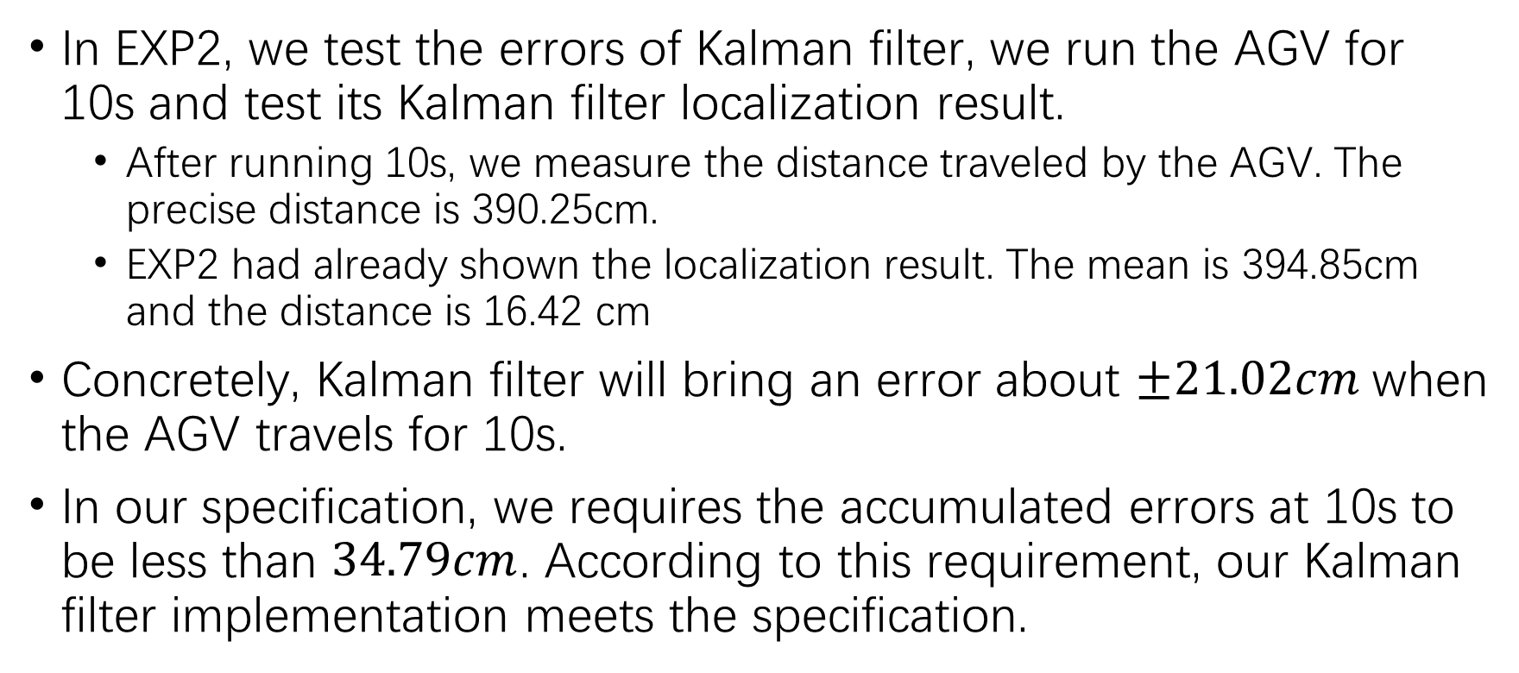
Verification
In EXP2, we test the errors of Kalman filter, we run the AGV for 10s and test its Kalman filter localization result.
After running 10s, we measure the distance traveled by the AGV. The precise distance is 390.25cm.
EXP2 had already shown the localization result. The mean is 394.85cm and the distance is 16.42 cm
Concretely, Kalman filter will bring an error about $±21.02cm$when the AGV travels for 10s.
In our specification, we requires the accumulated errors at 10s to be less than $34.79cm$. According to this requirement, our Kalman filter implementation meets the specification.

Slide 2
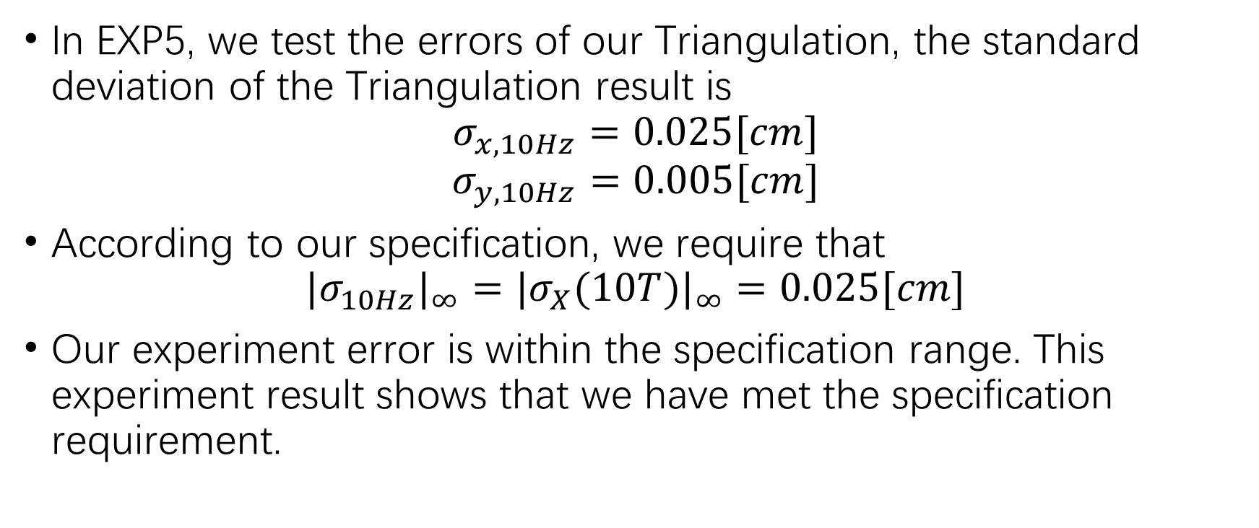
Verification
In EXP5, we test the errors of our Triangulation, the standard deviation of the Triangulation result is
$$σ_{x,10Hz}=0.025[cm]$$
$$σ_{y,10Hz}=0.005[cm]$$
According to our specification, we require that
$${|σ_{10Hz}|}_{∞}={|σ_{X}(10T)|}_{∞}=0.025[cm]$$
Our experiment error is within the specification range. This experiment result shows that we have met the specification requirement.

Slide 3
Verification
In EXP6, we test the errors of the dynamic localization. We test the localization in two kinds of moving tracks: circle and sine. The errors are
In conclusion, the errors in circle motion is 7.2cm, and the errors in sine motion is 8.6cm. These two results are both within 10cm, which is the specification limit.
 | Average (m) | Standard Deviation (m)
Circle | 0.048 | 0.024
Sine | 0.060 | 0.026

Slide 4
Operation Demo
Add the whole video here

