Slide 1
6 Different Methods
4 library preparation kits
Consistency between triplicates
NEB
2 methods to account for amplification bias
Illumina
Clontech
NEXTflex
͌
͌
?
?
Deduped
Fivpercent
Performance metrics
1) Accuracy Analysis – how well does each method detect different sequences of the same quantity?
- adapter ligation bias, reverse transcription bias, and amplification bias could reduce this
2) Detection Analysis – How many unique sequences are detected by each method?
- adapter ligation bias, reverse transcription bias, and amplification bias could reduce this
3) Consistency Analysis – Across batch and triplicates – how similar are the results obtained by each method?
Not associated with bias… or is it… maybe certain sequences are more prone to variance due to the above biases

Slide 2

Detection
Accuracy
Consistency
Number of unique miRNAs
Different miRNAs equivalently quantified?
Consistency across batch
In each sample
_
→
3
𝑥
͌
?
=
?
Number of unique miRNAs
3
Across triplicates
→
Consistency between triplicates
=
?
→
3
͌
͌
?
?

Slide 3


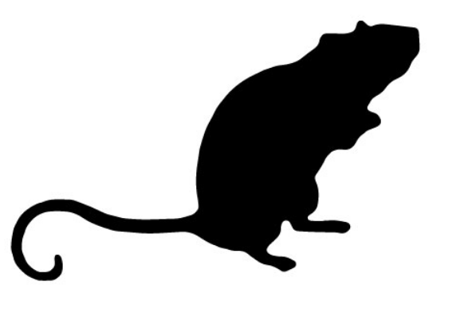
library preparation kits
methods for RT and PCR bias
NEB
Fivpercent
*Clontech
Illumina
*NEXTflex
Deduped
* designed for adapter ligation bias
Bias Tests
Consistency Test
Accuracy
Detection
Consistency
Number of unique miRNAs?
Consistency across batch?
Different miRNAs equivalently quantified?
In each sample
_
𝑥
͌
→
3
=
?
?
→
3
=
?
Consistency between triplicates?
Across triplicates
→
3
͌
͌
?
?
→ Sequence specific assessment
→ interpretation of potential bias
→ Sequence specific assessment
→ interpretation of potential bias
→ Sequence specific assessment

Slide 4
Compounding this issue, miRNAs with higher efficiencies of these steps, may be overrepresented and thus skew the count estimates of other lower expressed miRNAs or miRNAs with lower efficiencies of these steps to the point that they do not have estimates meeting the detection threshold minimum.

Slide 5
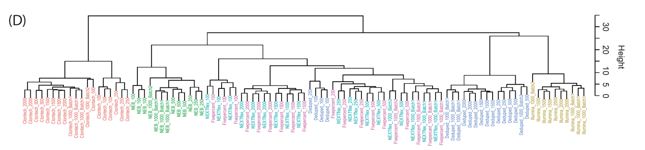
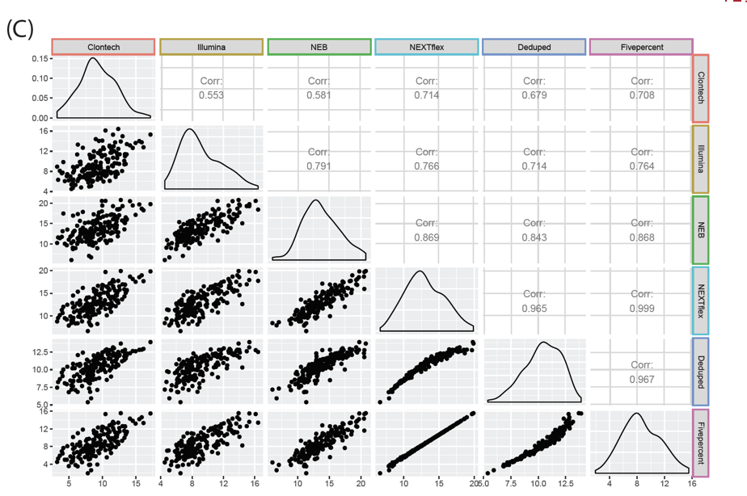
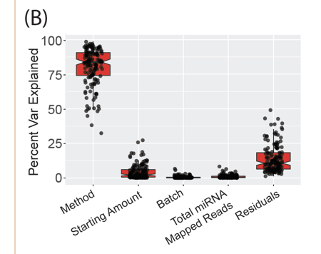
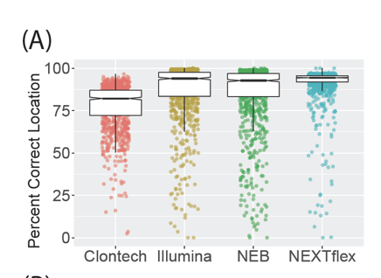
(A)
(B)
(C)
(D)

