Slide 1
OSL Project Research

Slide 2
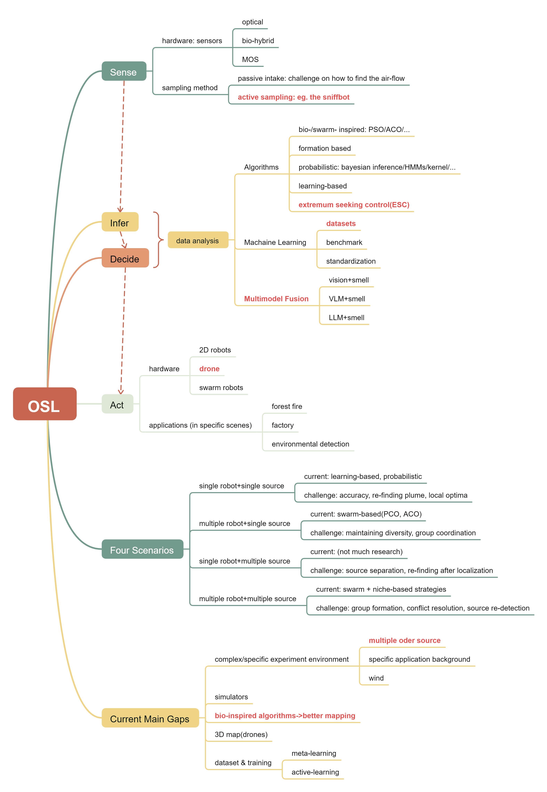
Overall Summary
Currently, the research gap mainly lies in scenarios like multiple odor source and 3D-mapping.
Hardware: active sampling methods, drones, etc
Software: bio-inspired solutions, extremum seeking control, multimodule fusion, meta-database, etc.
The key is to improve robustness, accuracy, and interpretability.

Slide 3
Summary of current attempts
6 recent essays

Slide 4
Robotic Improvements
Bio-inspired strategy against olfactory sensory deficiency in OSL
bio-inspired algorithm
solving hardware failure scenarios
CDMI algorithm (POD+PDF sampling->controlling under sensor impairment
future outlook: 3D, “switch” strategy
Sniffbot
active-sampling
active sampling: air pump+solenoid valve
Trident algorithm
future outlook: multiple source. multiple robots, memory mechanism

Slide 5
Algorithm Improvements
LLM
robustness to environment changes
explanations on decision making
environment module+reasoning module+memory module
reasoning according to similar cases in the memory and the detection of environment.
future outlook: dynamic memory base, multiple source
Noise enhances localization
a counterintuitive assumption
theoretical explanations
DNS simulating
adding noise on location perception->better OSL outcome
future outlook: real time validation

Slide 6
Algorithm Improvements
Multi-agent reinforcement learning
multi-source+multi-robot
Action-Specific Double Deep Recurrent Q-Network
last action+state+teammate’s states->LSTM->Q-learning outcome
training->hyperparameters
future outlook: real world validation
Deep Reinforcement Learning
open AI Gym simulation
PPO deep learning
future outlook: multiple source, real world validation

Slide 7
Future Research Plan

Slide 8
Research Aim
Exploration and development of an algorithm on multi-source backgrounds
Main challenges:
(1) Identification of individual sources
(2) Avoidance of local optima
(3) Cooperation and communication between swarm robots

Slide 9
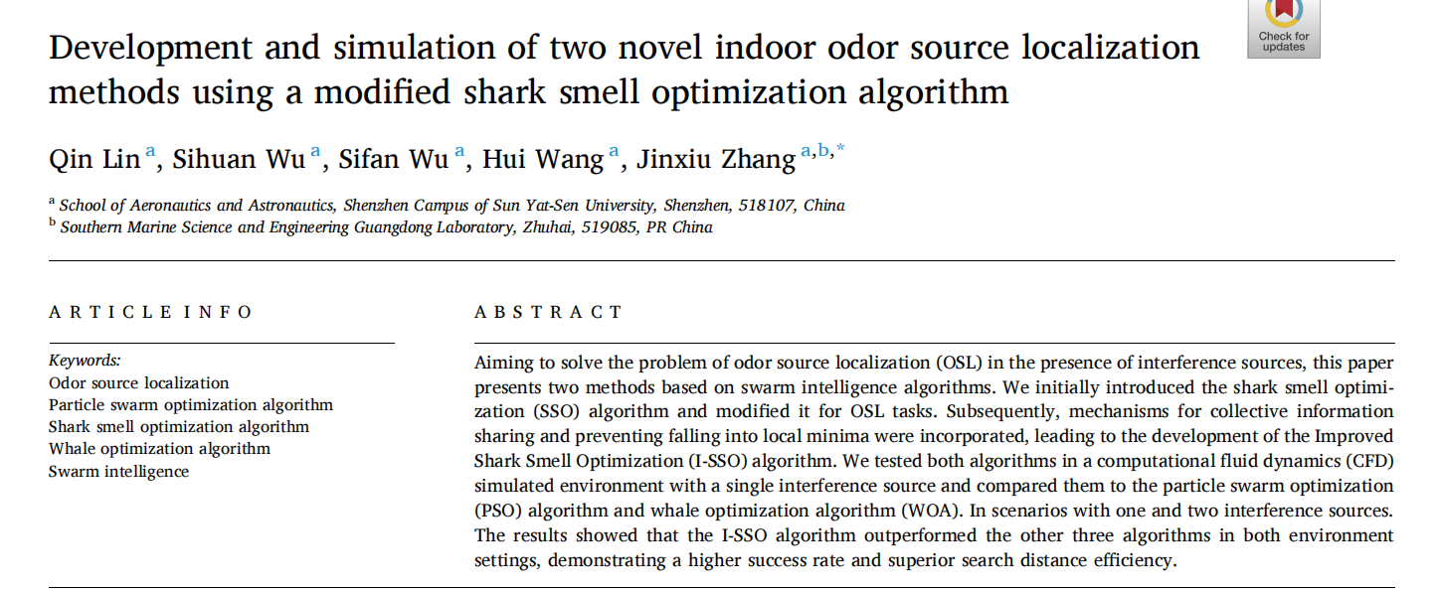
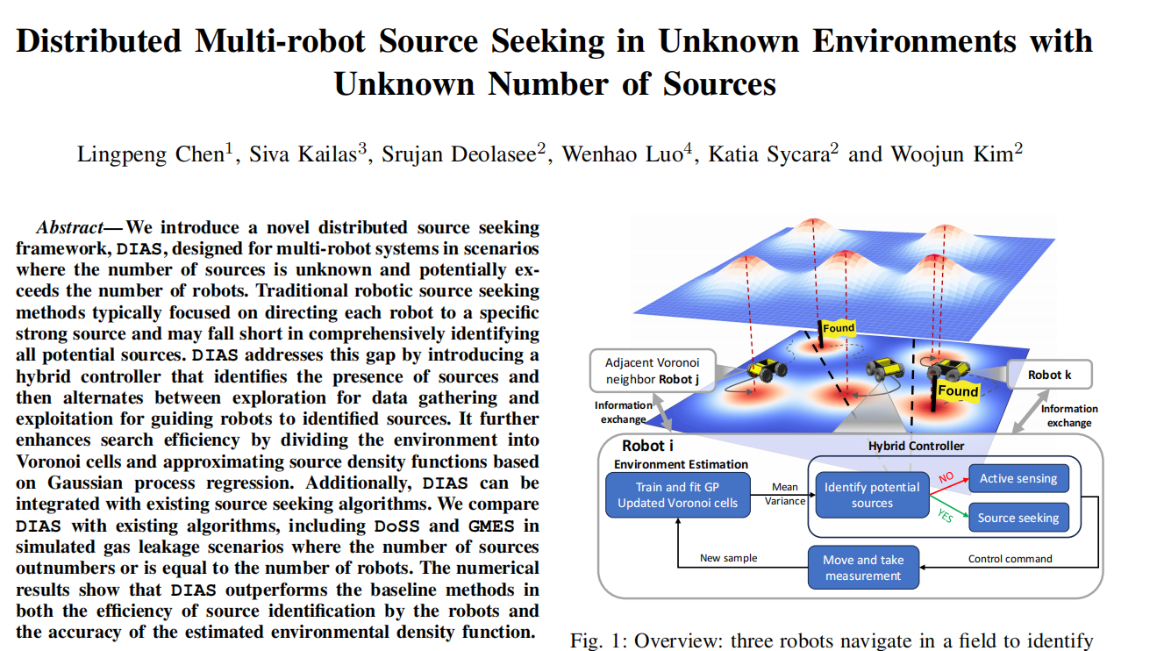
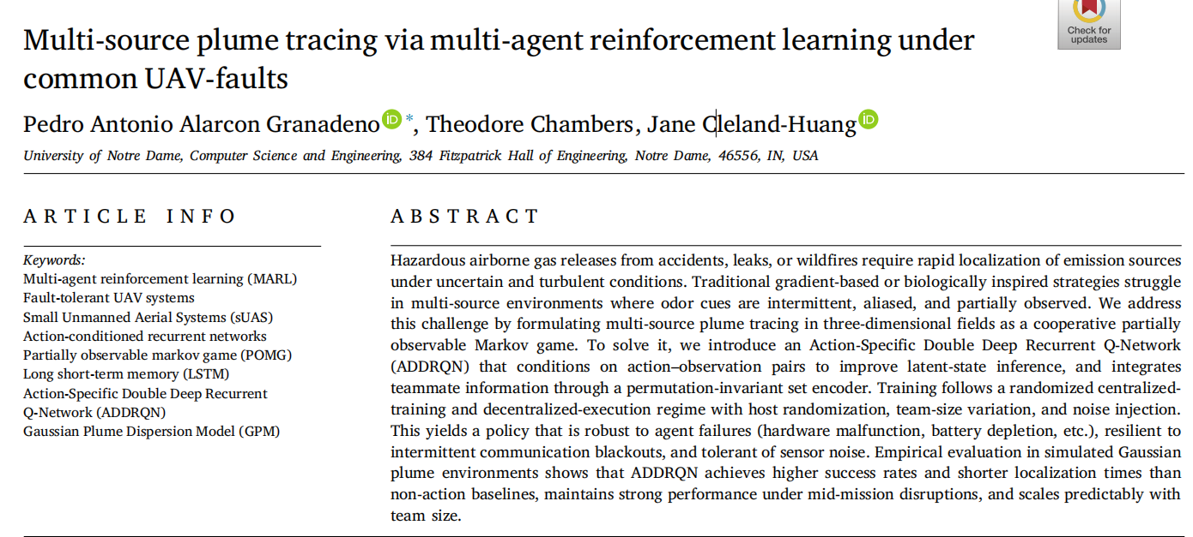
Major References

Slide 10
Main References
I-SSO algorithm:
-rotation movement->exploration method
-variance triggered escape->avoid local optima
-swarm best->information communication
ADDRQN:
-deep Q-learning
-state+action+memory->learning method, robustness to environment
DIAS:
-dividing space according to Voronoi
-predict according to Gaussian process
A possible combination:
ADDRQN learning method+I-SSO(escape+rotation)
-replacing greedy exploration with rotation
-inviting variance triggered escape

Slide 11
A Possible Combination: ADDRQN + I-SSO
I-SSO contributes hand-designed exploration; ADDRQN contributes a learned policy under partial observation. Combining them targets five weaknesses neither addresses alone.
Sample efficiency — rotation sampling replaces ε-greedy with a structured exploration prior, so fewer episodes are spent on uninformative random actions.
Local optima — variance-triggered escape is an explicit stall signal that RL would otherwise have to discover through reward shaping, and it transfers to re-finding a plume after one source is claimed.
Plume intermittency — ADDRQN’s action-conditioned recurrent state covers exactly where I-SSO’s gradient assumption fails: a zero reading becomes informative rather than misleading.
Transfer cost — rotating in place is nearly free on a real robot, keeping the learned action set cheap enough to move from simulation to hardware.
Interpretability — the variance trigger gives a readable reason for each behaviour switch, which a bare Q-network cannot offer.

Slide 12
Research Plan
Reproducing the algorithms on multiple source OSL
Comparing the performance (on real robots?)
Seek possible future advancements

Slide 13
Research Stage I- reproducing algorithms
I-SSO (matlab/python)
-use CFD to produce simulation environment
-robot defining and movement(forward/rotation)
-swarm communication
-variance triggered escape
DIAS (python+ROS simulation)
-Voronoi division
-GP regression
-identifying potential source
-controller (state machine)
-Ergodic Control
-MPC
-communication

Slide 14
Research Stage I- reproducing algorithms
ADDRQN:
仿真环境搭建：高斯羽流模型+UAV运动学+设计稀疏奖励函数
ADDRQN网络：（1）三个MLP（当前观测/动作编码/Q值输出层）；（2）GRU的队友编码；（3）GRU或者LSTM的时序聚合器；（4）将上述子系统聚合
训练框架搭建：（1）多桶回放缓冲；（2）随机化训练；（3）ε-greedy探索；（4）整合上述训练搭建训练主循环
复现三个评测实验
搭建真实场景进行模拟

Slide 15
Research Stage II- combination
I-SSO variance triggered escape+DIAS: potential of “marking interference source”
replacing MPC (in DIAS) with ADDRQN: combining RL and GP, lowering training cost
Voronoi division+ADDRQN: divide the task+ allowing UAV failure

