Slide 1
TPL, async, await
Xiaoguo Ge - June 7, 2017

Slide 2
TPL, async/await
Asynchrony Background
Benefits
Cost - Complexity
Patterns and Anti-Patterns

Slide 3
Background
Past Attempts
APM - BeginInvoke, EndInvoke
EAP - WebClient.OnDownloadStringCompleted
State of the Art
TPL – Dispatch job to thread pool
async/await – A disguised way of registering a callback
Reference: http://joeduffyblog.com/2016/11/30/15-years-of-concurrency/

Slide 4
Concurrency vs Asynchrony
Concurrency – running in parallel
Asynchrony – waiting in parallel

Slide 5
Benefits
User Actions
Non-blocking UI
Desktop UI only,
ASP.NET Non-blocking by default
Increase Throughput
Thread costs memory
Increase parallelism
STA
Windows
Tasks
Thread Pool

Slide 6
Benefits
User Actions
User Actions
User Actions
Non-blocking UI
Desktop UI only,
ASP.NET Non-blocking by default
Increase Throughput
Thread costs memory
Increase parallelism
pages
api
Thread Pool

Slide 7
Benefits
Throughput without TPL
Assuming 5000 threads in thread pool
16 logic cores per CPU
Non-blocking UI
Desktop UI only,
Does not apply to ASP.NET
Increase Throughput
Saving threads
Thread costs resource
Increase parallelism
Request duration | Requests/second | CPU time/request
10 seconds | 500 | 32 ms
1 second | 5000 | 3.2 ms
200 ms | 25K | 0.064 ms

Slide 8
Benefits
foreach()
{
Task.run()
}
Task.Whenall()
Non-blocking UI
Desktop UI only,
Does not apply to ASP.NET
Increase Throughput
Saving threads
Thread costs resource
Increase parallelism

Slide 9
Complexity
The compiled code is not what you have written
Determining the running thread is difficult
Stack spilling
Thread ambient information
Performance cost

Slide 10
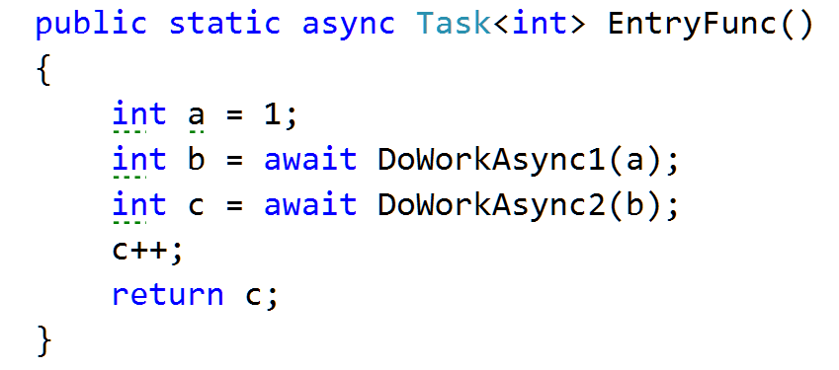
Complexity
thread_0
State1 @ thread_0
State2 @ thread_1
State3 @ thread_2
State1 in thread_0
State2 in thread_1 by thread_0.CurrentSynchronizationContext.Post()
State3 in thread_2 by thread_1.CurrentSynchronizationContext.Post()

Slide 11
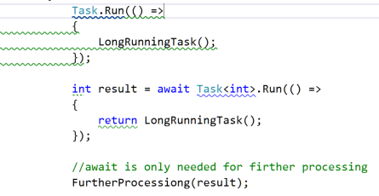
Patterns and Anti-Patterns – Non-blocking UI
Pattern
Anti-Pattern
ASP.Net is already Non-Blocking
Non-Blocking UI is not a valid reason for using TPL or async/await.

Slide 12
Patterns and Anti-Patterns – Through Put
Pattern
Anti-Pattern
Wrapping synchronous calls into tasks.
Task.Run()
Blocking a asynchronous call
Task.Wait, Task.Result
Faking a asynchronous call
Task.FromResult
await when not interested in the result/exception
async Task foo()
{
….
await AsyncMethod();
}

Slide 13
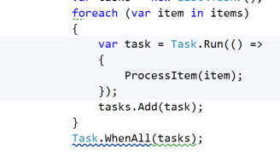
Patterns and Anti-Patterns - Parallelism
Pattern
A Better Option

