Slide 1
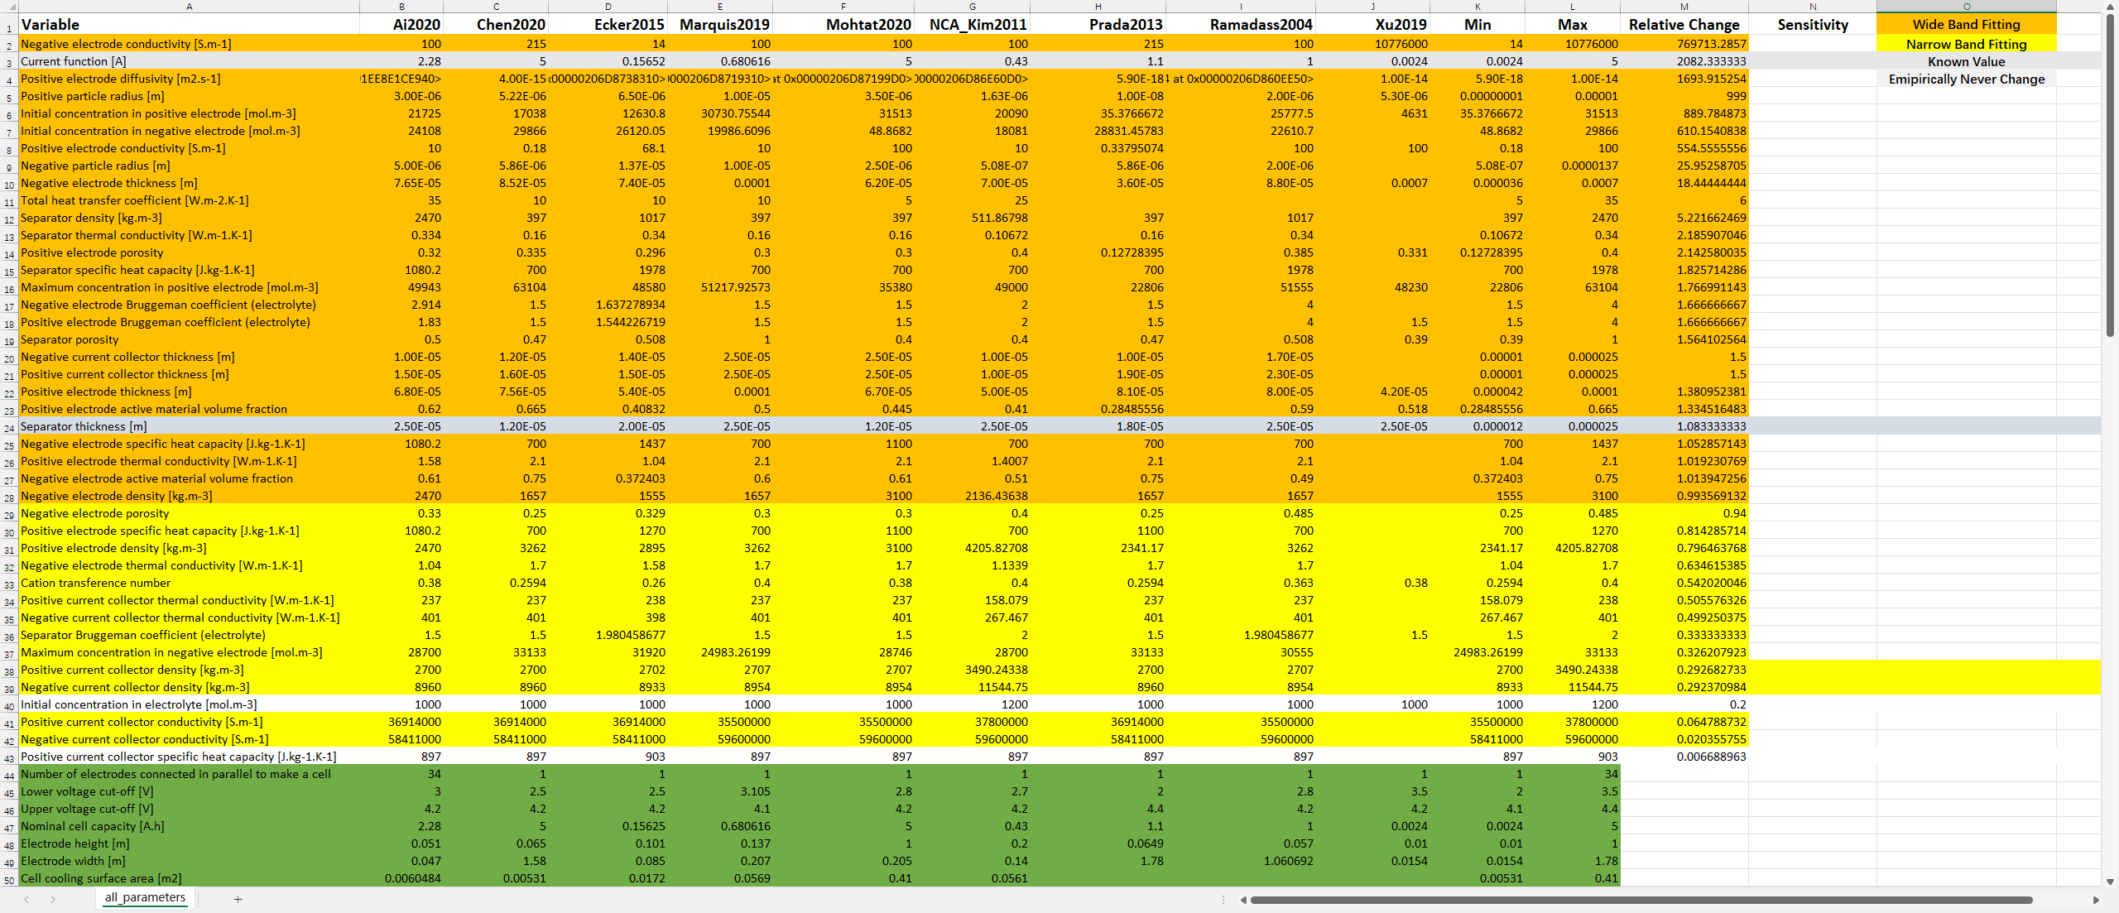
参数更新-Pybamm
参数筛选
设计目标函数
执行仿真
计算RMSE
优化算法

Slide 2
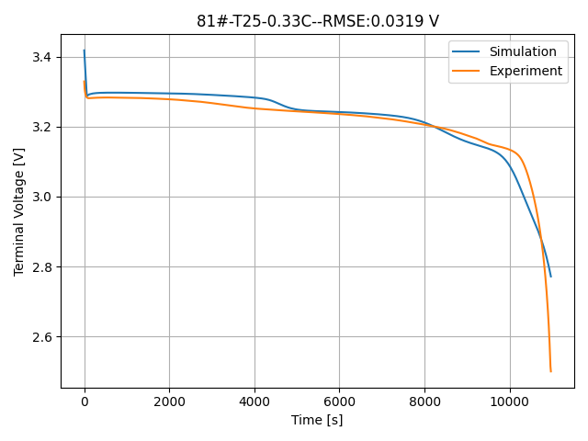
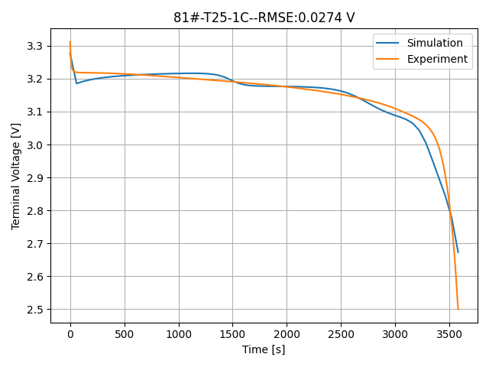
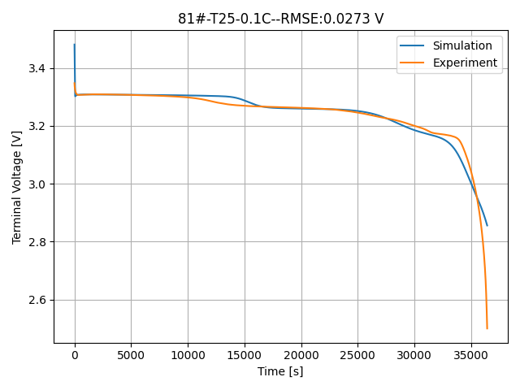
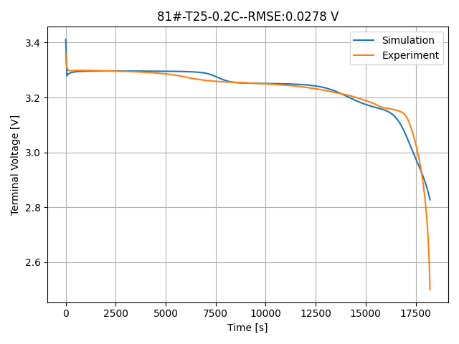
27组参数
Method: GA
Generations 200
Sol 40
Parents 20
未归一化

Slide 3
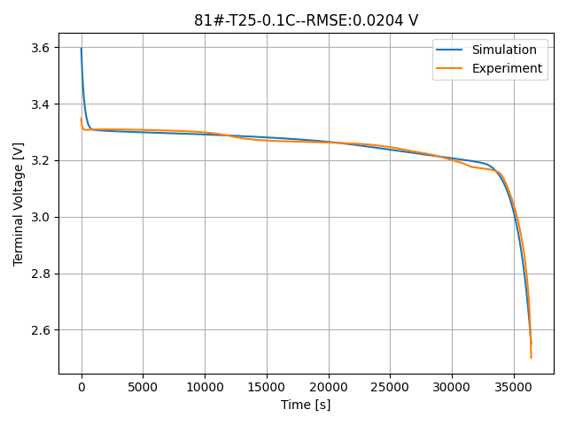
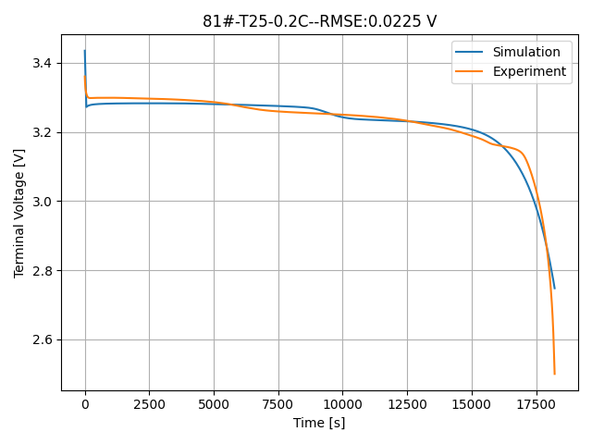
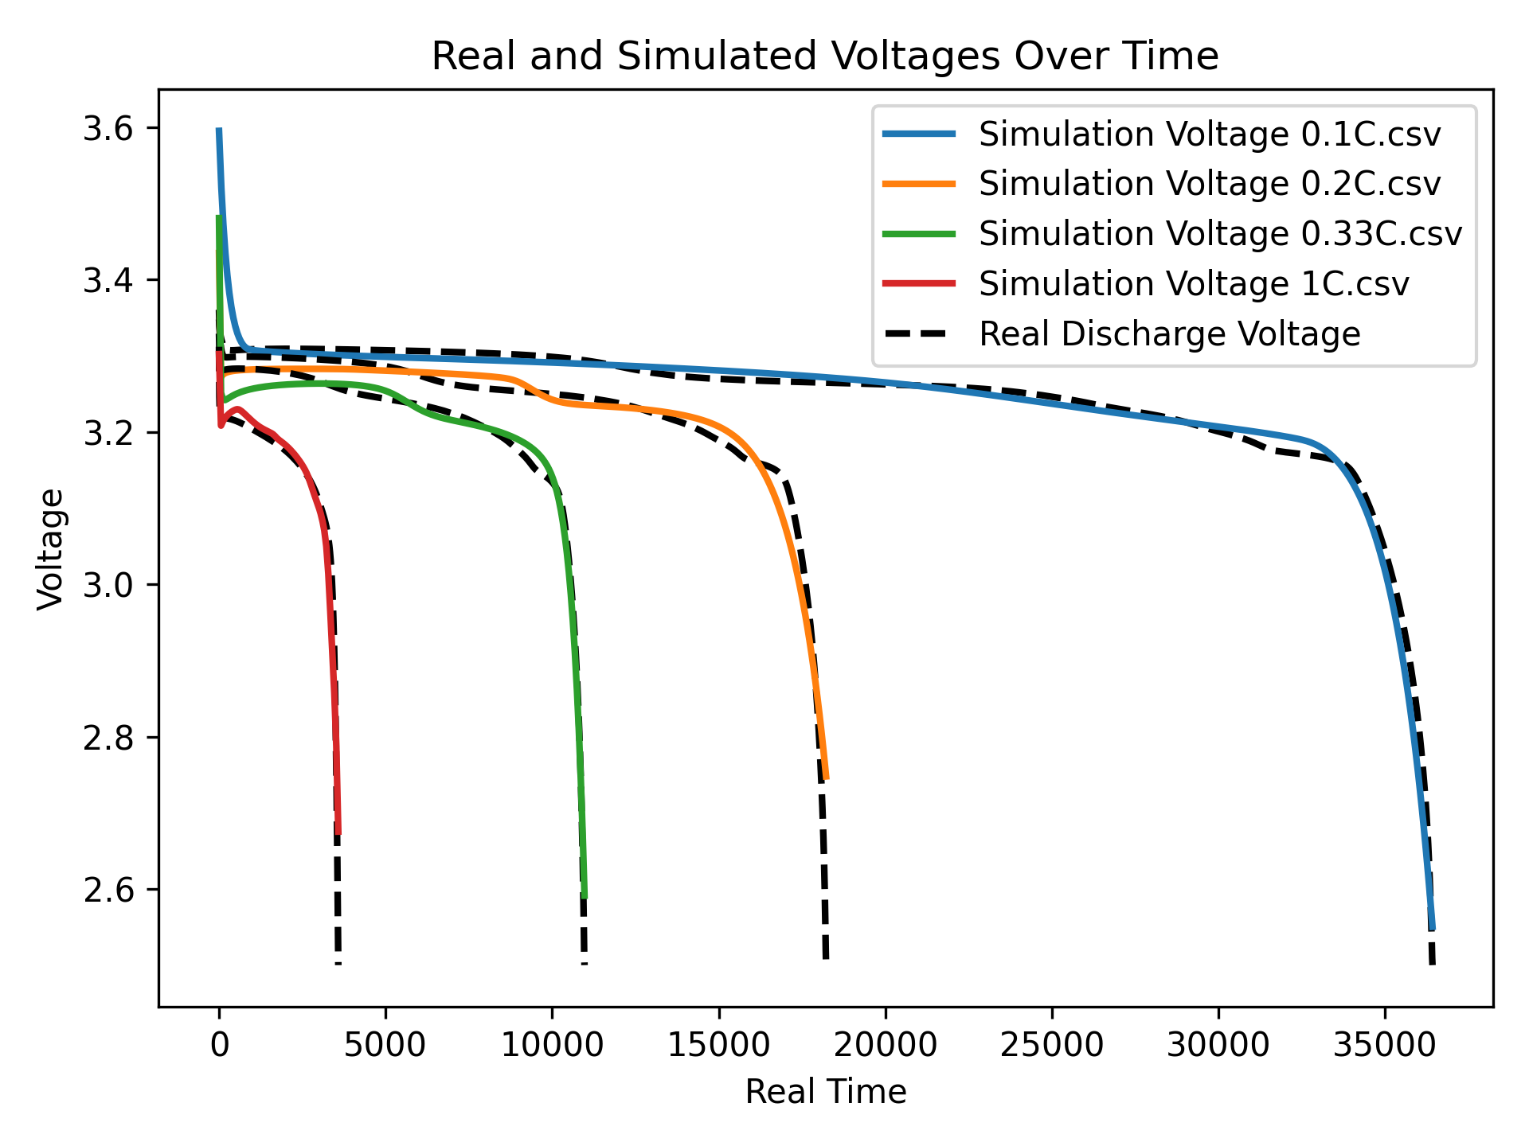
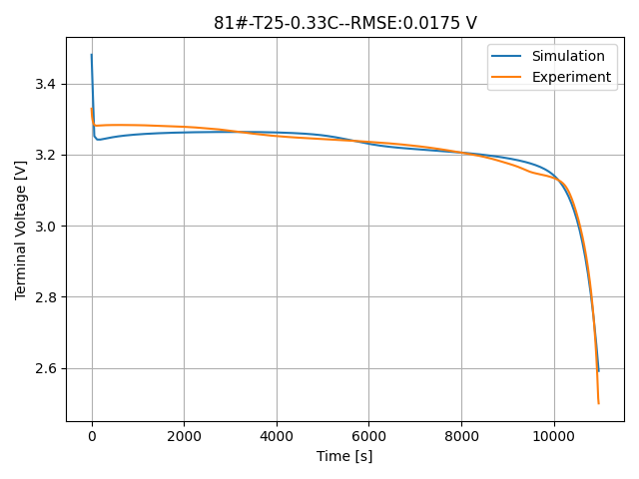
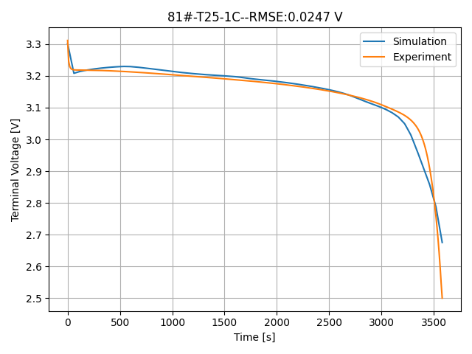
42组参数
Method: GA
Generations 200
Sol 40
Parents 20
参数归一化
RMSE for 0.1C: 0.0073V
RMSE for 0.2C: 0.0098 V
RMSE for 0.33C: 0.0079 V
RMSE for 1C.: 0.0083 V

Slide 4
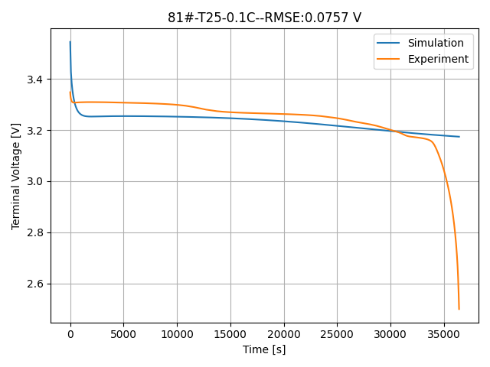
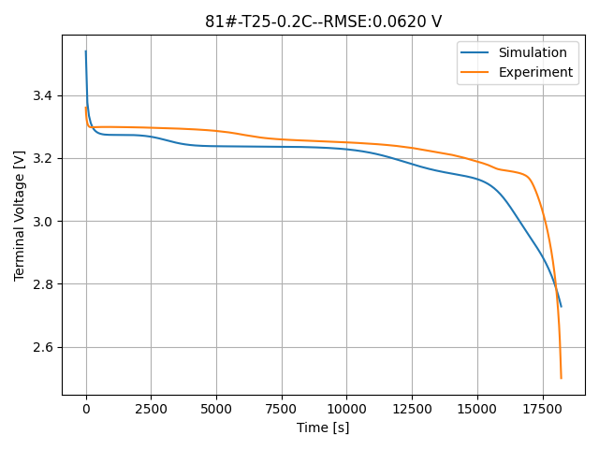
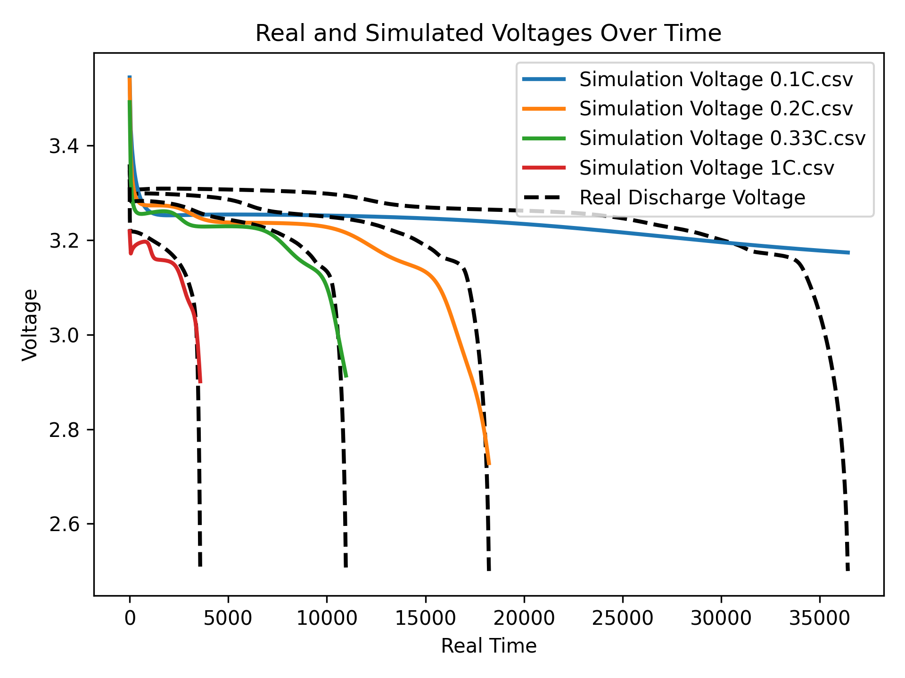
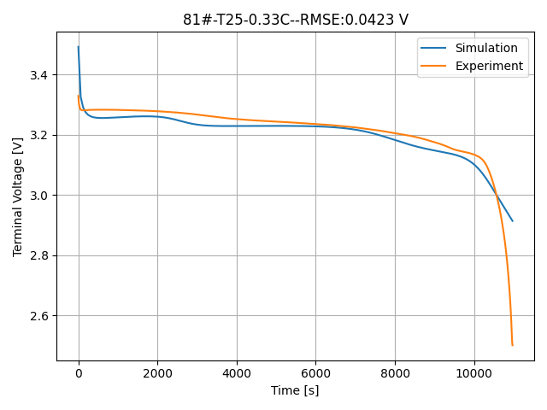
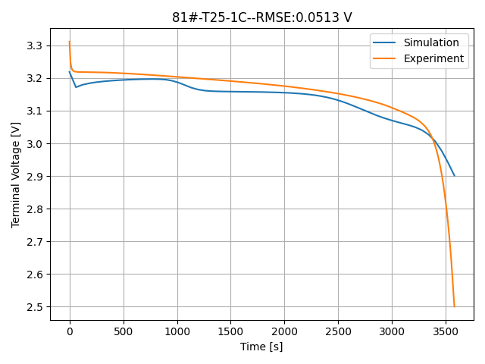
42组参数
Method: Bayes
N calls 500
参数归一化
RMSE for 0.1C: 0.0320
RMSE for 0.2C: 0.0403
RMSE for 0.33C: 0.0208
RMSE for 1C: 0.0255

Slide 5
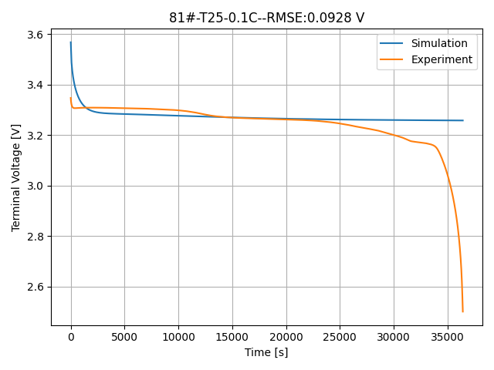
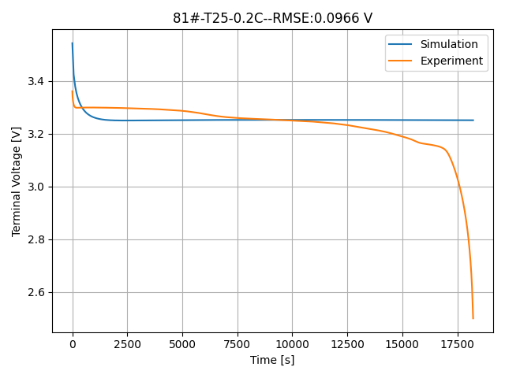
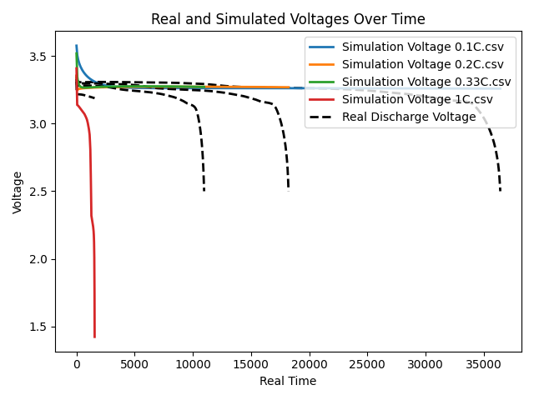
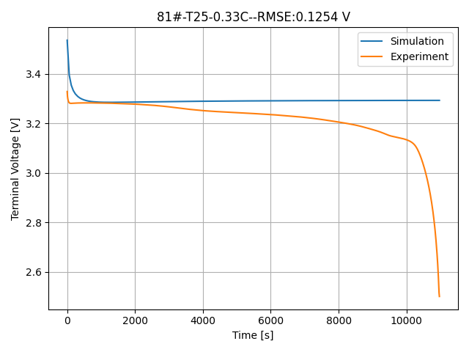
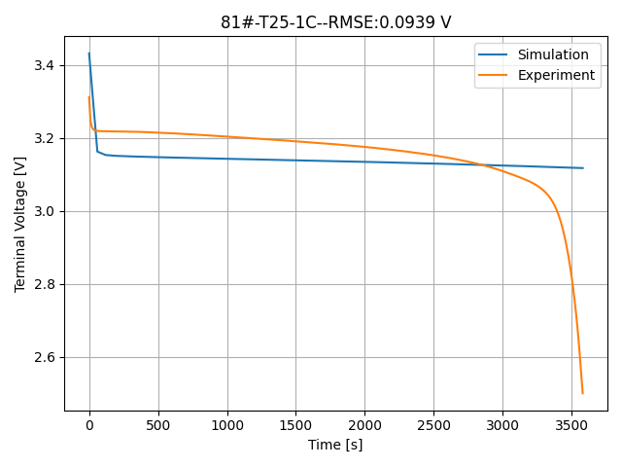
42组参数
Method: Local
Max Iter 7
参数归一化
RMSE for 0.1C: 0.0320
RMSE for 0.2C: 0.0403
RMSE for 0.33C: 0.0208
RMSE for 1C: 0.0255

Slide 6
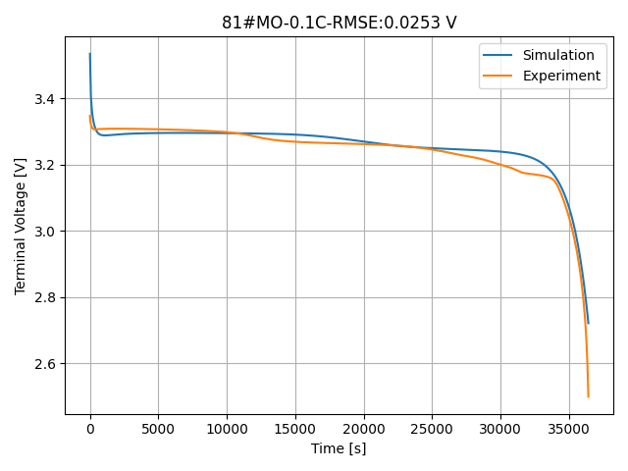
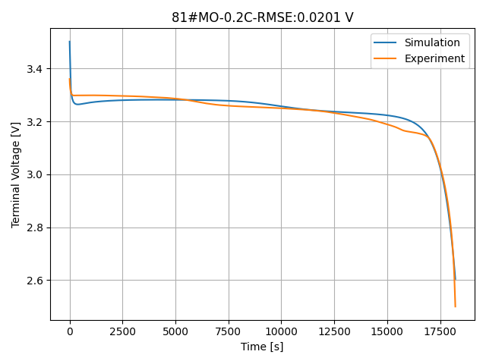
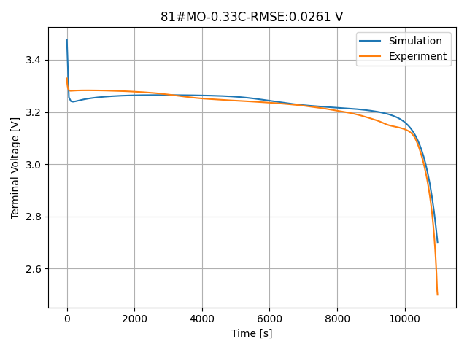
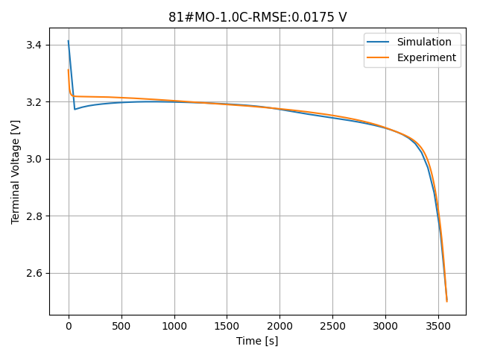
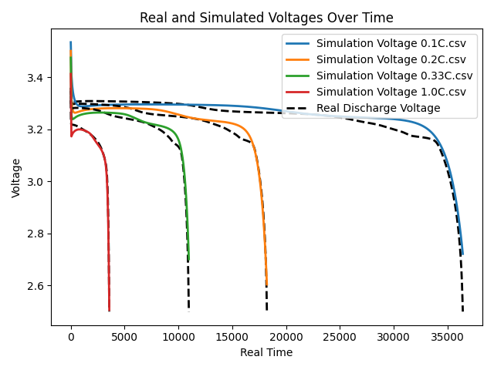
多目标优化
四种工况
42组参数
Method: NSGA2
Generations 200
Sol 40
Parents 20
参数归一化
RMSE for 0.1C: 0.0135V
RMSE for 0.2C: 0.0122 V
RMSE for 0.33C: 0.0107 V
RMSE for 1.0C: 0.0053 V

Slide 7
Solution idx: 0, Fitness: [-0.02528368 -0.02010612 -0.02614469 -0.01746876]
Solution idx: 21, Fitness: [-0.02385159 -0.01942114 -0.02506837 -0.0600114 ]
Solution idx: 5, Fitness: [-0.06208009 -0.06789176 -0.07734275 -0.19711066]
Solution idx: 6, Fitness: [-0.07214282 -0.07352577 -0.07696954 -0.09042975]
Solution idx: 9, Fitness: [-0.07881335 -0.07210385 -0.07320916 -0.42324318]
Solution idx: 14, Fitness: [-0.09216827 -0.09216611 -0.09402016 -0.06467298]
Solution idx: 16, Fitness: [-0.07381418 -0.07403447 -0.07715867 -0.07946996]
Solution idx: 29, Fitness: [-0.06781063 -0.0645991 -0.0714184 -0.46041879]
Solution idx: 35, Fitness: [-0.07195064 -0.07299533 -0.07778155 -0.14593675]
Solution idx: 2, Fitness: [-0.07965046 -0.07962096 -0.08495685 -0.08165822]
Solution idx: 8, Fitness: [-0.07370151 -0.0774802 -0.08221429 -0.09045106]
Solution idx: 15, Fitness: [-0.08216594 -0.07963066 -0.08061405 -0.08621438]
Solution idx: 26, Fitness: [-0.0634022 -0.06849639 -0.08318001 -0.47752533]
Solution idx: 30, Fitness: [-0.0952305 -0.09701479 -0.10154396 -0.08070614]
Solution idx: 32, Fitness: [-0.07310716 -0.07437364 -0.07825718 -0.097206 ]
Solution idx: 3, Fitness: [-0.08326269 -0.08250451 -0.08506162 -0.08187204]
Solution idx: 7, Fitness: [-0.07633718 -0.07786829 -0.0835886 -0.09805755]
Solution idx: 27, Fitness: [-0.0800438 -0.08106785 -0.08585914 -0.09281255]
Solution idx: 33, Fitness: [-0.08519032 -0.08405839 -0.08311515 -0.20299201]
Solution idx: 17, Fitness: [-0.07901143 -0.08030531 -0.08472302 -0.11602208]
Solution idx: 28, Fitness: [-0.09375778 -0.09125385 -0.09151779 -0.08717177]
Solution idx: 36, Fitness: [-0.09005301 -0.08984881 -0.09262989 -0.08934875]
Solution idx: 39, Fitness: [-0.08259314 -0.08488497 -0.09142747 -0.10302895]
Solution idx: 11, Fitness: [-0.096374 -0.09051337 -0.08638393 -0.25345431]
Solution idx: 20, Fitness: [-0.08771698 -0.08985835 -0.0957491 -0.10934974]
Solution idx: 23, Fitness: [-0.09032468 -0.09148843 -0.09536087 -0.09526511]
Solution idx: 19, Fitness: [-0.09304705 -0.09710244 -0.105498 -0.13450368]
Solution idx: 25, Fitness: [-0.09319497 -0.09392413 -0.09758392 -0.0974617 ]
Solution idx: 4, Fitness: [-0.13436265 -0.13689343 -0.12144523 -0.12189381]
Solution idx: 24, Fitness: [-0.13835391 -0.1466968 -0.14092778 -0.24459015]

