Slide 1
Robust and Multi-disciplinary Design Optimization with Applications on Engineering Design
by
Ruixiang ZHENG
November 10, 2024
Modified material from:
Dr. Mian Li
Dr. Jianhua Zhou
Dr. Yanjun Zhang
Dr. Ruixiang Zheng
Notes:
Thank you Professor Li, Good afternoon everyone. Before I start, I would like to thank all committee members and all other audients to come to my defense.
The topic of my dissertation is

Slide 2

Motivation and Objective
Tolerances of parts & measurement errors
Compression ratio &
Friction loss
*
In engineering design optimization, we may have to consider
Uncertainty due to uncontrollable variations
Multiple disciplines
Computational efficiency has to be improved
Objective: Develop efficient robust optimization approaches and multi-disciplinary optimization methods with applications on tolerance design of gas engines
* Picture from SGMW.
Notes:
Nowadays engineering systems are becoming more and more complex. E.g., the engine is a complex system. And in engineering design optimization, we may have to consider the following issues:
1….. E.g., for an engine, tolerances of parts and measurement errors of experiments, and they contribute to uncertainty
2, usually there are multiple discipline involved. e.g., for an engine, the compression ratio and the friction loss are two of the most important disciplines that will affect the system performance.
3. Given these complexities, efficient optimization methodologies are needed to deal with uncertainty and multiple disciplines.
So the objective of this research is to …. The terminologies will be explained right now.

Slide 3
Deterministic and Robust Optimization
Definition of deterministic and robust optimization
f : objective function
g_{j}: inequality constraints
h_{i}: equality constraints
x: vector of design variables
Uncertainty
deterministic optimum
Probability based:
Lots of history data needed
Interval based:
Lower and upper bounds needed
Commonly used in ME, e.g., diameter of a shaft is Φ10±0.005mm
f
f
deterministic
robust
optimum
robust
x*
x_{R}*
-Δp
p₀
Δp
Notes:
Here we provide the definition for optimization.
First for deterministic optimization, the formulation is shown here, f,g,,h,(the equality constraints can be transformed to inequality constraints) x…. E.g., in this figure, this point gives the minimum function value and is the deterministic optimum.
On the contrary to deterministic optimization, for robust optimization, uncertainties have to be taken into consideration. That is, p is not fixed at p0, but varies within this interval, and the robust solution lies here.
What’s the difference between the two solutions? As shown in this figure, when the parameter varies within the uncertainty interval, the objective variation of the deterministic case is much larger than the robust case. And the variation for the robust case is what we can accept.
Generally, there are two types of uncertainties: probability based and interval based. Probability based uncertainties use the probability distribution, like mean and standard deviation, to represent uncertainty, and this needs a lot of history data. While interval uncertainty only uses the lower and upper bounds, as is shown here. It is also commonly used in ME. E.g., the diameter of a shaft is

Slide 4
Robust Optimization (RO)
Worst-case RO formulation*:
Inner optimization problems
Leads to “double-looped”
* Li, M., 2007, “Robust Optimization and Sensitivity Analysis with Multi-Objective Genetic Algorithms: Single- and Multi-disciplinary Applications,” PhD dissertation, Department of Mechanical Engineering, UMD, USA.
Notes:
In this case, we would like to show the worst case RO formulation. Compared to the previous general formulation, two additional constraints are included, they are the robustness indices for the objective and constraints.
The objective robustness index is illustrated in this figure. This bar shows the acceptable objective variation region delta f0. the solid line shows the nominal objective value, and the dashed lines show the variation due to uncertainty. The robustness index ensures that the variation of the objective should always be within delta f0.
The constraint robustness index is illustrated here. This is the nominal value, and the dark area shows the variation region. The constraint robustness index ensures that no matter how the constraint varies, it should always be within the feasible region that g is no larger than 0.
Note that those robustness indices formulate the inner optimization problems, this leads to a double-looped optimization problem, such that it becomes computationally burdensome.

Slide 5
Multi-discipline Optimization (MDO)
x₁
f₁, g₁
Multi-objective optimization (MOO):
Discipline 1
z
output
y₁
y₂
f, g
Discipline 2
x₂
f₂, g₂
x_{i}: Local design variables of discipline i
z : Global design variables of discipline i
y_{i}: Coupling variables, output from
discipline i and input to other
disciplines
f_{i} : Objective function of discipline i
g_{i}: Inequality constraints of discipline i
A_{j}: Analysis of discipline i
Notes:
This slide shows the formulation of an MDO problem.
Here we use a two-disciplinary system to illustrate the problem formulation. We have two disciplines, 1 and 2. discipline 1 has design variable x1, and x1 only appears in discipline 1. also x2 for discipline 2. x1 and x2 are called local design variables, since they only occur in one discipline.
There are global design variables z that appears in both disciplines. y1 and y2. y1 is the output of discipline 1 and input to discipline 2.
F1,g1,f2,g2,…
Note that if no coupling variables exist, then this MDO problem can be regarded as a multi-objective problem MOO.

Slide 6
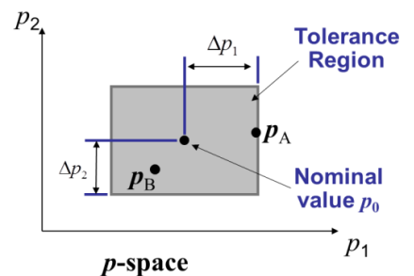
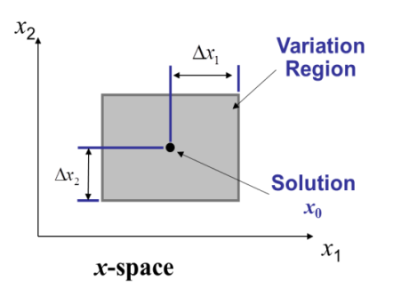
Research Focus
Deterministic Optimum
Uncertainty
f
x*
Pareto Optima
Global and Coupling
MOO and MDO
Full autonomy optimization
Sequential optimization
Notes:
Given the background, there are two perspectives of the research focus. First considering uncertainties, we are going to develop efficient RO methods to quickly determine the robust optimum solution.
Then considering the global and coupling variables, we use full autonomy and sequential optimization strategies to solve for the Pareto optimum. The full autonomy and sequential strategies will be discussed later.
What is Pareto optima. Usually trade-offs exist between the two objectives. If we want to minimize f1 and f2 at the same time, we cannot obtain a single solution but a bunch of solutions, and for all the Pareto solutions, there is not one solution that is able to say I am the best, since compared to all the other solutions, if a have a smaller f1, I do have a larger f2. in the same way, if I have a smaller f2, I do have a larger f1.

Slide 7
Research Topic 1*: Sequential Quadratic Programming for RO Motivation and Objective
Motivation
Uncontrollable variations exist in parameters or design variables
RO involve an inner-outer double-looped structure
Efficient methods to solve most kinds of problems are needed
SQP is an efficient solver to be applied
p₂
p₁
f
x
Objective: Develop an efficient robust optimization algorithm based on SQP to solve problems with interval uncertainty
* Zhou, J. H., Cheng, S., and Li, M., 2012, “Sequential Quadratic Programming for Robust Optimization with Interval Uncertainty,” Journal of Mechanical Design, 134(10), pp. 10091301-10091313.
Notes:
The motivation is that, as mentioned previously, uncertainty…
SQP is an efficient solver, which will be introduced later.

Slide 8
Previous Work
Example Refs. | Probability necessary | Gradient-based | Non-gradient based | Computationally efficient
Youn, et al, 2003; | ✓ | ✓ |  | ✓
Du and Chen, 2004; |  | ✓ |  | ✓
Tang, et al., 2012; |  | ✓ |  | ✓
Soyster, A. L., 1973; |  | Linear problems |  | ✓
Bertsimas, D., and Sim. M., 2006; |  | ellipsoidal uncertainty set
Li, M., 2007; |  |  | ✓
Saha, and Ray, 2011;
SQP-RO |  | ✓ |  | ✓
Notes:
a lot of RO methods have been proposed, and the typical ones are reviewed here.
These approaches are probability based, and lots of history data are needed.
These two approaches are interval based, but they use non-gradient based algorithms as the solver, and is computationally inefficient. Our proposed does not need probability information, and applies gradient based solver, such that it is computationally efficient.

Slide 9
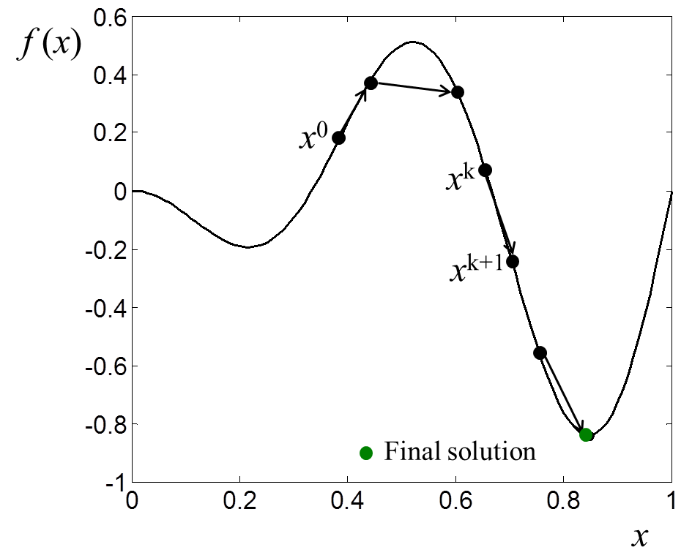
Background: SQP*
Sequential Quadratic Programming:
Sequential method:
Start
Initialization: iteration number k=0, convergence tolerance ε, and x₀
Solve for d^{(k)}
Update k=k+1,
x^{(k+1)}=x^{(k)} +d^{(k)}
Quadratic Programming:
N
Y
x^{(k)} is solution
* Arora, J. S., 2004, “Introduction to Optimum Design”, 2nd eds., Elsevier, New York, USA.
Stop
Notes:
Now let’s take a look at the SQP methodology as a background in this research thrust.
First, a sequential method searches for the solution from a starting point x0 to x1, to xk and then to the final solution step by step.
For quadratic programming, it has a quadratic objective with linear constraints.
If they are combined together, we will obtain the SQP methodology: start, initialization settings, e.g., the initial starting point. Then Taylor’s expansion is applied to get the quadratic formulation, the objective is approximated to the second order and the constraints to the first order with respect to the step size d. solve for d, if it is small enough, say 10 (-5), stop, if not, update x and continue to find d until it is small enough.

Slide 10
SQP-RO
Difficulty arises: SQP cannot directly deal with absolute value constraints that are non-differentiable
Solution: transform the objective and constraint robustness index such that they are differentiable and can be linearized.
recall
Equivalent to
Easy way
p_{max} for objective
p_{max}
p₂
p₀
p_{jmax}
p_{jmax} for constraint j
p₁
Notes:
Recall the robustness constraints that contribute to the inner optimization problem. Difficulty arises since SQP cannot directly deal with the problem shown here since it is an optimization problem with absolute values.
So we transform the indices such that they are differentiable and can be linearized. For the objective robustness index, the absolute value is equivalent to this squared value, and the constraint robustness index can be expressed in an easy way that no matter how p varies, the constraint should always be non-positive. These two problems can now be solved and pmax is found which leads to the maximum variation of the objective, and pjmax is found which leads to the maximum variation of the constraint. Pamx and pjmax are substituted to the equation. Thus the inner optimization problem is solved and can be linearized with this formulation.

Slide 11
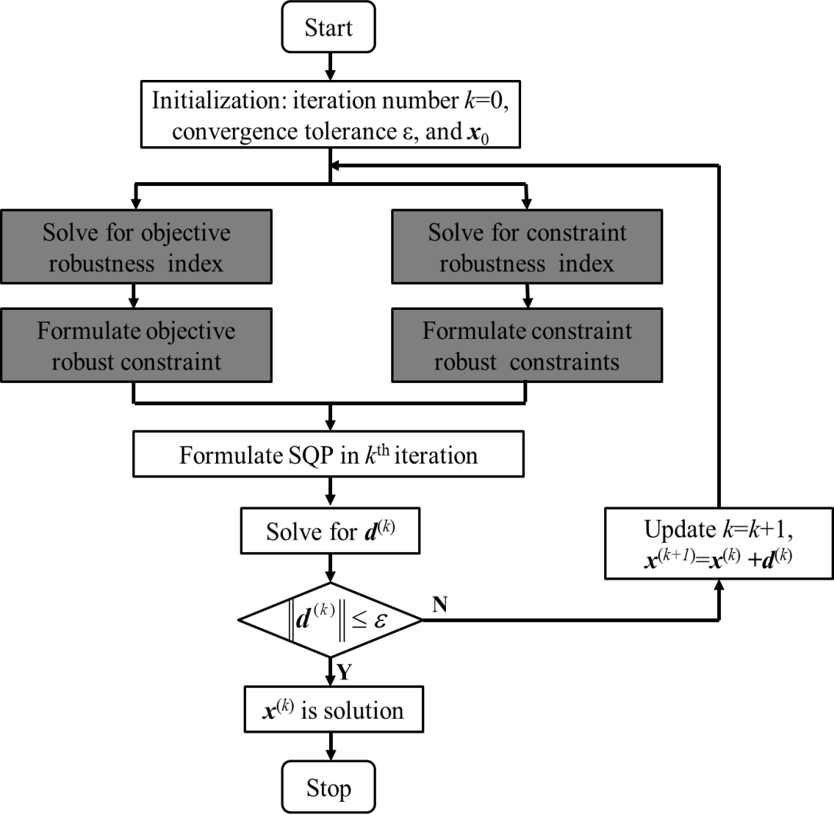
SQP-RO
Flowchart of SQP-RO:
Formulation of SQP-RO:
Notes:
The flowchart for SQP-RO is shown here. It shares a similar structure with SQP, and the dark blocks show the procedure we have just discussed.
The formulation gives the detailed procedure for the flowchart.

Slide 12
Engineering Example - Formulation
Compressing spring*
Minimize Spring Deflection
s.t.:
Shear stress ≤ 80 ksi
Surge wave frequency ≤ 100 Hz
Outer diameter ≤ 1.5 in
Total mass ≤ 2.309 x 10⁻⁵ lbm
spring deflection ≤ 0.75 in
Design Variables (x):
0.05 ≤ wire diameter (d) ≤ 0.20
0.25 ≤ the mean coil diameter (D) ≤ 1.30
2 ≤ # of active coils (N) ≤ 15
Uncertainty & Acceptable Objective Variance: [Δd, ΔD, ΔP] = [0.001in, 0.01in, 0.1lbf]
Acceptable objective variance: Δδ = 0.1
Solution | Deterministic | Robust
d | 0.0765 | 0.0525
D | 1.3000 | 0.3372
N | 6.3602 | 14.9000
*Gunawan, S., 2004, “Parameter Sensitivity Measures for Single Objective, Multi-Objective, and Feasibility Robust Design Optimization,” PhD dissertation, Department of Mechanical Engineering, UMD, USA.
Notes:
With the SQP-RO proposed, now we give an engineering example to show the applicability of the proposed approach.
This Is a compressing spring. we want to design the wire diameter, the coil diameter, and the number of coils to minimize the spring deflection.
Uncertainties exist in two of the diameters and the force applied. The acceptable objective variation is 0.1.
Note that the number of coils should be rounded. in practical engineering design, we should go back to check whether the design is still feasible with the rounded number of coils. But here, we did not repeat this procedure.

Slide 13
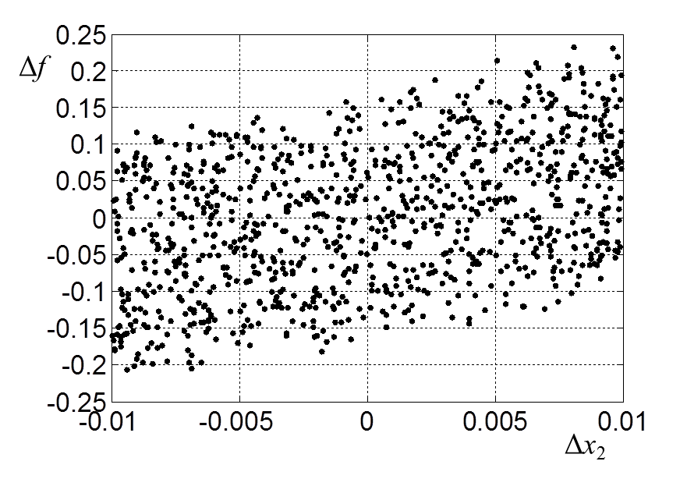
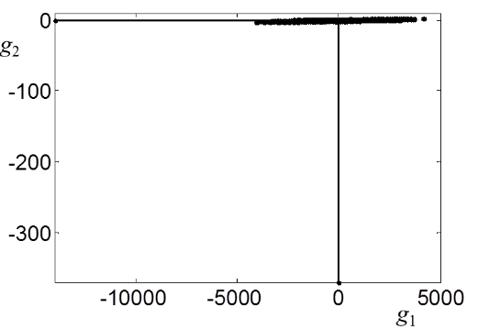
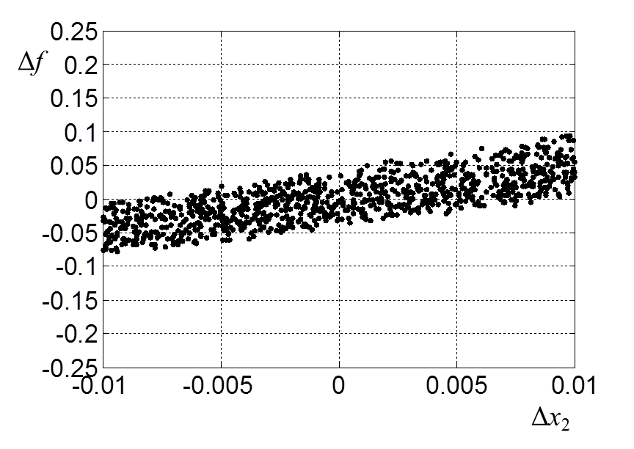
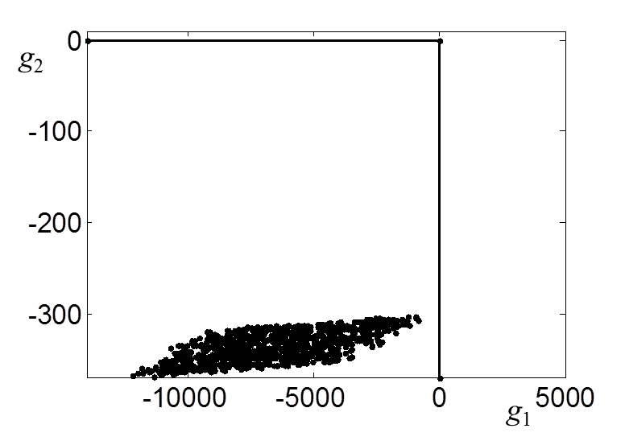
Engineering Example - Results
Solution
Deterministic case
Robust case
D=0.3372
N=15
d=0.0525
D=1.3000
N=6
=0.0765
Monte Carlo simulation results
Notes:
The minimum deflection of the robust solution is larger than the deterministic solution, but the objective variation due to uncertainty of the robust case is smaller than the deterministic case.
The two springs are with different dimensions.
We did [ˈmɑntiˈkɑrlo] simulations to show the robustness of the two solutions. It is shown that for the deterministic case, the variation of the objective reaches 0.25, which is larger than the allowed 0.1, and also the constraint are violated. But for the robust solution, the variation of the objective is within 0.1, and the constraints are satisfied.

Slide 14
Comparison of Results
Computational Efficiency of Five Numerical Examples
Computational Efficiency of Three Engineering Examples
Notes:
We also tested other numerical and engineering examples, the computational efficiency is listed here. The number of function evaluations of SQP-RO is at most five times of the deterministic SQP. It should be noted that for other algorithms like GA, the number of function evaluations of the robust case could be hundreds times of the deterministic case. The deterministic case is set as a baseline here.
The computational time is also shown, and compared to the deterministic case, SQP-RO also shows its efficiency.

Slide 15
Research Topic 2*: Sequential MOO and Sequential MDO Motivation and Objective
Motivation:
Most existing methods do not give full autonomy to subsystems, i.e., subsystems only perform optimization with respect to its local variables
There is nested optimization between system and subsystems, calculation is burdensome
Objective: propose a novel MDO (MOO) approach which gives full optimization autonomy to the subsystems in the initial stage, and subsystems perform optimization in a sequential way
*Zhou, J. H., Li, M., and Xu, M., 2015a, “A New Sequential Multi-Disciplinary Optimization Method Based on A Novel Sequential Multi-Objective Optimization Approach”, Journal of Mechanical Design, under review.
Notes:
For most existing MDO approaches, they do not give full optimization autonomy to each subsystems, that is, the system determines the shared global and coupling variables and send them to the subsystems. The subsystems only perform optimization w.r.t. their local variables.
This also lead to another problem that there is nested optimization between the system and subsystems, such that the calculation is very burdensome.
So the objective of this research is to propose////

Slide 16
Previous Work
Example Refs. | Single-level | Multi-level | Disciplines have full optimization autonomy | Optimization structure
Cramer, et al., 1993, MDF | ✓
Cramer, et al., 1993, IDF
Haftka, R. T., 1985, AAO/SAND
Shin and Park, 2005, MDOIS
Sobieszczanski-Sobieski, 1988, CSSO |  | ✓ |  | Nested
Sobieszczanski-Sobieski et al., 1998, BLISS
Braun, 1996, CO
Michelena, et al., 1999, ATC
S-MDO |  | ✓ | ✓ | Sequential
Notes:
Here list the typical MDO approaches.
These four approaches are single-level methods that can not deal with complex systems.
These approaches are multi-level methods but with nested optimization structure.
The proposed approach is also a multi-level method that gives subsystems full optimization autonomy and with a sequential optimization structure, such that the computational efficiency can be greatly improved.

Slide 17
Illustrative Observations
Single global variable and no local variable
f₂
f₁
f₂
f₁
Full autonomy optimization: identify the optimal solutions of each objective individually
Z₁₀ (z₁*)
Z₂₀ (z₂*)
z
f₂
f₁
f₂
B
A
C
Monotonicity check for two objectives
A
B
C
Z₁₀ (z₁*)
Z₂₀ (z₂*)
z
f₁
Potential Pareto points
Notes:
This slide shows a simplest case where the new idea comes from.
The simplest case is a two-obbjective optimization problem with only one global variable without any local variables, as shown in this figure.
Now we have f1 and f2, the minimum point of f1 and f2 can be determined using any optimization approach. It is found that out of the interval defined by z1 and z2, the [mɒnətə'nɪsɪtɪ] of the two objectives is the same with each other, as a result, it can be proved that points in this interval will contribute to the Pareto front. so only this interval should be considered.
Let’s consider another case. Still f1 and f2, the minimum solutions of f1 and f2. note that in this area beyond the interval defined by z1 and z2, the two objectives are with different monotonicity. As a result, points in this beyond region may dominate points in the interval. As A dominates B and C. so we have to expand the interval to this region to search for the Pareto front. as summarized in this flowchart, first we given ful optimization automony to find the individual optimal solutions, and then we check for the monotonicity of the two objectives in the region beyond the area defined by the individual optimal solutions, then we can determine the region that contain the potential Pareto points.
We discussed other cases as with local variables or more global varialbes,

Slide 18
S-MDO/S-MOO
Start
Stop
Y
N
# of points in F = s?
Full autonomy optimization of each subsystem
Subsystem 1
Subsystem 2
Non-dominated sorting of (f_{1k}*, f_{2k}*) & determination of Pareto front set F
z₁, y_{2_1}, y_{1_1}
z₂, y_{1_2}, y_{2_2}
System decision making and dispatching
x_{1k}*, f_{1k} *
z*_{eq k}, x_{2k}*, f_{2k}*
Z=expand[z₁, z₂]
Y₁=[y_{1_1}, y_{1_2}]
Y₂=[y_{2_1}, y_{2_2}]
Sequential optimization
f_{1k}*, one of x_{1k}* and y_{1k} or both
z_{k}*, y_{1k}(target),
y_{2k}(const.)
y_{2k} (target),
y_{1k} (const.)
Subsystem 1
Subsystem 2
Notes:
Flowchart for the proposed approach is shown. Start, full autonomy optimization, system making decisions and dispatching variables to subsystems, subsystems then perform optimization sequentially, non-dominated sorting of the obtained solutions, check for stopping criteria, if satisfied, stop, if not, the system dispatches other points.
There are mainly four major steps:

Slide 19
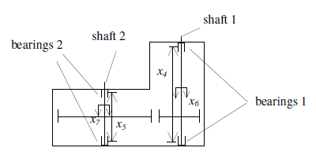
S-MOO Engineering Example
Minimize f1=volume of speed reducer
Minimize f2=stress in shaft 1
s.t.: Stress in shaft 2 ≤ 1100 kPa
Stress in shaft 2 ≤ 1100 kPa
.......
x₂, x₃, x₄, x₆
x₁, x₅, x₇
Subsystem 1
x₁ ~ x₇
min f₁
s.t. g₁≤ 0
Subsystem 2
x₂, x₃, x₄, x₆
min f₂
s.t. g₂≤ 0
Notes:
To show the applicability of the propose approach, we first give an MOO engineering example, the speed reducer.
We want to minimize the volume of the speed reducer and the stress in shaft 1.
These are local variables of subsystem 1, and these are shared global variables for both subsystems. The solution is shown in this figure. MOGA is multi0obbjective genetic algorithm, IDF is a single-level MDO approach and CO is a multi-level MOD approach as reviewed previously.
Our sequential method is able to find multiple Pareto solutions, but CO and IDF can find Pareto solutions with weighted suubm methods.

Slide 20
Numerical Example: S-MDO
x₁, x₂, x₃
Subsystem 1
x₁, x₂, x₃
min f₁
s.t. g₁≤ 0
y₁
Subsystem 2
x₁, x₂, x₃
min f₂
s.t. g₂≤ 0
y₂
Notes:
We give another numerical MDO example here.
The formulation is given, the relationship of the two subsystems are shown here, there are no local variables, but only global variables, and also coupling variables.
The solutions are also shown. The left figure gives the Pareto front, which is compared with IDF/MDF and CO. MDF is also a single-level MDO approach. The right figure shows the relationship between the two coupling variables. Just to give an image of how the two variables are coupled

Slide 21
Comparison of Results
Computational Efficiency of S-MOO Examples
Computational Efficiency of S-MDO Examples
Nomenclature of Tables
* GA is used as the optimizer
Notes:
We tested other MOO and MDO approaches, and the computational efficiency is listed in the tables.
First compared to MOGA, the total number of function calls or the number of function evaluations of the proposed approach is much smaller.
Compared to IDF and MDF, the average number of function calls is a little bit larger for most cases, and compared to CO, the average number of function calls is much smaller.
Average # of function calls is defined as the # of functions of each Pareto point.
IDF and MDF are two basic MDO algorithms and CO is a popular multi-level MDO appraoch.

Slide 22
Research Topic 3*: RO with Interval and Model Uncertainty
Bayesian framework can analyze the differences between computer simulations and physical experiments.
y^{e}(x) = y^{r}(x)+ ε = y^{m}(x)+ δ(x) +ε
y^{e}
y^{e} : experimental observation
y^{r} : real result of physical system
y^{m}: simulation output
δ : bias function
ε : experimental error
y^{r}
y^{m}
δ
Model uncertainty quantification
Establish a GP model for y^{m}(•)
Simulation training data
**Establish a GP model for δ(•)
Simulation and experimental training data
**Derive the GP model for y^{r}(•)
* Wang, S., Chen, W., and Tsui, K. L., 2009, “Bayesian Validation of Computer Models,”
Technometrics, 51(4).
**Arendt, P. D., 2012, "Quantification and Mitigation of Multiple Sources of Uncertainty
in Simulation Based Design," PhD Dissertation, Northwestern University, Evanston, IL.
Notes:
Bayesian framework is to analyze the differences between computer simulations and physical experiments as this equation.
where ye is the experimental observation; yr is the real output of the physical system; ym is the simulation output; δ is the bias function to capture the inaccuracy of the simulation model; and ε /epsilon/ is the random experimental error.
Based on the Bayesian framework, model uncertainty in the simulation model can be quantified as follows.
The first step is to establish a GP model for ym.
The second step is to establish a GP model for the bias function δ. The detailed procedure can be found in the second reference.
The third step is to derive the GP model for the real output based on above two GP models. Finally the GP model for the real output can be used to replace the simulation model for optimization and analysis.

Slide 23
Motivation and Objective
Motivation
Uncertainties in simulation models: parameter uncertainty, model uncertainty, and other errors
Simulation Result
Simulation Optimum
Real Optimum
Most existing RO approaches only considered parameter uncertainty, but overlooked model uncertainty
Real Output
x
Objective
develop a new RO approach considering interval parameter uncertainty and model uncertainty in design optimization
* Zhang, Y. J., Li, M., Zhang, J., and Li, G., 2016, "Robust Optimization With Parameter and Model Uncertainties Using Gaussian
Processes," Journal of Mechanical Design, 138(11), p. 111405.
Notes:
As we have discussed, there exist various types of uncertainties in the simulation model, such as parameter uncertainty, model uncertainty, and other errors.
Among these uncertainties, model uncertainty is the difference between the physical system and the simulation model as shown in this figure.
However, in most existing RO approaches, only parameter uncertainty was considered but model uncertainty has been ignored.
As a result, the objective of research step 1 is to develop a new RO approach considering interval parameter uncertainty and model uncertainty in design optimization problems.

Slide 24
Previous Work: RO
Example Refs. | Interval parameter uncertainty | Probabilistic parameter uncertainty | Model uncertainty | Constrained
Jung and Lee, 2002 |  | ✓ |  | ✓
Janak, et al., 2007 |  | ✓ |  | ✓
Li, et al., 2006 | ✓ |  |  | ✓
Zhou and Li, 2014 | ✓ |  |  | ✓
Gu, et al., 2000 |  | ✓ | ✓(Assumed to be known) | ✓
Chen, et al., 2008 |  | ✓ | ✓(Unknown)
Research Step 1 | ✓ |  | ✓(Unknown) | ✓
Notes:
Here is part of the literature review.
Most existing RO approaches considered parameter uncertainty, including interval-based and probability-based.
Only a few works have considered model uncertainty in robust design. Some of them assumed model uncertainty to be known, which is impractical in most cases. Some of them only considered model uncertainty in the objective function and are not applicable /'æplɪkəbl/ for problems with constraints.
In this step, the proposed RO approach can deal with interval parameter uncertainty and model uncertainty in both the objective function and constraints, where model uncertainty is unknown and quantified by the Bayesian approach.

Slide 25
Background
Optimization with interval parameter uncertainty P
Interval parameter uncertainty
Worst-case RO formulation*
Objective Robustness
Feasibility Robustness
* Li, M., 2007, “Robust Optimization and Sensitivity Analysis with Multi-Objective Genetic Algorithms: Single- and Multi-disciplinary Applications,” PhD dissertation, Department of Mechanical Engineering, UMD, USA.
Notes:
The background introduces the RO approach considering interval parameter uncertainty, which is denoted as P in this work.
Here uncertainty in parameters is represented by an interval and Δp denotes the half variation range around the nominal value p0. Also, the design variables x may also have interval uncertainty.
Considering interval parameter uncertainty, the RO formulation using the worst-case method is shown as this formulation.
For objective robustness, the objective variation caused by interval parameter uncertainty should be within the acceptable objective variation region, which is usually determined by the designer.
For feasibility robustness, all the constraints should be always satisfied when uncertain parameters change within their intervals.

Slide 26
Proposed Approach (1/3)
Optimization with model uncertainty M
Quantify model uncertainty M
Bayesian framework
GP model
Assumption:
Sufficient samples for GP modeling
RO considering M
GP model: Mean m^{r}(x, p₀); STD σ^{r}(x, p₀)
f ^{r}(x , p₀): use as objective
ensure to be small enough
: use as constraints
ensure to be small enough
Notes:
Now I will introduce the proposed approach in this section.
First we consider robust optimization with model uncertainty, which is denoted by M in this work. Since parameter uncertainty is not considered, p is fixed at p_{0.}
Using the Bayesian framework, the functions with model uncertainty in the left formulation should be replaced by their corresponding real outputs as in the right formulation.
When using GP models, the real output GP models will provide mean and the standard deviation functions,
which can be used to formulate the robust optimization considering model uncertainty as this equation.
In this equation, we assume that the obtained GP models are accurate enough with sufficient training samples.
Thus we use the mean function of the real output GP model as the new objective.
And the standard deviation is guaranteed to be small enough to ensure the accuracy of the GP model.
As for constraints, we use mean+kσ to replace the original constraints, where k is a positive value to specify the confidence degree of the feasibility.
Also, the standard deviations of constraints should be guaranteed to be small enough.

Slide 27
Proposed Approach (2/3)
RO considering M with P
RO considering P and M
Considering interval parameter uncertainty P: the worst-case technique
Objective: ensure variation caused by uncertain parameters to be within an acceptable range
Constraints: should be always satisfied when uncertain parameters change
Notes:
Based on the RO formulation considering model uncertainty, we continue to consider the effect of interval parameter uncertainty.
Considering interval parameter uncertainty, the worst-case technique can be used to formulate the proposed RO approach as this equation.
The additional constraint is used to ensure the objective variation caused by interval parameter uncertainty to be within an acceptable range.
And all the constraints should be always satisfied when uncertain parameters change.

Slide 28
Proposed Approach (3/3)
Flowchart of the proposed RO approach
Start
For each simulation model with model uncertainty
Latin hypercube sampling
Collect simulation and experimental data
Establish GP models for simulation models
Establish GP models for bias functions
For each simulation model with model uncertainty
Based on training data
Derive GP models for real outputs
For each simulation model with model uncertainty
Run the proposed RO algorithm
Using GP models for real outputs
Notes:
Here shows the flowchart of the proposed RO approach.
The first step is to collect simulation and experimental training data for each simulation model with model uncertainty.
The Second step is to establish GP models for simulation models and bias functions based on the collected training data.
Next step is to derive the GP models for the real outputs.
The last step is to run the proposed RO algorithm to find the robust optimal design with respect to interval parameter uncertainty and model uncertainty.

Slide 29
Example: Three-Bar Truss* (1/2)
Problem formulation
RO formulation
*
Minimize Stress on Bar 1(σ)
s.t.
g₁: Horizontal deflection at node 4 ≤ 0.5 cm
g₂: Vertical deflection at node 4 ≤ 0.5 cm
g₃: Stress on Bar 2 ≤ 140 MPa
g₄: Buckling load on Bar 1 ≤ F_{b1}
g₅: Buckling load on Bar 2 ≤ F_{b2}
g₆: Buckling load on Bar 3 ≤ F_{b3}
g₇: Total volume ≤ 2000 cm³
Design Variables (x):
30º ≤ the angle (θ) ≤ 40º
2cm² ≤ cross section area of Bars 1 and 3(A₁) ≤ 10cm²
Uncertainties:
P : Δx = (5º, 0.1cm²)
M: δ_{f} in the objective function f
δ_{g} in three constraints g₂, g₅, g₇
*Gunawan, S., 2004, “Parameter Sensitivity Measures
for Single Objective, Multi-Objective, and Feasibility
Robust Design Optimization,” Ph.D. dissertation,
Department of Mechanical Engineering, UMD, USA.
Notes:
Now we use some examples to demonstrate the proposed approach.
The first example is to design a three-bar truss as shown in the Figure.
The objective is to minimize the stress in No. 1 bar subjected to 7 constraints.
There are two design variables: the angle ['æŋɡl] θ and the cross section area
A₁
There exist interval parameter uncertainty in design variables and model
uncertainty in the objective and constraints. For the purpose of simplicity
[sɪm'plɪsɪtɪ] and demonstration, only three representative constraints are
assumed to involve model uncertainty.
Using the proposed RO approach, the problem can be formulated as this equation.

Slide 30
Example: Three-Bar Truss (2/2)
Solutions
Deterministic solution x_{d} = (40, 6.3640) σ_{d} = 134.5612 MPa | Robust optimal solution w.r.t. interval parameter uncertainty x_{P} = (40, 6.2640) σ_{P} = 136.4638 Mpa | Robust optimal solution w.r.t. interval parameter and model uncertainties x_{PM} = (39.6528, 6.0519) σ_{PM} = 143.7691 MPa
Monte Carlo simulation results
Notes:
For the three-bar truss, we find three kinds of solutions, which are the deterministic solution, the robust optimal solution with respect to interval parameter uncertainty, and the robust optimal solution with respect to interval parameter and model uncertainties, respectively.
To verify the robustness, Monte Carlo simulations are conducted for the three solutions respectively. The results show that:
All the three solutions are objectively robust.
But for feasibility robustness, as shown in these figures, g₇ becomes infeasible for the deterministic solution and the robust optimal solution with
only parameter uncertainty. At the same time, all the constraints remain feasible for the robust optimal solution with both parameter and model uncertainties.
Thus the proposed RO approach is capable of identifying robust optimal solutions with respect to interval parameter uncertainty and model uncertainty.

Slide 31
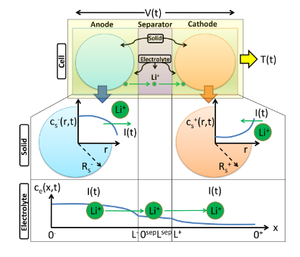
Recent Research Progress:
MDO for DFN electrochemical modeling
电化学参数辨识背景
工业需求驱动
电动汽车产业快速发展，要求更精确的电池管理系统
储能系统规模扩大，需要准确的电池状态估计
电池制造质量控制需要可靠的参数表征方法
技术发展基础
计算能力的提升使得复杂算法可实现
传感器技术进步提供更丰富的测量数据
高精度仿真为参数辨识提供新方法
需求背景
电池P2D模型
研究现状
当前不足
传统方法
电化学阻抗谱(EIS)测量
循环伏安法(CV)表征
恒流充放电测试
新兴方法
机器学习辅助参数辨识
在线自适应参数估计
多尺度混合辨识方法
方法局限性
大多数方法仅适用于特定工况
缺乏统一的评价标准
可解释性不足
2.实用性问题
计算复杂度过高
需要专业设备
支持应用场景受限
Notes:
Bayesian framework is to analyze the differences between computer simulations and physical experiments as this equation.
where ye is the experimental observation; yr is the real output of the physical system; ym is the simulation output; δ is the bias function to capture the inaccuracy of the simulation model; and ε /epsilon/ is the random experimental error.
Based on the Bayesian framework, model uncertainty in the simulation model can be quantified as follows.
The first step is to establish a GP model for ym.
The second step is to establish a GP model for the bias function δ. The detailed procedure can be found in the second reference.
The third step is to derive the GP model for the real output based on above two GP models. Finally the GP model for the real output can be used to replace the simulation model for optimization and analysis.

Slide 32
Recent Research Progress:
MDO for DFN electrochemical modeling
基于全局敏感性分析的参数选择
参数准备
定义问题字典（参数名称、范围）
Saltelli采样
生成结构化采样矩阵
模型评估
对每个采样点进行模型计算
Sobol全局敏感性分析
设定采样数量
确保采样覆盖性和效率
收集输出结果
使用特定结构的输出结果
计算各类敏感性指标
针对电化学模型适用性强
电化学参数 | 一阶指数 (S1) | 总指数 (ST)
负极锂离子初始浓度 | 0.5024 | 0.9087
负极厚度 | 0.2285 | 0.5904
正极厚度 | 0.1604 | 0.3112
正极活性材料比例 | 0.1571 | 0.2676
正极锂离子最大浓度 | 0.0545 | 0.4990
非线性特性处理：
电化学模型具有强非线性特性
参数间存在复杂的耦合关系
Sobol方法不受模型线性假设限制
2. 定量评估能力：
一阶敏感性指数(S1)：反映单个参数的直接影响
总敏感性指数(ST)：包含参数的所有交互效应
交互效应(ST-S1)：揭示参数间的耦合强度
3. 结果可靠性：
提供敏感性指标的置信区间
支持不同参数重要性的统计检验
参数筛选：
ST < 0.01可考虑忽略
S1接近ST表示主要为直接效应
ST >> S1表示强交互作用
Notes:
Bayesian framework is to analyze the differences between computer simulations and physical experiments as this equation.
where ye is the experimental observation; yr is the real output of the physical system; ym is the simulation output; δ is the bias function to capture the inaccuracy of the simulation model; and ε /epsilon/ is the random experimental error.
Based on the Bayesian framework, model uncertainty in the simulation model can be quantified as follows.
The first step is to establish a GP model for ym.
The second step is to establish a GP model for the bias function δ. The detailed procedure can be found in the second reference.
The third step is to derive the GP model for the real output based on above two GP models. Finally the GP model for the real output can be used to replace the simulation model for optimization and analysis.

Slide 33
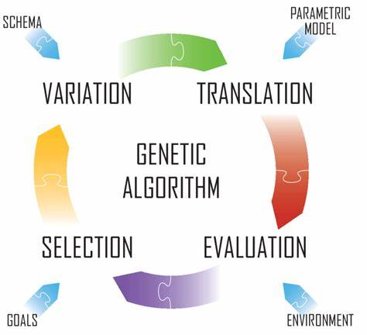
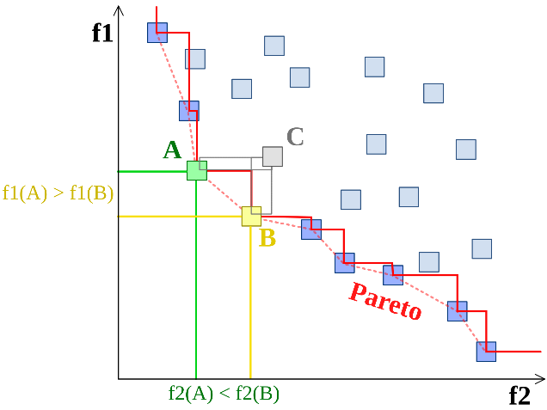
Recent Research Progress:
MDO for DFN electrochemical modeling
非支配排序基因算法（NSGA）
敏感性分析筛选关键参数
参数编码与种群初始化
非支配排序分层
拥挤度计算与选择
NSGA算法的显著优势
Pareto优化： NSGA基于Pareto支配的概念，通过将解空间划分为不同的非支配前沿，并保持解的多样性，能够找到较好的Pareto前沿解集。
高收敛性： NSGA采用了快速非支配排序和拥挤度距离的策略，能够在多目标优化问题中具有较好的收敛性。它可以快速收敛到Pareto前沿，并提供多样性和均匀分布的解。
适应于多目标问题： NSGA适用于多目标优化问题，能够同时优化多个冲突的目标。它可以处理带约束和非约束的多目标优化问题，适应范围广。
参数较少： NSGA相对简单，参数较少，易于实现和应用。一般只需要设置种群大小、交叉概率和变异概率等少数几个参数。
高效的非支配排序和拥挤距离计算： NSGA-II算法采用快速非支配排序算法对种群中的个体进行排序。
基因算法
帕累托最优
Notes:
Bayesian framework is to analyze the differences between computer simulations and physical experiments as this equation.
where ye is the experimental observation; yr is the real output of the physical system; ym is the simulation output; δ is the bias function to capture the inaccuracy of the simulation model; and ε /epsilon/ is the random experimental error.
Based on the Bayesian framework, model uncertainty in the simulation model can be quantified as follows.
The first step is to establish a GP model for ym.
The second step is to establish a GP model for the bias function δ. The detailed procedure can be found in the second reference.
The third step is to derive the GP model for the real output based on above two GP models. Finally the GP model for the real output can be used to replace the simulation model for optimization and analysis.

Slide 34
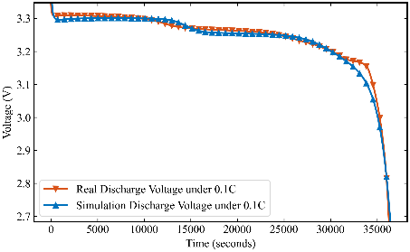
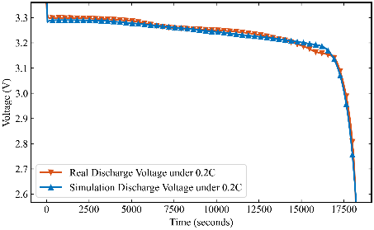
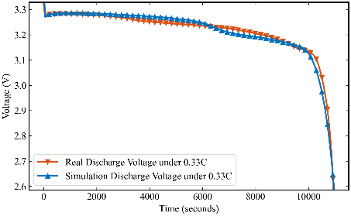
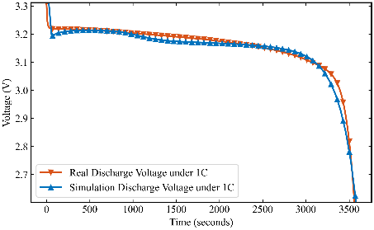
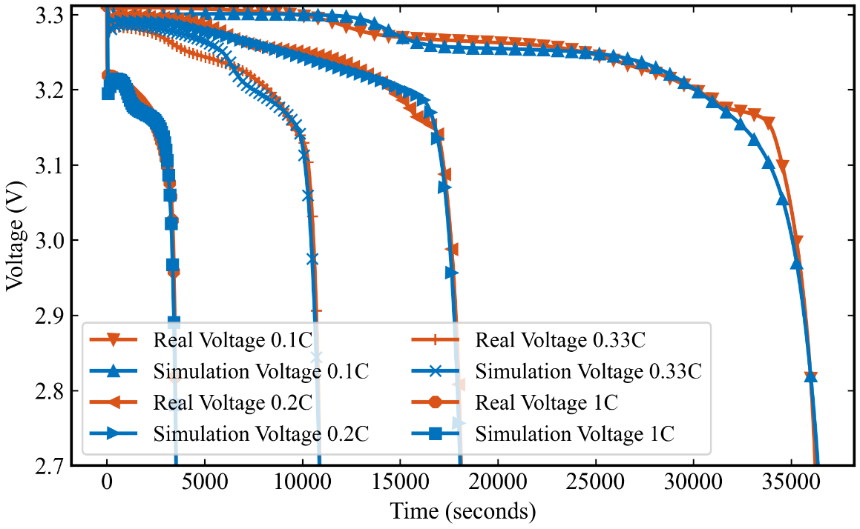
Recent Research Progress:
MDO for DFN electrochemical modeling
RMSE for 0.1C: 7.4 mV
RMSE for 0.2C: 6.0 mV
RMSE for 0.33C: 12.5 mV
RMSE for 1C: 10.3 mV
算法：NSGA 电池模型：DFN
参数量：42 不同工况独立训练，得出的参数不同
DFN模型是一个基于物理的电池模型，它源自于Doyle等人的工作，并由Fuller和Newman进一步发展。这个模型详细描述了锂离子电池的电化学行为，包括锂离子在电极中的扩散、电解液中锂离子的迁移和电池的电荷平衡。
DFN模型能够模拟电池的电压响应，预测电池性能，并且是理解和预测电池退化现象的重要工具。
单工况参数辨识实验结果
Notes:
Bayesian framework is to analyze the differences between computer simulations and physical experiments as this equation.
where ye is the experimental observation; yr is the real output of the physical system; ym is the simulation output; δ is the bias function to capture the inaccuracy of the simulation model; and ε /epsilon/ is the random experimental error.
Based on the Bayesian framework, model uncertainty in the simulation model can be quantified as follows.
The first step is to establish a GP model for ym.
The second step is to establish a GP model for the bias function δ. The detailed procedure can be found in the second reference.
The third step is to derive the GP model for the real output based on above two GP models. Finally the GP model for the real output can be used to replace the simulation model for optimization and analysis.

Slide 35
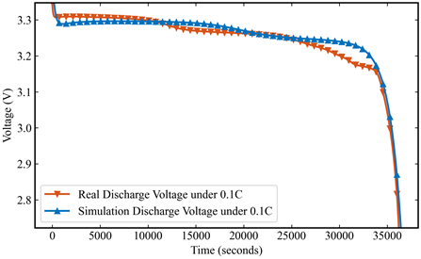
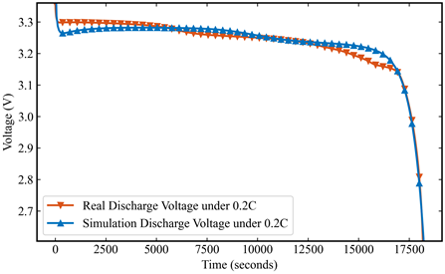
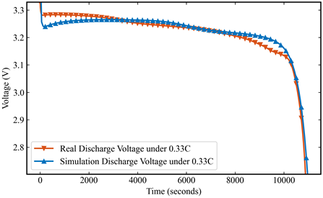
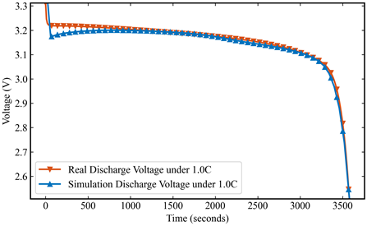
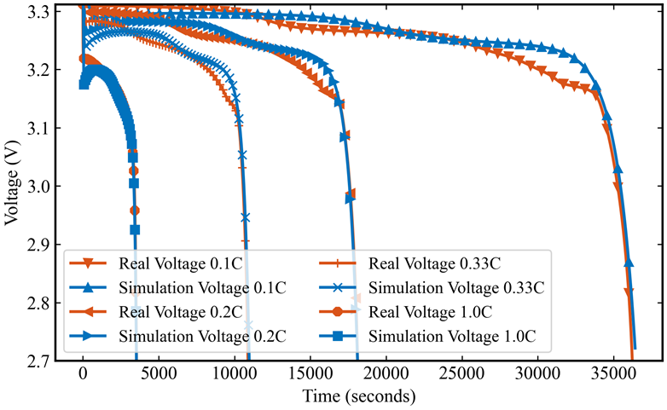
Recent Research Progress:
MDO for DFN electrochemical modeling
RMSE for 0.1C: 13.5 mV
RMSE for 0.2C: 12.2 mV
RMSE for 0.33C: 10.7 mV
RMSE for 1C: 5.3 mV
算法：NSGA 电池模型：DFN
参数量：42 跨工况联合训练，相同电化学参数，在后续的实验中，我们会加入DFN模型与SPMe模型的结果对比
DFN与SPMe模型的区别
模型维度和复杂性：DFN模型更为复杂，考虑了电极的多孔结构和详细的电化学机制，而SPMe模型则简化了这些过程，将电极视为单个球形粒子。
计算成本：DFN模型由于其复杂性，计算成本较高，而SPMe模型通过简化模型结构，显著降低了计算成本。
跨工况参数辨识实验结果
Notes:
Bayesian framework is to analyze the differences between computer simulations and physical experiments as this equation.
where ye is the experimental observation; yr is the real output of the physical system; ym is the simulation output; δ is the bias function to capture the inaccuracy of the simulation model; and ε /epsilon/ is the random experimental error.
Based on the Bayesian framework, model uncertainty in the simulation model can be quantified as follows.
The first step is to establish a GP model for ym.
The second step is to establish a GP model for the bias function δ. The detailed procedure can be found in the second reference.
The third step is to derive the GP model for the real output based on above two GP models. Finally the GP model for the real output can be used to replace the simulation model for optimization and analysis.

