Slide 1

NFC Antenna & PCB Design
Joaquin Sabin
Austin Weber
Dylan Robens
Alex Schroeder

Slide 2
Project Overview
We are designing and creating our own Near-Field Communication (NFC) antenna which is based on the same technology as RFID. We are going to integrate 3 of these antennas into a custom PCB which will be controlled via a microcontroller. (Complete by first semester)
We will then have a second microcontroller hooked up to the 3 antennas which will be able to process and interact with NFC chips. Based on the NFC data being received, the microcontroller will output a command to the rest of the circuit.
We plan to house our PCB in a shelf to be used to display amiibo figures.
Notes:
Joaquin

Slide 3
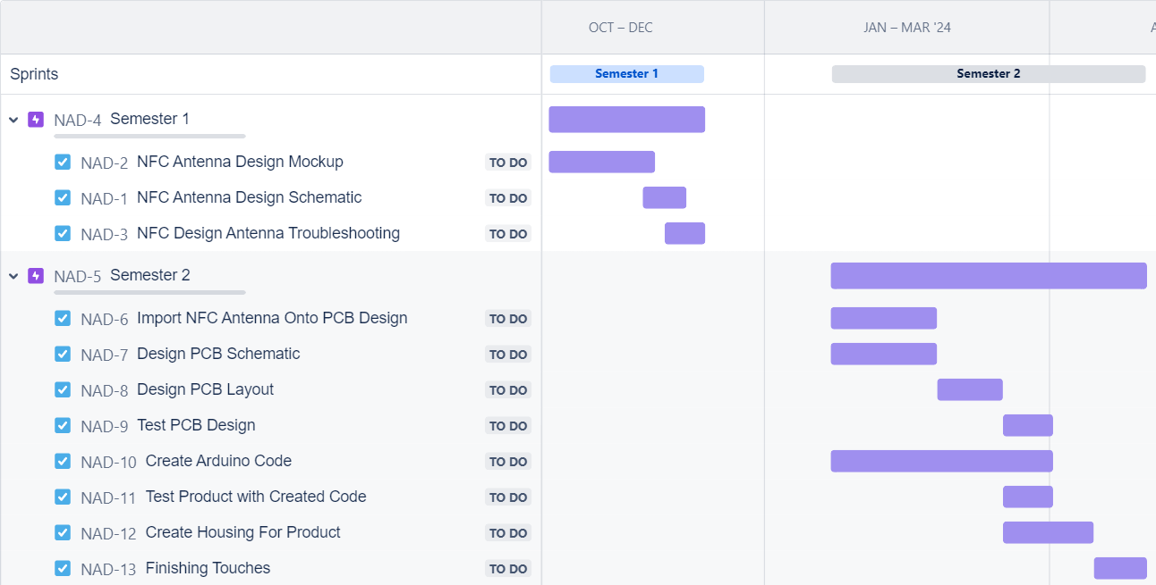
Gantt Chart
Notes:
Alex
Fall Semester
Research NFC properties
Selecting and calculating parameters for the Low pass filter present on the antenna
Calculating the matching circuit present with the antenna
Calculate NFC antenna parameters
Calculating the resistance, inductance, and capacitance of the antenna
Design and simulate NFC antenna
Using RFSim99, to get an accurate reading of how our created antenna will operate
Spring Semester
Create custom PCB with embedded NFC antenna and power sharing
Importing our antenna design onto our custom-made board
Test/debug PCB
Testing to see if our components are behaving as expected
Program PCB logic
Creating code from scratch to utilize the data we will be scanning with the antenna
Design shelf/housing in CAD
Build case/shelf and assemble project

Slide 4
Member Roles
Dylan
Antenna design research
3D Modeling
PCB Design Layout
Arduino Programming
NFC reader and chip interface protocol research
Alex
Antenna Design Research
Antenna Simulation
PCB Layout Design
PCB Schematic Design
Joaquin
Antenna Design Research
Antenna Simulation
PCB Logic Design
3D Modeling
Austin
Antenna design research
NFC215 chip data structure and storage
Arduino programming
NFC reader and chip interface protocol research
Notes:
Dylan
Everyone is doing design research for the antenna. It’s the main focus of our capstone project currently and we want to ensure that we nail the design of the antenna down.
Alex and Joaqin plan on doing Antenna simulation to ensure that our Antenna design is working as intended in theory.
Meanwhile Dylan and Austin will do NFC reader and chip interface protocol research
Second Semseter:
Alex, Dylan, and Joaqin will all be working on the PCB Layout and Logic design as we want to square away the PCB design early on
Austin will be working on the NFC 215 Chip Data structure and storage while this is going on.
Austin and Dylan will work on Arduino programming so that our custom pcb will work as intended once we receive it, and that way we can hopefully start testing as soon as we get it.
Dylan and Joaquin plan on doing 3d Modelling to house the PCB Semester 2 after the NFC Antenna is squared away

Slide 5
Basics of How NFC Works
RF Field
Passive RFID tag operates at different frequency ranges
HF: 13.56 MHz (Target frequency)
RF Field Modulation
Antenna design: Coiled Octagon
Antenna induces a magnetic field
NFC chip sends signal when current is induced
Notes:
Dylan
NFC Antennas work by sending out an RF field that will oscillate at a designated frequency (Passive RFID Tags operate at different frequencies)
Passive RFID tag operation frequency ranges:
LF: 125-134 kHz
HF: 13.56 MHz (This is the target frequency we are hoping to achieve as this allows us to operate with what we need)
UHF: 856-960 MHz
The NFC antenna will modulate its own RF field to send commands through its antenna
The antenna will be in the shape of a octagon which will be coiled with multiple turns in it
The antenna will induce a magnetic field, this magnetic field will induce a current within the receiving NFC chip
NFC chip will be powered on when a current is induced and modifies the RF field which the Antenna will detect.

Slide 6
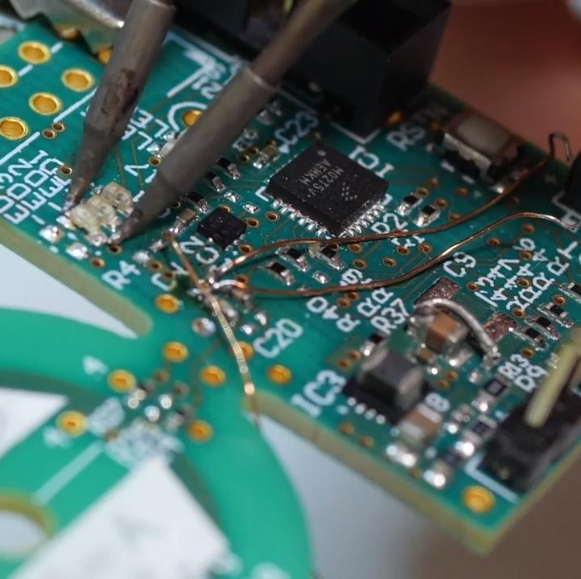
Background NFC Information
NFC ISO 14443
International standard for proximity chips/cards used in Identification and Transmission protocols
14443-2 is for Radio frequency and Signal Interfacing
Two types of NFC Antennas: A & B
Communicate at 13.56 MHz
Modulation and Initialization are the only differences.
Radius is proportional to reading field distance
We have decided upon 14443-2 Type A for our design.
Notes:
Alex
Our selected antenna will have a microprocessor that uses the NFC ISO 14443
International standard for proximity chips/cards used in identification and transmission protocols
Specific standard we selected is used for radio for radio frequency and signal interfacing
Two types of NFC microprocessors that we could have selected, A & B
Both communicate at 13.56 MHz and we have to create an antenna that operates at that frequency
Between these two standards, modulation and initialization are the only differences
The radius of the antenna itself is directly proportional to the maximum distance at which the antenna can scan for signals
Based on all of these factors, we chose a 13334-2 type A microprocessor for our antenna design

Slide 7
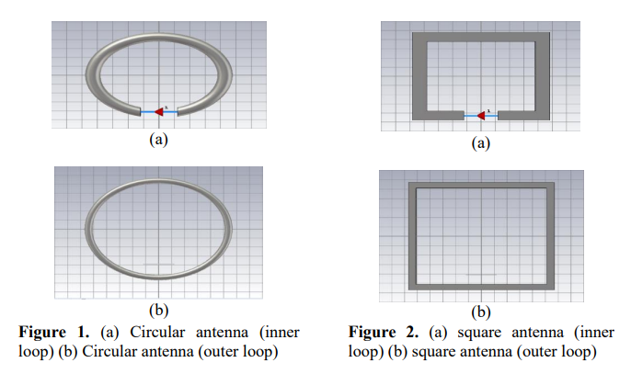
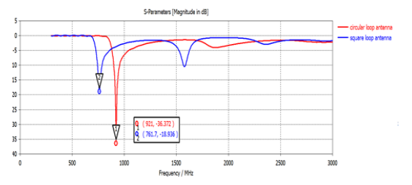
Antenna Design
Circular Vs Square Loop Antenna Design
Both have fields primarily determined by thickness of gap between antenna coils, the radius of the loop, and the number of turns
The square shape has more stability while the circle has less data loss
Overall, we decided to go with a hybrid approach and create an octagon-shaped antenna. We will roughly have the stability of a square with the losses of a circle
Notes:
Joaquin

Slide 8
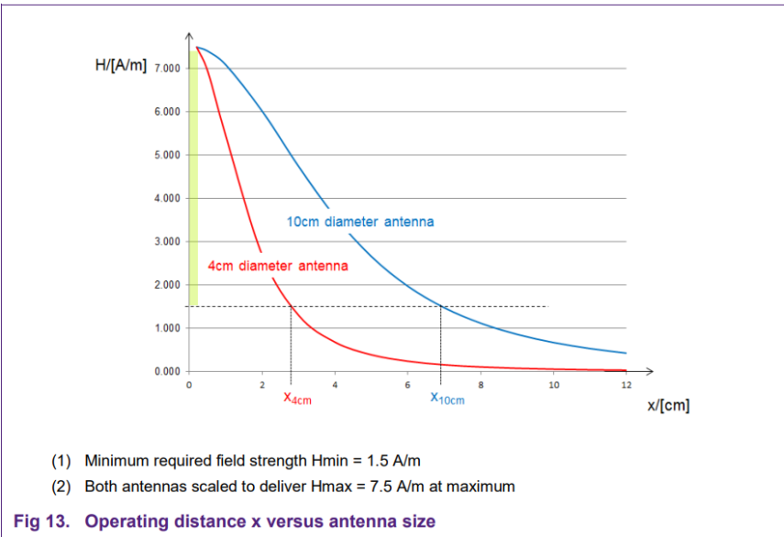
Antenna Design Cont.
Field Strength directly proportional to Radius/Diameter
Larger Diameter => Larger field strength
Smaller Diameter => Smaller field strength
We need a smaller antenna so we can fit a limit-switch/button into the system so it can scan only when set down.
We are aiming for a 4cm diameter antenna which will give us a ~3cm field range
Notes:
Joaquin

Slide 9
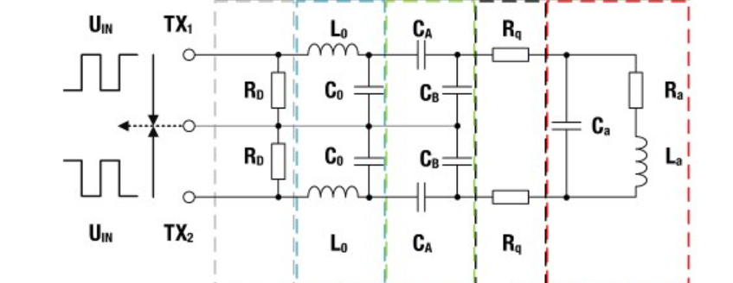

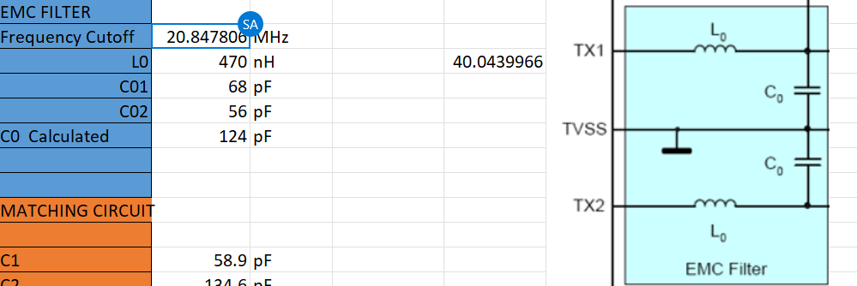
Antenna Design Equations:
Need to know Inductance, Capacitance, and Resistance of components for our NFC Antenna
EMC Filter values are decided to reach Cut Off Frequency we desire.
Cut Off Frequency calculated with the Inductance and Capacitance of the EMC Filter.
Need to find out Capacitance A and Capacitance B for the Matching circuit.(Formula on right) ->
Capacitance is dependent upon EMC Filter variables
Once we figure out the matching circuit values, we can calculate what the output of our entire circuit will be.
Notes:
Alex:
Need to know Inductance, Capacitance, and Resistance of components for our NFC Antenna
Multiple parts to the antenna design:
EMC Filter, Matching circuit, Antenna Circuit
EMC Filter values are decided to reach Cut Off Frequency we desire.
Cut Off Frequency calculated with the Inductance and Capacitance of the EMC Filter.
Dylan:
Matching circuit has capacitance values that are dependent upon the EMC Filter
For our matching circuit we need to find out Capacitance A and Capacitance B
Once we figure out the Matching Circuit values we can Calculate the Antenna circuit values

Slide 10
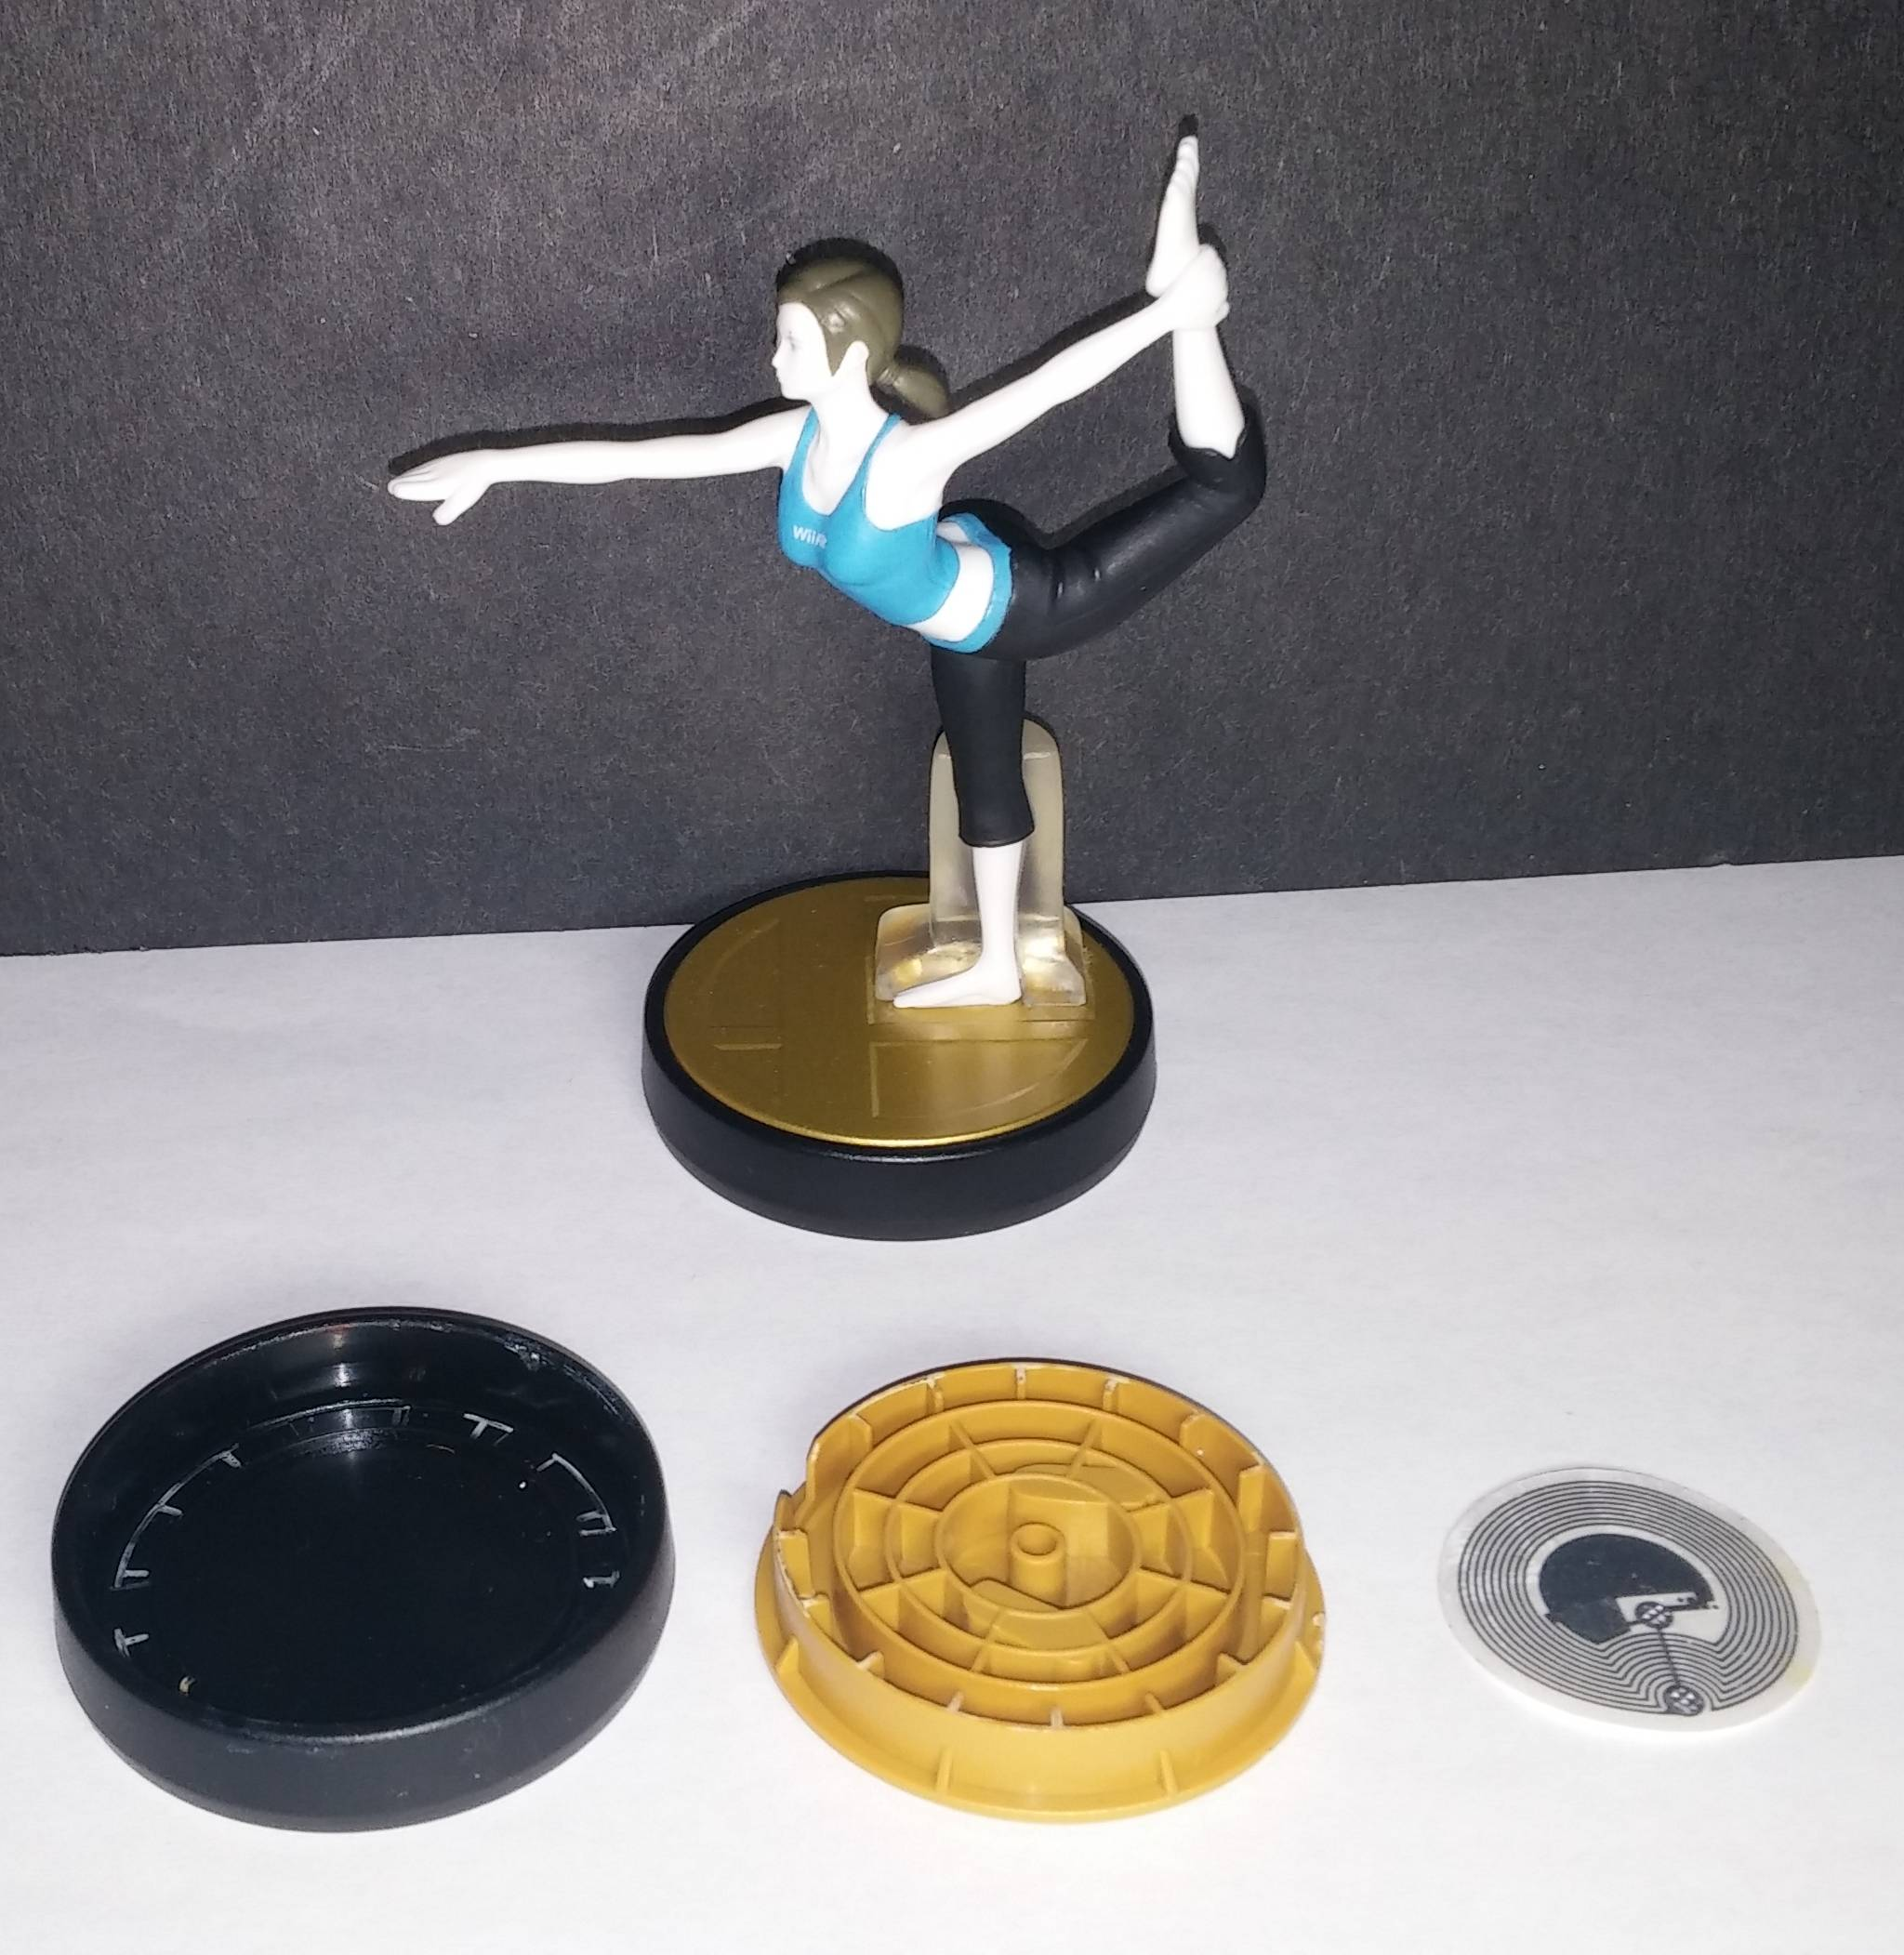
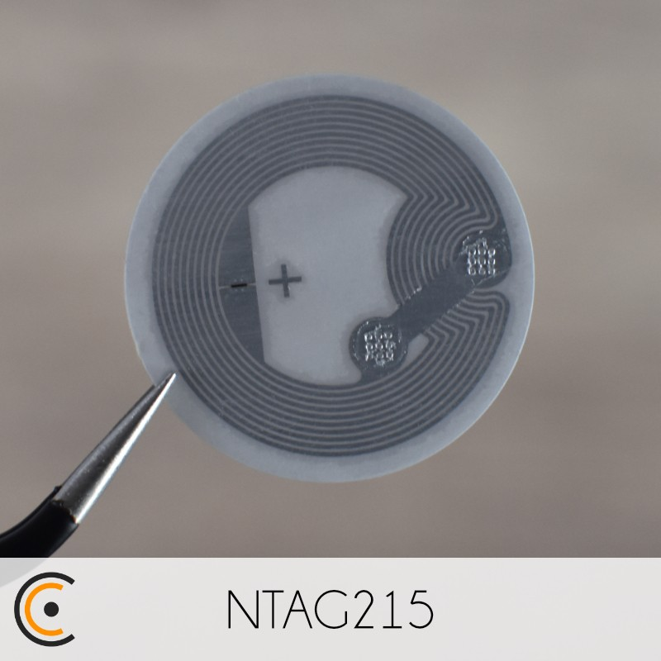
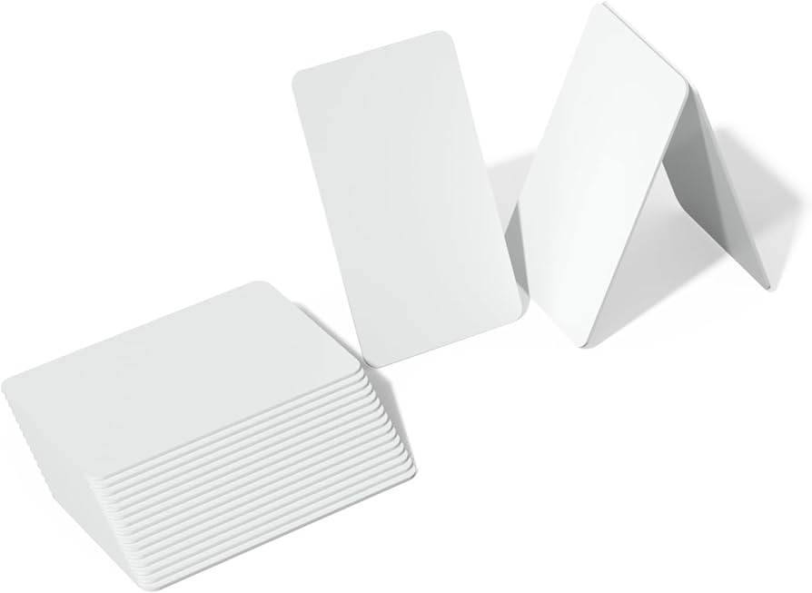

The NTAG215 Chip
Very common NFC chip
This is what we are actually reading data from
It is a tiny chip stored inside of the Amiibo figures (shown to the right)
Notes:
Austin

Slide 11
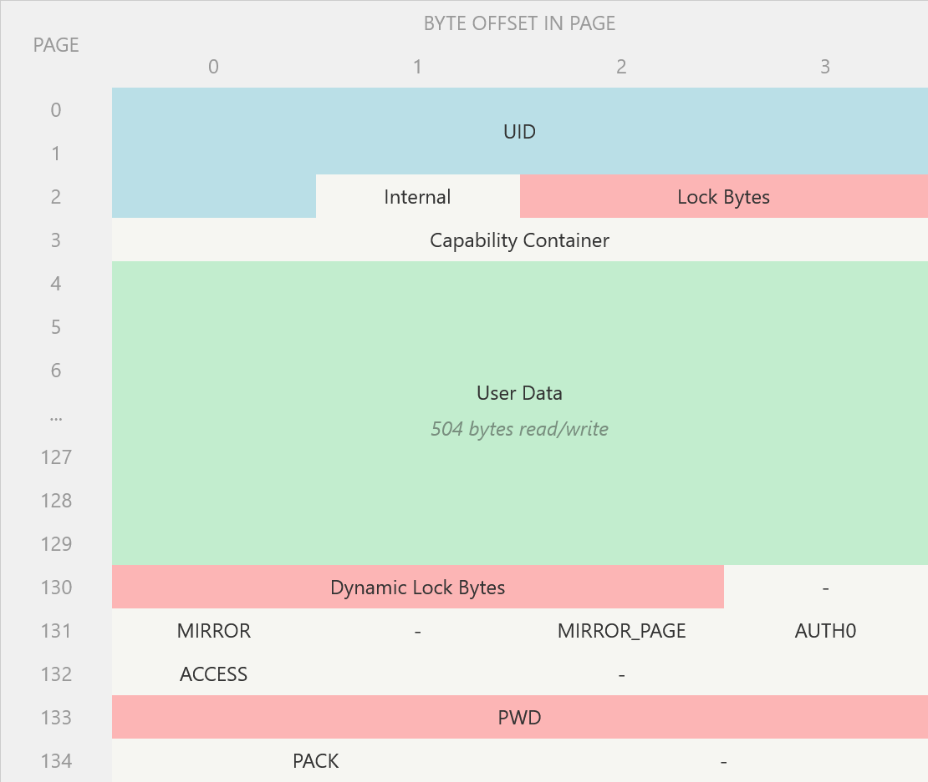
NTAG215 Data Information
540 Bytes of EEPROM, 504 of which are available for user data
Transfer rate of 106 kbit/s
Total transfer can be completed in 40ms
Memory is stored in 4-byte chunks known as “pages”
Total of 135 pages
7-byte serial number that is set at the factory
+2 checksum bytes
Lock bytes which specify pages that cannot be written to
Notes:
Austin

Slide 12
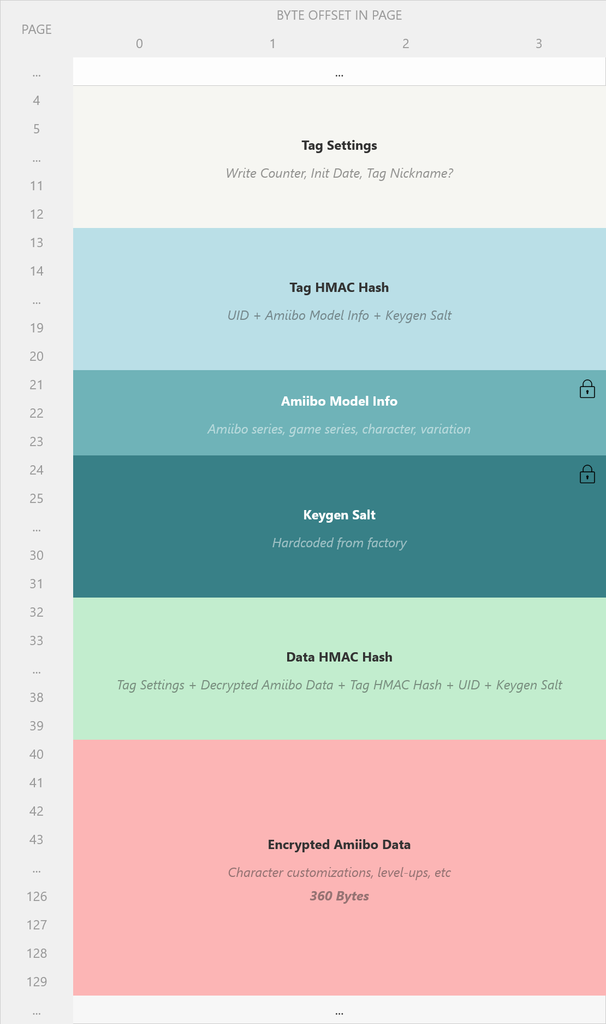
Amiibo Specific Information
Amiibo Model Type
This is the important data for what we want to do
It is not encrypted, however it is locked
Located at pages 21 and 22
Encrypted Amiibo Data
360 bytes total
Requires a copywritten encryption key
Not legally obtainable
Notes:
Austin

Slide 13
Parts
3x NFC Reader
1x Arduino Mega
1x Multi-Color LED COMMON CATHODE
1x White Filament
4x Custom PCB board
Notes:
Alex
Above are the parts that we selected that will be used for primarily testing in the future
We selected these to best replicate the PCB that we will be creating in the future
Having these components ahead of time will allow other areas to have active development simultaneously
Also purchased white filament for 3D Printing, selected this based on what we want our final color to be
We have a goal to purchase 4 custom PCB boards at the end of this project, pending how much each board will cost

Slide 14
Design Challenges
Researched around RC522
CLRC663 is now being used
CLRC663 is a newer chip
Simulation software difficulties
Notes:
Dylan
We researched and planned to use the RC522 chip but learned that it is mostly obsolete now- and is no longer in stock. We then had to restart our research and decided to go with the CLRC663 chip instead as it is the newest chip.
Due to the CLRC 663 being newer, it can support updated technologies but has less documentation and libraries
Finding a simulation software for NFC antennas has been difficult, but we have a few resources we can use. Although we still have to do all the calculations as well as how to use any software we found.

Slide 15

Questions?

