Slide 1


NFC Antenna design
By:
Dylan Robens, Austin Weber,
Joaquin Sabin, Alex Shroeder

Slide 2

Project Overview
Design and Create NFC antenna PCB
Integrate Antenna PCB with a microcontroller on the same board.
Integrated board will be able to process and interpret all data received
NFC antenna will be to scan all Passive RFID NFC chips.
Interface with Amiibo?
Notes:
Dylan
We are designing and creating our own Near-Field Communication (NFC) antenna which is based on the same technology as RFID. We are going to integrate 3 of these antennas into a custom PCB which will be controlled via a microcontroller. (Complete by first semester)
We will then have a second microcontroller hooked up to the 3 antennas which will be able to process and interact with NFC chips. Based on the NFC data being received, the microcontroller will output a command to the rest of the circuit.
We plan to house our PCB in a shelf to be used to display amiibo figures
Our Antenna will be able to scan all types of Passive RFID NFC Chips present as they operate at 13.56 MHz
We plan on using Amiibo at the moment to test multiple NFC antennas at the same time as they all have pre-filled data in their chips that is unique. We could very easily switch over to cards like our stout cards, or building keys

Slide 3
Roles
Alex Schroeder – PCB Design, Testing, Final Report
Austin Weber - Code Design, Testing, Final Report
Dylan Robens - Code Design, Shroud Creation, Final Report
Joaquin Sabin – PCB Design, Shroud Creation, Final Report
Notes:
Austin

Slide 4
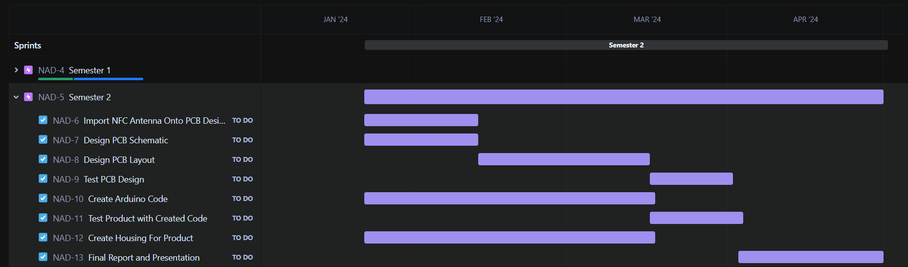
Gantt Chart
Notes:
Joaquin

Slide 5

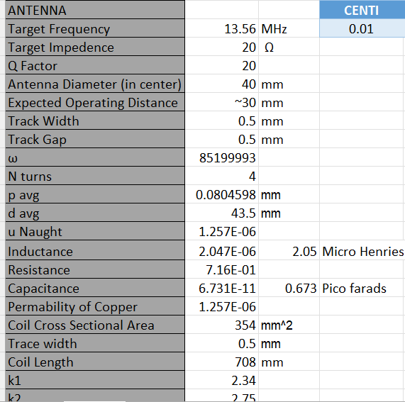

Background Research
Basics of NFC Communication and how it works
Calculating Components
NXP Antenna documentation
What Antenna shape is most effective for NFC
Notes:
NFC stands for Near Field Communication. It works by using a coil to induce a short range electromagnetic field that, when a passive RFID chip is brought into range of the Antenna’s field, will induce a current within the chip and thus power the chip which will allow for data transfer.
We dug through multiple NXP documents. NXP is a company that has multiple documents outlining the design process and decisions you have to make while designing an NFC antenna
NXP outlines how to calculate most components
Did some in-depth research on what Antenna shape was best for NFC antennas and learned about the direct proportionality of the diameter and the strength of the field.

Slide 6
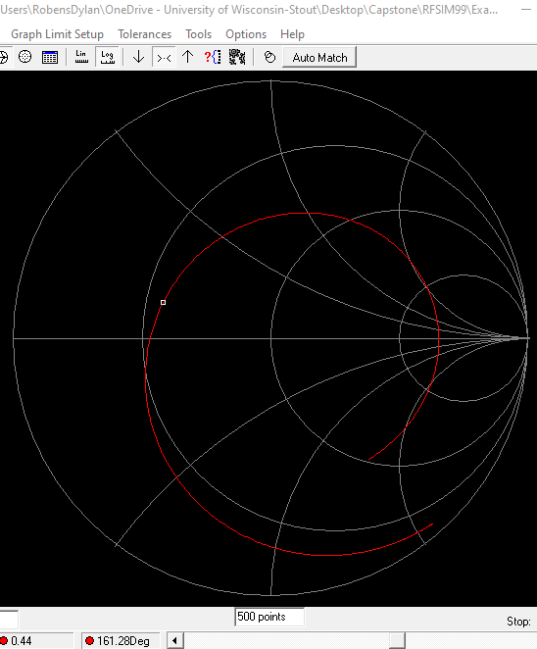
Antenna Design
Designed the antenna in Altium Designer
All antenna components were calculated through background research
Used a program called RFSim99 to validate research results
Achieved an optimum antenna design through simulating the equivalent circuit of our antenna
Notes:
Dylan
Since last time we have presented we have finalized our antenna component values
We have tested our antenna via an RFSim 99 simulation, and with that we were able to conclude that with our current component values, our Antenna design will work when we go to test it and ensure that its worked.
The Antenna design has also been constructed within Altium designer
What's next for us is that we need to order a PCB to test if our Antenna design.

Slide 7

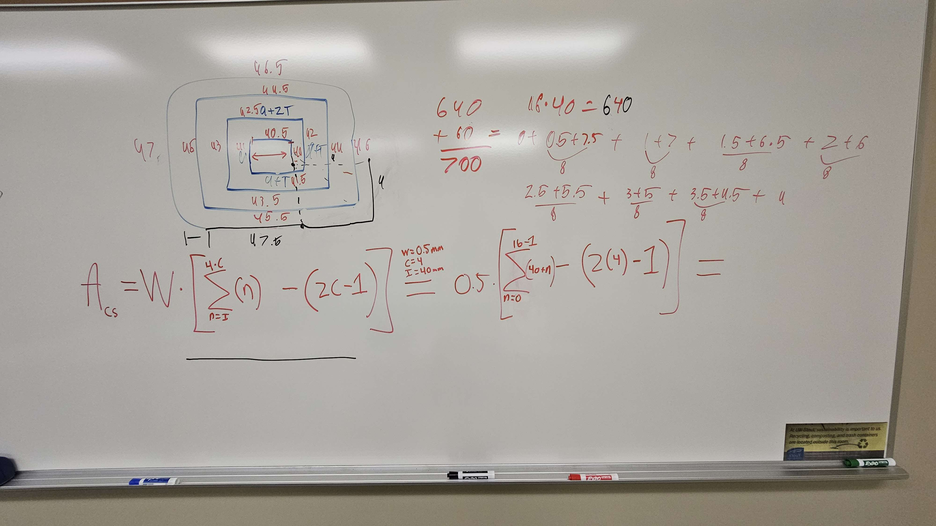
Notes:
Austin

Slide 8
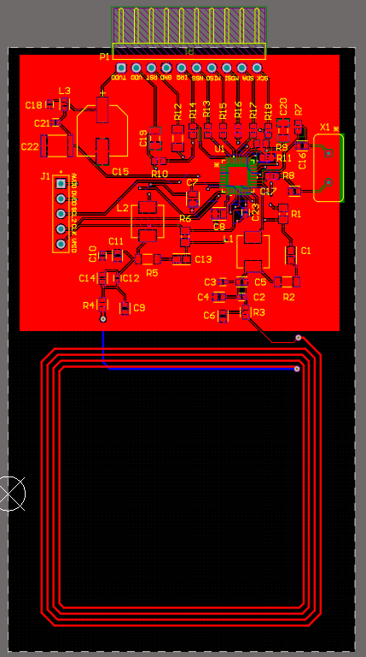
Part Selection
Antenna test board – allows us to verify that our design works
Four PCBs for the final design – complete with the finished antenna circuit integrated with an Arduino Mega chip (ATmega2560)
3D printed shroud to house the electrical components

Slide 9
Plan for next semester
Receive our custom PCB
Integrate it with our Arduino Mega
Complete the Arduino Mega program
Design the final PCB with Arduino integration
Send in the final PCB for manufacturing
3D model and print final PCB housing
Notes:
Joaquin

Slide 10
Tests
EMF testing of the antenna
CLRC663 chip testing through Arduino Mega
Read and Write tests of the CLRC663
General program ability testing
Notes:
Austin

