Slide 1
Title: Blockchain-based Anti-Counterfeiting System for Firearms
Name: Letheba Geberalters
Surname: Kaka
Student Number:222003507

Slide 2

Problem Background:

Slide 3
Surge in counterfeit weapons
Threat to public safety, crime and violence
Current systems: opaque, lack transparency, tamper-proof safeguards
Difficulty in tracing firearms at crime scenes

Slide 4

Research Problem

Slide 5
Objective: Use blockchain technology to create a decentralized, secure, and tamper-proof anti-counterfeiting system for firearms
Goals: Verify manufacturing and buyer details, ensure efficient traceability for criminal investigations

Slide 6

Existing Solutions

Slide 7
Reliance on centralized databases managed by authorities
Issues: Tampering by authorities, lack of security and transparency
Inadequate verification of manufacturing and buyer information
Vulnerability to fraudulent activities

Slide 8

Proposed Solution

Slide 9
Integration of blockchain technology
Ensures immutability, transparency, and security
Encryption of confidential information
Integration with law enforcement systems

Slide 10
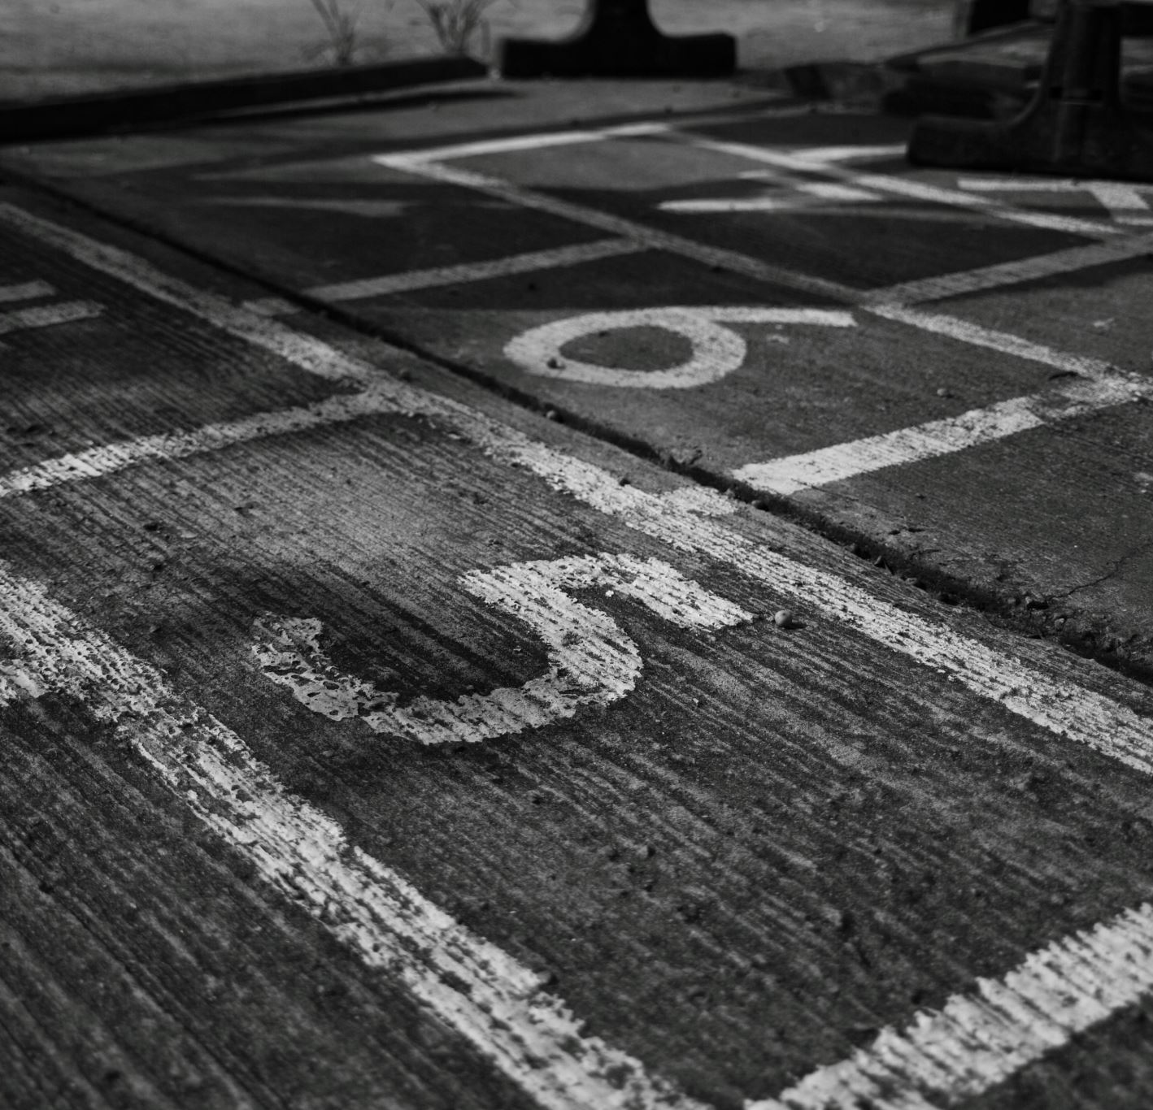
Approach

Slide 11
Approach 1 - Blockchain Integration
Approach 3 - Data Encryption
Approach 4 - Integration with External Systems

Slide 12

Novelty

Slide 13

Unique application of blockchain technology to counteract firearm counterfeiting
Ensures data authenticity and integrity
secure interactions
Integration with law enforcement adds practical value

Slide 14
Libraries And Technologies Utilized
For the UI: JavaFX (SceneBuilder)
For the Database: MySQL Server

Slide 15
User Interfaces
Law Enforcement: Access and verify firearm information
Manufacturers: Record and manage firearm data
Buyers: View purchased firearm information

Slide 16

System Workflow

Slide 17
The Firearm manufactures registers new firearms before selling
The firearm details will be added to the blockchain
A customer will then buy the newly registered firearms from the manufacturer
The purchase details will be added to the blockchain
The buyers must make an application to the authorities to get firearm license
The application details will be added to the blockchain
The authorities will retrieve the applications in the blockchain to approve or reject the application
The authorities can reject or aprove and then the information will be added to the blockchain
The authorities can all details about all the transactions in the blockchain
The firearm owner can retrieve his or her firearm details from the blockchain

Slide 18
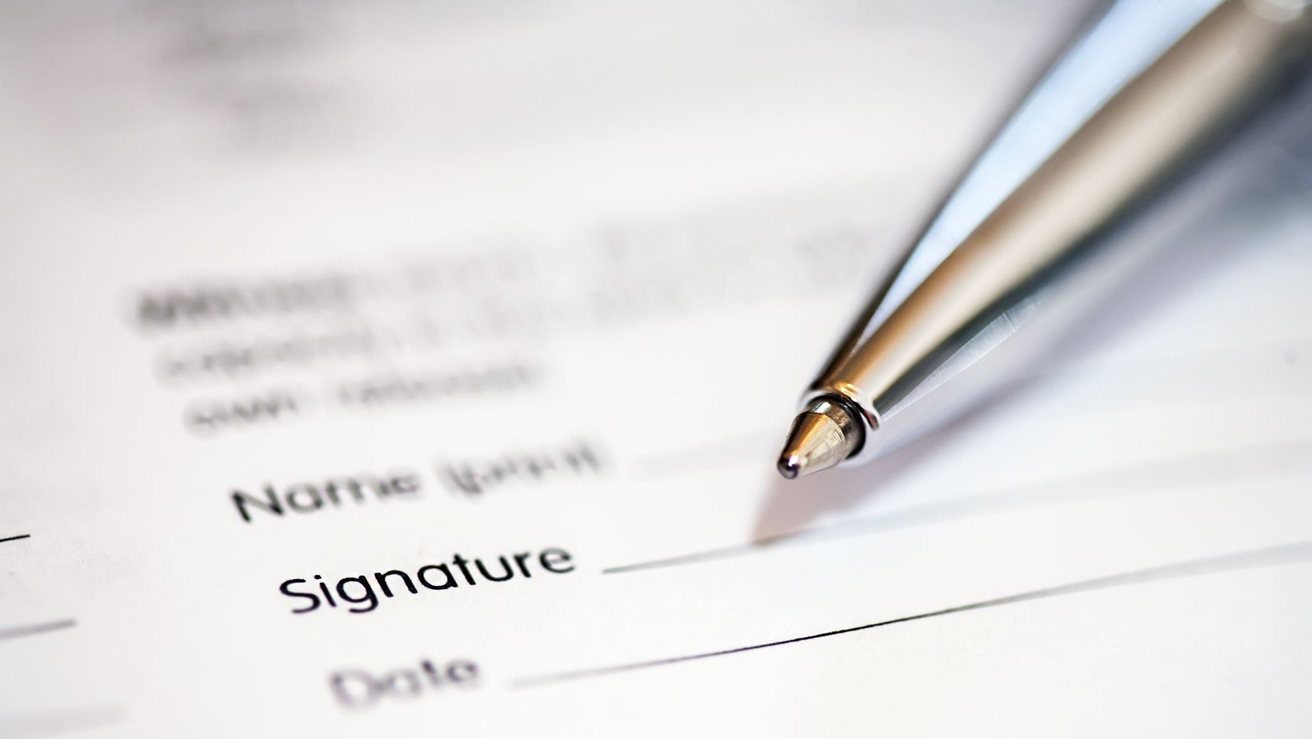
Conclusion

Slide 19

Enhances law enforcement capabilities in criminal investigations
Ensures transparency, security, and traceability
Blockchain technology provides a robust solution for anti-counterfeiting of firearms

