Slide 1
Chapter 5
Financial Regulation

Slide 2
Contents
What is financial regulation?
Objectives of financial regulation
Asymmetric Information as a Rationale for Financial Regulation
Types of Financial Regulation
Financial Markets Regulations and Ethics

Slide 3
Financial regulation
Financial regulation refers to the oversight and supervision of financial institutions, markets, and instruments by government or regulatory agencies to ensure stability, transparency, fairness, and consumer protection.

Slide 4
Financial regulation…
The financial system is among the most heavily regulated sectors of the economy, and
banks are among the most heavily regulated of financial institutions.
Unfortunately, the regulatory process may not always work very well, as evidenced by the recent global financial crisis.
We can use economic analysis of financial regulation to explain the worldwide crisis and to consider how the regulatory system can be reformed to prevent future such disasters.

Slide 5
Objectives of Financial Regulation
Stability: Prevent financial crises by ensuring systemic stability in the economy.
Consumer Protection: Safeguard consumers from fraud, unfair practices, and exploitation.
Transparency: Promote accurate and timely disclosure of financial information.
Market Efficiency: Ensure efficient functioning of financial markets and promote fair competition.
Monetary Policy Implementation: Regulate financial institutions to support the effective implementation of monetary policy.
Prevention of Financial Crimes: Combat money laundering, fraud, and financing of terrorism.

Slide 6
Asymmetric Information As A Rationale For Financial Regulation
Asymmetric information-the fact that different parties in a financial contract do not have the same information-leads to adverse selection and moral hazard problems, which have an important impact on our financial system.
The concepts of asymmetric information,
especially
adverse
selection, and
moral hazard are
why
useful in
understanding regulation.
governments pursue financial

Slide 7
Government Safety Net
Financial intermediaries, like banks, are particularly well suited to solving adverse selection and moral hazard problems because they make private loans that help avoid the free-rider problem.
However, this solution to the free-rider problem creates another asymmetric information problem, because depositors lack information about the quality of these private loans.
This asymmetric information problem leads to other problems that interfere with the proper functioning of the financial system.

Slide 8
Cont’d
Bank Panics and the Need for Deposit Insurance
A bank failure (in which a bank is unable to meet its obligations to pay its depositors and other creditors, and so must go out of business) meant that depositors would have to wait until the bank was liquidated (until its assets had been turned into cash) to get their deposit funds; at that time, they would be paid only a fraction of the value of their deposits.
Because they couldn‟t know if bank managers were taking on too much risk or were outright crooks, depositors would be reluctant to put money in banks, thus making banking institutions less viable.

Slide 9
Cont’d
In addition, depositors‟ lack of information about the quality of bank assets can lead to a bank panic, in which many banks fail simultaneously.
Because the simultaneous failure of many banks leads to a sharp decline in bank lending, bank panics have serious, harmful consequences for the economy.
Why bank panics occur?
Suppose an adverse shock hits the economy. As a result of the shock, 5% of banks have such large losses on loans that they become insolvent (have a negative net worth and so are bankrupt). Because of asymmetric information, depositors are unable to tell whether their bank is a “good” bank or one of the 5% that are insolvent. Depositors at bad and good banks recognize that they may not get back 100 cents on the dollar for their deposits and therefore are inclined to withdraw them.

Slide 10
Cont’d
Indeed, because banks operate on a “sequential service constraint” (a first-come, first-served basis), depositors have a very strong incentive to be the first to show up at the bank, because if they are last in line, the bank may have paid out all its funds and they will get nothing.
The incentive to “run” to the bank to be first is why withdrawals when there is fear about the health of a bank is described as a “bank run.”
Uncertainty about the health of the banking system in general can lead to runs on both good and bad banks, and the failure of one bank can hasten the failure of others (referred to as the contagion effect).
If nothing is done to restore the public‟s confidence, a bank panic can ensue.
Bank panic is a financial crisis that occurs when many banks suffer runs at the same time, as people suddenly try to convert their threatened deposits into cash or try to get out of their domestic banking system altogether.

Slide 11
Cont’d
A government safety net for depositors can short-circuit runs on banks and bank panics, and by providing protection for the depositor, it can overcome depositors‟ reluctance to put funds into the banking system.
One form of safety net is deposit insurance, such as that provided by the Federal Deposit Insurance Corporation (FDIC) of the United States. The FDIC uses two primary methods to handle a failed bank.
In the first, called the payoff method, the FDIC allows the bank to fail and pays off depositors up to the $250,000 insurance limit. After the bank has been liquidated, the FDIC lines up with other creditors of the bank and is paid its share of the proceeds from the liquidated assets.
In the second method, called the purchase and assumption method, the FDIC reorganizes the bank, typically by finding a willing merger partner who assumes (takes over) all of the failed bank‟s liabilities so that no depositor or other creditor loses a penny. The FDIC often sweetens the pot for the merger partner by providing it with subsidized loans or by buying some of the failed bank‟s weaker loans.

Slide 12
Cont’d
Other Forms of the Government Safety Net
In other countries, governments have often stood ready to provide support to domestic banks facing runs even in the absence of explicit deposit insurance.
Furthermore, banks are not the only financial intermediaries that can pose a systemic threat to the financial system.
When financial institutions are very large or highly interconnected with other financial institutions or markets, their failure has the potential to bring down the entire financial system.
This is exactly what happened with Bear Stearns and Lehman Brothers, two investment banks, and AIG, an insurance company, during the global financial crisis in 2008.

Slide 13
Cont’d
One way in which governments provide support is through lending from the central bank to troubled institutions, as the Federal Reserve did during the global financial crisis.
This form of support is often referred to as the “lender of last resort” role of the central bank.

Slide 14
Cont’d
Drawbacks of the Government Safety Net
Although a government safety net can help protect depositors and other creditors and prevent, or ameliorate, financial crises, it is a mixed blessing.
Moral Hazard and the Government Safety Net
The most serious drawback of the government safety net stems from moral hazard, the incentives of one party in a transaction to engage in activities detrimental to the other party.
With a safety net, depositors and creditors know they will not suffer losses if a financial institution fails, so they do not impose the discipline of the marketplace on these institutions by withdrawing funds when they suspect that the financial institution is taking on too much risk.

Slide 15
Cont’d
Consequently, financial institutions with a government safety net have an incentive to take on greater risks than they otherwise would, because taxpayers will foot the bill if the bank subsequently goes belly up.
Financial institutions can place the following bet: “Heads, I win; tails, the taxpayer loses.”
Adverse Selection and the Government Safety Net
Because depositors and creditors protected by a government safety net have little reason to impose discipline on financial institutions, risk-loving entrepreneurs might find the financial industry a particularly attractive one-they know they will be able to engage in highly risky activities.

Slide 16
Cont’d
Even worse, because protected depositors and creditors have so little reason to monitor the financial institution‟s activities, without government intervention outright crooks might also find finance an attractive industry for their activities because it is easy for them to get away with fraud and embezzlement.
“Too Big to Fail”
The moral hazard created by a government safety net and the desire to prevent financial institution failures have presented financial regulators with a particular quandary, the too-big-to-fail problem, in which regulators are reluctant to close down large financial institutions and impose losses on the institution‟s depositors and creditors because doing so might precipitate a financial crisis.
Knowing that the financial institution will be bailed out, creditors have little incentive to monitor the institution and pull their money out when the institution is taking on excessive risk.

Slide 17
Cont’d
Financial Consolidation and the Government Safety Net
Financial consolidation has been proceeding at a rapid pace, leading to both larger and more complex financial organizations.
Financial consolidation poses two challenges to financial regulation because of the existence of the government safety net.
First, the increased size of financial institutions resulting from financial consolidation increases the too-big-to-fail problem, because there are now more large institutions whose failure would expose the financial system to systemic (system-wide) risk. Thus, more financial institutions are likely to be treated as too big to fail, and the increased moral hazard incentives for these large institutions to take on greater risk increases the fragility of the financial system.

Slide 18
Cont’d
Second, financial consolidation of banks with other financial services firms means that the government safety net may be extended to new activities, such as securities underwriting, insurance, or real estate activities, as occurred during the global financial crisis. This situation increases incentives for greater risk- taking in these activities, which can also weaken the fabric of the financial system.

Slide 19
Types of Financial Regulation
There are eight basic types of financial regulation aimed at lessening asymmetric information problems and excessive risk taking in the financial system:
Restrictions on asset holdings
Capital requirements
Prompt corrective action
Chartering and examination
Assessment of risk management
Disclosure requirements
Consumer protection, and
Restrictions on competition.
https://market.nbebank.com/directives/bankingbusiness1.html
Notes:
NBE Requirements
Any licensed commercial bank shall maintain liquid assets of not less than fifteen percent (15%) of its net current liabilities.
The minimum paid up capital required to obtain a banking business license shall be Birr 500 million (birr five hundred million), which shall be fully paid in cash and deposited in a bank in the name and to the account of the bank under establishment.

Slide 20
Restrictions on Asset Holdings
The moral hazard associated with a government safety net encourages too much risk taking on the part of financial institutions.
Bank regulations that restrict asset holdings are directed at minimizing this moral hazard, which can cost taxpayers dearly.
Even in the absence of a government safety net, financial institutions still have the incentive to take on too much risk.
Because banks are the financial institutions most prone to panics, they are subjected to strict regulations that restrict their holdings of risky assets, such as common stocks.

Slide 21
Cont’d
Bank regulations also promote diversification, which reduces risk by limiting the dollar amounts of loans in particular categories or to individual borrowers.
With the extension of the government safety net during the global financial crisis, and the calls for regulatory reform in its aftermath, it is likely that nonbank financial institutions may face greater restrictions on their holdings of risky assets in the future.
The danger exists, however, that these restrictions may become so onerous that the efficiency of the financial system will be impaired.

Slide 22
ii. Capital Requirements
Government-imposed capital requirements are another way of minimizing moral hazard at financial institutions.
When a financial institution is forced to hold a large amount of equity capital, the institution has more to lose if it fails and is thus more likely to pursue less risky activities.
Capital functions as a cushion when bad shocks occur, making it less likely that a financial institution will fail, thereby directly adding to the safety and soundness of financial institutions.
Capital requirements for banks take two forms:

Slide 23
Cont’d
The first type is based on the leverage ratio, the amount of capital divided by the bank‟s total assets. To be classified as well capitalized, a bank‟s leverage ratio must exceed 5%.
Regulators are also become increasingly worried about the increase in banks‟ off-balance-sheet activities.
To help combat the problems of risky assets and off- balance-sheet activities, banking officials from industrialized nations agreed to set up the Basel Committee on Banking Supervision which implemented the Basel Accord, which deals with a second type of capital requirements, risk-based capital requirements.

Slide 24
Cont’d
The Basel Accord, which requires that banks hold as capital at least 8% of their risk-weighted assets, has been adopted by more than 100 countries. Assets are allocated into four categories, each with a different weight to reflect the degree of credit risk.
Over time, the limitations of the Basel Accord have become apparent, because the regulatory measure of bank risk, as stipulated by the risk weights, can differ substantially from the actual risk the bank faces. This discrepancy has resulted in regulatory arbitrage, a practice in which banks keep on their books assets that have the same risk-based capital requirement but are relatively risky, such as a loan to a company with a very low credit rating, while taking off their books low- risk assets, such as a loan to a company with a very high credit rating. The Basel Accord thus might lead to increased risk taking, the opposite of its intent.
To address these limitations, the Basel Committee on Bank Supervision came up with a new capital accord, often referred to as Basel 2. However, in the aftermath of the global financial crisis, the committee developed an even newer accord, which the media has dubbed “Basel 3.”

Slide 25
iii. Prompt Corrective Action
If the amount of a financial institution‟s capital falls to low levels, two serious problems result.
First, the bank is more likely to fail because it has a smaller capital cushion if it suffers loan losses or other asset write-downs.
Second, with less capital, a financial institution has less “skin in the game” and is therefore more likely to take on excessive risks. In other words, the moral hazard problem becomes more severe, making it more likely that the institution will fail and the taxpayer will be left holding the bag.
To prevent this, in US, the Federal Deposit Insurance Corporation Improvement Act of 1991 adopted prompt corrective action provisions that require the FDIC to intervene earlier and more vigorously when a bank gets into trouble.

Slide 26
iv. Chartering and Examination
Overseeing who operates financial institutions and how they are operated, referred to as financial supervision or
prudential supervision, reducing adverse
is an important and moral
method for
the
selection
hazard in
financial industry.
Because financial
institutions can
be
used
by
crooks or
overambitious entrepreneurs to
engage
in highly
speculative
activities, such undesirable people are
often eager to run a
financial institution.
institutions
is one method of
Chartering financial preventing this adverse
selection problem; through
chartering, proposals for new institutions are screened to prevent undesirable people from controlling them.

Slide 27
Cont’d
Regular on-site examinations, which allow regulators to monitor whether the institution is complying with capital requirements and restrictions on asset holdings, function to limit moral hazard.
Bank examiners give banks a CAMELS rating. The acronym is based on the six areas assessed: capital adequacy, asset quality, management, earnings, liquidity, and sensitivity to market risk.
With this information about a bank‟s activities, regulators can enforce regulations by taking formal actions such as issuing cease and desist orders to alter the bank‟s behavior, or even closing a bank if its CAMELS rating is sufficiently low.
Bank examinations are conducted by bank examiners scheduled and unscheduled.

Slide 28
Assessment of Risk Management
Although the traditional on-site examinations focus is still important in reducing excessive risk taking by financial institutions, it is no longer thought to be adequate in today‟s world, in which financial innovation has produced new markets and instruments that make it easy for financial institutions and their employees to make huge bets easily and quickly.
This change in the financial environment resulted in a major shift in thinking about the prudential supervisory process throughout the world.
Bank examiners, for example, now place far greater emphasis on evaluating the soundness of a bank‟s management processes with regard to controlling risk.

Slide 29
Cont’d
Now, bank examiners give a separate risk management rating, from 1 to 5, that feeds into the overall management rating as part of the CAMELS system.
Four elements of sound risk management are assessed to arrive at the risk management rating:
The quality of oversight provided by the board of directors and senior management;
The adequacy of policies and limits for all activities that present significant risks;
The quality of the risk measurement and monitoring systems; and
The adequacy of internal controls to prevent fraud or
unauthorized activities on the part of employees.

Slide 30
Cont’d
Guidelines which require the bank‟s board of directors to establish interest-rate risk limits, appoint officials of the bank to manage this risk, and monitor the bank‟s risk exposure.
Interest-rate risk limits includes:
Internal policies and procedures
Internal management and monitoring
Implementation of stress testing and value-at risk (VaR)

Slide 31
Disclosure Requirements
To ensure that better information is
available in the
marketplace, regulators
institutions adhere to
can require that financial
certain standard accounting
principles and disclose a wide range of information that helps the market assess the quality of an institution‟s portfolio and the amount of its exposure to risk.
More public information about the risks incurred by financial institutions and the quality of their portfolios can better enable stockholders, creditors, and depositors to evaluate and monitor financial institutions and so act as a deterrent to excessive risk taking.

Slide 32
vii. Consumer Protection
The existence of asymmetric information suggests that consumers may not have enough information to protect themselves fully in financial dealings.
Consumer protection regulation has taken several forms:
Requires all lenders, not just banks, to provide information to consumers about the cost of borrowing, including the disclosure of a standardized interest rate and the total finance charges on the loan.
The global financial crisis has illustrated the need for greater consumer protection, because so many borrowers took out loans with terms they did not understand and that were well beyond their means to repay.

Slide 33
viii. Restrictions on Competition
Increased competition can also increase moral hazard incentives for financial institutions to take on more risk.
Declining profitability resulting from increased competition could tip the incentives of financial institutions toward assuming greater risk in an effort to maintain former profit levels.
Thus, governments in many countries have instituted regulations to protect financial institutions from competition.
These regulations took two forms in the United States in the past. First were restrictions on branching. The second form involved preventing nonbank institutions from competing with banks by preventing them from engaging in banking business.
Disadvantages restrictions on competition: Higher consumer charges and Decreased efficiency.

Slide 34
Financial Markets Regulations and Ethics
The risk of losing money that can arise from many types of financial transactions has meant that financial markets have always been subject to the need for rules and codes of conduct to protect investors and the general public.
As markets developed, there grew a need for market participants to be able to set rules so that there were agreed standards of behavior and to provide a mechanism so that disputes could be settled readily.
This need developed into what is known as self- regulation, when, for example, as well as fulfilling its main function of providing a secondary market for shares, a stock exchange would also set rules for its members and police their implementation.

Slide 35
Cont’d
With the development of global financial markets came the need for improved and common standards, as well as international co-operation.
Self-regulation became increasingly untenable and most countries moved to a statutory approach (that is, with rules laid down by law so that breaking them is a criminal offence). They also established their own, independent regulatory bodies.
The need regulatory
for international co-operation between bodies also led to the creation of an
international organization, the International Organization of Securities Commissions (IOSCO).

Slide 36
Cont’d
IOSCO designs objectives and standards that are used by the world‟s regulators as international benchmarks for all securities markets.
Today there is a significant level of co-operation between financial services regulators worldwide and, increasingly, they are imposing common standards.
Anti-money laundering rules are probably the best example.

Slide 37
Cont’d
The main purposes and aims of regulation, in all markets globally, are to:
Maintain and promote fairness, efficiency, competitiveness, transparency and orderliness
Promote understanding by the public of the operation and functioning of the financial services sector
Provide protection for members of the public investing in or holding financial products
Minimize crime and misconduct in the industry reduce systemic risks, and
Assist in maintaining the market‟s financial stability by taking appropriate steps.

Slide 38
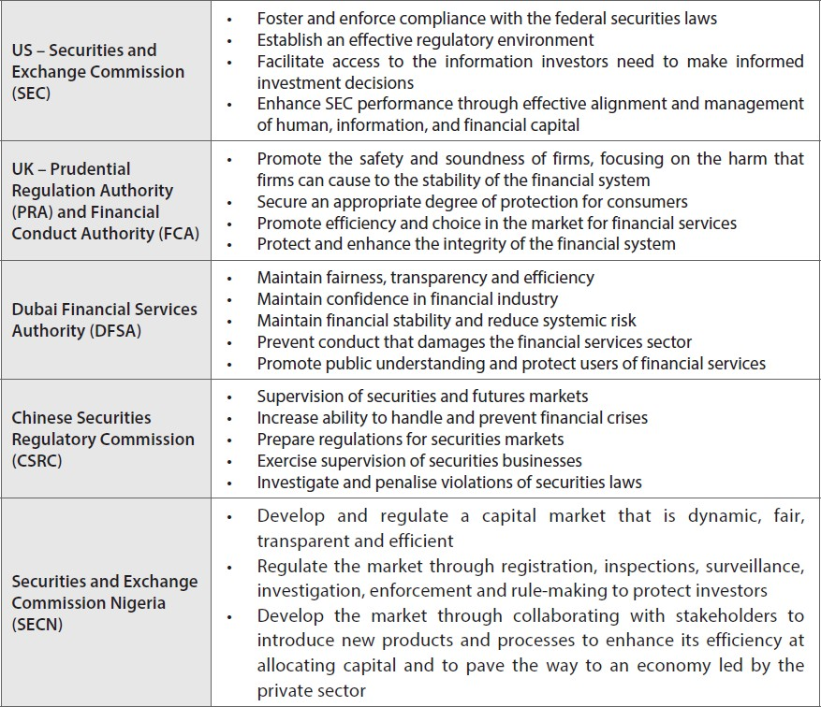
Examples of Regulators Worldwide

Slide 39
Cont’d
Ethical Issues in Financial Markets
Money Laundering:
Money laundering is the process of turning money that is derived from criminal activities – dirty money – into money which appears to have been legitimately acquired and which can therefore be more easily invested and spent – clean money.
Insider Trading:
When directors or employees of a listed company buy or sell shares in that company, there is a possibility that they are committing a criminal act – insider dealing.
For example, a director may be buying shares in the knowledge that the company‟s last six months of trade was better than the market expected. The director has the benefit of this information because he is „inside‟ the company. In nearly all markets, this would be a criminal offence, punishable by a fine and/or a jail term.

Slide 40
Cont’d
Market Abuse:
Market abuse may arise in circumstances where financial investors have been unreasonably disadvantaged, directly or indirectly, by others who behave unlawfully. Certain types of behavior, such as insider dealing and market manipulation, can amount to market abuse.
Market manipulation include:
Giving false or misleading signals about the supply of, demand for or price of a financial instrument
Using fictitious devices or other deception or contrivance that is likely to
affect the price of financial instruments
Disseminating information which gives, or is likely to give, false or misleading signals as to supply, demand or price of financial instruments, etc.

Slide 41
The End!

