Slide 1

Python – variables
mgr inż. Natalia Szulc

Slide 2
Hello world
print(”Hello Python world!”)
message = ”Hello Python world!”
print(message)
message = ”Hello PWR World!”
print(message)

Slide 3
Rules for variable naming
YES | NO
message | Message
message_1 | 1_message
name | n
greeting_message | greeting message

Slide 4
What can be a variable?
Python is completely object oriented
You do not need to declare the variables type
Every variable in Python is an object
Type | Example
String | ”Hello world!”
Integer | 23
Float | 3.1415
List | [23, 3.1415, ”Hello world!”]
Tuple | (23, 3.1415, ”Hello world!”)

Slide 5
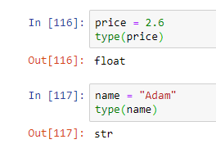
How to check variable type?
to check what type our variable is, use the command: type()

Slide 6

Strings
”This is a string.”
’This is also a string.’ #This is a comment
’I told my friend, ”Python is my favourite language!”’

Slide 7

Strings
name = ”ada lovelace”
print(name.title())
.title() #String method
Another methods: .upper(), .lower(), .capitalize(), .strip()

Slide 8
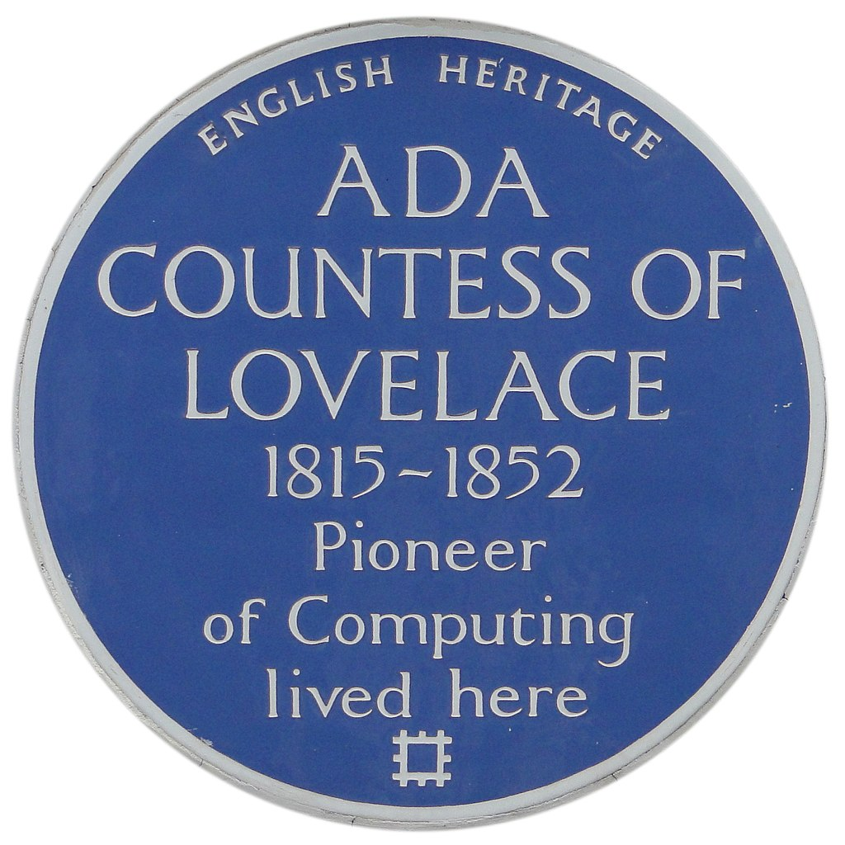
Strings
name = ”ada lovelace”
message = ”Hello, ” + name.title() + ”!”
print(message)

Slide 9

Numbers
number = 123
result = number * 123
print(result)
year = 365,25 #amount of days
day = 24 #amount of hours
print(”Average year contains ” + str(year*day) + ” hours”)

Slide 10

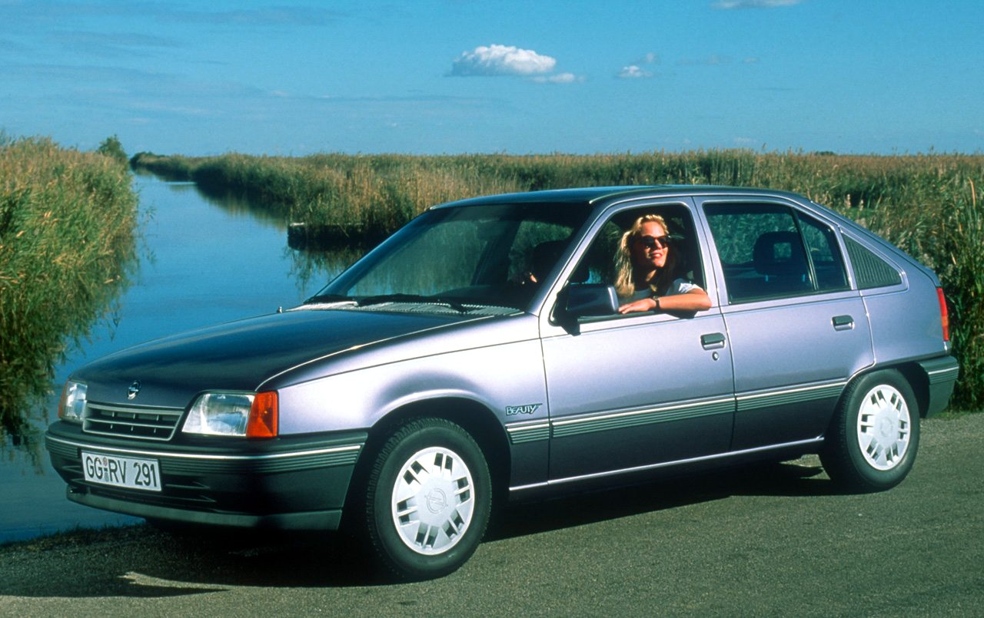

Lists
cars = [’opel’, ’kia’, ’vw’, ’rover’, ’lada’]
print(cars[0]) #first
print(cars[-1]) #last
print(len(cars)) #length of list is 5
cars.append(’dacia’)
print(len(cars)) #length of list is 6

Slide 11
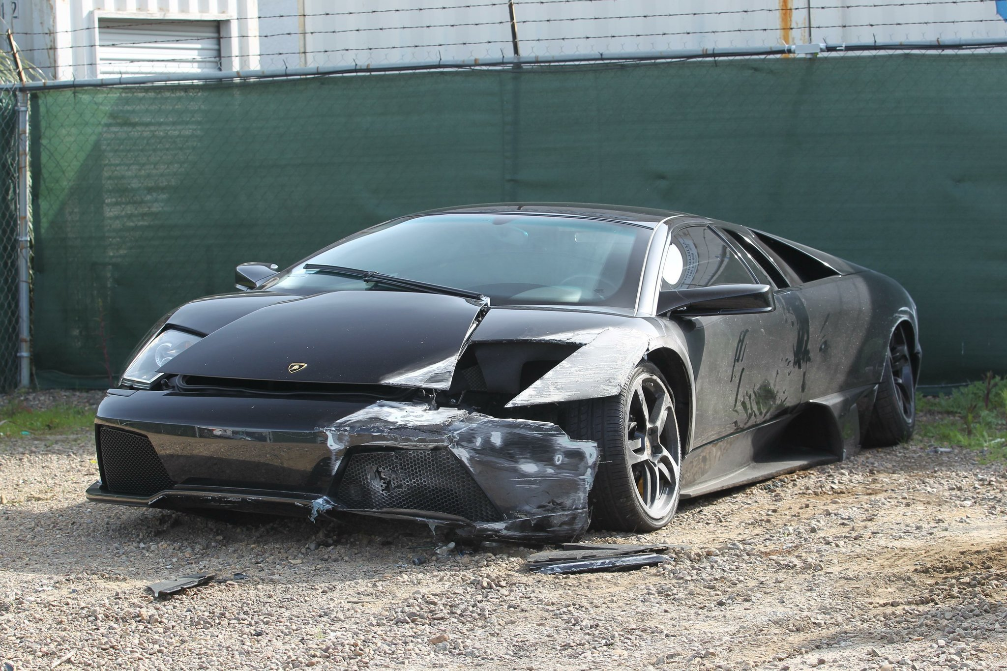
Lists
print(cars)
cars.insert(0, ’lamborghini’)
print(cars)
too_expensive = ’lamborghini’
cars.remove(too_expensive)
print(cars)
del cars[0]
print(cars)

Slide 12
Type conversion
The process of converting the value of one data type (integer, string, float, etc.) to another data type is called type conversion. Python has two types of type conversion:
1. Implicit Type Conversion
2. Explicit Type Conversion

Slide 13
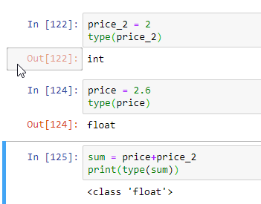
Implicit Type Conversion
Python automatically converts one data type to another.
This proces doesn’t need any user involvement

Slide 14
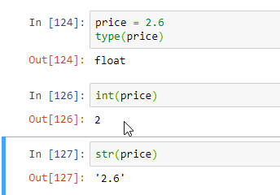
Explicit Type Conversion
In this type user convert the data type of an object to required data type using functions like int(), str(), float(), list() etc

Slide 15

Exercise
Create variables favourite_fruit and price.
Set their values and print a sentence explaining what is your favourite fruit and how much does it cost.

