Slide 1

Python – Lists
mgr inż. Natalia Szulc

Slide 2
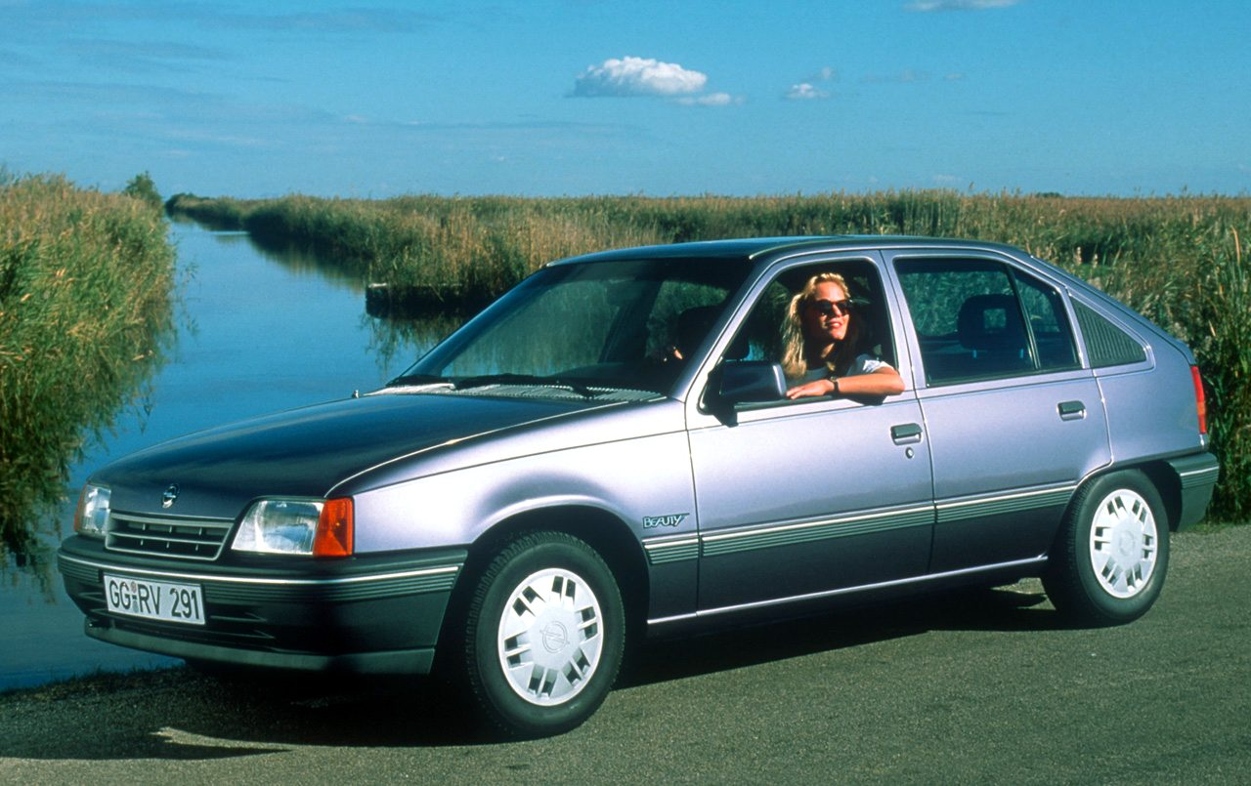

Organizing lists
cars = [’opel’, ’kia’, ’vw’, ’rover’, ’lada’, ’aro’]
print(sorted(cars))
print(cars)
cars.sort()
print(cars)

Slide 3
Looping in lists
cars = [’opel’, ’kia’, ’vw’, ’rover’, ’lada’, ’aro’]
for car in cars:
print(car) #indent of four spaces
OR:
for i in range(len(cars)):
print(cars[i]) #indent of four spaces

Slide 4
Looping in lists
for car in cars:
print(car.title() + ’ is a nice car.’)
for i in range(len(cars)):
print(’Car number ’ + str(i) + ’ is ’ + cars[i].title() + ’.’)
print(’These were my favourite car brands’) #not indented – what happened?

Slide 5

Using range()
even_numbers = list(range(2,11,2))#from 2 to 11 by 2
print(even_numbers)
odd_numbers = list(range(1,11,2))#from 1 to 11 by 2
print(odd_numbers)

Slide 6
Looping – other examples
squares = []
for value in range(1,11):
print(’We are adding ’ + str(value) + ’^2 to our list.’)
squares.append(value**2)
print(squares) #not indented

Slide 7

List slicing
cities = [’Wrocław’, ’Warszawa’, ’Poznań’, ’Łódź’, ’Lublin’, ’Jelenia Góra’, ’Wałbrzych’, ’Gdańsk’, ’Szczecin’]
print(cities[1:3])
print(cities[:3])
print(cities[3:])
print(cities[-2:])

Slide 8

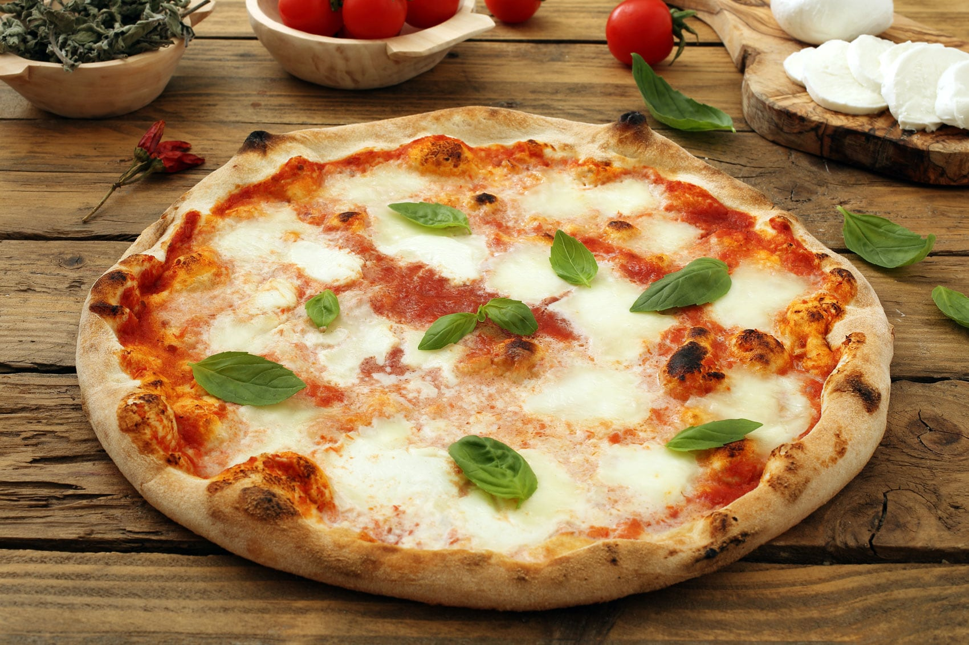
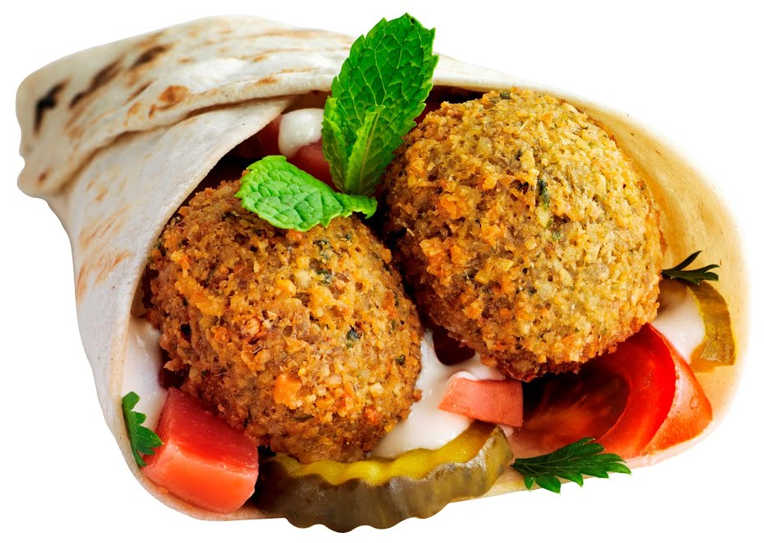
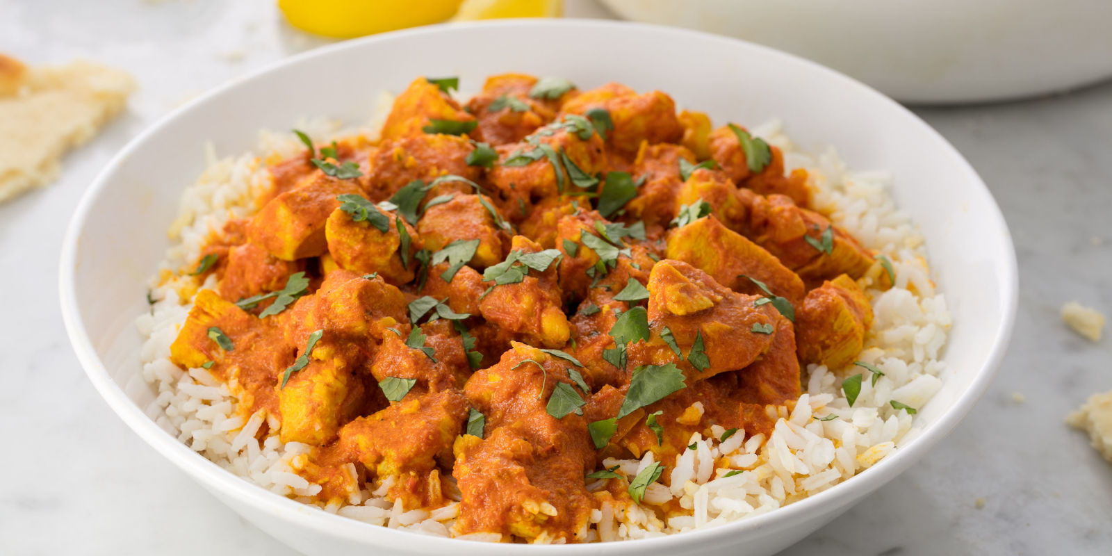
List copying
my_foods = [’pizza’, ’falafel’, ’lasagne’]
friend_foods = my_foods #will connect them
my_foods.append(’curry’)
print(my_foods)
print(friend_foods) #not what we want!
friend_foods = my_foods[:] #list is equal to every element of second list, proper copying
my_foods.append(’burger’)
print(my_foods)
print(friend_foods) #its ok!

Slide 9


Exercises
Create list with values of W(x)=4x³−x²−4x+1 for x from 1 to 20.
Create list with some famous scientists, written lowercase. Print a sentence ’I want to be like …’ with every of them, capitalizing their names, adding ’.’ at the end. Use loop.

