Slide 1

AI-DAO:
An intelligent supply chain prototype

Slide 2
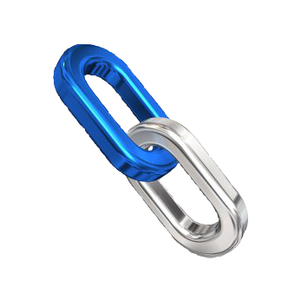
DAO
Decentralized Autonomous Organization
resides in a blockchain
peer-to-peer
Blockchain
distributed database
hashes connect blocks
Ethereum
Smart Contracts

Slide 3
Why implementing AI in Blockchains?
Secure
Transparent
Accessable
Distributed

Slide 4
P
Use Case
Producer and supplier
one step supply chain
simple data for prototype
demand list = words from book
resources = letters
resources need time to emerge
prediction as controller
goal: demand graph close to 0
S
S
S
S

Slide 5
Production List
P
R1
R2
R3
R4
R
Oracle

Slide 6
Oracle

Slide 7
Contracts

Slide 8
Results

Slide 9
Extension for real Blockchains
Real data
Prototype
Real DAO
outside parameter
prediction improvement
consider sub supplier

