Slide 1
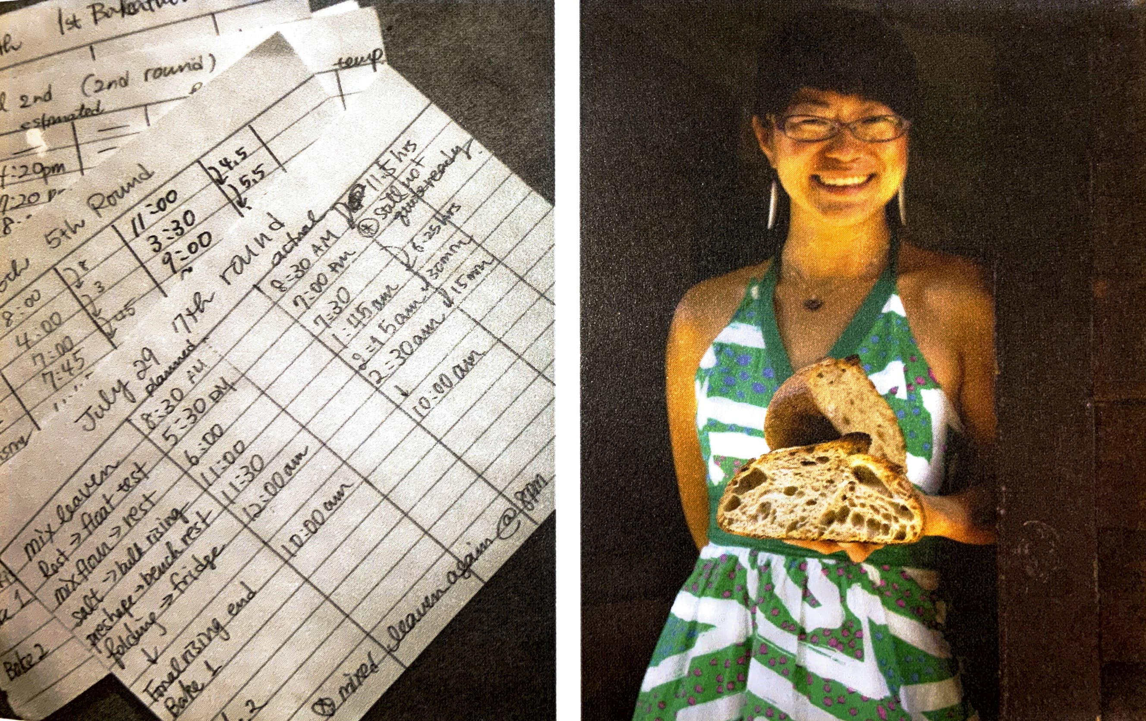
Version control
dough rises slowly
dough doesn’t rise
bread doesn’t rise in oven
taste: sour vs. not sour
your favorite flour is out of stock
For coding:
some file format changes, so you update your code
you find a bug in your code, so you need to fix it
Always have a continuous "before and after" record for other work – why not for your code as well?

Slide 2
Version control
You might implement some kind of versioning system already
Things get particularly messy when you're collaborating.
Vince Buffalo (2015). Bioinformatics Data Skills. O'Reilly Media

Slide 3
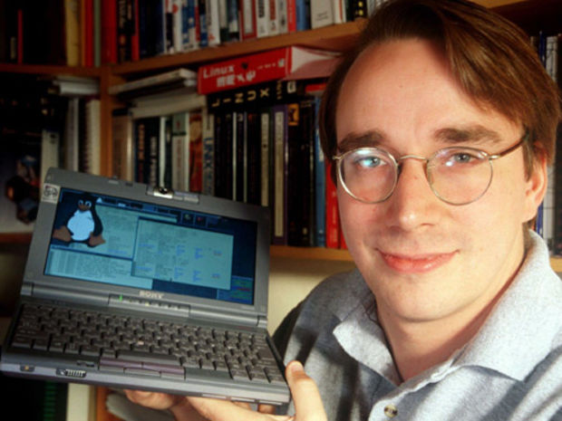
Version control
A particularly vexing problem for software engineers
many different version control systems
Git is among the most popular
written by Linus Torvalds (the Linux dude)
designed to manage thousands of collaborators, all working simultaneously
Vince Buffalo (2015). Bioinformatics Data Skills. O'Reilly Media

Slide 4
Version control with Git
Git allows you to keep snapshots of your project.
easily trace the origins of bugs and rollback changes
easily trace the evolution of your code
easily document your code – important for reproducibility
Git helps you keep track of important changes to code.
Git helps you keep software organized and available after people leave your lab.
Git allows you to share your code with others.
Git is widely used in the data science community.
Vince Buffalo (2015). Bioinformatics Data Skills. O'Reilly Media

Slide 5
Install git

Slide 6
Configure Git
Git commands take the form 'git <subcommand>'
Configure Git
$ git config --global user.name "Andrew Alverson"
$ git config --global user.email "aja@uark.edu"
$ git config --global color.ui true
$ git config --global core.editor nano
$ git config --list
Vince Buffalo (2015). Bioinformatics Data Skills. O'Reilly Media

Slide 7
Create a repository from scratch
Create a local repository in directory called ‘bio_project’
bio_project $ cd /Users/aja/Desktop/biol5153/
/Users/aja/Desktop/biol5153
biol5153 $ mkdir bio_project
biol5153 $ cd bio_project/
/Users/aja/Desktop/biol5153/bio_project
bio_project $ git init
Initialized empty Git repository in /Users/aja/Desktop/biol5153/bio_project/.git/
bio_project $ ls -al
total 0
drwxr-xr-x 3 aja staff 102 Mar 21 10:07 .
drwxr-xr-x 14 aja staff 476 Mar 21 10:06 ..
drwxr-xr-x 10 aja staff 340 Mar 21 10:07 .git
bio_project $
how/where Git manages your repository
Vince Buffalo (2015). Bioinformatics Data Skills. O'Reilly Media

Slide 8
Keeping track of files with Git
Add content to 'bio_project' and check the status of the files
bio_project $ mkdir data
bio_project $ touch data/README data/file1.fasta data/file2.fasta
bio_project $ touch README
bio_project $ git status
On branch main
Initial commit
Untracked files:
(use "git add <file>..." to include in what will be committed)
README
data/
nothing added to commit but untracked files present (use "git add" to track)
bio_project $
we're on the main branch, the default branch for Git
a list of files in the directory that Git is not tracking
Vince Buffalo (2015). Bioinformatics Data Skills. O'Reilly Media

Slide 9
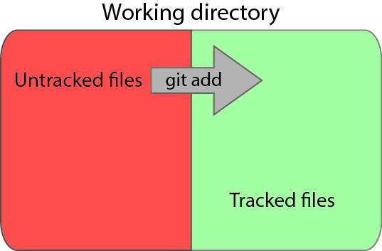
Tracking files with git add
Vince Buffalo (2015). Bioinformatics Data Skills. O'Reilly Media

Slide 10
Tracking files with git add
bio_project $ git add README data/README
bio_project $ git status
On branch main
Initial commit
Changes to be committed:
(use "git rm --cached <file>..." to unstage)
new file: README
new file: data/README
Untracked files:
(use "git add <file>..." to include in what will be committed)
data/file1.fasta
data/file2.fasta
bio_project $
when first tracking a file, its current version is staged
Vince Buffalo (2015). Bioinformatics Data Skills. O'Reilly Media

Slide 11
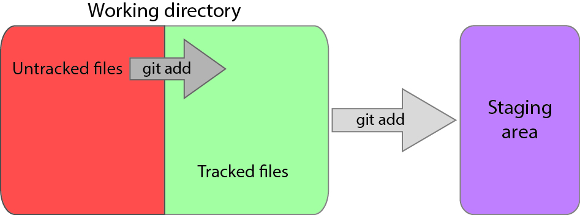
Staging files with git add
a file that's tracked just means Git knows about it
a file that's staged means it's tracked and the latest changes are ready to be archived, i.e., included in the next commit
new changes are not automatically stored – we need to explicitly tell Git when to archive a set of changes with git commit
Vince Buffalo (2015). Bioinformatics Data Skills. O'Reilly Media

Slide 12
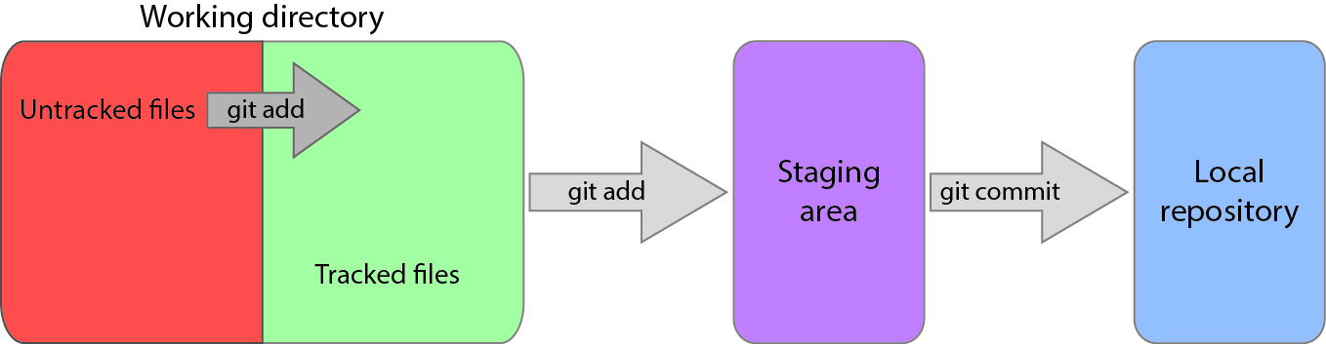
Storing changes with git commit
Why do I have to stage files first?
Vince Buffalo (2015). Bioinformatics Data Skills. O'Reilly Media

Slide 13
Staging is what you want.
You'll often work on many different files in a project
Changes will be complete for some files, incomplete for others
You don't want to commit and store changes at a meaningless stage of development
Staging allows you to commit changes for select files at meaningful points of development
Alternative is to take snapshots of the entire set of tracked files en masse – those snapshots will be pretty random for some files
Vince Buffalo (2015). Bioinformatics Data Skills. O'Reilly Media

Slide 14
Tracking files with git add
Remember, git add does two things:
alerts Git to start tracking a file
stages changes made to a file that's already being tracked
Important: Changes made to a file since the last time it was staged will not be included in the next commit unless they are staged with git add.
Vince Buffalo (2015). Bioinformatics Data Skills. O'Reilly Media

Slide 15
Staging files with git add
bio_project $ echo "The README file for my project" >> README
bio_project $ git status
On branch main
Initial commit
Changes to be committed:
(use "git rm --cached <file>..." to unstage)
new file: README
new file: data/README
Changes not staged for commit:
(use "git add <file>..." to update what will be committed)
(use "git checkout -- <file>..." to discard changes in working directory)
modified: README
Untracked files:
(use "git add <file>..." to include in what will be committed)
data/file1.fasta
data/file2.fasta
bio_project $
committing now would not include the change above
Vince Buffalo (2015). Bioinformatics Data Skills. O'Reilly Media

Slide 16
Staging files with git add
Stage the updated version of README
bio_project $ git add README
bio_project $ git status
On branch main
Initial commit
Changes to be committed:
(use "git rm --cached <file>..." to unstage)
new file: README
new file: data/README
Untracked files:
(use "git add <file>..." to include in what will be committed)
data/file1.fasta
data/file2.fasta
bio_project $
Vince Buffalo (2015). Bioinformatics Data Skills. O'Reilly Media

Slide 17
Storing changes with git commit
Vince Buffalo (2015). Bioinformatics Data Skills. O'Reilly Media

Slide 18
Storing your changes with git commit
Commit your changes
bio_project $ git commit -m "initial import"
[main (root-commit) 19ad95b] initial import
2 files changed, 1 insertion(+)
create mode 100644 README
create mode 100644 data/README
bio_project $
Check the status
bio_project $ git status
On branch main
Untracked files:
(use "git add <file>..." to include in what will be committed)
data/file1.fasta
data/file2.fasta
nothing added to commit but untracked files present (use "git add" to track)
bio_project $
Vince Buffalo (2015). Bioinformatics Data Skills. O'Reilly Media

Slide 19
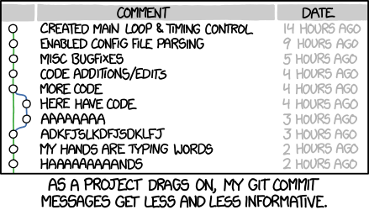
Provide informative commit messages
http://xkcd.com/1296/
Vince Buffalo (2015). Bioinformatics Data Skills. O'Reilly Media

Slide 20
Undoing a stage with git reset
If you change your mind about a file that's not ready for staging, you can unstage it with git reset
bio_project $ echo "Wrote the best script of my life" >> README
bio_project $ git add README
bio_project $ git status
On branch main
Changes to be committed:
(use "git reset HEAD <file>..." to unstage)
modified: README.md
bio_project $
Follow Git's instructions (note: HEAD is a pointer to the last commit on our current branch)
bio_project $ git reset HEAD README
Unstaged changes after reset:
M README.md
bio_project $
Vince Buffalo (2015). Bioinformatics Data Skills. O'Reilly Media

Slide 21
Ignore files with .gitignore
Tell Git to stop reminding us that our data files aren't being tracked
create a file called .gitignore in the 'bio_project' directory
add a list of files (one per line) that you want Git to ignore, for example: data/*.fasta
bio_project $ echo 'data/*.fasta' > .gitignore
bio_project $ git status
On branch main
Untracked files:
(use "git add <file>..." to include in what will be committed)
.gitignore
nothing added to commit but untracked files present (use "git add" to track)
bio_project $ git add .gitignore
bio_project $ git commit .gitignore -m "adding .gitignore"
[main 28d84f4] adding .gitignore
1 file changed, 1 insertion(+)
create mode 100644 .gitignore
bio_project $ git status
On branch main
nothing to commit, working directory clean
bio_project $
now we have a "clean" directory with no annoying messages
Vince Buffalo (2015). Bioinformatics Data Skills. O'Reilly Media

Slide 22
Viewing your commit history with git log
Use git log to see all of your commits
bio_project $ git log --name-status
commit 6f274dbbcd32148a658e3b970e9090d042042bd4
Author: andrewalverson <andy.alverson@gmail.com>
Date: Tue Mar 22 11:42:51 2016 +0300
added project start date
M README
commit 28d84f4de818b85c79ca400c5cd96e47e5644b07
Author: andrewalverson <andy.alverson@gmail.com>
Date: Mon Mar 21 20:43:11 2016 +0300
adding .gitignore
A .gitignore
commit 19ad95bfa5e1a0fe356cf0e4fb53eafbde210f6b
Author: andrewalverson <andy.alverson@gmail.com>
Date: Mon Mar 21 20:34:04 2016 +0300
initial import
A README
A data/README
bio_project $ git log --abbrev-commit --pretty=oneline -n 3
SHA-1 checksum provides a unique ID for each commit

Slide 23
Renaming and deleting tracked files
Git will become confused if you delete or rename tracked files, so you have to do it Git's way
bio_project $ git mv README README.md
bio_project $ git mv data/README data/README.md
bio_project $ git status
On branch main
Changes to be committed:
(use "git reset HEAD <file>..." to unstage)
renamed: README -> README.md
renamed: data/README -> data/README.md
bio_project $ git commit -m "add markdown extenstion to README files"
[main 989d893] add markdown extenstion to README files
2 files changed, 0 insertions(+), 0 deletions(-)
rename README => README.md (100%)
rename data/{README => README.md} (100%)
bio_project $ git status
On branch main
nothing to commit, working directory clean
bio_project $
Vince Buffalo (2015). Bioinformatics Data Skills. O'Reilly Media

Slide 24
Retrieving old versions with checkout
You've archived old versions, revert/restore with git checkout
bio_project $ git log README.md
commit 25ce9c2844274db2b9973fa42c7ccacd3dc6264e
Author: andrewalverson <andy.alverson@gmail.com>
Date: Wed Mar 30 12:45:13 2016 -0500
added data to README
commit 989d893a7342a57a225c28895b278eaa436d4553
Author: andrewalverson <andy.alverson@gmail.com>
Date: Tue Mar 22 12:04:25 2016 +0300
add markdown extenstion to README files
bio_project $ git checkout 989d893a7342a57a225c28895b278eaa436d4553 README.md
bio_project $ cat README.md
The README file for my project
Project started 2016-02-14
bio_project $

Slide 25


Collaborating with Git

Slide 26
Version control
You probably implement some kind of versioning system already
Things get particularly messy when you're collaborating.
Vince Buffalo (2015). Bioinformatics Data Skills. O'Reilly Media

Slide 27
Clone an existing repository
can clone a repository from anywhere
most common to clone from a repository hosting service (e.g., GitHub)
biol5153 $ git clone https://github.com/lh3/seqtk.git
Cloning into 'seqtk'...
remote: Counting objects: 265, done.
remote: Total 265 (delta 0), reused 0 (delta 0), pack-reused 265
Receiving objects: 100% (265/265), 128.50 KiB | 5.00 KiB/s, done.
Resolving deltas: 100% (149/149), done.
Checking connectivity... done.
biol5153 $
Vince Buffalo (2015). Bioinformatics Data Skills. O'Reilly Media

Slide 28
Clone an existing repository
You've cloned the seqtk repository.
biol5153 $ cd seqtk/
/Users/aja/Desktop/biol5153/seqtk
seqtk $ ls -al
total 304
drwxr-xr-x 16 aja staff 544 Mar 21 10:13 .
drwxr-xr-x 15 aja staff 510 Mar 21 10:12 ..
drwxr-xr-x 13 aja staff 442 Mar 21 10:13 .git
-rw-r--r-- 1 aja staff 22 Mar 21 10:13 .gitignore
-rw-r--r-- 1 aja staff 1086 Mar 21 10:13 LICENSE
-rw-r--r-- 1 aja staff 303 Mar 21 10:13 Makefile
-rw-r--r-- 1 aja staff 1567 Mar 21 10:13 README.md
-rw-r--r-- 1 aja staff 18784 Mar 21 10:13 khash.h
-rw-r--r-- 1 aja staff 8795 Mar 21 10:13 kseq.h
-rw-r--r-- 1 aja staff 10524 Mar 21 10:13 ksort.h
-rw-r--r-- 1 aja staff 4439 Mar 21 10:13 kstring.h
-rw-r--r-- 1 aja staff 15865 Mar 21 10:13 ksw.c
-rw-r--r-- 1 aja staff 2396 Mar 21 10:13 ksw.h
-rw-r--r-- 1 aja staff 2880 Mar 21 10:13 kvec.h
-rw-r--r-- 1 aja staff 50583 Mar 21 10:13 seqtk.c
-rw-r--r-- 1 aja staff 5722 Mar 21 10:13 trimadap.c
seqtk $
Vince Buffalo (2015). Bioinformatics Data Skills. O'Reilly Media

Slide 29
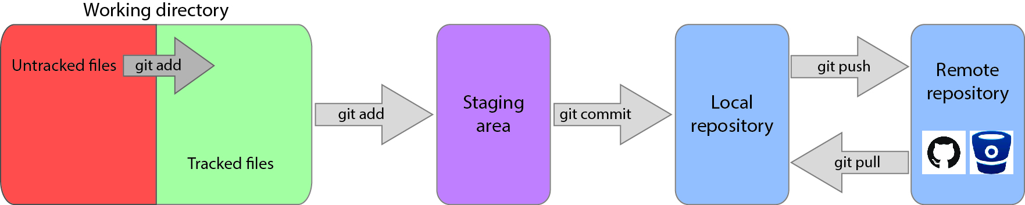
Version control with Git
Remote repository: a copy of your repository hosted elsewhere
Vince Buffalo (2015). Bioinformatics Data Skills. O'Reilly Media

Slide 30
Version control with Git
push: send a change to a shared central repository
pull: grab a change from a repository
Vince Buffalo (2015). Bioinformatics Data Skills. O'Reilly Media

Slide 31
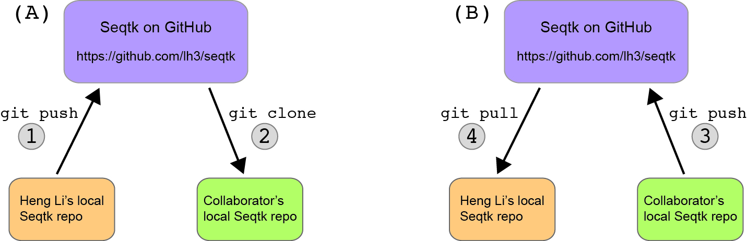
Collaborating through a shared central repository
The commit log will be a mix of changes made by Heng Li and other contributors

Slide 32
Create an account on Github
https://github.com/

Slide 33
Explore your account settings

Slide 34
Create a new repository

Slide 35
Create a new repository

Slide 36
Create a new repository

Slide 37
Connecting with git remote
bio_project $ git remote add origin https://github.com/andrewalverson/bio_project.git
bio_project $ git push -u origin main
Counting objects: 17, done.
Delta compression using up to 8 threads.
Compressing objects: 100% (12/12), done.
Writing objects: 100% (17/17), 1.57 KiB | 0 bytes/s, done.
Total 17 (delta 2), reused 0 (delta 0)
To https://github.com/andrewalverson/bio_project.git
* [new branch] main -> main
Branch main set up to track remote branch main from origin.
bio_project $

Slide 38
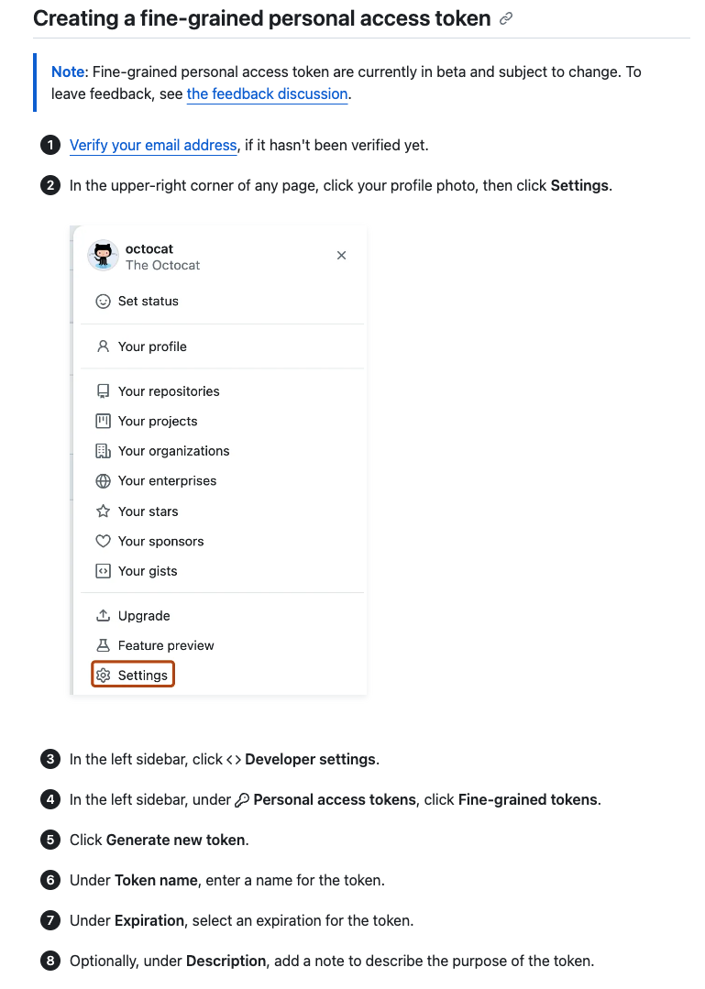
Authentication with a personal access token (Link)
Select classic token
Select all the permissions
This will be your password

Slide 39
Working with branches
Experiment with your project without risk of messing up the main, working main branch
Add major new feature without affecting the current working version
you may find that adding the new feature required more work than anticipated
abandon the effort and revert to unscathed working version
Once the major change is complete, merge with the main, incorporating it into the working production version
Collaborators can work on their own separate branches and individually merge them onto the main
It's all done virtually, i.e., without copying everything
Vince Buffalo (2015). Bioinformatics Data Skills. O'Reilly Media

Slide 40
Working with branches
Main
v0.1
v0.2
v1.0
git merge
merge is
a commit
Develop

Slide 41
Working with branches
Create, then switch to, a new branch called readme-changes
bio_project $ git branch readme-changes
bio_project $ git branch
* main
readme-changes
bio_project $ git checkout readme-changes
M README.md
Switched to branch 'readme-changes'
bio_project $ git branch
main
* readme-changes
bio_project $
Now edit README.md on the readme-changes branch
Vince Buffalo (2015). Bioinformatics Data Skills. O'Reilly Media

Slide 42
Working with branches
Make and commit edits on the readme-changes branch
bio_project $ nano README.md
bio_project $ git add README.md
bio_project $ git commit -m "added data to README"
[readme-changes 25ce9c2] added data to README
1 file changed, 4 insertions(+)
bio_project $
bio_project $ git log --abbrev-commit --pretty=oneline -n 3
25ce9c2 added data to README
989d893 add markdown extenstion to README files
6f274db added project start date
bio_project $
Vince Buffalo (2015). Bioinformatics Data Skills. O'Reilly Media

Slide 43
Working with branches
Merge edits on the readme-changes branch to the main branch
switch to the branch you want to merge onto
merge changes
bio_project $ git branch
main
* readme-changes
bio_project $ git checkout main
Switched to branch 'main'
bio_project $ git merge readme-changes
Updating 989d893..25ce9c2
Fast-forward
README.md | 4 ++++
1 file changed, 4 insertions(+)
bio_project $ cat README.md
Vince Buffalo (2015). Bioinformatics Data Skills. O'Reilly Media

Slide 44
Extras

Slide 45
Compare files with git diff
Use git diff to view file changes
show difference between file in your working directory to what's been staged
if nothing's staged, show difference between last commit and current version
bio_project $ echo "Project started 2016-02-14" >> README
bio_project $ git diff
diff --git a/README b/README
index 551a348..7992ba1 100644
--- a/README
+++ b/README
@@ -1 +1,2 @@
The README file for my project
+Project started 2016-02-14
bio_project $
1
2
Two file versions (a and b): '---' = original version, '+++' = modified version
The actual change
leading space: nothing changed
leading '+': added line
leading '-': deleted line
changed lines are shown as deleted, then added
Vince Buffalo (2015). Bioinformatics Data Skills. O'Reilly Media

Slide 46
Compare files with git diff
What's the result? Why?
bio_project $ git add README
bio_project $ git diff
bio_project $ git diff --staged
diff --git a/README b/README
index 551a348..7992ba1 100644
--- a/README
+++ b/README
@@ -1 +1,2 @@
The README file for my project
+Project started 2016-02-14
bio_project $
By default, git diff shows the difference between files in your wd and what’s been staged.
If changes haven’t been staged, git diff shows the difference between your last commit and the current version
Vince Buffalo (2015). Bioinformatics Data Skills. O'Reilly Media

Slide 47
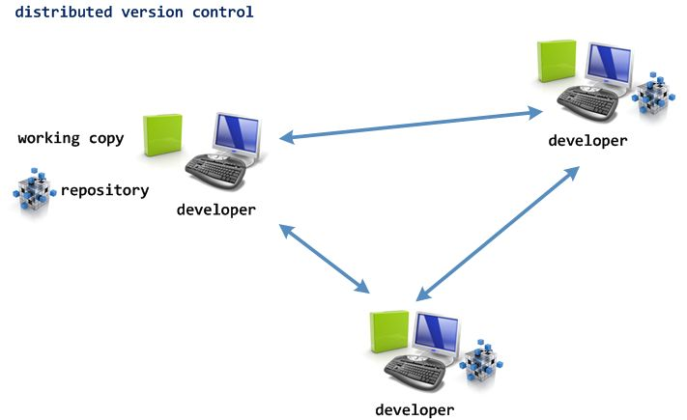
Distributed version control
In a distributed model, every developer has her own repo.
Jill's changes live in her local repo, Betsy's changes live in her local repo, etc.
Each person can share her changes with all the other collaborators
Compare with Centralized Version Control
http://www.infoq.com/articles/DVCS-Enterprise/
Notes:
centralized version control: single central repository on which clients synchronize; client–server model

Slide 48
Collaborating through a shared central repository
Merge conflicts can arise when two people are working on the same file
These need to be manually resolved

