Slide 1
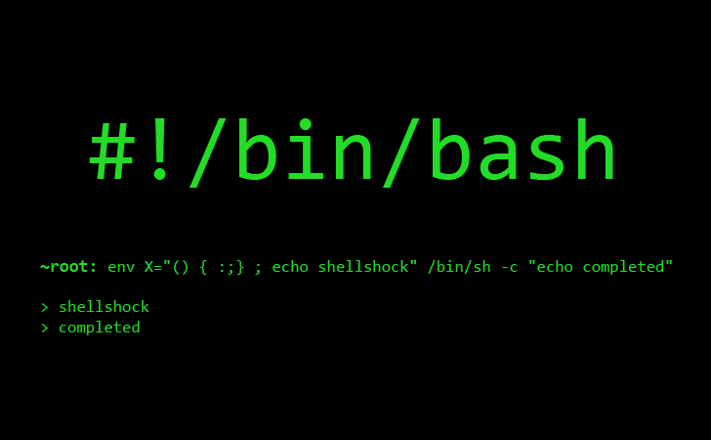


Practical Programming for Biologists

Slide 2
Course structure and grading
Structure
Lecture. Demonstrate. Practice.
Grading
Exercises | 60%
DataCamp | 40%

Slide 3
To-do list
Find and bookmark the class GitHub page
Enroll in the DataCamp class
Register for an AHPCC user account (link)
your advisor is your sponsor, not me
Download files.tgz

Slide 4

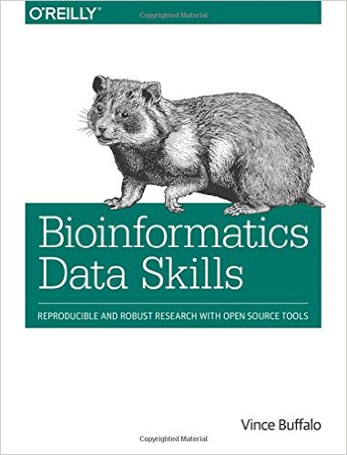
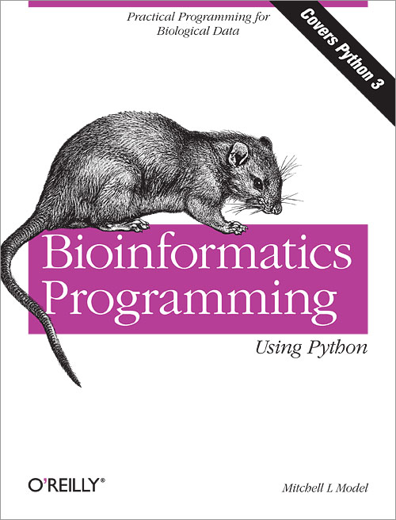
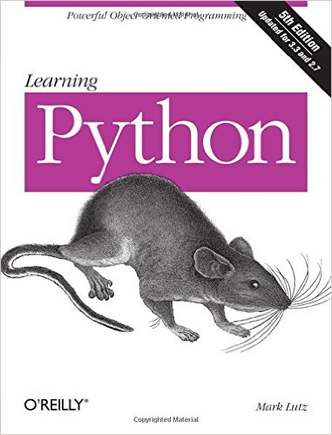

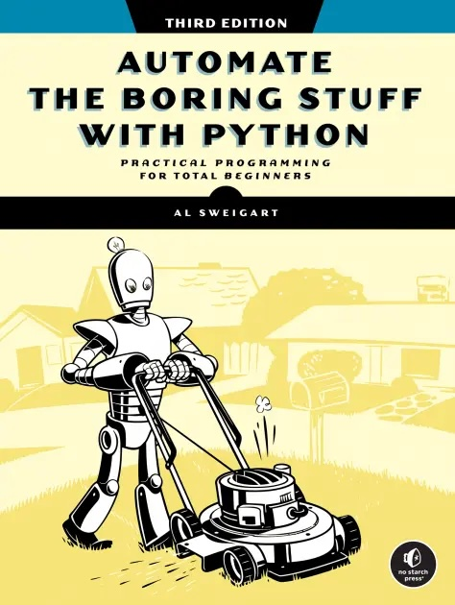
Good books

Slide 5
Choosing an Operating System for Data Science
Mac OS X
Pros
Unix is fully and naturally integrated into the OS
Python pre-installed
Can still use Microsoft Office, Adobe, etc.
Easiest transition to make – the choice of many data scientists
Can run almost all Linux-based software
Cons
The hardware is expensive, and the OS is proprietary
Does not have the full set of U/Li-nux commands

Slide 6


An aside: Unix vs. Linux
Unix | Linux (Linus' Unix)
proprietary | open source
targeted development | diverse development
more consistency b/n versions | less consistency b/n versions
development restrictions | no restrictions
patches are highly tested | not as much beta testing
more slowly evolving | huge open-source community identifies and fixes problems quickly

Slide 7


Slide 8
Choosing an Operating System
Linux
Pros
You can install as the OS on any PC – a Linux box is a fraction of the price of a comparably outfitted Mac
Compatible with all the important bioinformatics software
People will think you're smart; you can snub Mac users
Open source
Cons
Open source
You've probably never used it; steeper learning curve
Maintaining a Linux box requires some time investment

Slide 9
Choosing an Operating System
Microsoft Windows
Pros
None
Cons
Too many to name
Windows is not designed for programming and bioinformatics applications
But there are some workarounds.

Slide 10
Running Linux alongside Windows
VMWare is the best solution: follow these instructions
Windows Subsystem for Linux 2 (WSL2) (link)
Use PuTTY, an SSH client that will allow you to just log into and use a remote computer
Boot into Linux from a flash drive
http://unetbootin.sourceforge.net/
Need to start and restart your computer to switch the OS

Slide 11
The command line
Why not just use a Graphical User Interface (GUI)?
Not good for long sequences of operations that need to be repeated on multiple datasets
No log of what you did and what commands you executed
Not conducive to executing jobs remotely on a cluster
Labor intensive to develop and generally restricted to a single OS
Use the command line!
Extremely, extremely powerful – NOT a primitive interface
Up-front investment with ENORMOUS long-term payoff
Absolute necessity for big datasets, which characterize modern biology
Automate tasks
Do and re-do and re-do and re-do analyses with minimal added effort
Easy to record what you did, minimizing mistakes while enhancing repeatability and troubleshooting

Slide 12
What's a Shell?
Interact within a SHELL
Intermediary between user and inner workings of the OS
A command interpreter, providing an interface with programs & utilities
A programming language, combining utilities in different ways to carry out some function(s)
May be used interactively or non-interactively
accepts input from the keyboard
accepts commands from a file
Execute builtin commands, implemented internally by the shell
cd, pwd, exit
Execute programs installed elsewhere on the file system
GNU Core Utilities (coreutils)
ls, mv, rm, mkdir, chmod, pwd

Slide 13
Bash
Lots of different shells
We'll use Bash or Zsh, the new default Shell in Mac OS X
Run from a text window, e.g., Terminal in Mac OS X
Could also use X11 (aka, "X"), which has GUI capabilities
Launch Terminal (Finder > Go > Utilities > Terminal)
Add Terminal to your dock by dragging and dropping

Slide 14
whoami

Slide 15
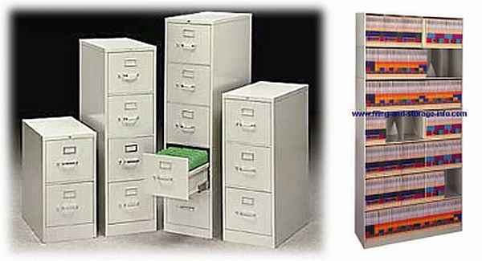
The File System

Slide 16
Reading
File not found by Monica Chin

Slide 17
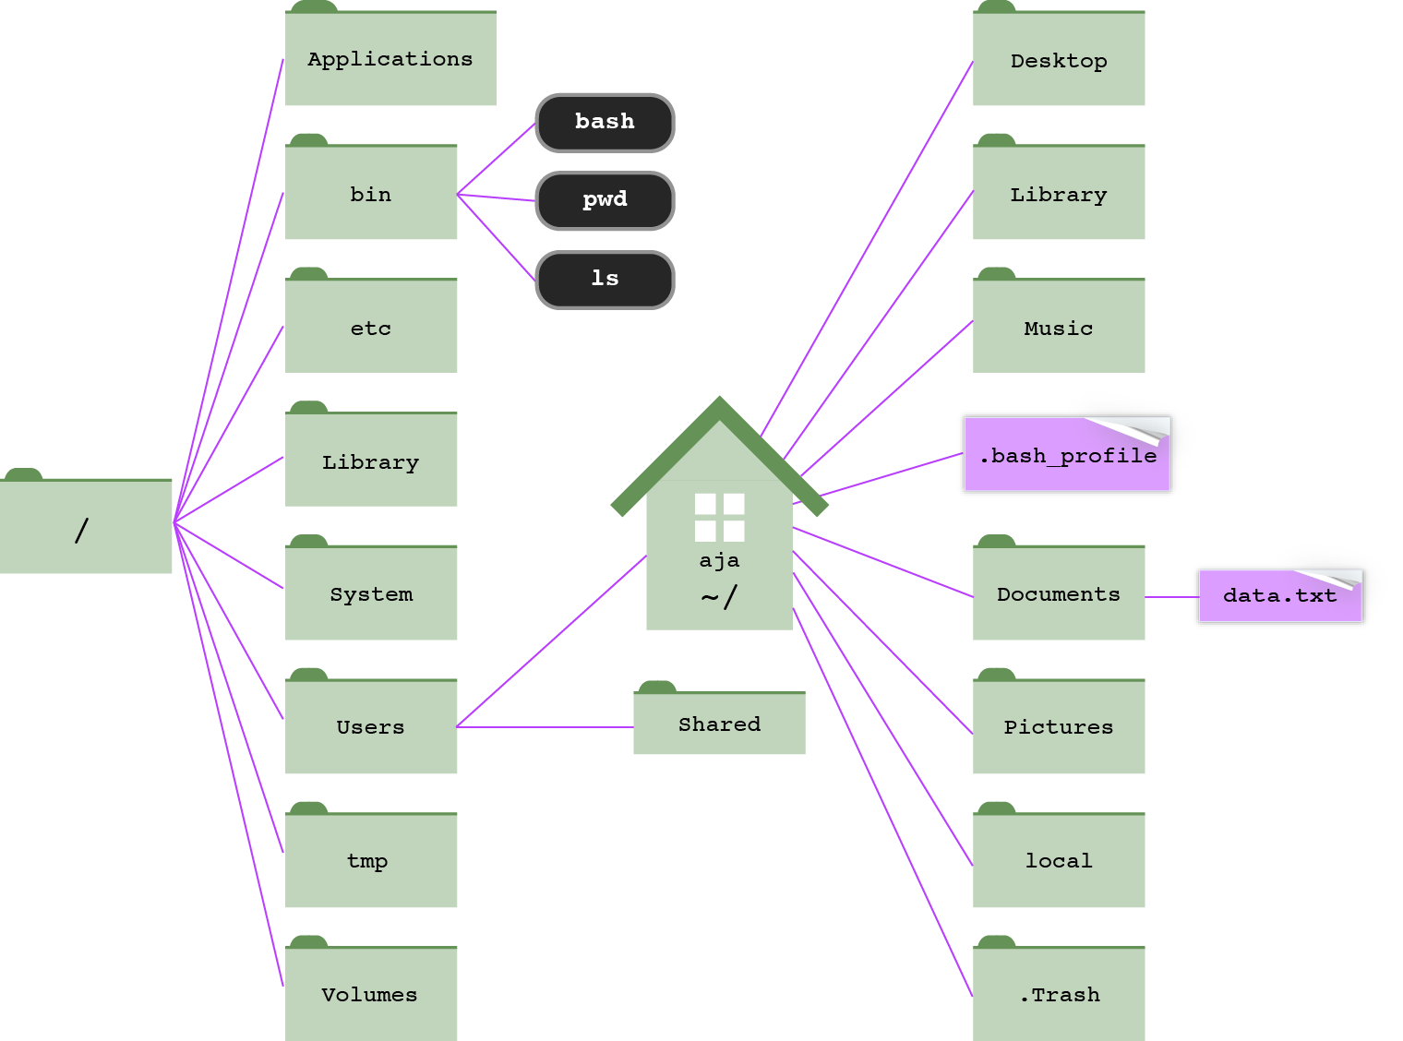
root directory
modified from Haddock & Dunn

Slide 18
Your PATH
A path is a written description of a location in the filesystem
Both directories and files have paths
Consists of directory names separated by forward slashes (/)
Absolute path – complete and unambiguous location starting from root; always starts with a forward slash (/)
/Users/aja/Desktop/watermelon_files/watermelon.fsa
Relative path – describes where a file or folder is in relation to another folder, usually the working directory
Working directory – where you're at right now; if you're in the Desktop, the relative path to watermelon.fsa is:
watermelon_files/watermelon.fsa

Slide 19
Download files.tgz

Slide 20
*MAC SHORTCUT*
You can enter a long path to a file by dragging and dropping that file from Finder into the Terminal window.
Drag ~/Desktop/Don't do this.txt to the Terminal

Slide 21
*NEW RULE*
You will no longer include spaces in your file names.
use underscores or dashes – my_file.txt
my-file.txt
or, mixed upper/lowercase – myFile.txt
or, dots – my.file.txt

Slide 22
Common Unix commands
$ pwd – prints path of working directory [absolute or relative?]
$ cd – change directory
$ cd .. [move up one directory]
$ cd ../../ [move up two directories]
$ cd [go home]
$ cd ~ [go home]
$ cd ~/Desktop/watermelon_files
$ cd /Users/aja/Desktop/watermelon_files
$ echo argument . . . – write arguments to STDOUT
$ echo $HOME [where's my home directory?]
$ echo crazy
$ echo crazy horse

Slide 23
Common Unix commands
$ clear – clear the Terminal screen
$ clear
$ exit – exit the session
always exit your session before closing the Terminal window and quitting Terminal
not doing so is analagous to uplugging your computer – unceremonious end to all your programs and processes

Slide 24
*AWESOME SHORTCUTS*
Auto-complete with tab
Re-run a previous command with Up [and down] arrow
Find an old command with Ctrl+r
Find an old command with history
Mac OS: open working directory in Finder with open .

Slide 25
*MORE SHORTCUTS*
Ctrl+a – go to beginning of command
Ctrl+e – go to end of command
Ctrl+u – erase command from cursor to start
Ctrl+l – clear the screen (executes clear command)

Slide 26
Common Unix commands
$ which argument – locate a command
$ which pwd
$ which cd
$ which python3
$ ls – list directory contents
$ ls [list contents of working directory]
$ ls ~/Desktop [list Desktop contents]
$ ls ~/Desktop/watermelon_files/
$ ls /Users/aja/Desktop/watermelon_files/
$ ls ~/Desktop/watermelon_files/watermelon.fsa

Slide 27
ls with arguments
-a : list all directory contents, including hidden files
-l : list in long format
-h : make file sizes human readable (only with -l)
-t : sort by time modified (most recently modified first)
-S : sort files by size
$ cd ~/Desktop/watermelon_files
$ ls -a -l
$ ls -al
$ ls -alS
$ ls -alSh

Slide 28
ls output
total 1208
-rw-r--r--@ 1 aja staff 371K Jan 8 20:14 watermelon.fsa
-rw-r--r--@ 1 aja staff 172K Jan 8 20:17 watermelon.gff.docx
-rw-r--r-- 1 aja staff 20K Jan 8 20:14 watermelon.gff
-rw-r--r--@ 1 aja staff 20K Jan 8 20:25 watermelon.mac.gff
drwxr-xr-x 62 aja staff 2.1K Jan 8 20:14 watermelon_nt
drwxr-xr-x 9 aja staff 306B Jan 8 20:29 .
drwxr-xr-x 8 aja staff 272B Jan 8 20:15 ..
-rw-r--r--@ 1 aja staff 228B Jan 8 20:30 watermelon_genes.mac.txt
-rw-r--r--@ 1 aja staff 228B Jan 8 20:29 watermelon_genes.unix.txt
file (-) or directory (d)
permission
how many files under that directory
who's the owner
name of user group
file size
date/time last modified
file name
-rw-r--r--
user
group
other

Slide 29

* wildcards *
* – the wildest of all wildcards, representing any number of any character (except a slash)
$ cd watermelon_files
$ ls *.txt
$ ls -al *.txt
$ ls -al *genes*
$ ls -al */sdh*

Slide 30
Try it
Show a long listing of all the atp genes in watermelon_genome/aa
How would you show the file sizes of atp genes in bytes? In kilobytes?
List all the ribosomal protein (rps and rpl) genes in watermelon_nt
List all the genomes in `genomes` that contain a ‘u’ in the filename
Based on file size, which is the largest genome in the mt_genomes directory?

Slide 31

Common Unix commands: cat
If a colleague asked you to send her a file with all the watermelon nad amino acid and nucleotide sequences, how would you do it? How long would it take for one species? 5 species? 100 species? 1,000 species?
$ cat – concatenate and print files to the screen
$ cat file1 file2 . . .
Try it.

Slide 32
Data streams in the Shell
0: standard input (STDIN)
what you type on the keyboard
can also come from file redirection via '<'
1: standard output (STDOUT)
the data that get printed to your Terminal screen
2: standard error (STDERR)
the error messages that get printed to your Terminal screen
What if we want to save this stuff?

Slide 33
Redirecting STDOUT
Use > to redirect STDOUT to a file instead of the screen
Write to a file
$ ls -al > contents.txt
$ cat aa/nad*.fasta > nad_genes.fasta
Append to an existing file
$ echo ’directory listing’ > dir.out
$ ls -al >> dir.out
Try it.
Write all the nad nucleotide sequences out to a file
Now write all the nad AA sequences out to the same file, without overwriting the nt sequences.

Slide 34
Do this
Create a single file with the following data, in order:
watermelon genome (`citrullus_lanatus.fasta`)
all the watermelon nucleotide sequences
all the watermelon amino acid sequences
Write your ouput to: ~/Desktop/watermelon_data.fasta

Slide 35

Redirecting output
If you redirect (single '>') to an existing file, it will completely overwrite it without warning.
Note: Before combining lots of files, make sure there's a newline character after the last line in the files.

Slide 36
Redirecting STDERR
STDERR is data stream #2
Use 2> to redirect STDERR to a file instead of the screen
Write to a file
$ ls –al watermelon.fsa nada.TXT
prints STDOUT and STDERR to screen
$ ls –al watermelon.fsa nada.TXT > listing.txt 2> err.txt
prints STDOUT and STDERR to files
$ ls –al watermelon.fsa nada.TXT 2> err.txt
prints STDOUT to screen, STDERR to a file
$ ls –al watermelon.fsa nada.TXT 2>> err.txt
appends STDERR to a file

Slide 37
Do this
Create a single file with the following data, in order, with a single command:
watermelon atp nucleotide sequences
watermelon atp amino acid sequences
Write your ouput to: atp.fa in $HOME

Slide 38
Common Unix commands: Viewing files
$ less filename – view a file
$ less watermelon.fsa
enhanced functionality compared to more (less is more!)
space bar, ⬆, ⬇, ⬅, ➔ to navigate

Slide 39
More on less
$ less watermelon.fsa
/search-term to search
n for next occurrence
N for previous occurrence
⬆ and ⬇
g to top of file
G to bottom of file
q to exit
Lots of options
-i : ignore case when searching
-S : do NOT fold long lines
-N : show line numbers

Slide 40
More on less
$ less -iSN watermelon.fsa
/search-term to search
n for next occurrence
N for previous occurrence
⬆ and ⬇
g to top of file
G to bottom of file
q to exit
Lots of options
-i : ignore case when searching
-S : do NOT fold long lines
-N : show line numbers

Slide 41
Manual pages
Two main ways to find help:
Man pages contain comprehensive program usage and options
$ man program
navigate and search as you would with less
q to exit
generally straightforward, but not always
Google

