Slide 1
Blood Vessel Simulation
HESP Project

Slide 2
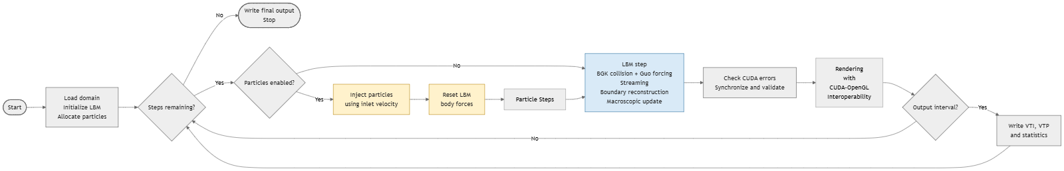
Project Overview

Slide 3
Core Simulation Concepts
Fluid -> LBM
Particles -> Spring
Interaction -> Particle <> Fluid
Mesh -> Generating

Slide 4
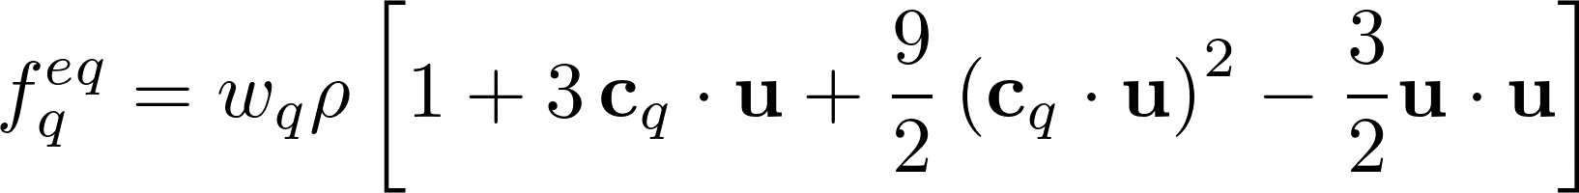
Collision
Collision Operator
During the collision every population is relaxed toward the equilibrium distribution.
Equilibrium Distribution
The local equilibrium state modeled to recover Navier-Stokes macroscopic behavior.
Guo Forcing Scheme
We apply the effect of the external forces to the fluid through the Guo forcing.

Slide 5

Stream
Streaming Operator
After the collision the populations propagate to the neighbour cells. We use a pull approach, every cell reads populations coming from the source cell.
Bounce-back
If the neighbour cell is Solid we apply the bounce-back. We take the populations that after the collision are going to the wall cell and we copy them in the opposite direction.

Slide 6
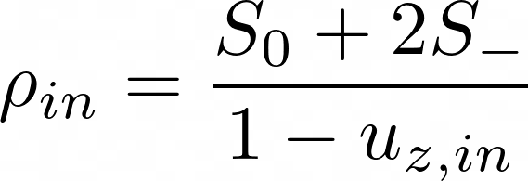
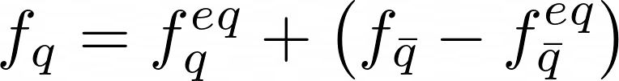
Inlet
Density Operator
The density is not imposed and it is calculated from the known populations where S0 are the populations with null normal component and S_ are the populations that move outside the domain.
Missing pop. computation
The missing populations are reconstructed assuming the non equilibrium part is equal to the one in the opposite direction.

Slide 7

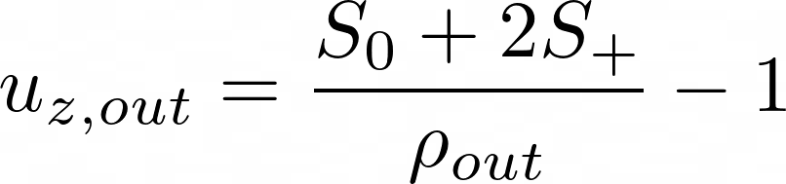
Outlet
Imposed Density
We impose density equal to one. Our fluid is not compressible so the pressure should be unitary everywhere. The imposed density back-propagates in the fluid
Normal velocity operator
The normal velocity is not imposed and it is calculated from the known populations where S0 are the populations with null normal component and S+ are the populations that move outside the domain.
Missing pop. computation
The missing populations are reconstructed with the equilibrium relation using the imposed density.

Slide 8
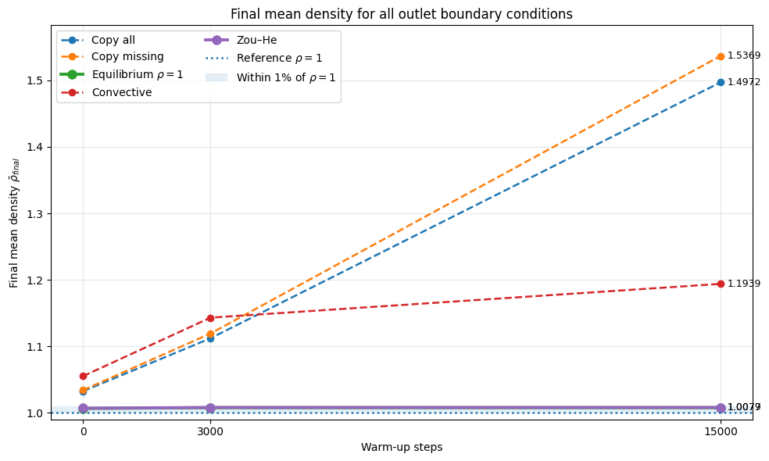
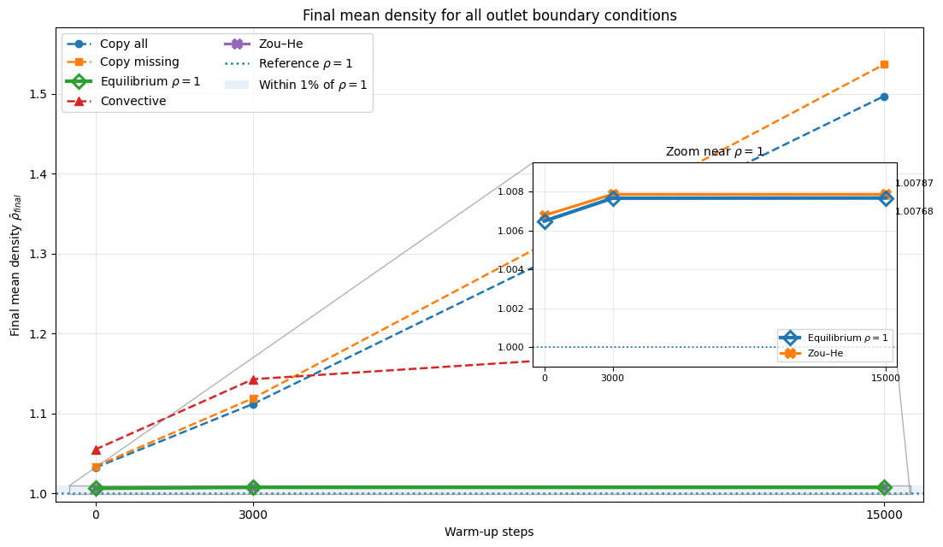
Tried outlet models results

Slide 9
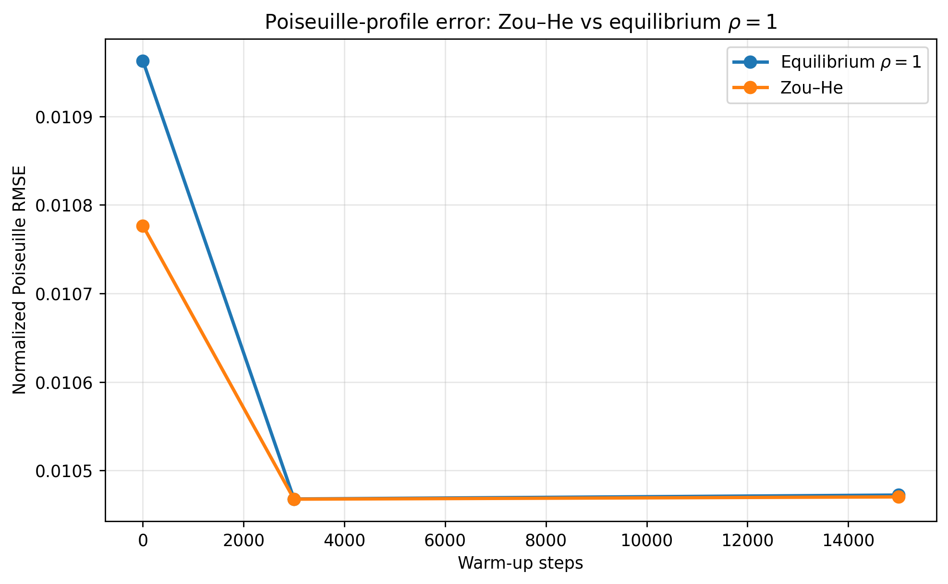
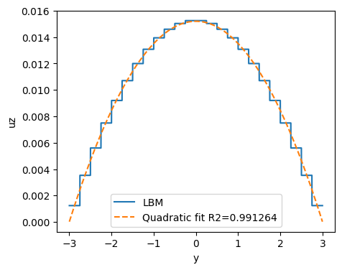
Zou-He vs Equilibrium_rho1
and Poiseuille Like Fluid Behaviour

Slide 10
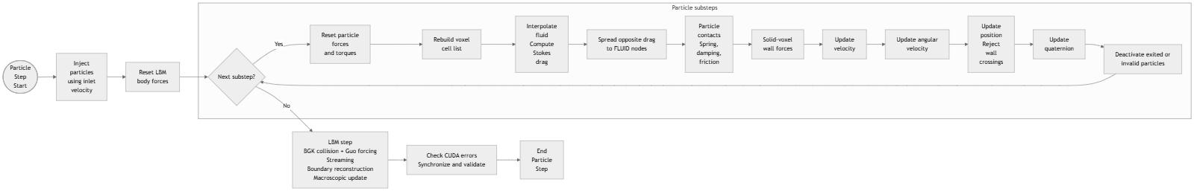
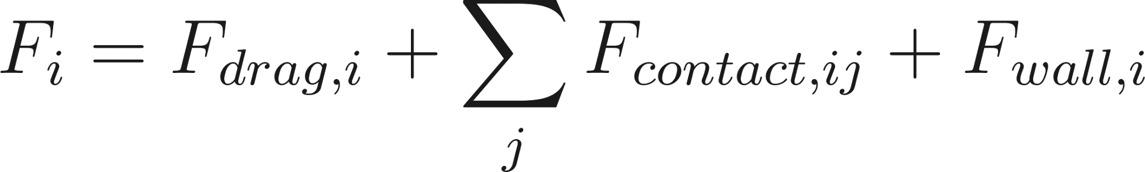
Particles

Slide 11
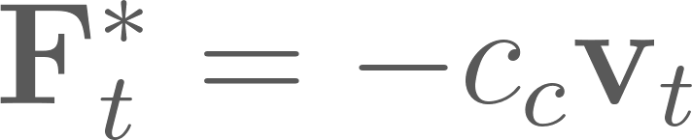
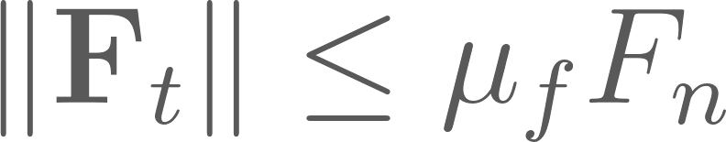
Particles (Particle - Particle)
Overlapping Particles if (searched in own voxel and 26 neighbor cells, 3 * 3 * 3 area):
Linear Spring-Dashpot Force: (n is normal vector pointing from particle j to particle i) (equal and opposite applied to both particles):
The trial tangential force (viscous):
Coloumb Bound:

Slide 12
Particles
Three species: red blood cells, platelets, and leukocytes
Particles are rigid bodies stored and processed on the GPU
RBCs have ellipsoidal orientation data, but all drag and contact calculations use an effective spherical radius
Particles are injected at inlet cells using the local fluid velocity
Particles are deactivated after leaving the grid or reaching an outlet
linked-cell list

Slide 13
Particles
1. Inject the requested species at inlet cells using the current fluid velocity.
2. Reset the LBM body-force arrays once.
3. For every particle substep:
1. reset particle forces, torques, and contact counts;
2. reset and rebuild the linked-cell list;
3. interpolate the unchanged current LBM fields and compute drag/reaction;
4. compute particle contacts and wall forces;
5. cap total force and update linear velocity;
6. cap speed and update angular velocity;
7. update position, check/cap velocity, and update orientation;
8. deactivate particles outside the grid or in an outlet cell;
9. copy the current force into `F_old`.
4. Advance the LBM once: BGK collision with forcing, streaming, boundary
conditions, and macroscopic reconstruction.

Slide 14
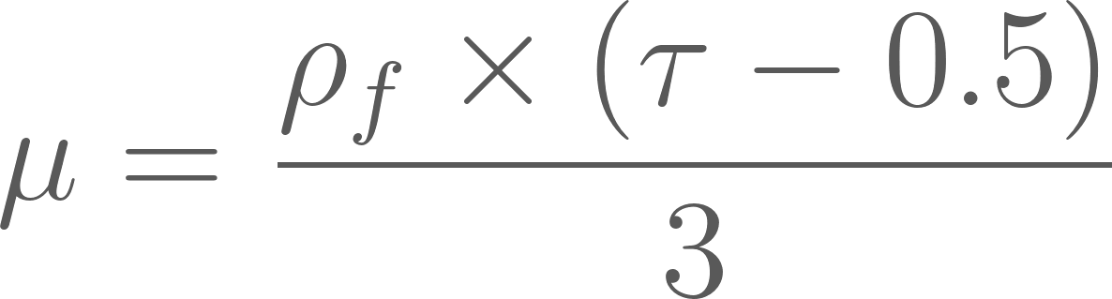
Particles (Fluid Drag)
Tau is BGK relaxation time, r is the spherical radius of the particle, u_f is interpolated fluid velocity and v_p is particle velocity
The equal and opposite force is distributed back to the same fluid cells
Because of N particle substeps, each substep only applies force with factor 1/N

Slide 15

Particles (Particle - Wall)
Penalty Force (for each neighboring solid face)

Slide 16
Particles (Integrator)
v <- v + 0.5 * (F_old + F_new) / m * dt_p
x <- x + v * dt_p + 0.5 * F_new / m * dt_p^2
F_old <- F_new

Slide 17
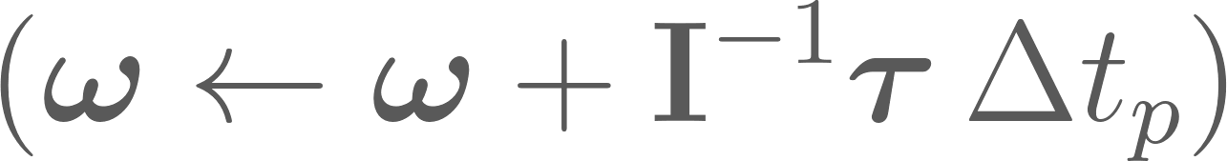
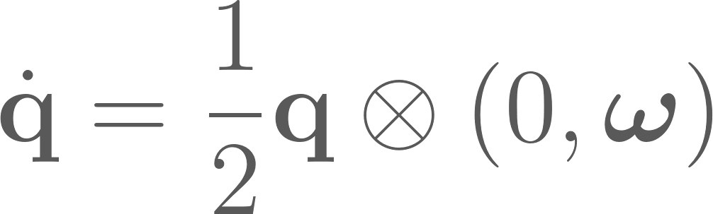
Particles (Roation)
Angular Velocity (explicit Euler):
Rotation Update:

Slide 18

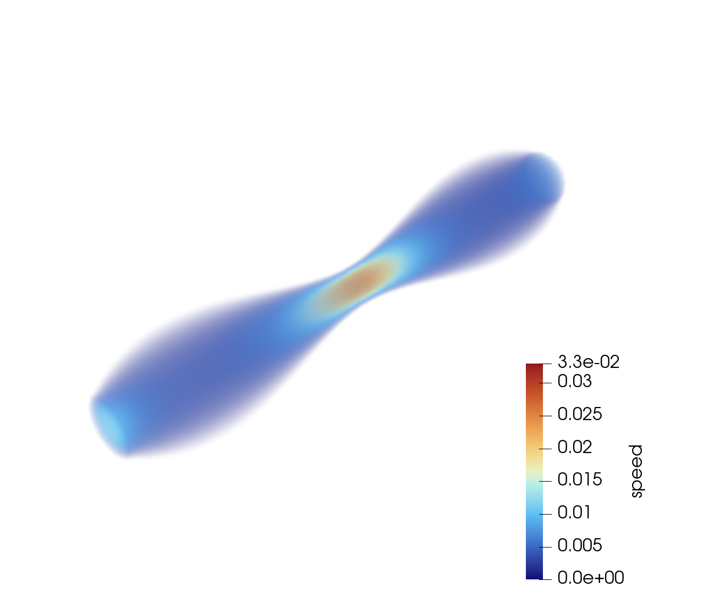
Results

Slide 19
Mesh preprocessing using gmsh and trimesh
We have also another alternative for the preprocessing through already implemented python libraries that take a file .geo and build a voxelized mesh ready to be used, Gmsh is used during preprocessing to generate the surface and volumetric mesh and to identify the wall, inlet, and outlet physical regions. Trimesh is then used to vectorize the voxelization process by testing batches of cell centers against the geometry. The meshes shown in the previous slide were generated using this preprocessing pipeline.

Slide 20
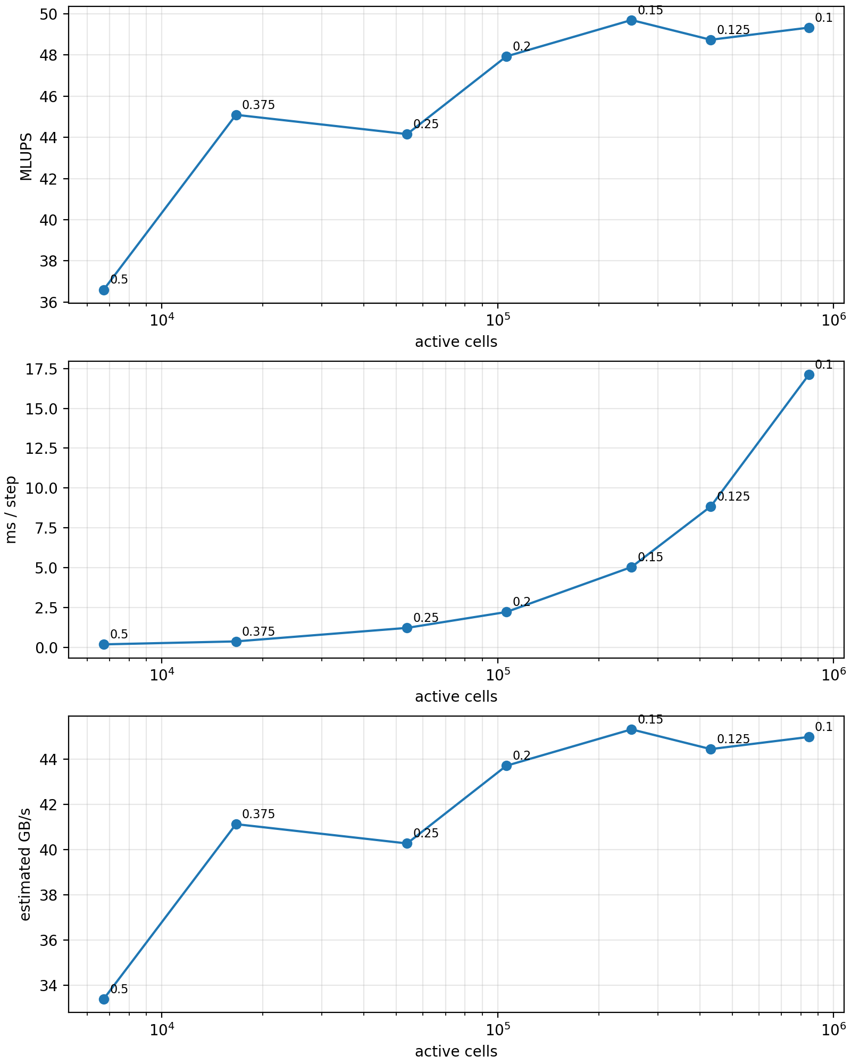
Profiling
As the mesh is refined (smaller dx), the number of active cells increases, leading to a longer execution time per iteration. However, the throughput (MLUPS) also improves, reaching a plateau around 49–50 MLUPS for the finest meshes. The estimated memory bandwidth follows the same trend, saturating at approximately 45 GB/s, indicating that the implementation becomes memory-bandwidth limited rather than compute-limited for large problem sizes. The slight fluctuations at the highest resolutions are likely due to measurement noise and cache effects rather than fundamental performance changes.
The profiling has been done on a cip.pool.fau.de computer mounting a Nvidia Geforce RTX 2080

Slide 21
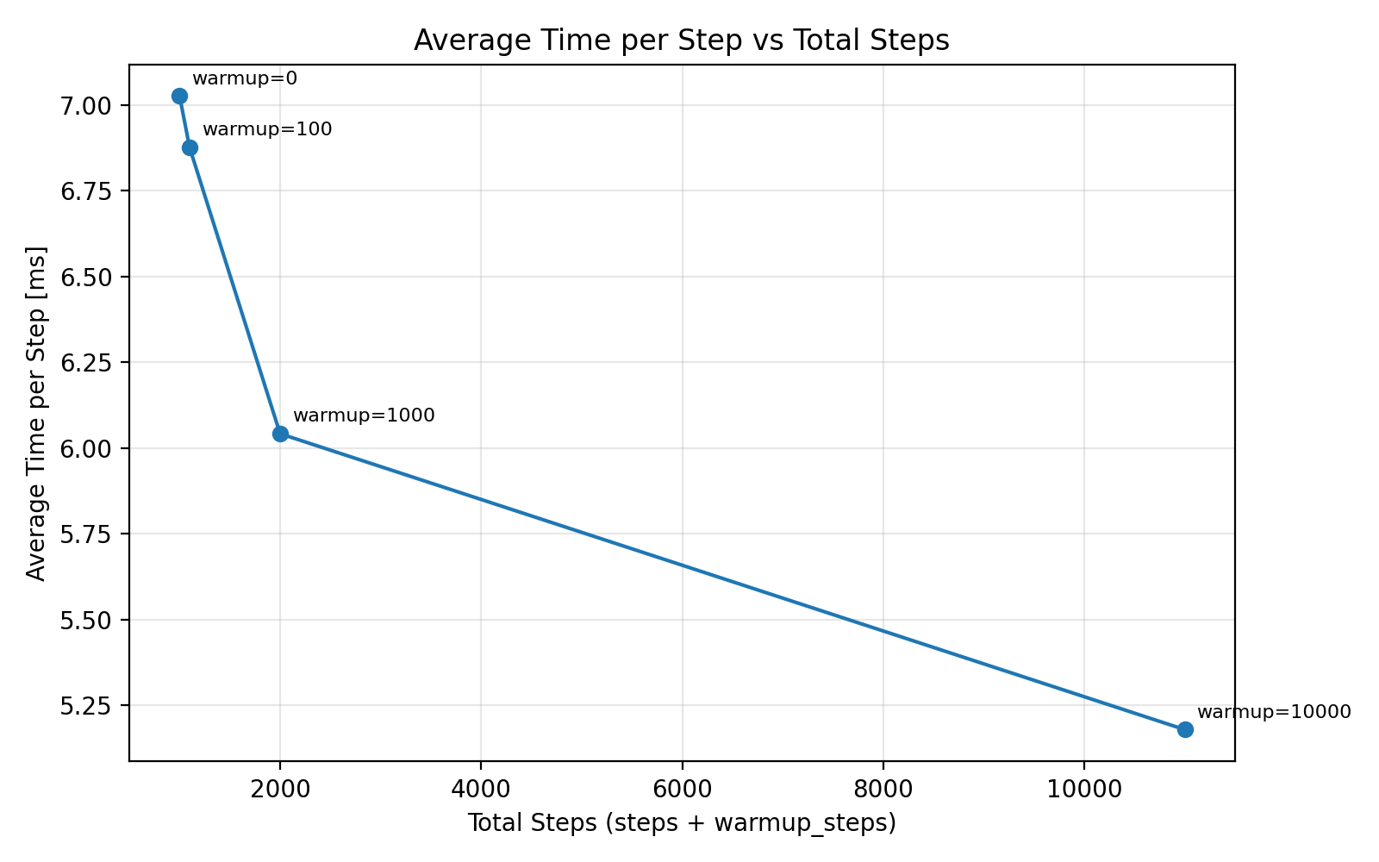
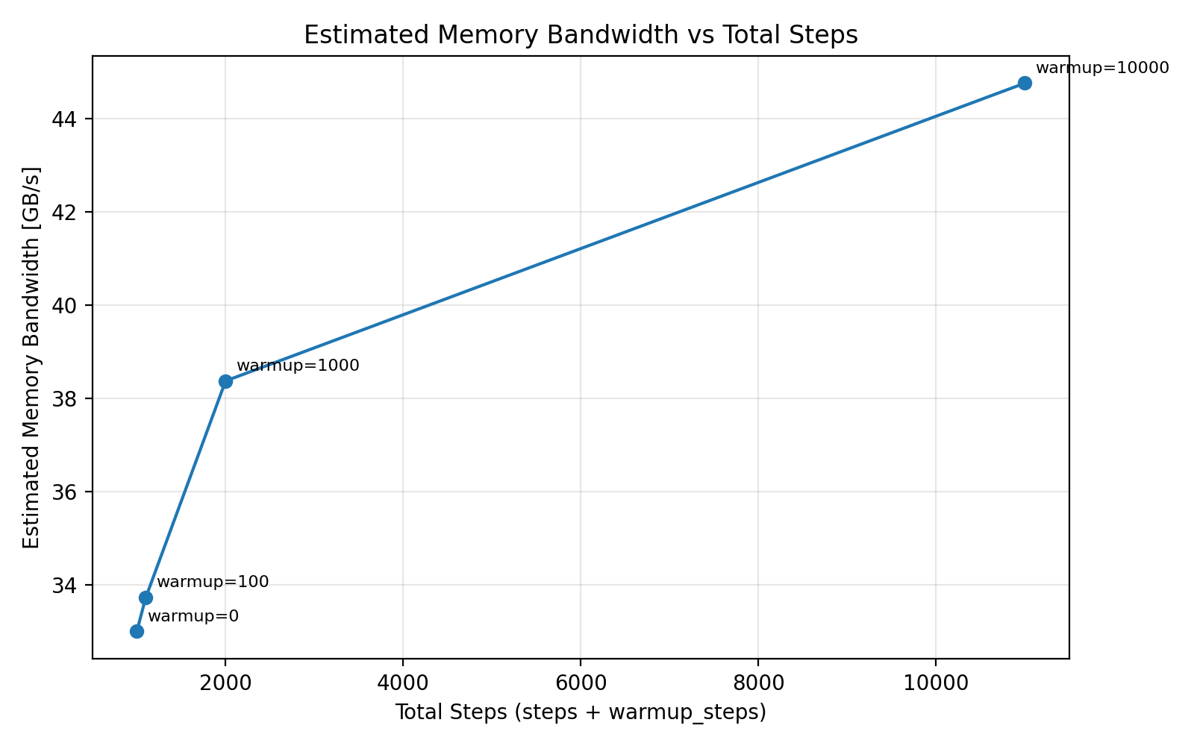
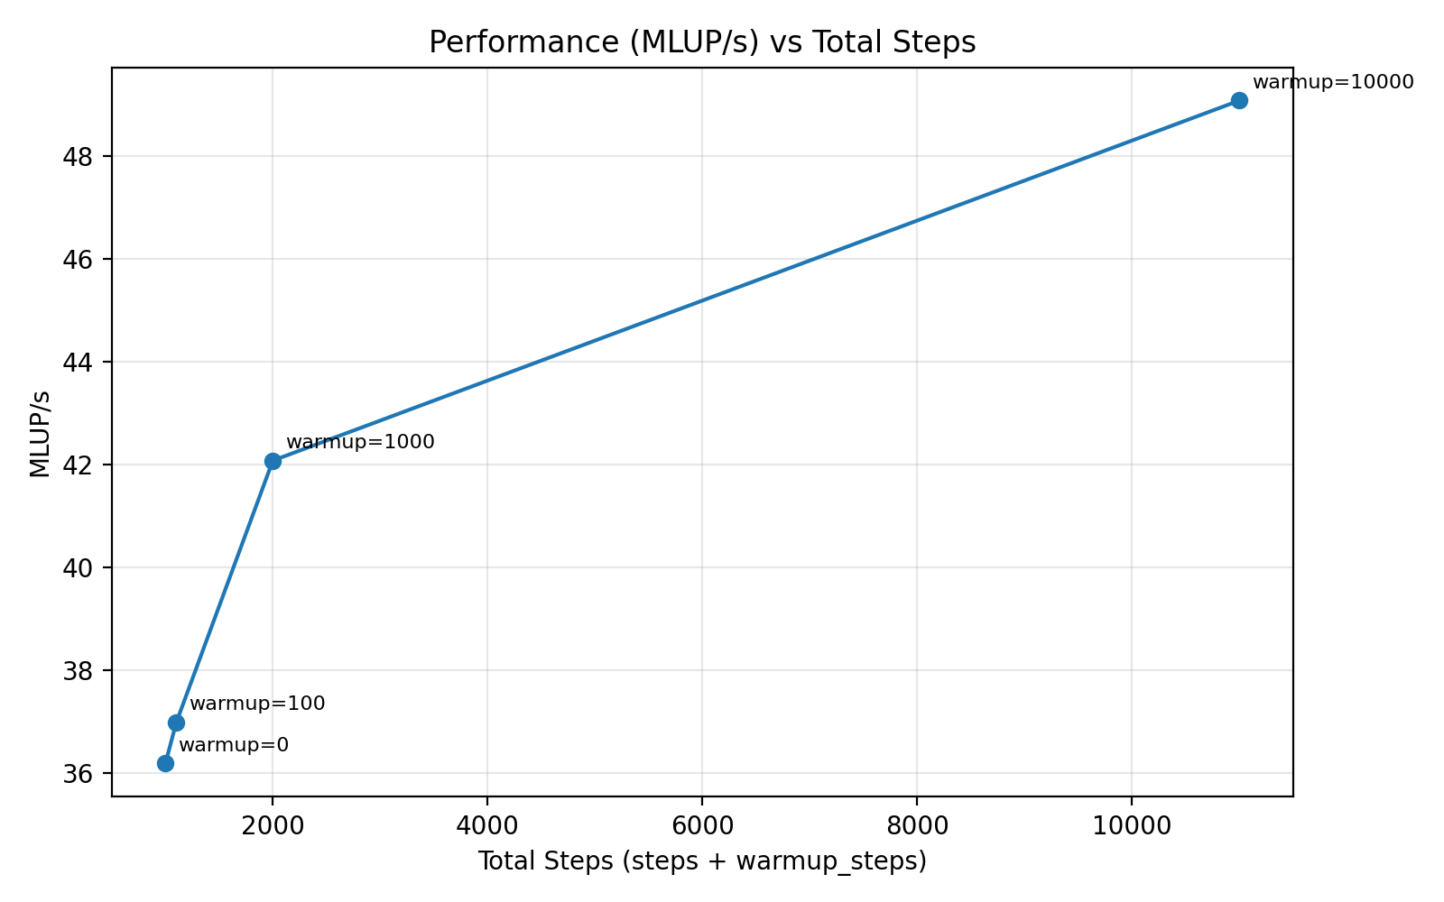
Plots of performance vs Step number

Slide 22
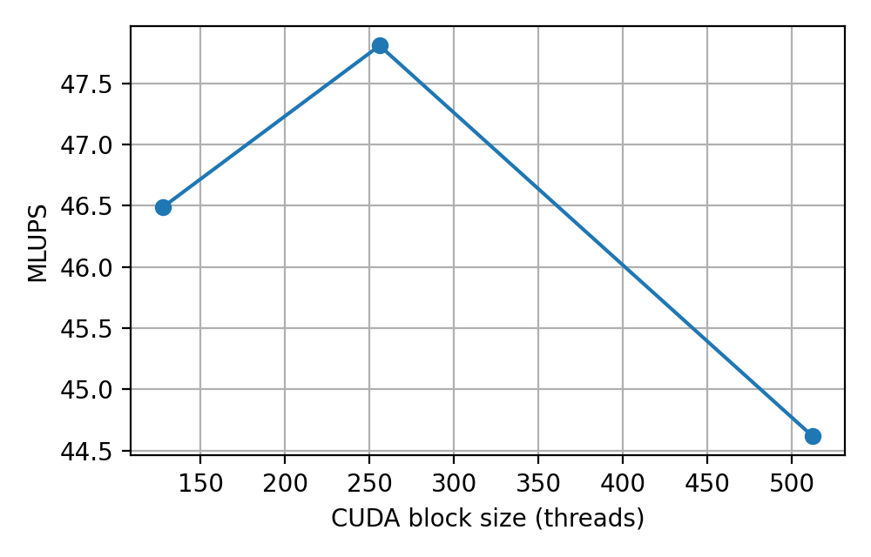
Effect of CUDA Block Size and kernel profiling
A sensitivity analysis of the CUDA thread block size was performed using 128, 256 and 512 threads per block. The best overall performance was obtained with 256 threads, achieving 47.8 MLUPS, approximately 7% higher than the 512-thread configuration. Kernel-level profiling revealed different behaviors: the collision kernel benefited from smaller blocks (24% speedup from 512 to 256 threads), likely due to increased occupancy and reduced register pressure, whereas the streaming kernel achieved its best performance with larger blocks, suggesting that it is primarily memory-bandwidth limited. Consequently, 256 threads per block represent the best trade-off between compute efficiency in the collision stage and memory throughput in the streaming stage. This also highlights that different kernels exhibit different optimal launch configurations, suggesting that kernel-specific block sizes could provide additional performance improvements.

Slide 23
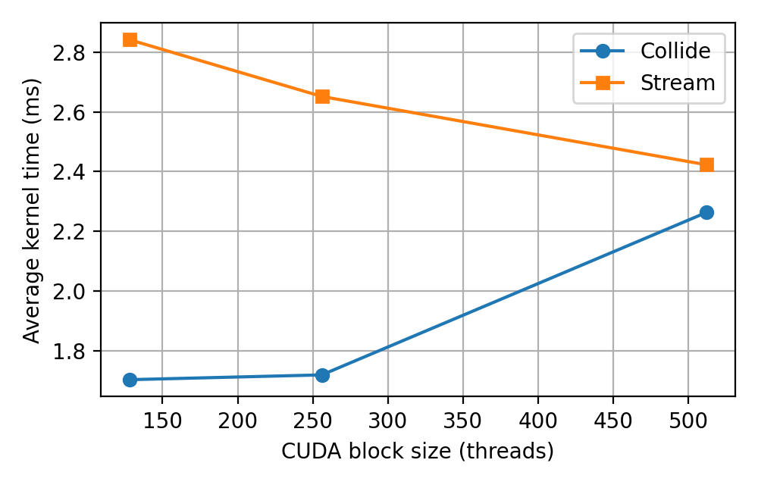
Effect of CUDA Block Size and kernel profiling
A sensitivity analysis of the CUDA thread block size was performed using 128, 256 and 512 threads per block. The best overall performance was obtained with 256 threads, achieving 47.8 MLUPS, approximately 7% higher than the 512-thread configuration. Kernel-level profiling revealed different behaviors: the collision kernel benefited from smaller blocks (24% speedup from 512 to 256 threads), likely due to increased occupancy and reduced register pressure, whereas the streaming kernel achieved its best performance with larger blocks, suggesting that it is primarily memory-bandwidth limited. Consequently, 256 threads per block represent the best trade-off between compute efficiency in the collision stage and memory throughput in the streaming stage. This also highlights that different kernels exhibit different optimal launch configurations, suggesting that kernel-specific block sizes could provide additional performance improvements. (128 collide - 512 stream)

Slide 24
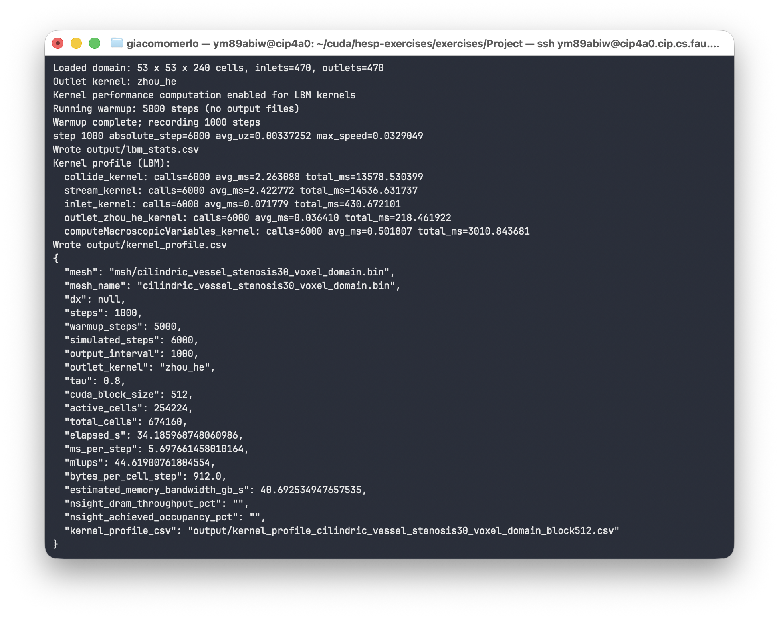
Example of a run on a cip.pool.fau.de computer mounting a Nvidia Geforce RTX 2080 with block size 512

Slide 25
CUDA Features used
Cuda Kernels
Device Memory (also __constant__)
Atomic operations
Cuda OpenGL Interoperability

